Slide 1
AI, Copilot and Viva Engage
Drive Microsoft 365 Copilot adoption and utilize AI within Viva Engage

Slide 2


The community toolkit for Copilot adoption
01
Copilot Adoption Community
Kickstart Copilot adoption with ready-to-use communities
Microsoft 365 Copilot in Engage
Boost productivity and engagement with AI assistance
Available with Microsoft Copilot license
02
Community Agent
Scale expertise and save time with AI-powered answers
Available with Microsoft Copilot license
03
Engage content in Copilot chat responses
Unlock organizational knowledge for everyone
Available with Microsoft Copilot license
04
Notes:
With Engage, we have AI-powered tools to empower your communities to grow and thrive. Each tool is designed to make adopting and using Copilot at work more impactful and running Engage communities and communications easier.

Slide 3

Your 3-week plan to build Copilot adoption
Week 1
Week 2
Week 3
Get Started
Set Up & Experiment
Expand & Optimize
Try Copilot in Engage and explore chat features.
Review your existing communities and identify where knowledge sharing is most active.
Launch a Copilot Adoption Community using the template.
Enable the Community Agent and test suggested content.
Assign community experts to review and verify agent responses.
Invite more members and designate additional experts.
Curate your SharePoint library, monitor agent responses, and refine your approach based on engagement.

Slide 4
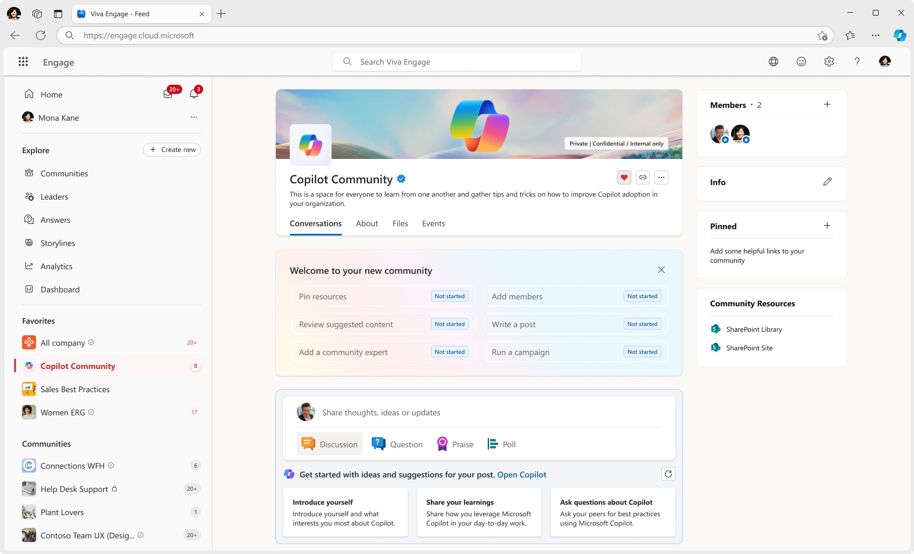
Introducing the Copilot Adoption Community
Pre-Built Community Template: A purpose-designed community template within Viva Engage, specifically created to support organizations adopting Microsoft 365 Copilot.
Centralized Knowledge Hub: Serves as a centralized space where employees can learn, share, and support each other in their Copilot journey, fostering collective understanding and engagement.
A Premium-Enabled Experience: It includes premium features such as related questions and the intelligent importer – that are typically reserved for paid Viva customers.
Suggested Content: To help admins with content ideas, suggested posts from Microsoft’s Copilot adoption resources.
One-Click Activation: Admins can launch the community with a single click from the Engage admin center, triggering initial setup.

Slide 5
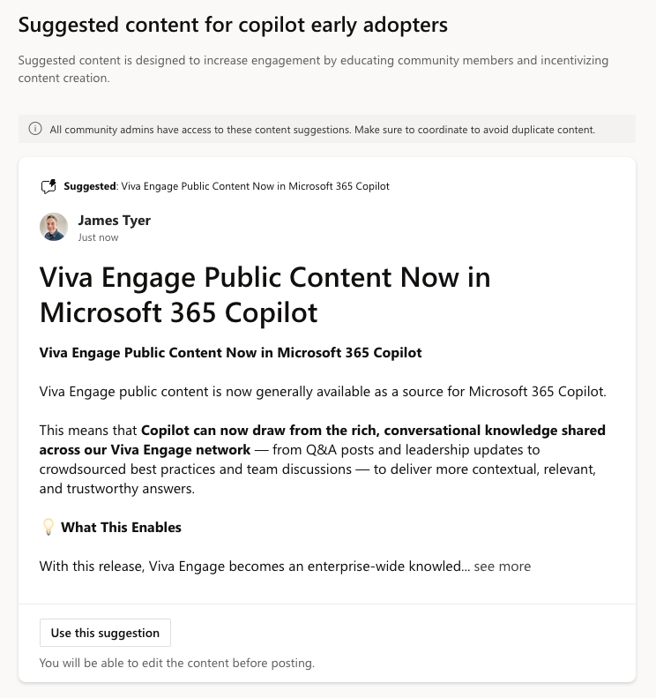
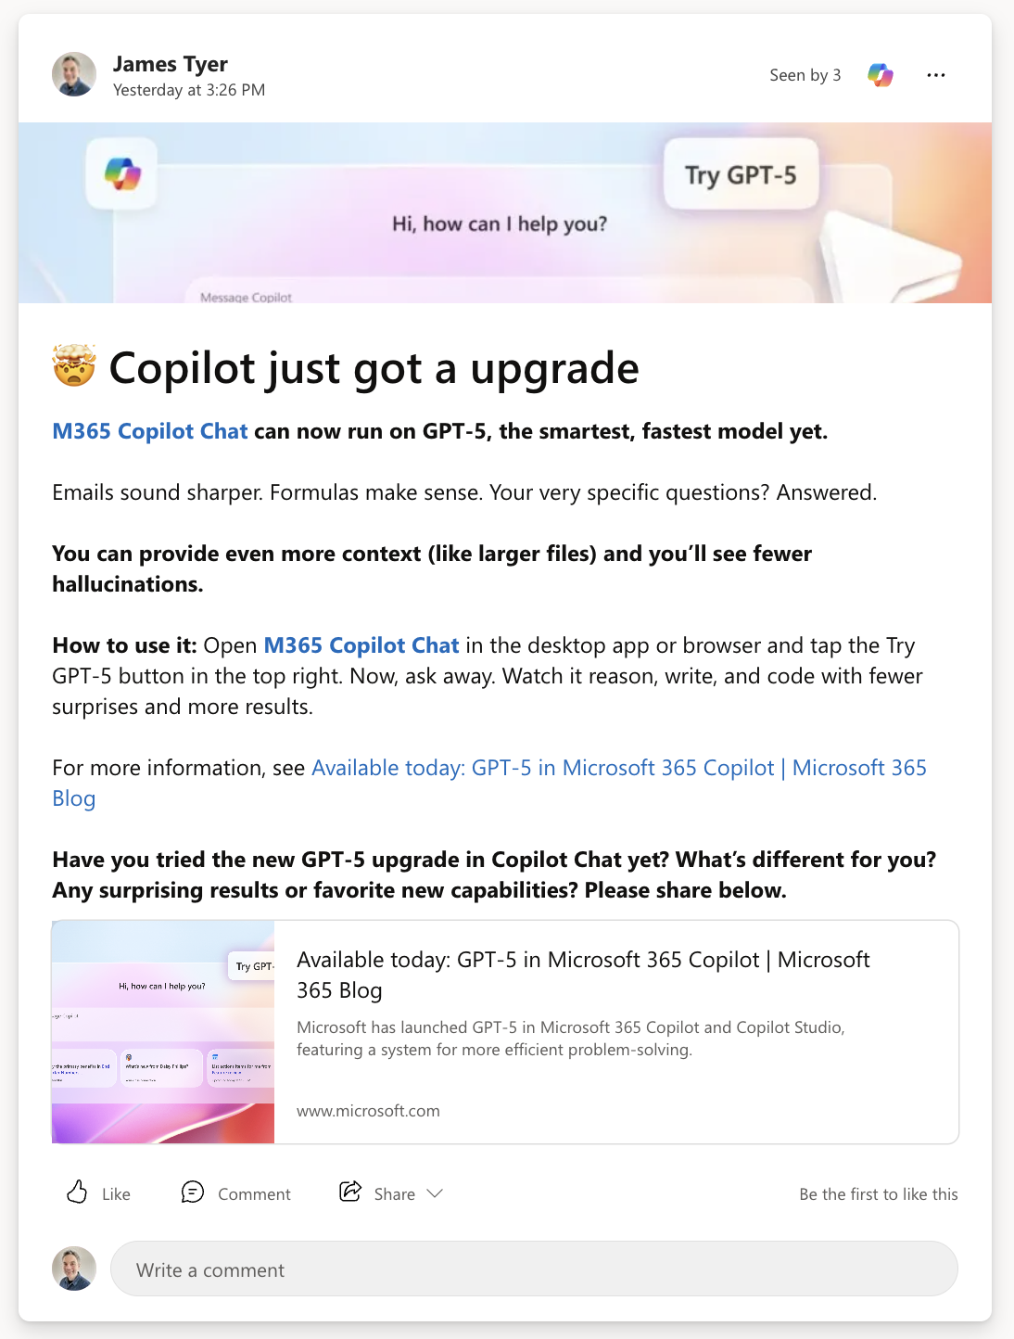
Suggested content
With suggested content for Copilot Chat, M365 Copilot and Copilot Studio, we make it easier for you to drive conversation and sharing in your community.
This includes sources such as the Copilot Adoption Center, the Great Copilot Journey, Copilot Prompt Gallery, and more...

Slide 6

Unlock Copilot Adoption
Copilot Adoption Community (CAC) users have +30% more active days on Microsoft 365 Copilot compared to Non-CAC users in the same network.
Setup your Copilot Adoption Community
Source: Based on internal Microsoft analytics (June 2024–July 2025). “Copilot Adoption Community users“ are those who interacted with a CAC; “Non-CAC users“ are M365 Copilot-enabled users in the same network. Days active measured over a 12-week period. Lift is statistically significant (p < 0.05).
Notes:
We’ve consistently seen that users in organizations which have an active Copilot Adoption Community achieve a 30% higher Copilot adoption rate.
On average, users spend six more active days per month with Copilot compared to those without the community. When you activate a Copilot Adoption Community, you turn AI potential into real progress.

Slide 7
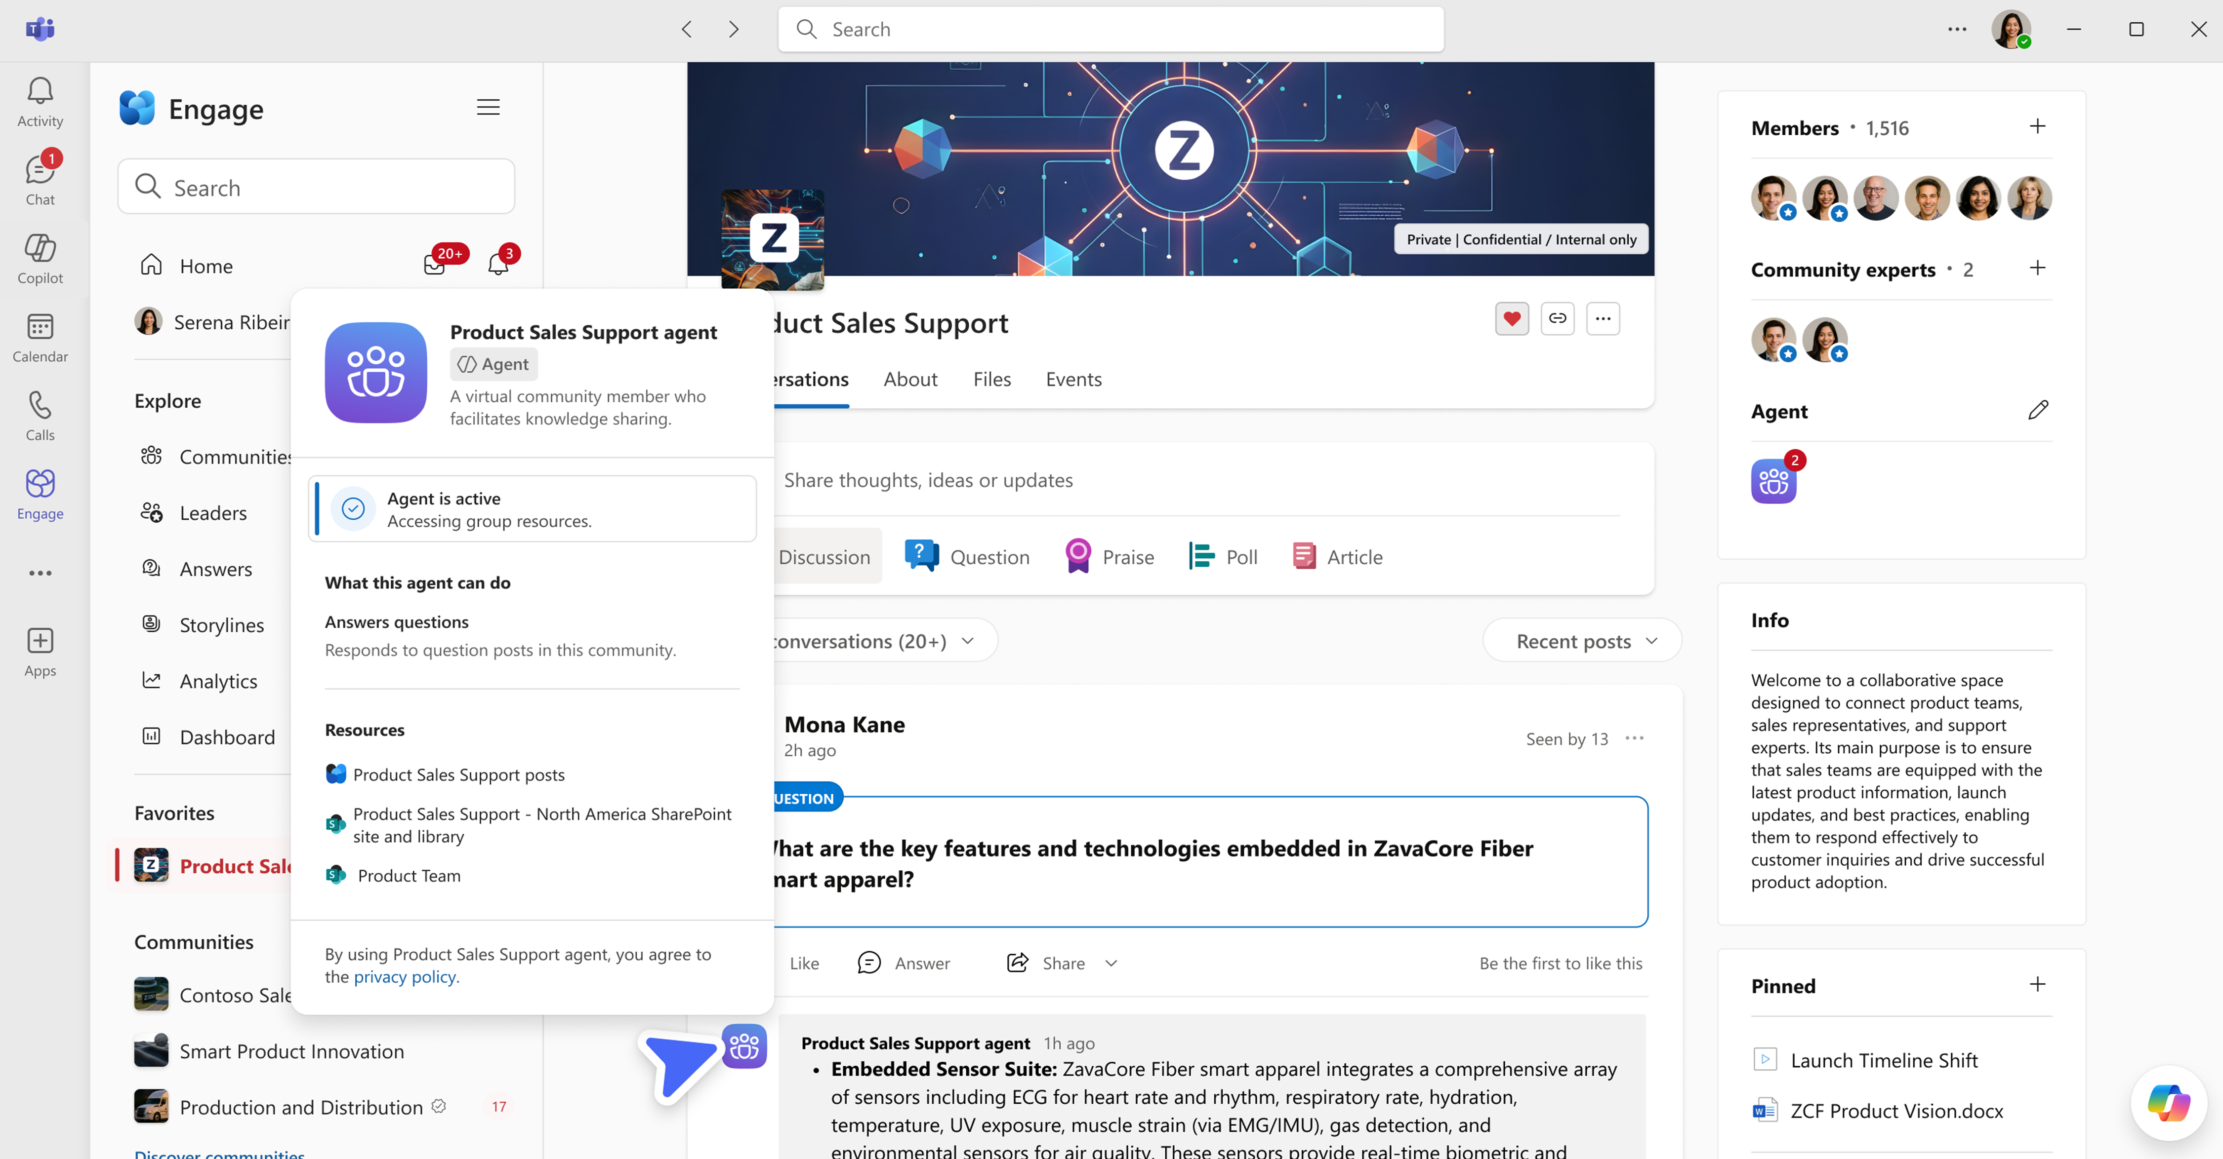
Community Agent
Purpose-built AI that answers questions using your community’s knowledge
Proactive and transparent:
Automatically drafts answers to open questions it’s confident about. Shows its reasoning, sources, and what it skipped.
Grounded in content you care about:
Uses community conversations and the connected SharePoint site. Admins can also add other SharePoint sites they own.
Deep research and reasoning:
Uses deep reasoning to draft responses. Reviewers can see the reasoning behind a suggested answer.
Expert review and verification:
Admins and experts can review, edit or approve drafts. Approved answers show as “Verified“ to establish trust with members.
Placeholder
Available in Public Preview. Requires Microsoft 365 Copilot license.
Ability to @ mention for follow up questions available in a future update.
Notes:
With Community Agents, you get a virtual community member to help you answer questions and engage in conversation, saving time on those repetitive questions.
The agent can be grounded in community questions and answers and SharePoint libraries – so the responses are rooted in YOUR context, not just generic web results.
Deep research and reasoning is used to build answers, which can be posted automatically or with your approval.
Let me show you how this works -

Slide 8
Get the most out of Community Agent
Step 1
Step 2
Step 3
Prepare your community
Set up your agent
Engage your members
Pick the right communities
Focus on Q&A-heavy spaces with active experts.
Benchmark analytics
Capture baseline Q&A metrics before rollout to measure impact later.
Set “Question“ as default
Ensures the agent can pick up questions effectively.
Opt in, then start small
Enable in the Engage admin center and begin with a few communities.
Require review (optional)
Use this option to get a feel for the agent’s responses.
Add SharePoint sites
Point the agent to sites that contain important context (FAQs, policies, product notes).
Seed high-signal content
Post how-to articles and ensure repeat questions have strong Verified answers.
Announce the agent
Share how it works, what sources it uses, who reviews (if enabled), and your review cadence.
Clarify roles for admins vs experts
Make sure everyone knows who reviews, edits, and approves answers.
Promote use of “Verified“
Encourage experts/admins to apply it so members quickly learn what to trust.
Notes:
Answer questions around the clock
By proactively surfacing answers while the community admin or experts are away, questions are addressed efficiently for all members
Information retrieval
Tracking down the right information and details can be tedious. The agent uses the community’s past conversations and SharePoint sites specified by the admin as grounding sources, dramatically reducing the time needed to locate accurate details
Scale expertise
Information often resides in the tacit knowledge of experts—shared in conversations but not documented. The agent efficiently scales expert insights across the organization, making valuable knowledge accessible rather than siloed

Slide 9
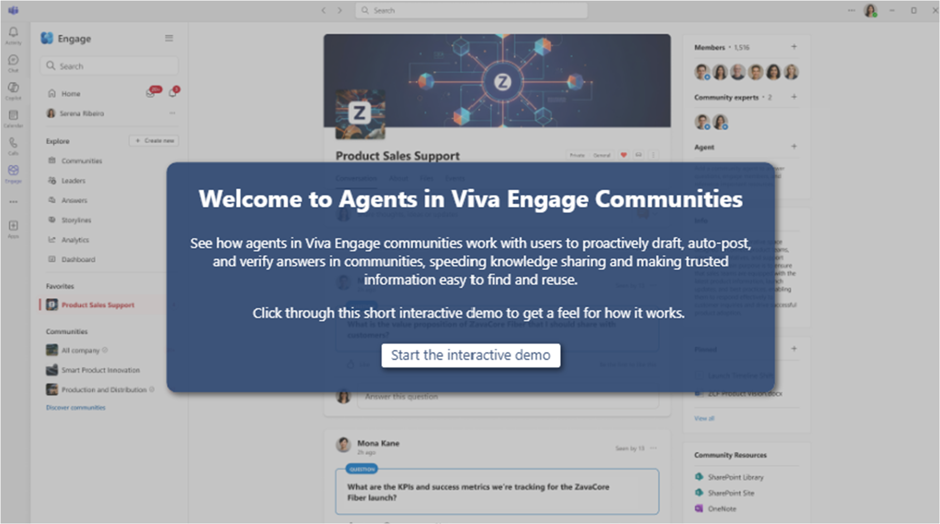
Community Agent Resources
View our interactive demo
Read our announcement blog
Set up agents in communities

Slide 10
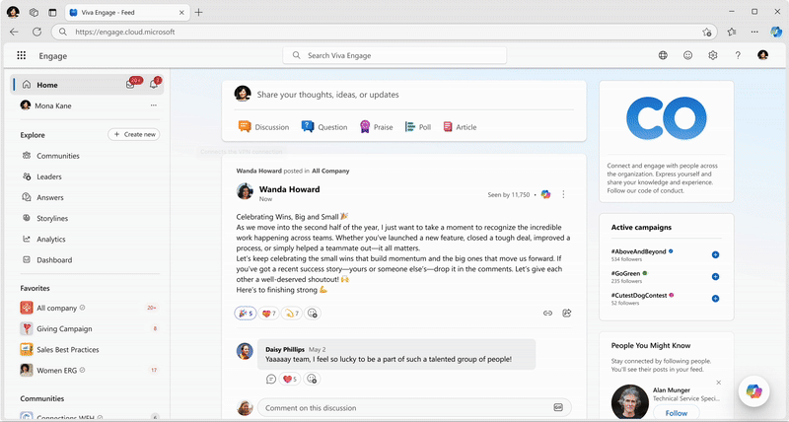
Microsoft 365 Copilot in Engage
Boost productivity and engagement with AI assistance
Context-Aware Responses:
Copilot provides responses tailored to your role and specific needs, enhancing relevance and efficiency.
Smart Catch-Up:
Summarizes recent activities in concise quick views to help you quickly get up to speed on what’s happening your network.
Scoped Search Capabilities:
Allows you to perform local or global searches to find relevant information efficiently.
Integrated Writing Assistance:
Copilot assists you in overcoming writer’s block, refining tone, and drafting posts using context from across Engage.
Generally available. Requires Microsoft 365 Copilot license
Notes:
In addition to accessing Engage content via M365 Copilot, Engage itself has an integrated Copilot experience tailored to Engage.

Slide 11

5 tips for prompting AI
Use these tips for prompting Copilot anywhere
01
02
03
04
05
Understand your persona
Have a clear objective
Know your audience
Create parameters
Add context
Tell Microsoft 365 Copilot what team member you need it to play.
Include the right prompt ingredients.
Different audiences have different needs and expectations.
Keep the conversation going and follow up with what you need.
Be as specific as possible and add as much information as you can.
Notes:
Five Tips for Prompting AI: How We’re Communicating Better at Microsoft with Microsoft Copilot
Tell Microsoft 365 Copilot what you need
Start by letting Copilot know what role you want it to play, so it can couch its answers appropriately.
Include the right prompt ingredients
Make sure to tell Copilot what you want it to do. Include goal, context, source and expectations
Know your audience
Different audiences have different needs and expectations.
Keep the conversation going
Copilot can help you best when it understands what you’re looking for in terms of tone, length, word count, or any other limitations or boundaries you set. Follow up on your prompts for more tailored responses
Add context
Be as specific as possible and add as much information as you can.
Art, not a science. Pick the framework that works for you. Tools are getting better, but your still have to give instructions—these tools can’t read minds, at least not yet.
Prompting is really just giving instructions—like you would to another person. The more details you provide the better.
It can feel like a lot of work to create these prompts at first—maybe you feel you could do it faster yourself. But this is a new skill you are building and it takes practice. You’ll quickly find that you have a few key prompt templates that help you quickly get higher quality first drafts.

Slide 12

Prompt Ingredients
To get the best response, it’s important to focus on some of the key elements below when phrasing your Copilot prompts.
Goal
Context
What response do you want from Copilot?
Why do you need it and who is involved?
Generate 3–5 bullet points to prepare me for a meeting with my team based on the latest Engage ’Project X’ updates. Focus on our Project community over the last month. Please use simple language so I can get up to speed quickly.
Which information sources or samples should Copilot use?
How should Copilot respond to best meet your expectations?
Source
Expectations
Notes:
Second, become familiar with the 4 ingredients that make up a successful prompt.
Your prompt should include a goal – what is it you ultimately want Copilot from Copilot?
Context – What’s the reason for needing this output, and who else might be involved
Source – Is there any reference material, like an existing deck or document that Copilot should refer to?
Finally expectations on how Copilot should best meet your expecations

Slide 13
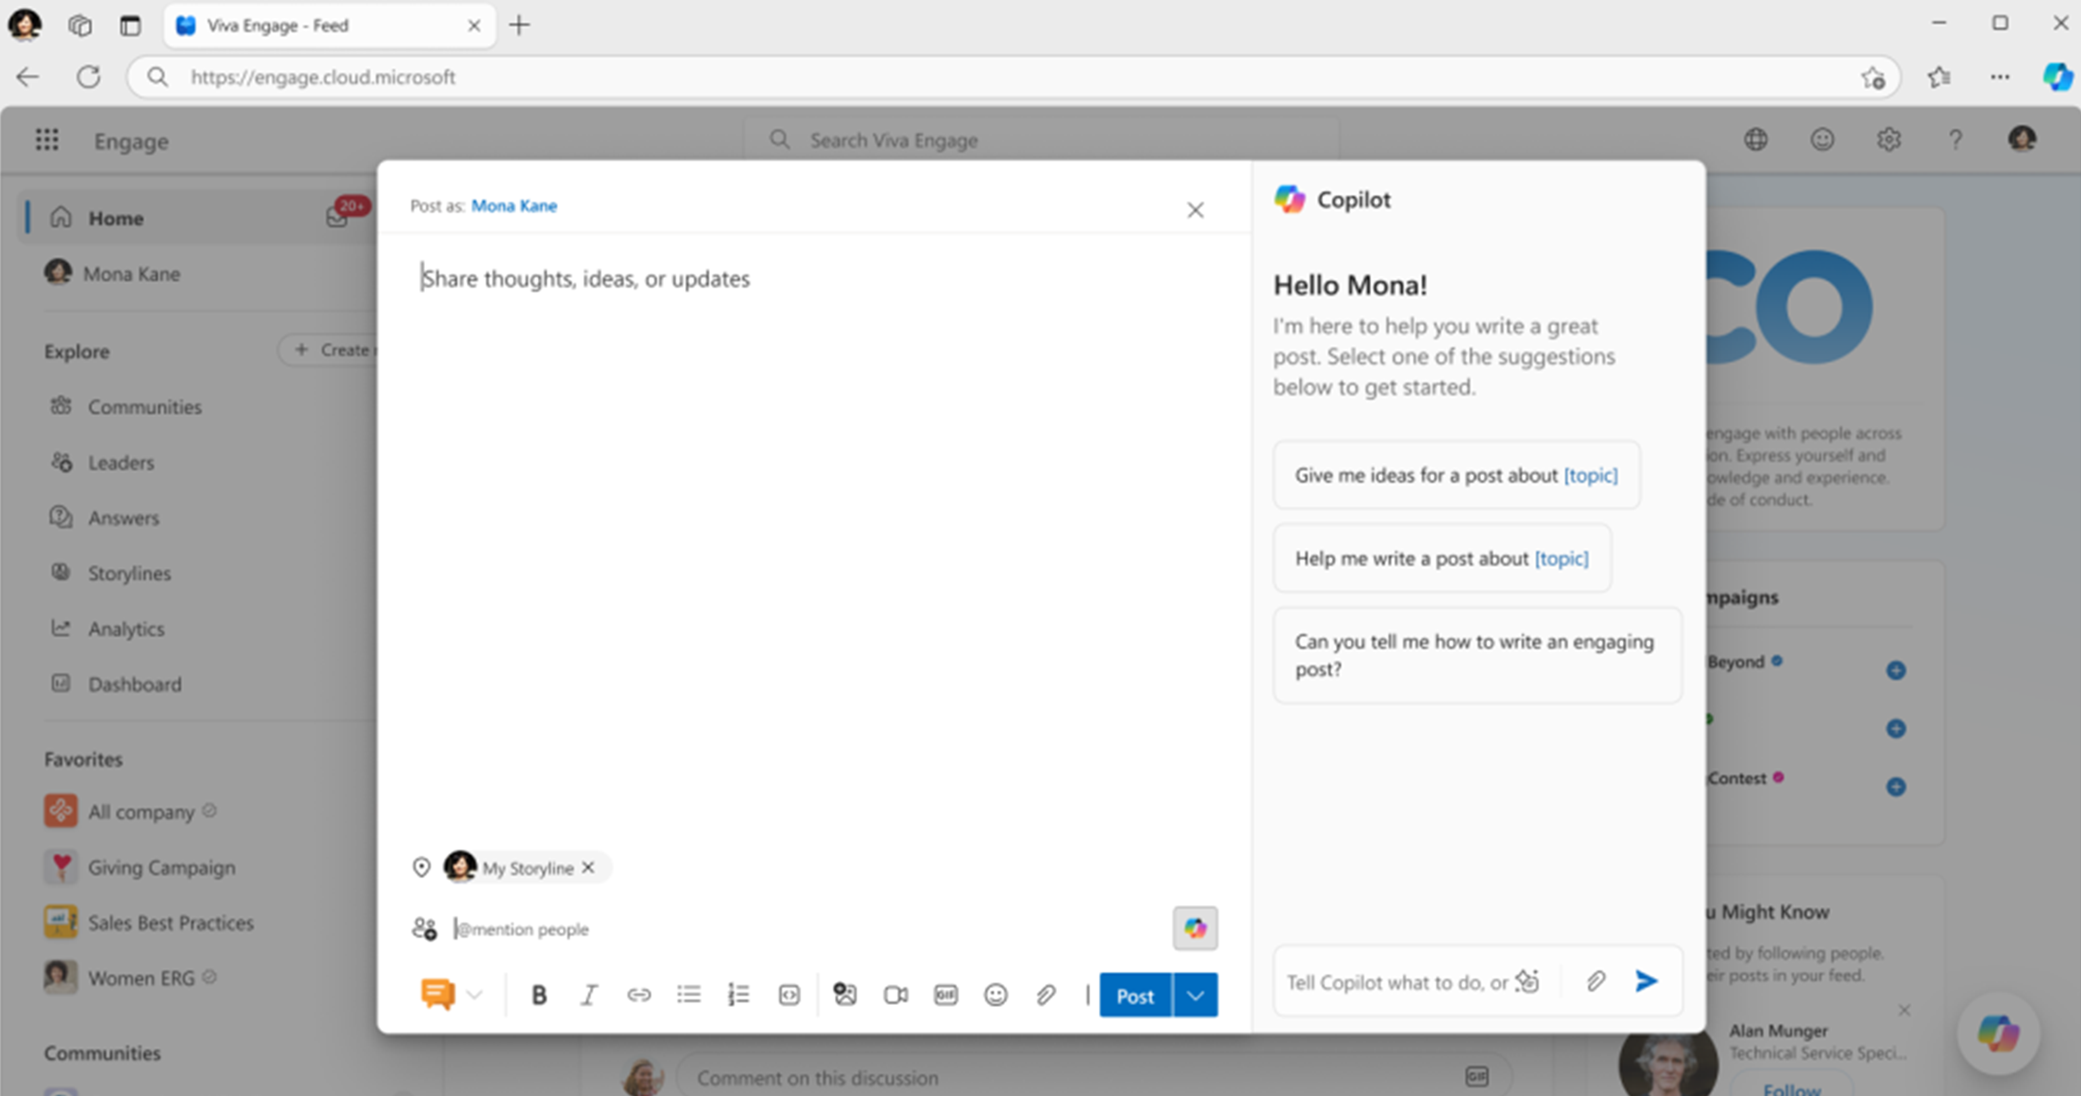
Copilot in Engage Resources
Get started with Microsoft 365 Copilot in Viva Engage
  Support documentation
  Learn documentation (for IT)
Learn more about
AI Summarization

Slide 14


DAY IN THE LIFE – Using Copilot in Viva Engage
Tanya, executive leader
Prompt Goals
Inspire, inform, and engage employees; monitor sentiment and feedback; amplify strategic initiatives.
Morning:
Catches up on trending themes across the organization using Copilot, surfacing the most discussed topics and emerging conversations in communities and storylines.
Reviews employee feedback from storylines and campaigns, leveraging Copilot to summarize main sentiments, concerns, and suggestions shared by employees.
Prompt Examples
Summarize employee feedback from recent Engage storylines and campaigns. What are the main sentiments, concerns, and suggestions shared by employees? Please include any notable quotes or recurring topics.
Midday:
Discovers posts from leadership peers, using Copilot to find and highlight communications from other leaders about new initiatives or strategic priorities.
Drafts strategic communications with Copilot’s writing assistance, preparing announcements, speeches, or updates with clarity and alignment to company tone.
Draft a post announcing our quarterly goals. Please use a confident, inspiring tone and include key performance highlights from this quarter.
Afternoon:
Searches for sentiment trends across communities, asking Copilot to analyze shifts in mood, recurring positive or negative topics, and engagement levels.
Monitors what employees are saying about new policies, using Copilot to summarize reactions, questions, and feedback from across communities and storylines.
What are employees saying about the new remote work policy in our Engage communities and storylines? Summarize key feedback, questions, and suggestions.
Benefits
Rapid insight into organizational sentiment.
Amplifies strategic messaging with minimal effort.
Enables proactive leadership communication.

Slide 15

DAY IN THE LIFE – Using Copilot in Viva Engage
Josh, employee communications manager
Prompt Goals
Craft clear, engaging internal messages; align with brand tone; manage comms calendar; measure impact.
Morning:
Uses Copilot to summarize overnight activity, highlighting trending topics and urgent issues.
Drafts a morning announcement with Copilot, ensuring clarity and company tone.
Prompt Examples
Draft a morning announcement post for all employees.
Pull in the latest updates from leadership and summarize recent campaign results.
Suggest language that matches our company tone and values.
Automatically check the post for clarity and inclusivity, and recommend edits if needed
Midday:
Reviews engagement metrics via Engage analytics to identify effective messages and follow-ups.
Collaborates with HR and leaders to address policy feedback, using Copilot to draft FAQ responses.
Search for posts and feedback about our new policy across all Engage communities. Identify the most common questions employees are asking. Draft clear responses for an FAQ document to share with HR and executive leaders.
Afternoon:
Reviews feedback on newsletters and campaigns with Copilot suggesting follow ups, and flagging sensitive topics.
Ends the day by generating a summary report with Copilot to guide leadership on
next steps.
Copilot, please generate a summary report of today’s communications and engagement trends across our Engage communities. Include key highlights, areas of high engagement, any emerging issues, and recommended next steps. Format the report for sharing with leadership to help inform tomorrow’s strategy.
Benefits
Saves hours on drafting and editing.
Ensures brand consistency and clarity.
Improves engagement through tailored messaging.

Slide 16

DAY IN THE LIFE – Using Copilot in Viva Engage
Amy, community manager
Prompt Goals
Foster engagement, moderate discussions, surface insights, support rituals.
Morning:
Catches up on new posts and conversations in specific communities using Copilot.
Summarizes individual threads for moderation, surfacing key points and issues.
Prompt Examples
Summarize this conversation thread for moderation. Include the main points discussed, the overall tone, any recurring questions, complaints, or suggestions for action, and highlight any policy violations or unresolved issues that may require follow-up.
Midday:
Searches for posts by specific users to monitor participation and address questions.
Identifies trending topics within a community to stay ahead of emerging discussions.
Find posts from [specific user] in this community and summarize the trending topics based on recent conversations. Highlight any emerging themes, frequently discussed subjects, and notable contributions from
the user.
Afternoon:
Drafts welcome or engagement posts with Copilot to foster inclusion and excitement.
Launches community challenges or polls to boost engagement and encourage interaction.
Draft a welcome or engagement post for new members in this community and suggest a community challenge or poll to boost participation and engagement. Highlight ways to encourage interaction and make new members feel included.
Benefits
Scales community moderation and engagement.
Automates repetitive tasks like summarizing and responding.
Enables proactive content planning and sentiment tracking.

Slide 17

DAY IN THE LIFE – Using Copilot in Viva Engage
David, Viva Engage user
Prompt Goals
Stay informed, communicate effectively, monitor engagement and join communities.
Morning:
Catches up on updates: Uses Copilot to summarize overnight activity, highlighting new posts, trending topics, and urgent issues across all communities. Stays informed and ready to engage.
Summarizes long threads: Asks Copilot to condense lengthy conversations into key points, making it easy to understand main outcomes and next steps without reading every message.
Prompt Examples
Summarize new posts and conversations from all my communities since yesterday. Highlight any trending topics or urgent issues I should know about.
Midday:
Searches for posts by leaders and peers: Uses Copilot to surface recent communications from leadership and colleagues, ensuring alignment with company priorities and participating in relevant discussions.
Drafts posts with writing assistance: Crafts clear, engaging posts about their experience or feedback, leveraging Copilot’s contextual writing support.
Show me engagement metrics for my recent posts. Which messages or threads need my follow-up today?
Afternoon:
Discovers trending themes: Identifies popular topics and joins discussions, contributing ideas and learning from others.
Reviews feedback and engagement: Uses Copilot to summarize comments and reactions on recent posts, understanding sentiment and responding thoughtfully.
Draft an end of day announcement for my team that matches our company’s tone.
Benefits
Saves time catching up and staying informed.
Makes it easier to participate in conversations and share ideas.
Surfaces relevant information and feedback for continuous improvement.
Supports proactive engagement and collaboration across the organization.

Slide 18
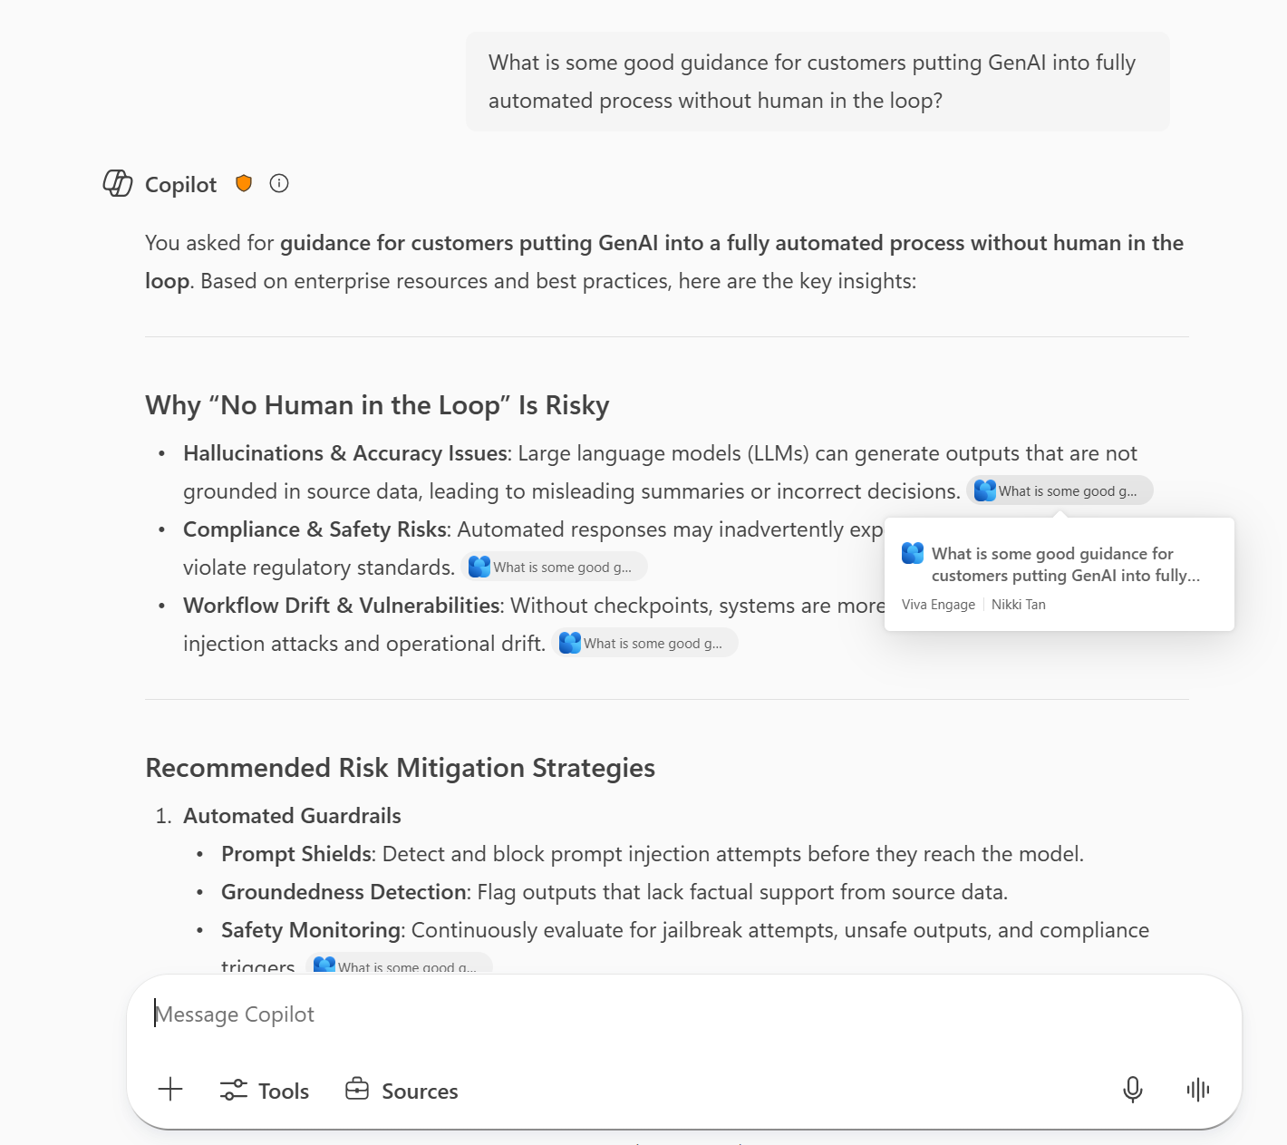
Engage content in Copilot chat responses
Unlock organizational knowledge for everyone
Copilot integration
Public and private Engage content is available for Copilot responses, making knowledge easy to access in chat.
Improved discoverability
Copilot surfaces relevant conversations from Engage—including answers, leadership posts and discussions within events—so key information is found when you need it.
Copilot only grounds responses in Viva Engage content that the user has permission to access
Generally available. Requires Microsoft 365 Copilot license
Notes:
All public and private Engage content is available for Copilot responses, making knowledge accessible and actionable for every employee.
Everyday conversations, Answers, events and leadership are more discoverable so that, if a user asks a question and relevant information is available in Engage, it will be highlighted in the Microsoft 365 Copilot response
Users can search only for content they are authorized to view in Enterprise Search and Copilot Search. This helps maintain compliance with your organization’s data security policies. Viva Engage citations and search results also show the community’s sensitivity label when one is applied

Slide 19
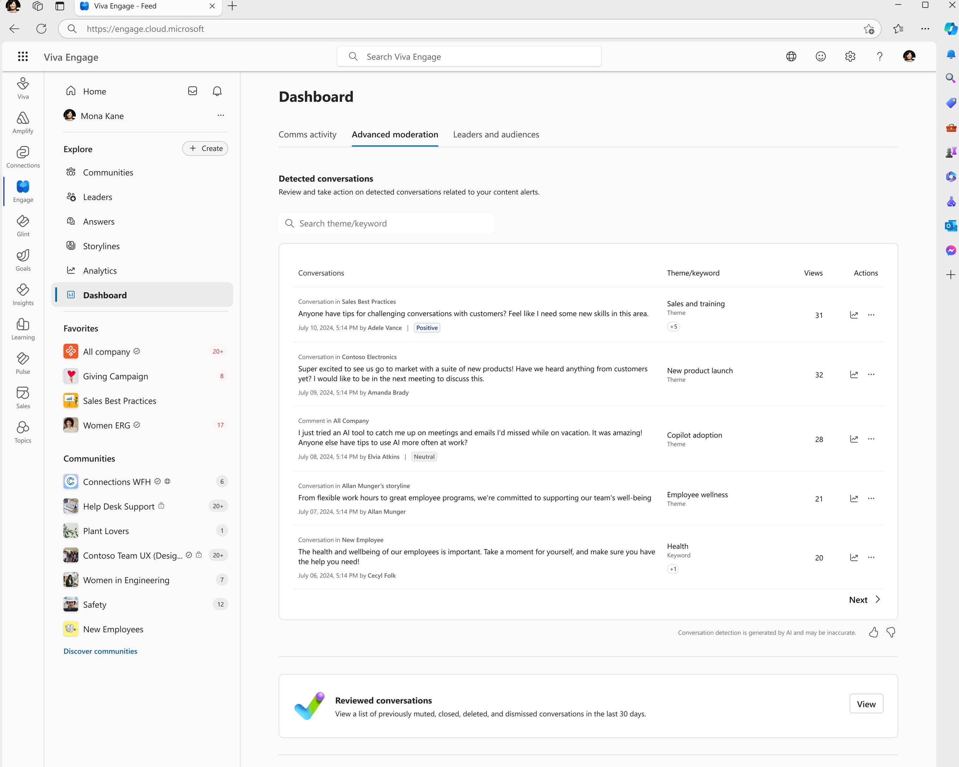
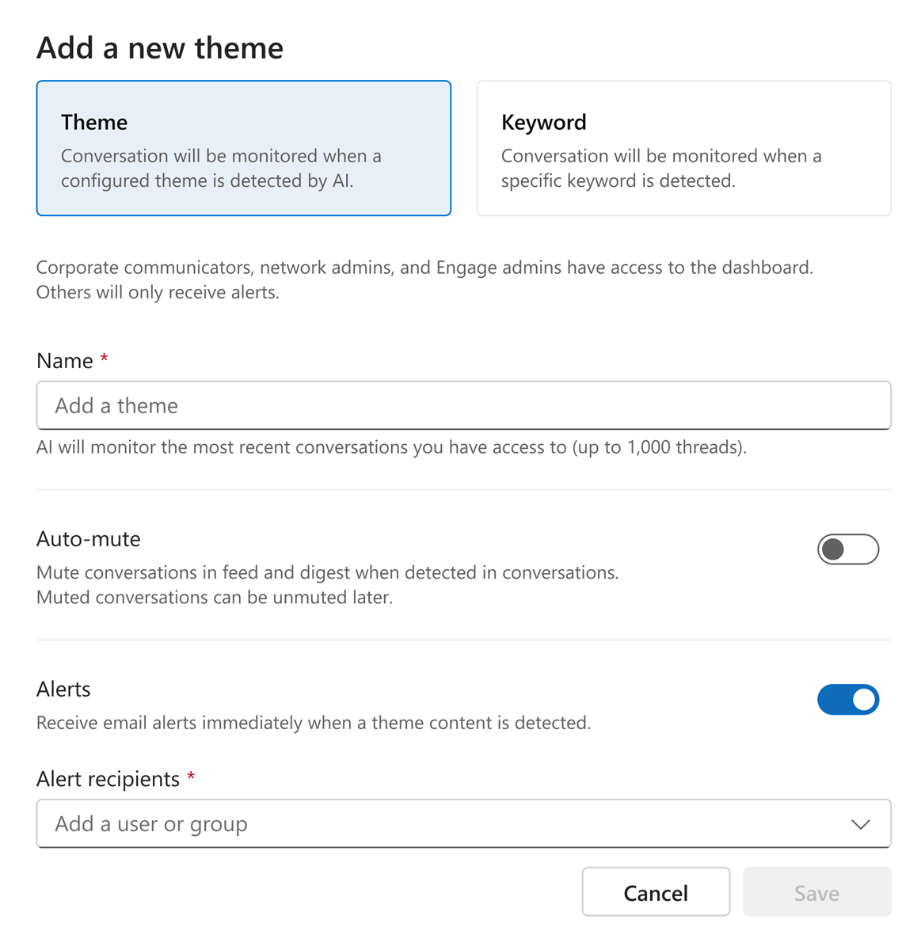
Keep Networks Productive using AI Theme Moderation
AI-based Themes to monitor, alert admins, and take action on discussions.
Surface key conversations to highlight and share them.
Enable open and appropriate communication while ensuring business content takes center stage.
Take action to track, alert, mute or block.
Generally available. Requires Viva C&C or Viva Suite license
Theme blocking coming soon
Notes:
One of the challenges we hear from leaders and communicators when considering a platform like Engage is this:
How do we balance the rewards of building trust via open communication with risks that ALSO come with open communication?
Communicators say: I simply don’t have the time to moderate and stay on top of every conversation that’s happening!
With AI-based Theme moderation – completely under your control – Engage can work with you manage this risk.

Slide 20


Resources
Read the latest in our Viva Engage blog
Microsoft Guide: Transforming communications with Engage – aka.ms/VivaEngage/eBook
Need Copilot tips?
  Copilot Prompt Gallery – aka.ms/PromptGallery ​
  Copilot Scenario library Comms – aka.ms/copilot/scenariolibrary
New to Engage? Check out our adoption site and deep dive masterclasses
Want to talk to other Engage customers?
Join our Customer Community

