Slide 1


Viva For AI transformation

Slide 2


While generative AI technology is here, enterprise AI adoption needs a transformation strategy
Adoption of new technology by consumers progresses faster than the enterprise which
is more complex ²
Enterprise Adoption for technologies like Copilot for Microsoft 365 needs engaged employees
Microsoft Viva shapes the employee
experience and enables your
AI Transformation and Performance
ChatGPT: 3 months ¹
100M
50M
Copilot for
Microsoft 365
Mobile phones: 16 years
Internet: 7 years
Facebook: 4.5 years
Time to reach 100M users
Sources: ¹ Microsoft Research; ² The state of AI in 2022 - and a half decade in review, McKinsey

Slide 3
The new performance equation
Performance
Resilience
Engagement
Productivity
energized, empowered, invested
getting work done
agile, skilled, flexible
achieving sustainable business outcomes
AI

Slide 4







Accelerated path to becoming an AI-powered high-performance organization with Microsoft Viva
Copilot Onboarding
Copilot Enablement
Copilot Adoption & Value Realization
* Use Viva Insights reports and Microsoft Copilot Dashboard
to identify ideal pilot groups.
Use Viva Pulse to get feedback and insights before Copilot/AI roll out to capture productivity obstacles and create baseline key metrics.
Create and drive actionable plans from Viva Insights reports to remove productivity barriers and obstacles.
* Use Viva Engage to share progress, learnings, and activities in communities. Curate knowledge base
via Topics and Answers
in communities.
* Use Microsoft Copilot Dashboard powered by Viva
to understand adoption rate, productivity gains, and ROI
for Copilot users.
Use Skills in Viva to assess current readiness and assign * Viva Learning path on generative AI based on proficiency level.
Use Viva Goals to unite Copilot users around shared adoption goals and measure progress.
Use Viva Amplify to run iterative AI campaigns on Copilot launch, use cases, trainings, and support for different user groups.
* Use Viva Learning to deliver bite-sized trainings on AI, Copilot, and lessons learned
in flow of work.
Use Viva Glint to get feedback, insights and user sentiment after Copilot/AI roll out.
Leverage Viva apps to identify core business scenarios
and pain points to resolve with AI Transformation
Leverage Viva apps to drive AI/Copilot for Microsoft 365 adoption and change management
Leverage Viva apps to measure effectiveness, productivity gains and ROI of AI adoption
* Seeded capabilities of app can also be utilized

Slide 5

Viva Amplify for
AI transformation

Slide 6

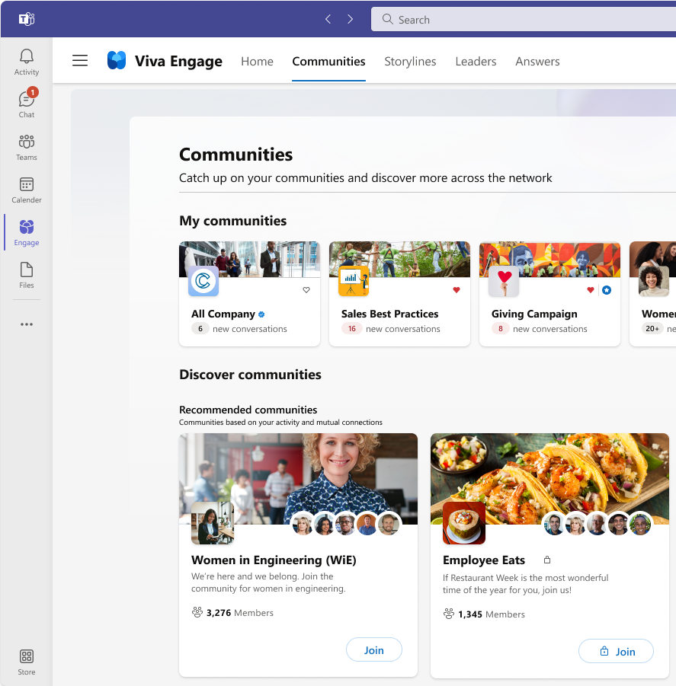
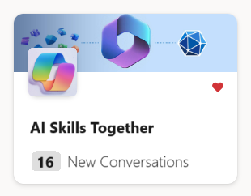
Supporting Copilot for
Microsoft 365 adoption with Viva Amplify
Drive engagement with pilot or general users in the right way
Maximize audience reach and target users with education and anticipation messaging
Tailor and target communications to specific distribution channels and groups, e.g. A Viva Engage Community for learning AI skills
Publish once to multiple apps and assess engagement through reports

Slide 7






Get started with your Copilot campaigns
1
What is our company vision for AI and where do Copilot goals fit in (consider using/sharing Viva Goals for Copilot)
2
Getting started with Copilot
and training/support
3
Sharing successful
use cases from others
Plan and manage
Plan launch and subsequent campaigns.
Design and
create content
Create the content
and get approvals
Measure effectiveness
How did users engage
with your content?
Orchestrate
and automate
Decide who will receive and in which channels
Publish universally
Review and hit send
Consider Viva
Pulse and Insights
Get qualitative feedback from Pulse surveys and behavioral data from Viva Insights to supplement engagement data

Slide 8
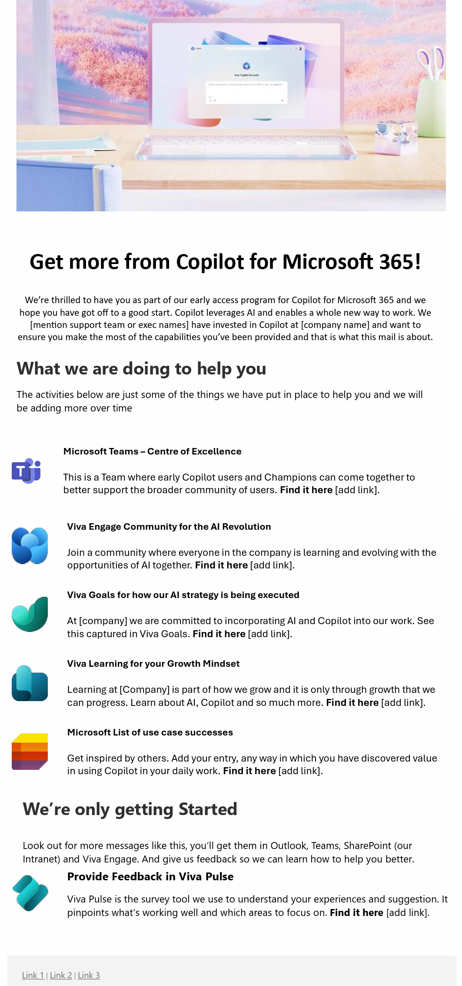
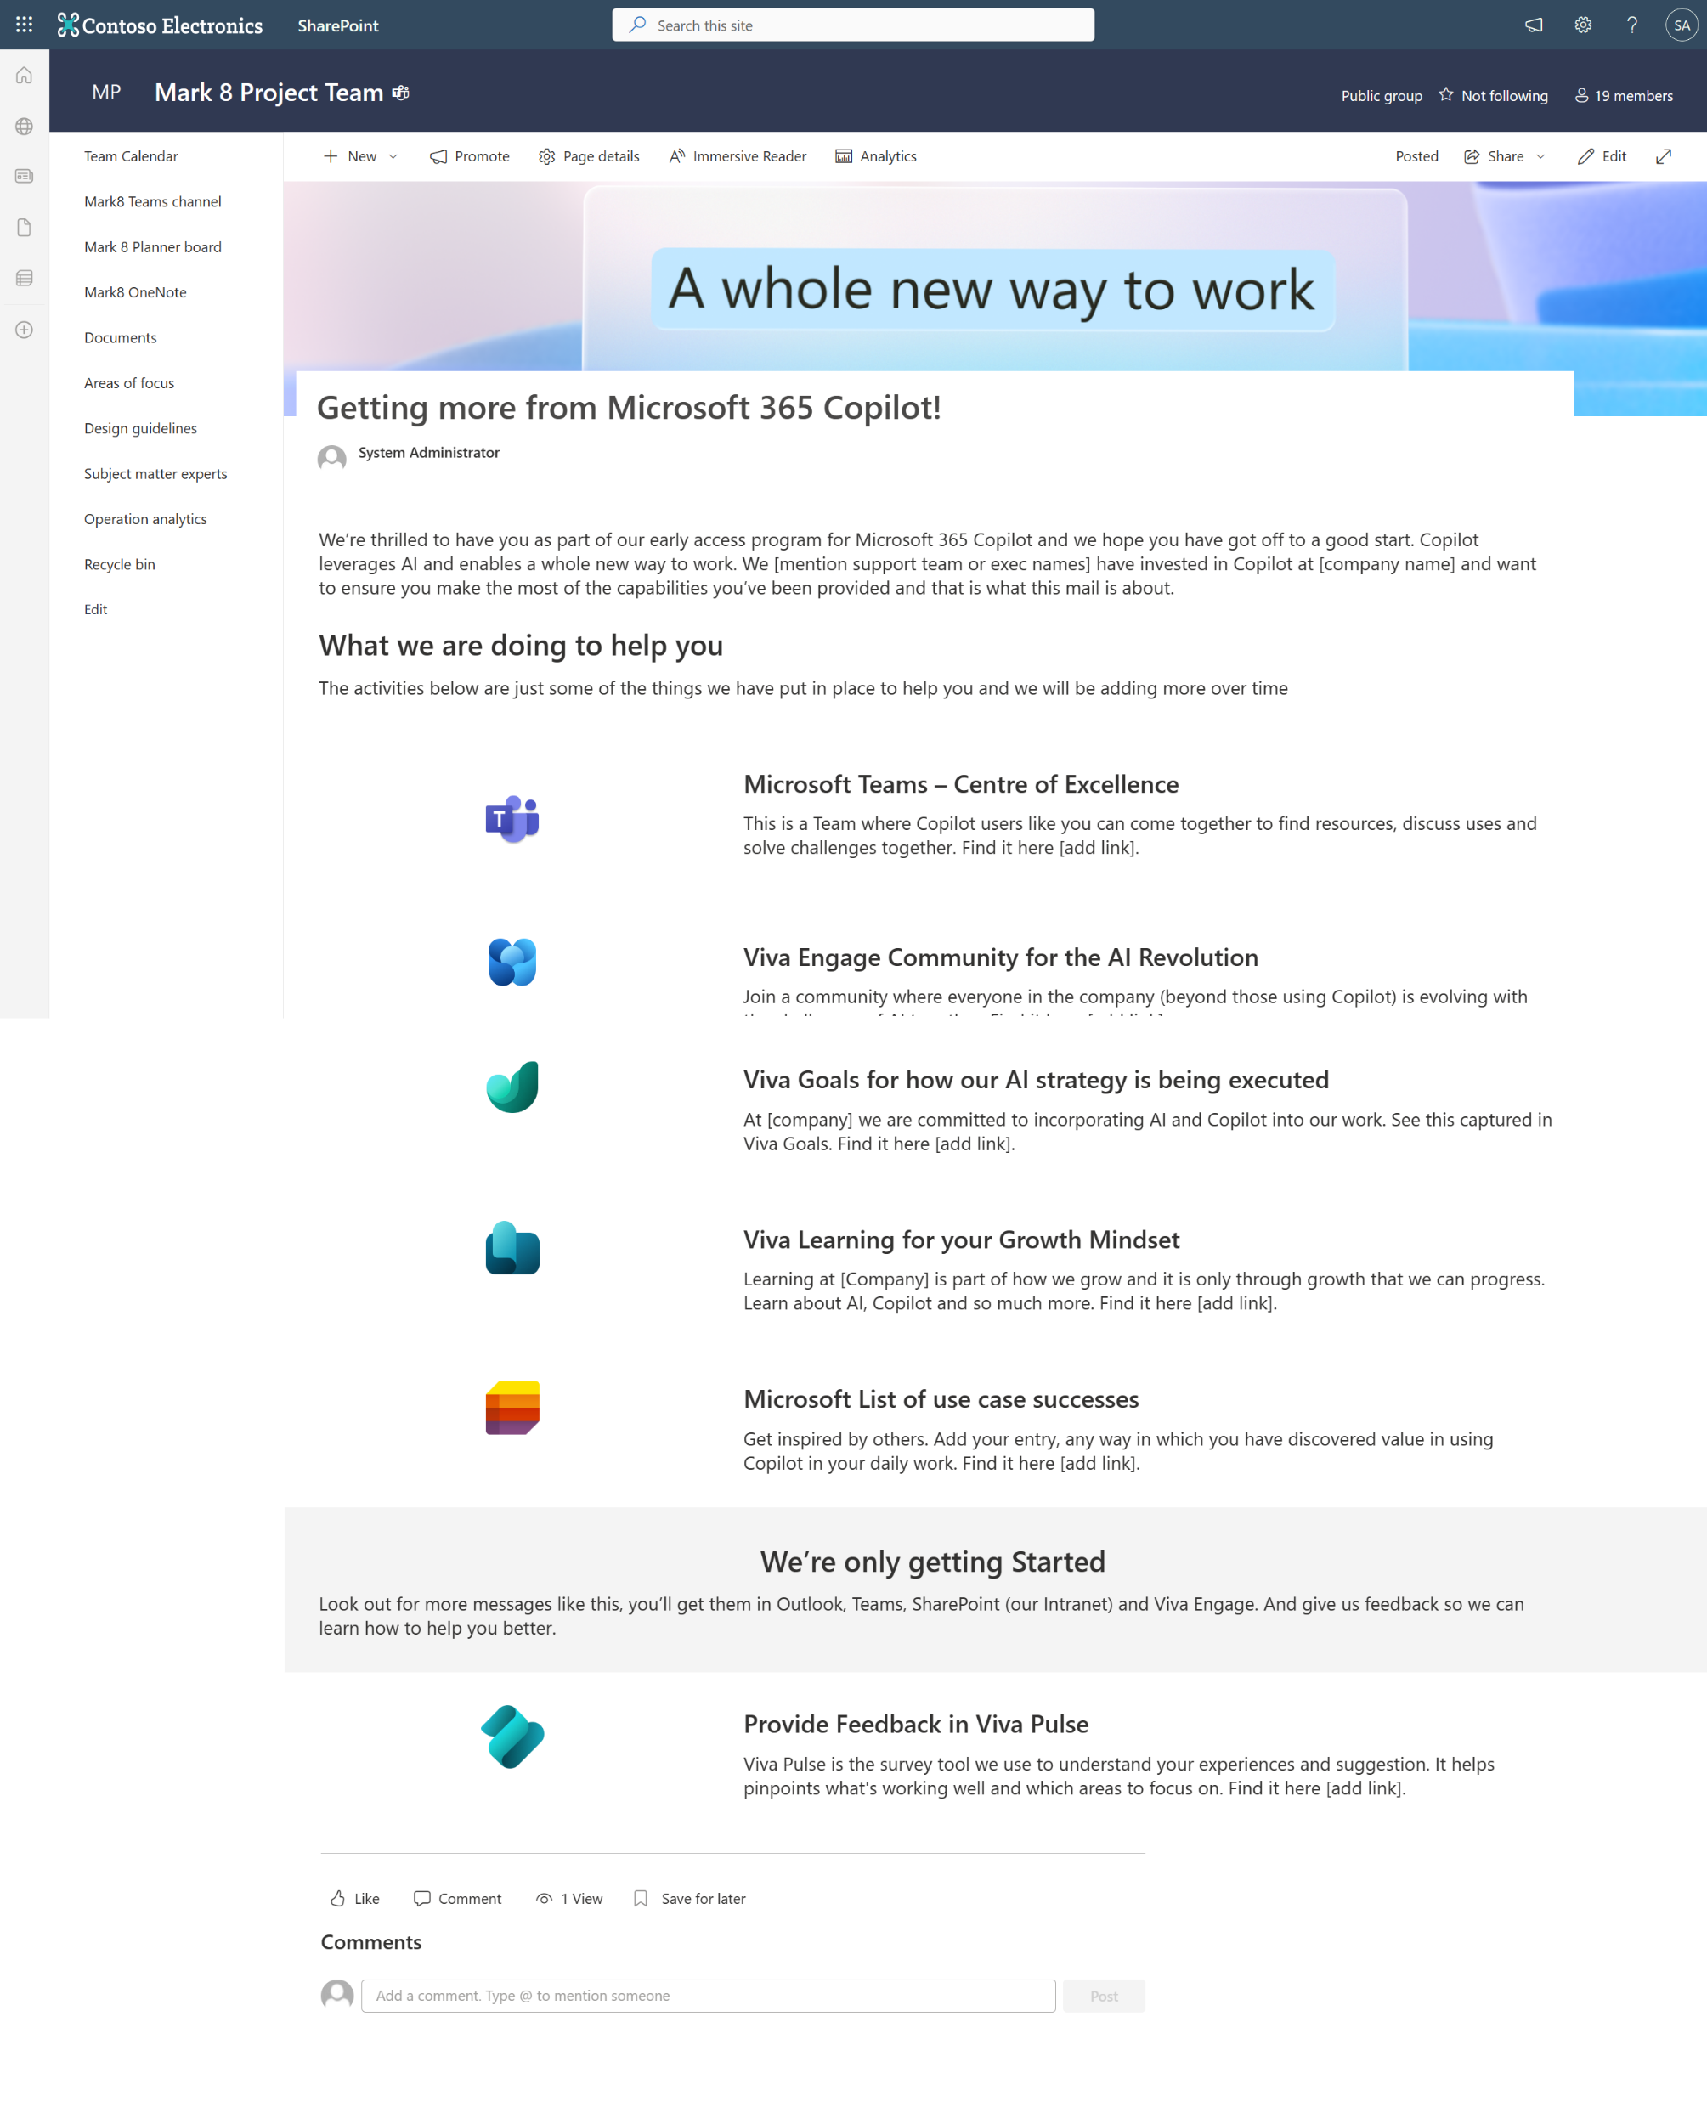
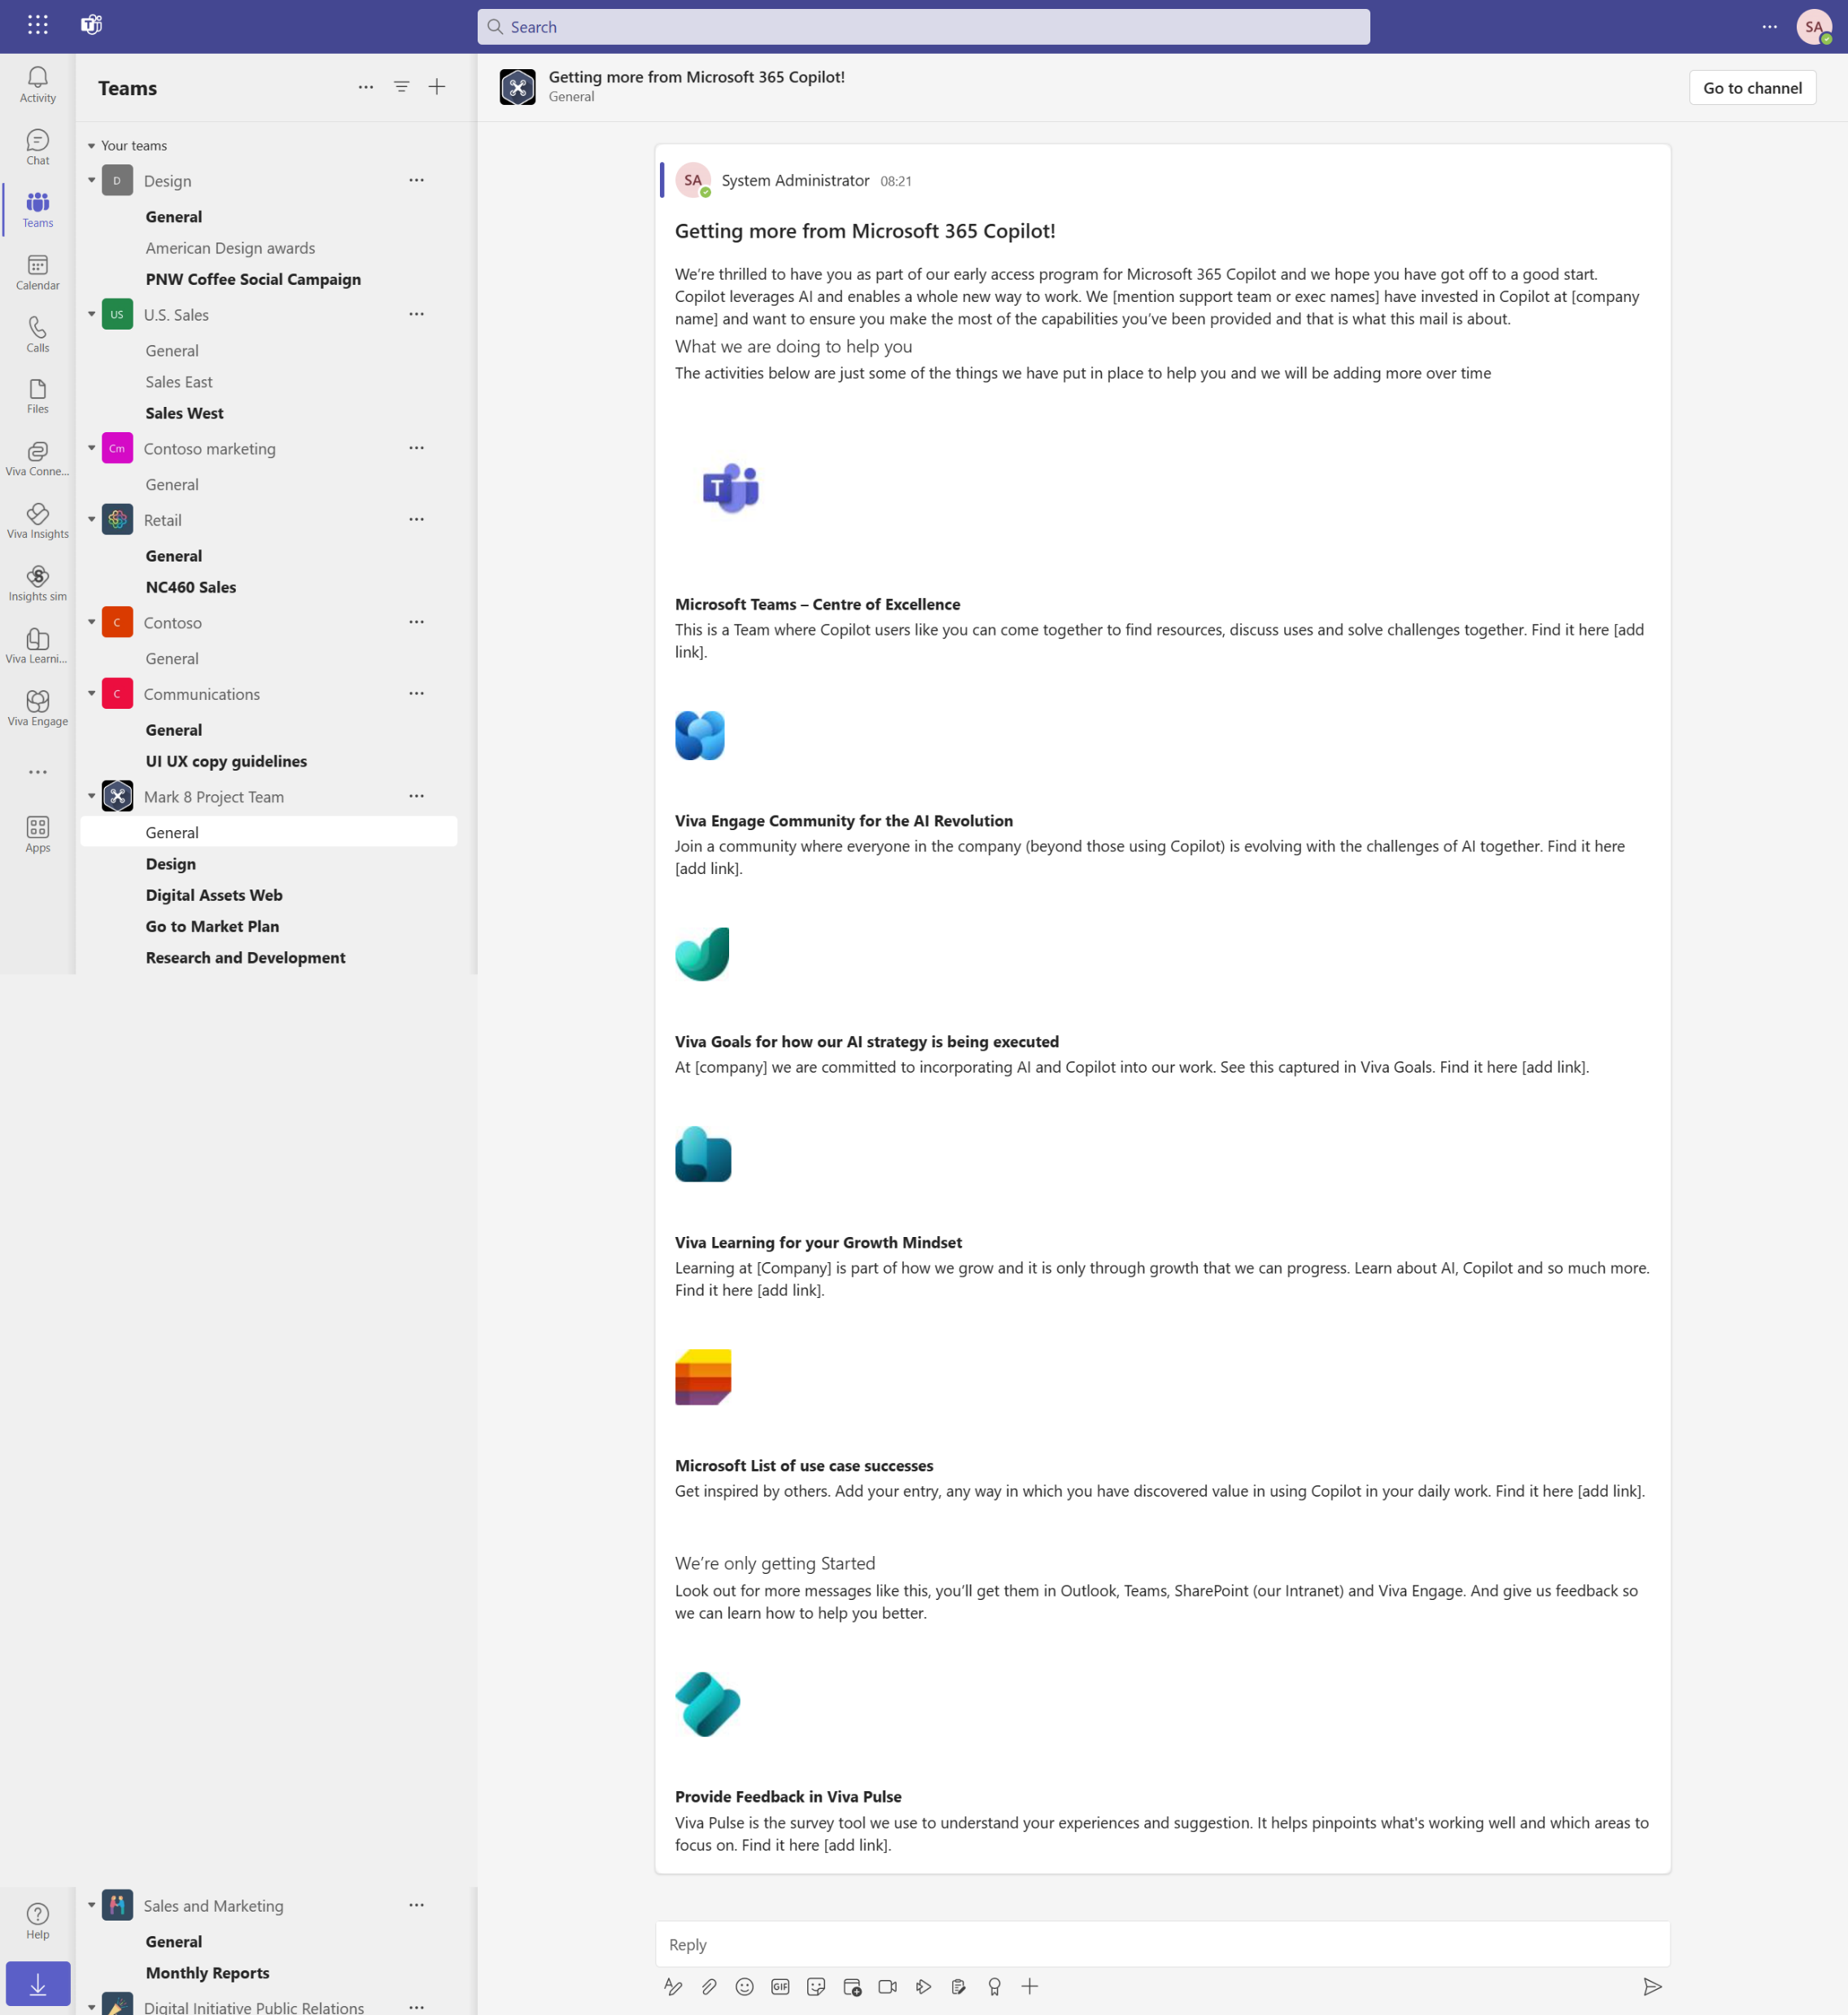
Campaign example
Outlook
SharePoint
Teams
Campaign email template

Slide 9

Viva Pulse for
AI transformation

Slide 10

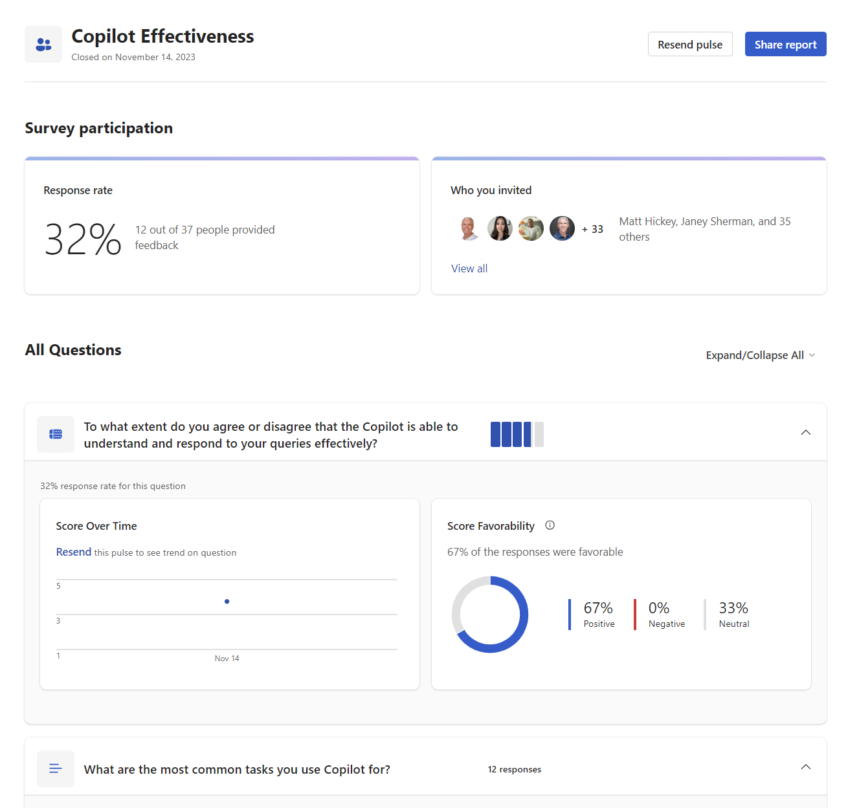
Supporting Copilot for Microsoft 365 adoption with Viva Pulse
Drive engagement with pilot or general users in the right way
Capture feedback and insights from
pilot users
Gather use cases directly relevant to
your organization
Measure Copilot growth and adoption before, during, and after roll out

Slide 11



Get started with your Copilot surveys
Plan and manage
Plan timing and launch
of Pulse surveys to be delivered over the 90 days
Design and
create content
Create the surveys
Measure effectiveness
Review user feedback
in an internal session
Orchestrate
and automate
Assign Viva Pulse licenses
to the appropriate audience
Publish universally
Review survey questions
and send to Copilot users
Consider Viva
Pulse and Insights
Get insights on users’ productivity from Insights
to prove value with data,
utilize campaigns in Amplify
to highlight use cases found
in surveys

Slide 12
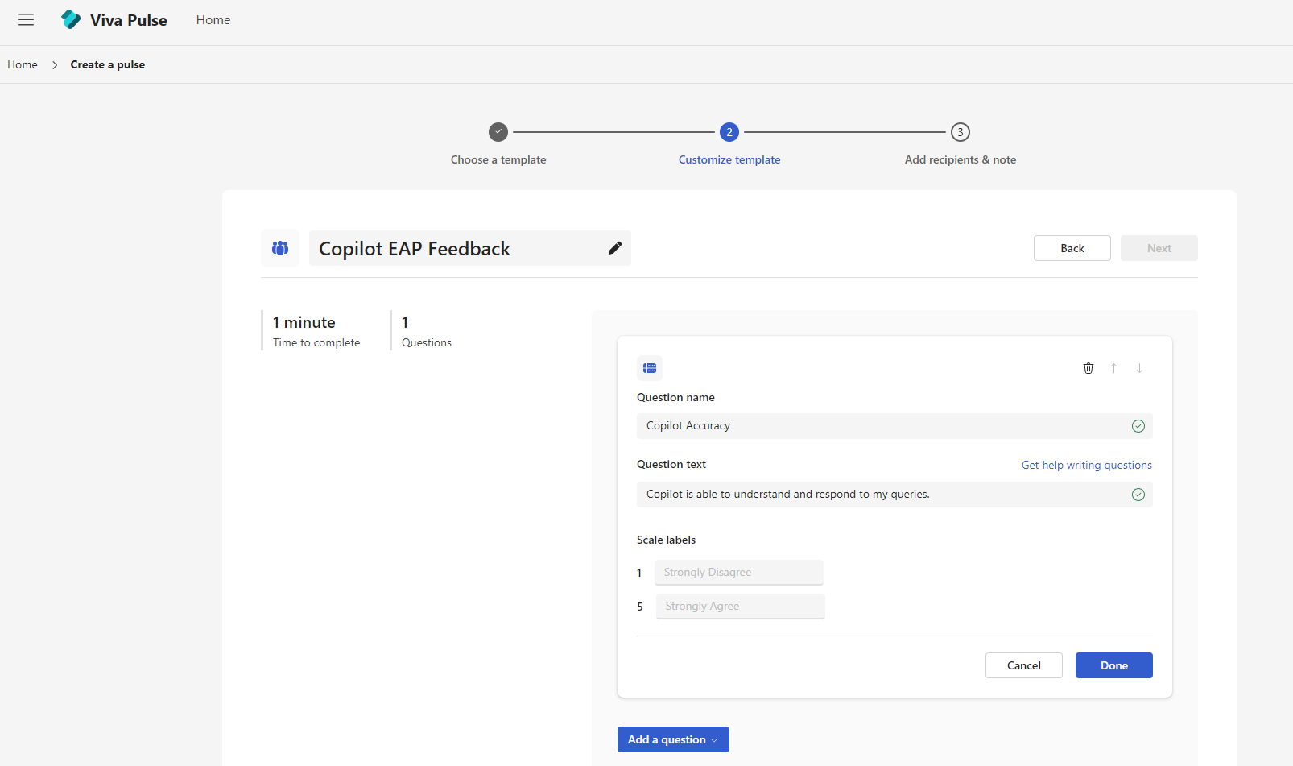
Sample survey questions
On a scale of 1-5, how satisfied are you
with the Copilot's ability to understand
and respond to your queries?
How often do you use Copilot in your
day-to-day work?
What are the most common tasks you
use Copilot for?
How has Copilot helped you in your work?
What improvements or changes would
you like to see in Copilot?
How easy or difficult is it to use Copilot?
How has Copilot impacted your productivity?
Would you recommend Copilot to
your colleagues?
Pro tip: It's important to include a mix of open-ended and close-ended questions to get a comprehensive understanding of the user's experience with Copilot. You can also include questions that ask for specific examples or instances where Copilot has been particularly helpful or where it could be improved.

Slide 13
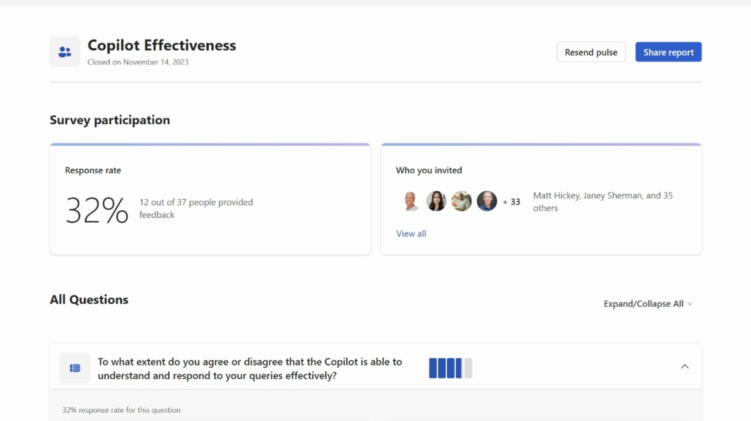
Reporting

Slide 14
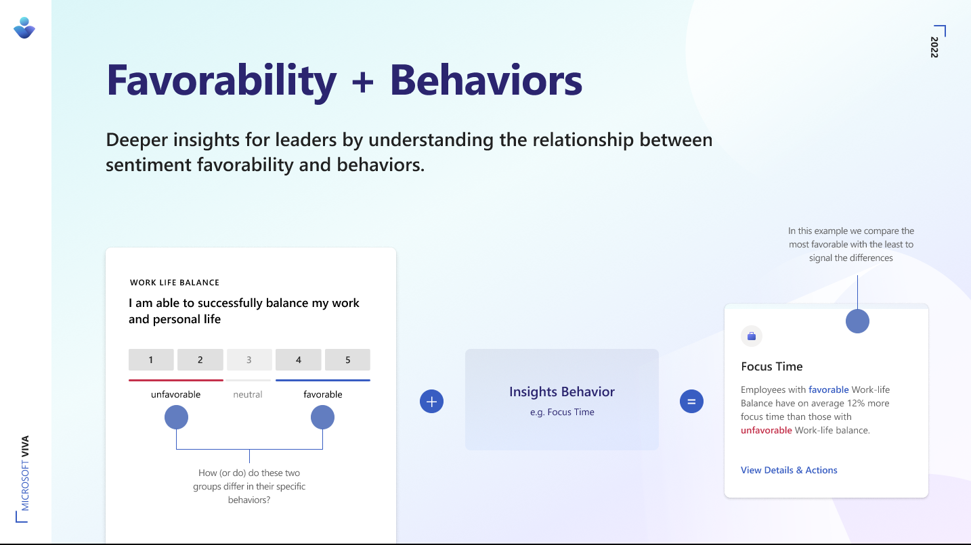
Favorability and behaviors
Deeper insights for leaders by understanding the relationship between sentiment favorability and behaviors.
In this example we compare the most favorable with the least to signal the differences
+
+

Slide 15

Viva Goals for
AI transformation

Slide 16
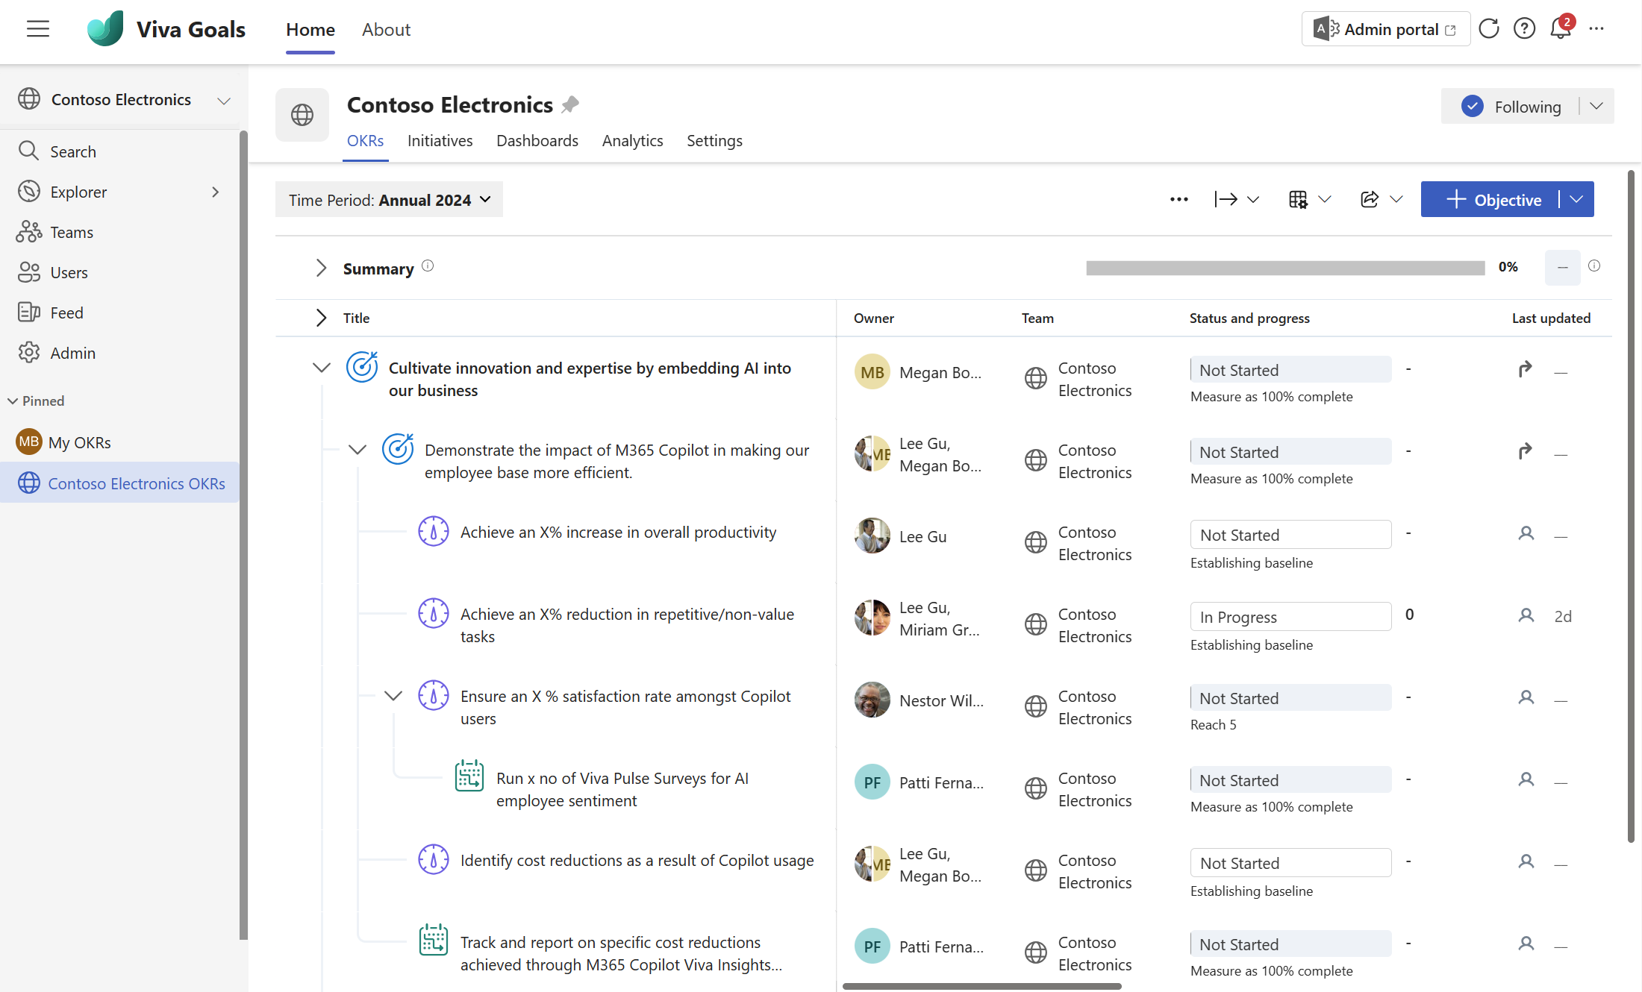
Copilot for Microsoft 365 Adoption with Viva Goals
Drive mission and alignment for Copilot for Microsoft 365
Create, manage and track goals for Copilot for Microsoft 365 deployment and adoption
Align employees with Copilot for Microsoft 365 goals, enhancing visibility and alignment with organizational AI goals
Provide a single, secure repository for Copilot for Microsoft 365 goals with easy-to-use updates, reporting and integrations

Slide 17
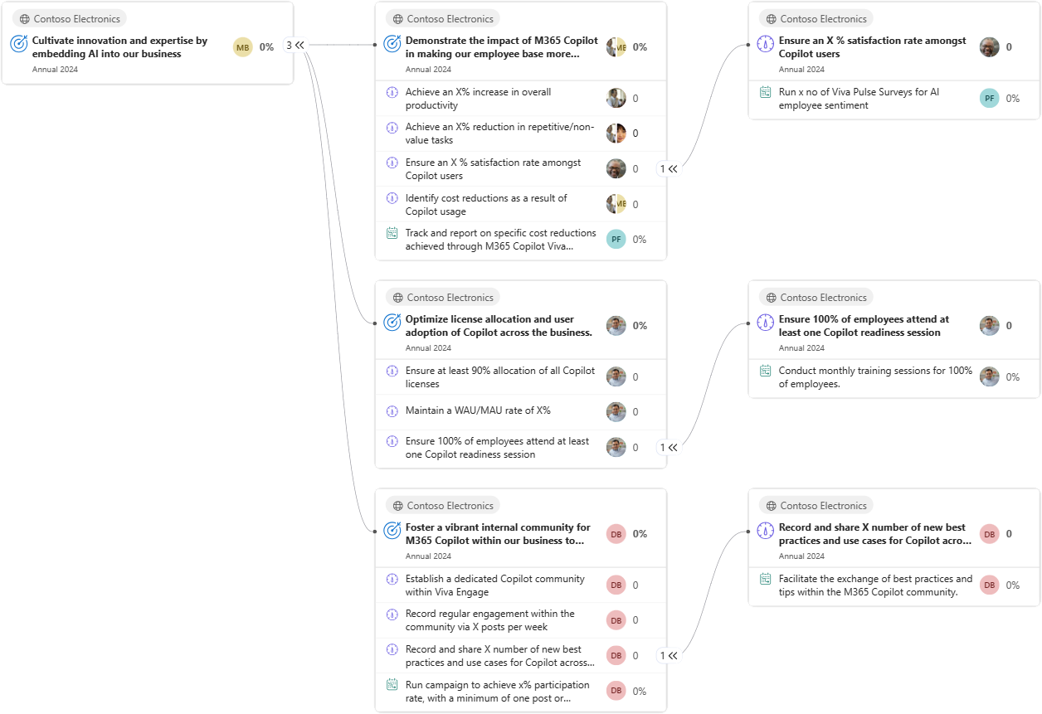
Sample OKRs for adopting Copilot for Microsoft 365

Slide 18
Get started with your Copilot for Microsoft 365 goals
Plan and manage
Engage Copilot v-team and understand key workstreams
Create and publish
Create Objectives and Key Results
Ex: Use Copilot OKR template
Measure effectiveness
Review OKRs progress with focus on learnings and next steps
Orchestrate
and automate
Configure Copilot for Microsoft 365 team
structure under AI Org
Check-in rhythm
Regular updates and
check-ins on KRs
Realize value
Consider Viva Engage, Amplify, Pulse, and Insights to drive sustained adoption on
Copilot for Microsoft 365

Slide 19

Viva Insights for
AI transformation

Slide 20
Will generative AI really transform work?
70%
68%
of Copilot users
reported that they
were more productive
of Copilot users said
it improved the quality
of their work
Source: Microsoft, What can Copilot’s earliest users teach us about generative AI at work?, November 2023.

Slide 21

Key questions org leaders have
How has been your organization’s Copilot experience so far?
How do you expect Copilot to transform work in your organization?
What metrics and insights do you need to assess Copilot impact?
How do you see Copilot impacting the employee experience/productivity and performance of your workforce?
What metrics and other inputs do you plan to use to determine whether to expand Copilot to additional users?

Slide 22
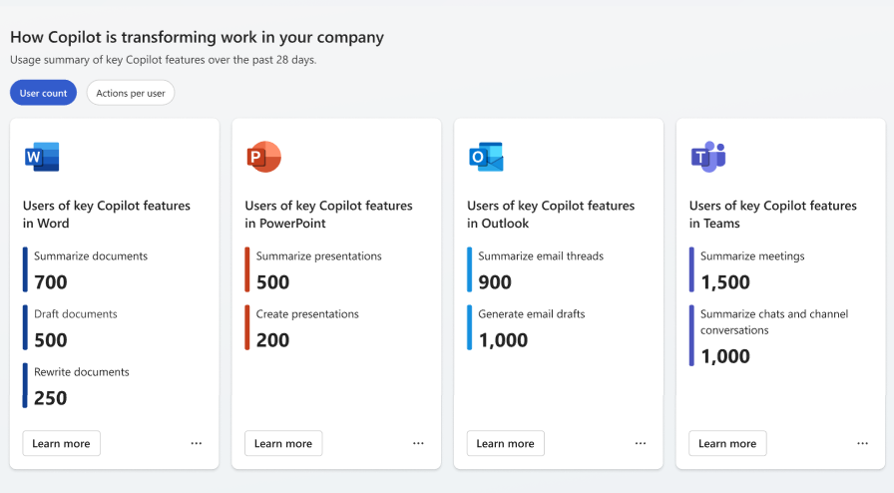
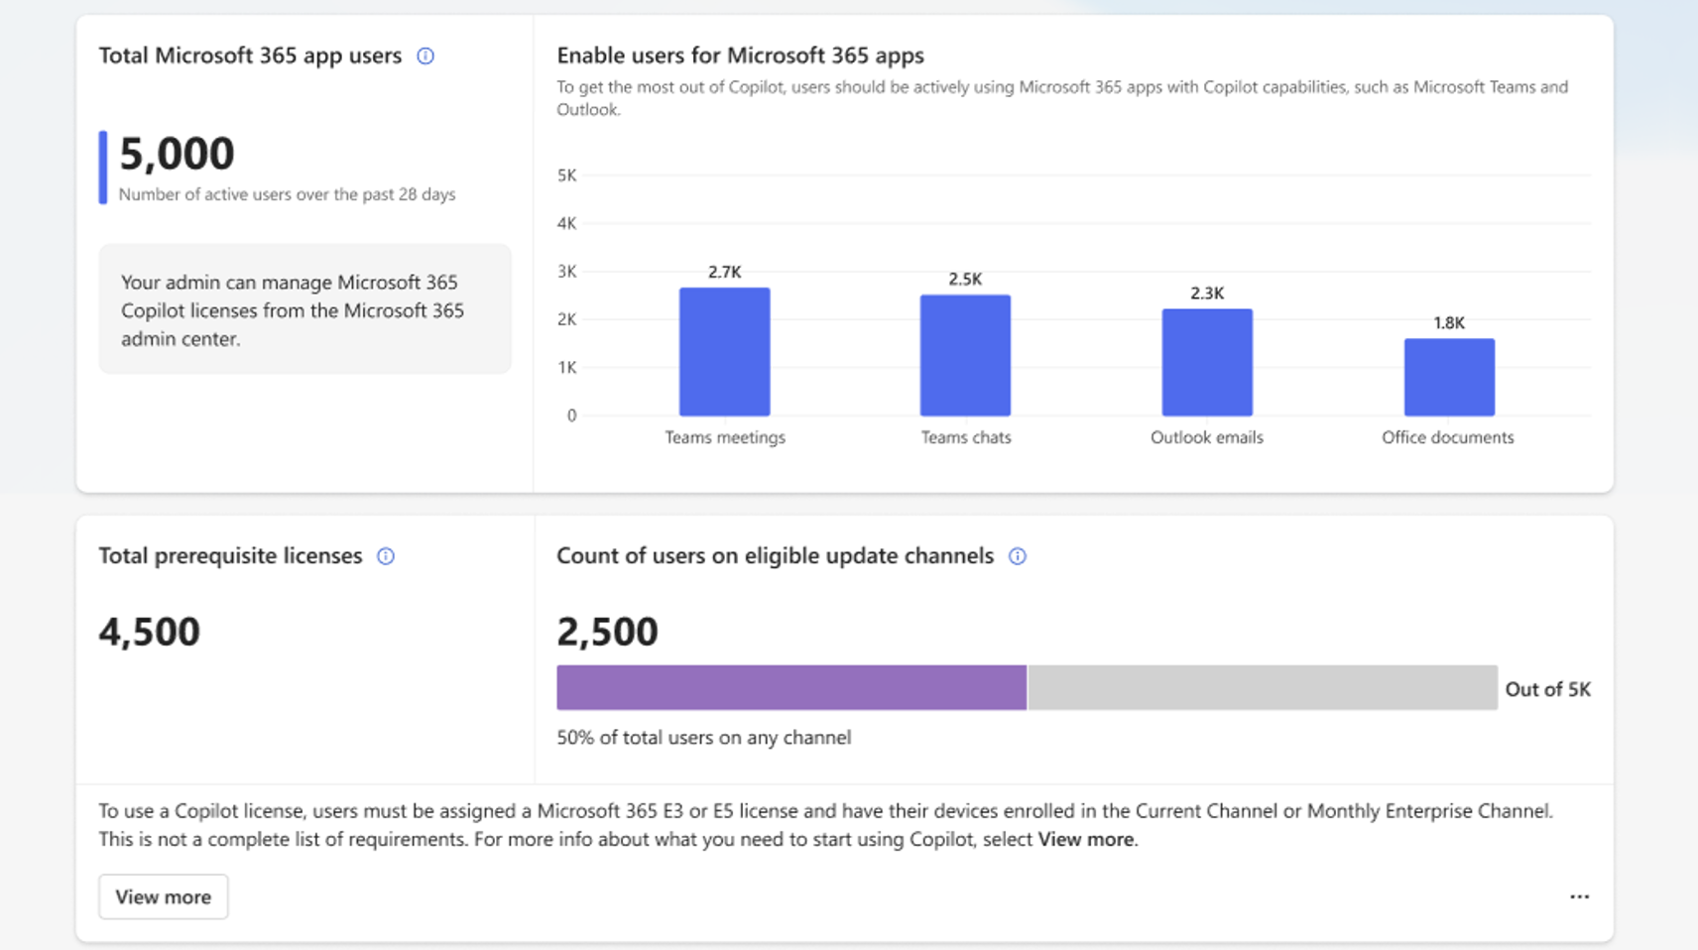
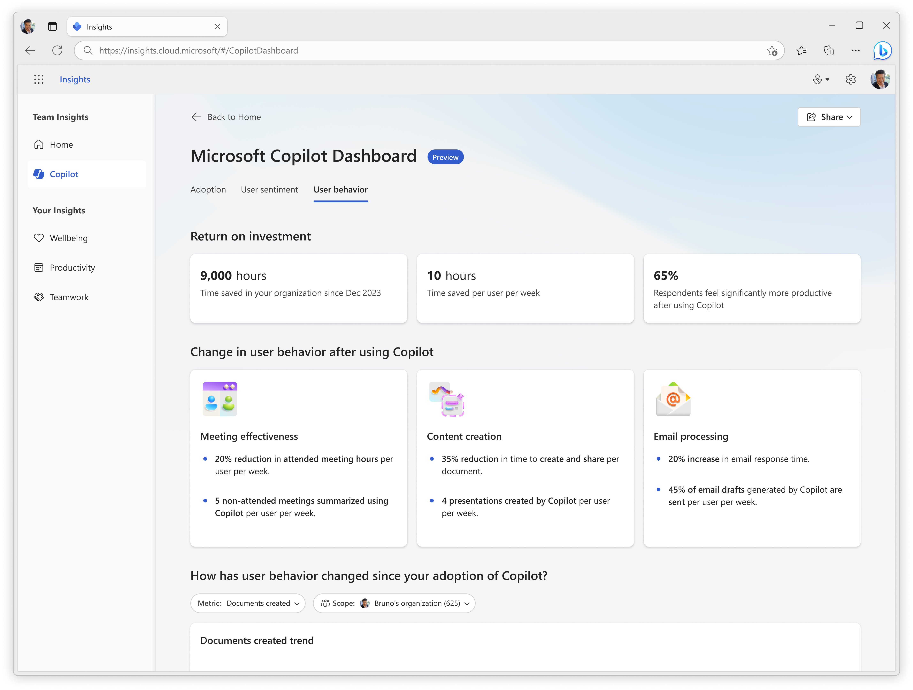
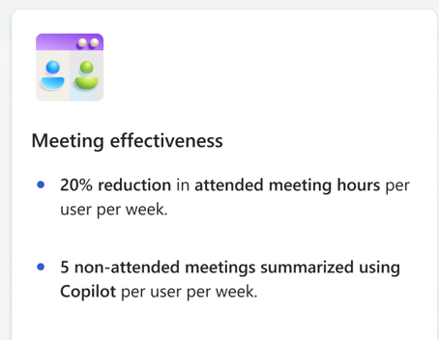

Microsoft Copilot Dashboard metrics
Readiness
Adoption
Impact
How many people in my organization are ready to
start using Microsoft Copilot?
How many people are using
Copilot and in what ways?
How can Copilot transform
work in my organization?
All metrics are tenant-level aggregates unless indicated otherwise in the table above
Reports will be expanded and iterated upon incrementally based on user feedback, research, and data availability

Slide 23

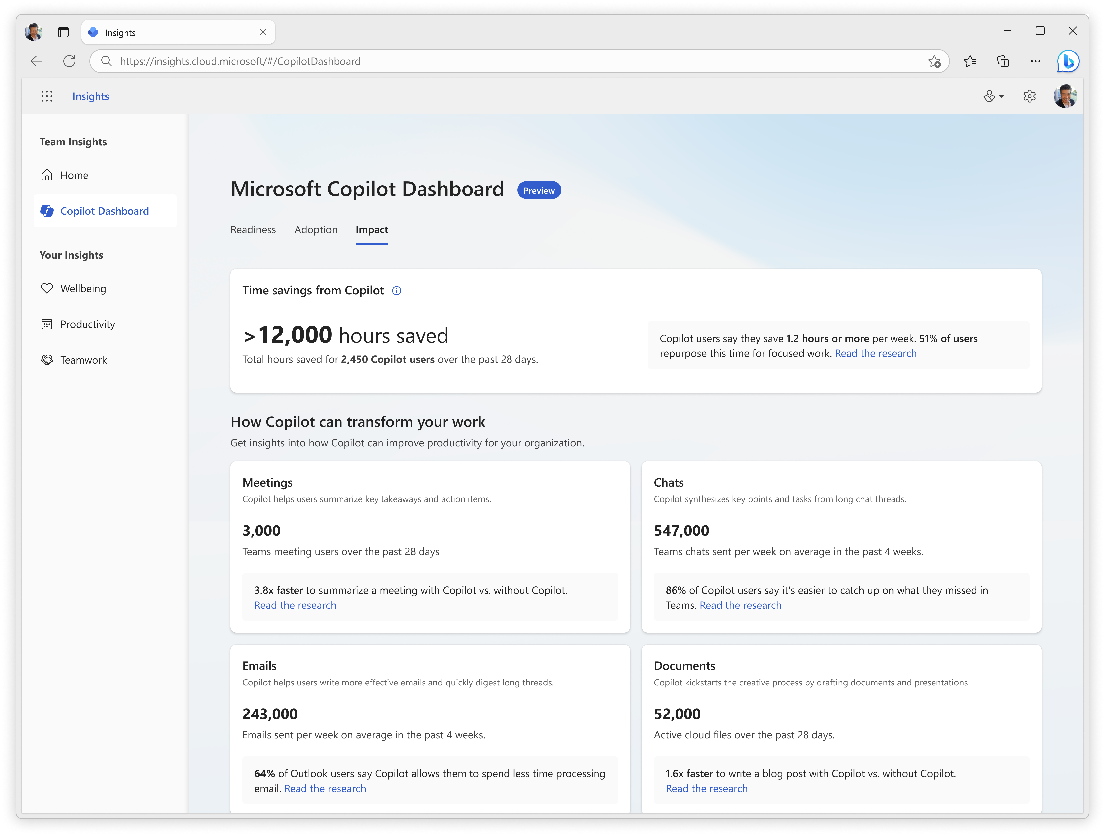
Measure Copilot for
Microsoft 365 effectiveness with Viva Insights
Microsoft Copilot Dashboard enables IT and business leaders to plan their AI readiness, drive adoption, and measure the impact of their ROI
Readiness: Get Insights on how many people in your organization are ready to start using Copilot for Microsoft 365
Adoption: Intel on how and when people are using Copilot
Impact: Insights on how Copilot transforms work in your organization

Slide 24
Get started with measuring effectiveness for Copilot for Microsoft 365
Plan and manage
Engage Copilot v-team and understand key workstreams
Assess Viva Insights reports
Analysts/leaders to assess existing PBI reports and Copilot Dashboard to understand productivity barriers and identify pilot user groups for roll out
Measure effectiveness
Check the productivity gains and ROI with Copilot Dashboard
Configure
access in mac
IT Admin or Global admin to configure access for required users for Copilot Dashboard in the Microsoft 365 admin center
Check-in rhythm
Take Actions for identified users on Copilot onboarding
and enablement journey
Validate user sentiment
Use Viva Glint/Viva Pulse
to get feedback and user sentiment after Copilot/AI rollout

Slide 25
Quantify productivity gains and time savings
Measure the impact of your Copilot deployment as behaviors change and work is transformed.
Coming early CY24

Slide 26
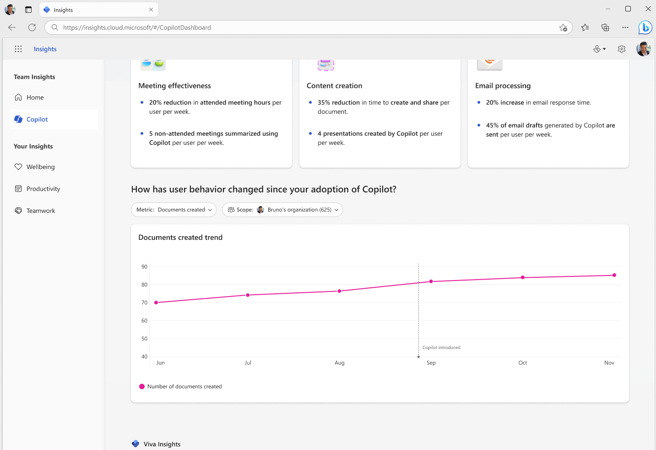
Compare before and after behaviors
Understand behavioral trends before and after Copilot adoption, such as meeting attendance and email processing time, and compare results across departments, functions, roles, and more.
Coming early CY24

Slide 27
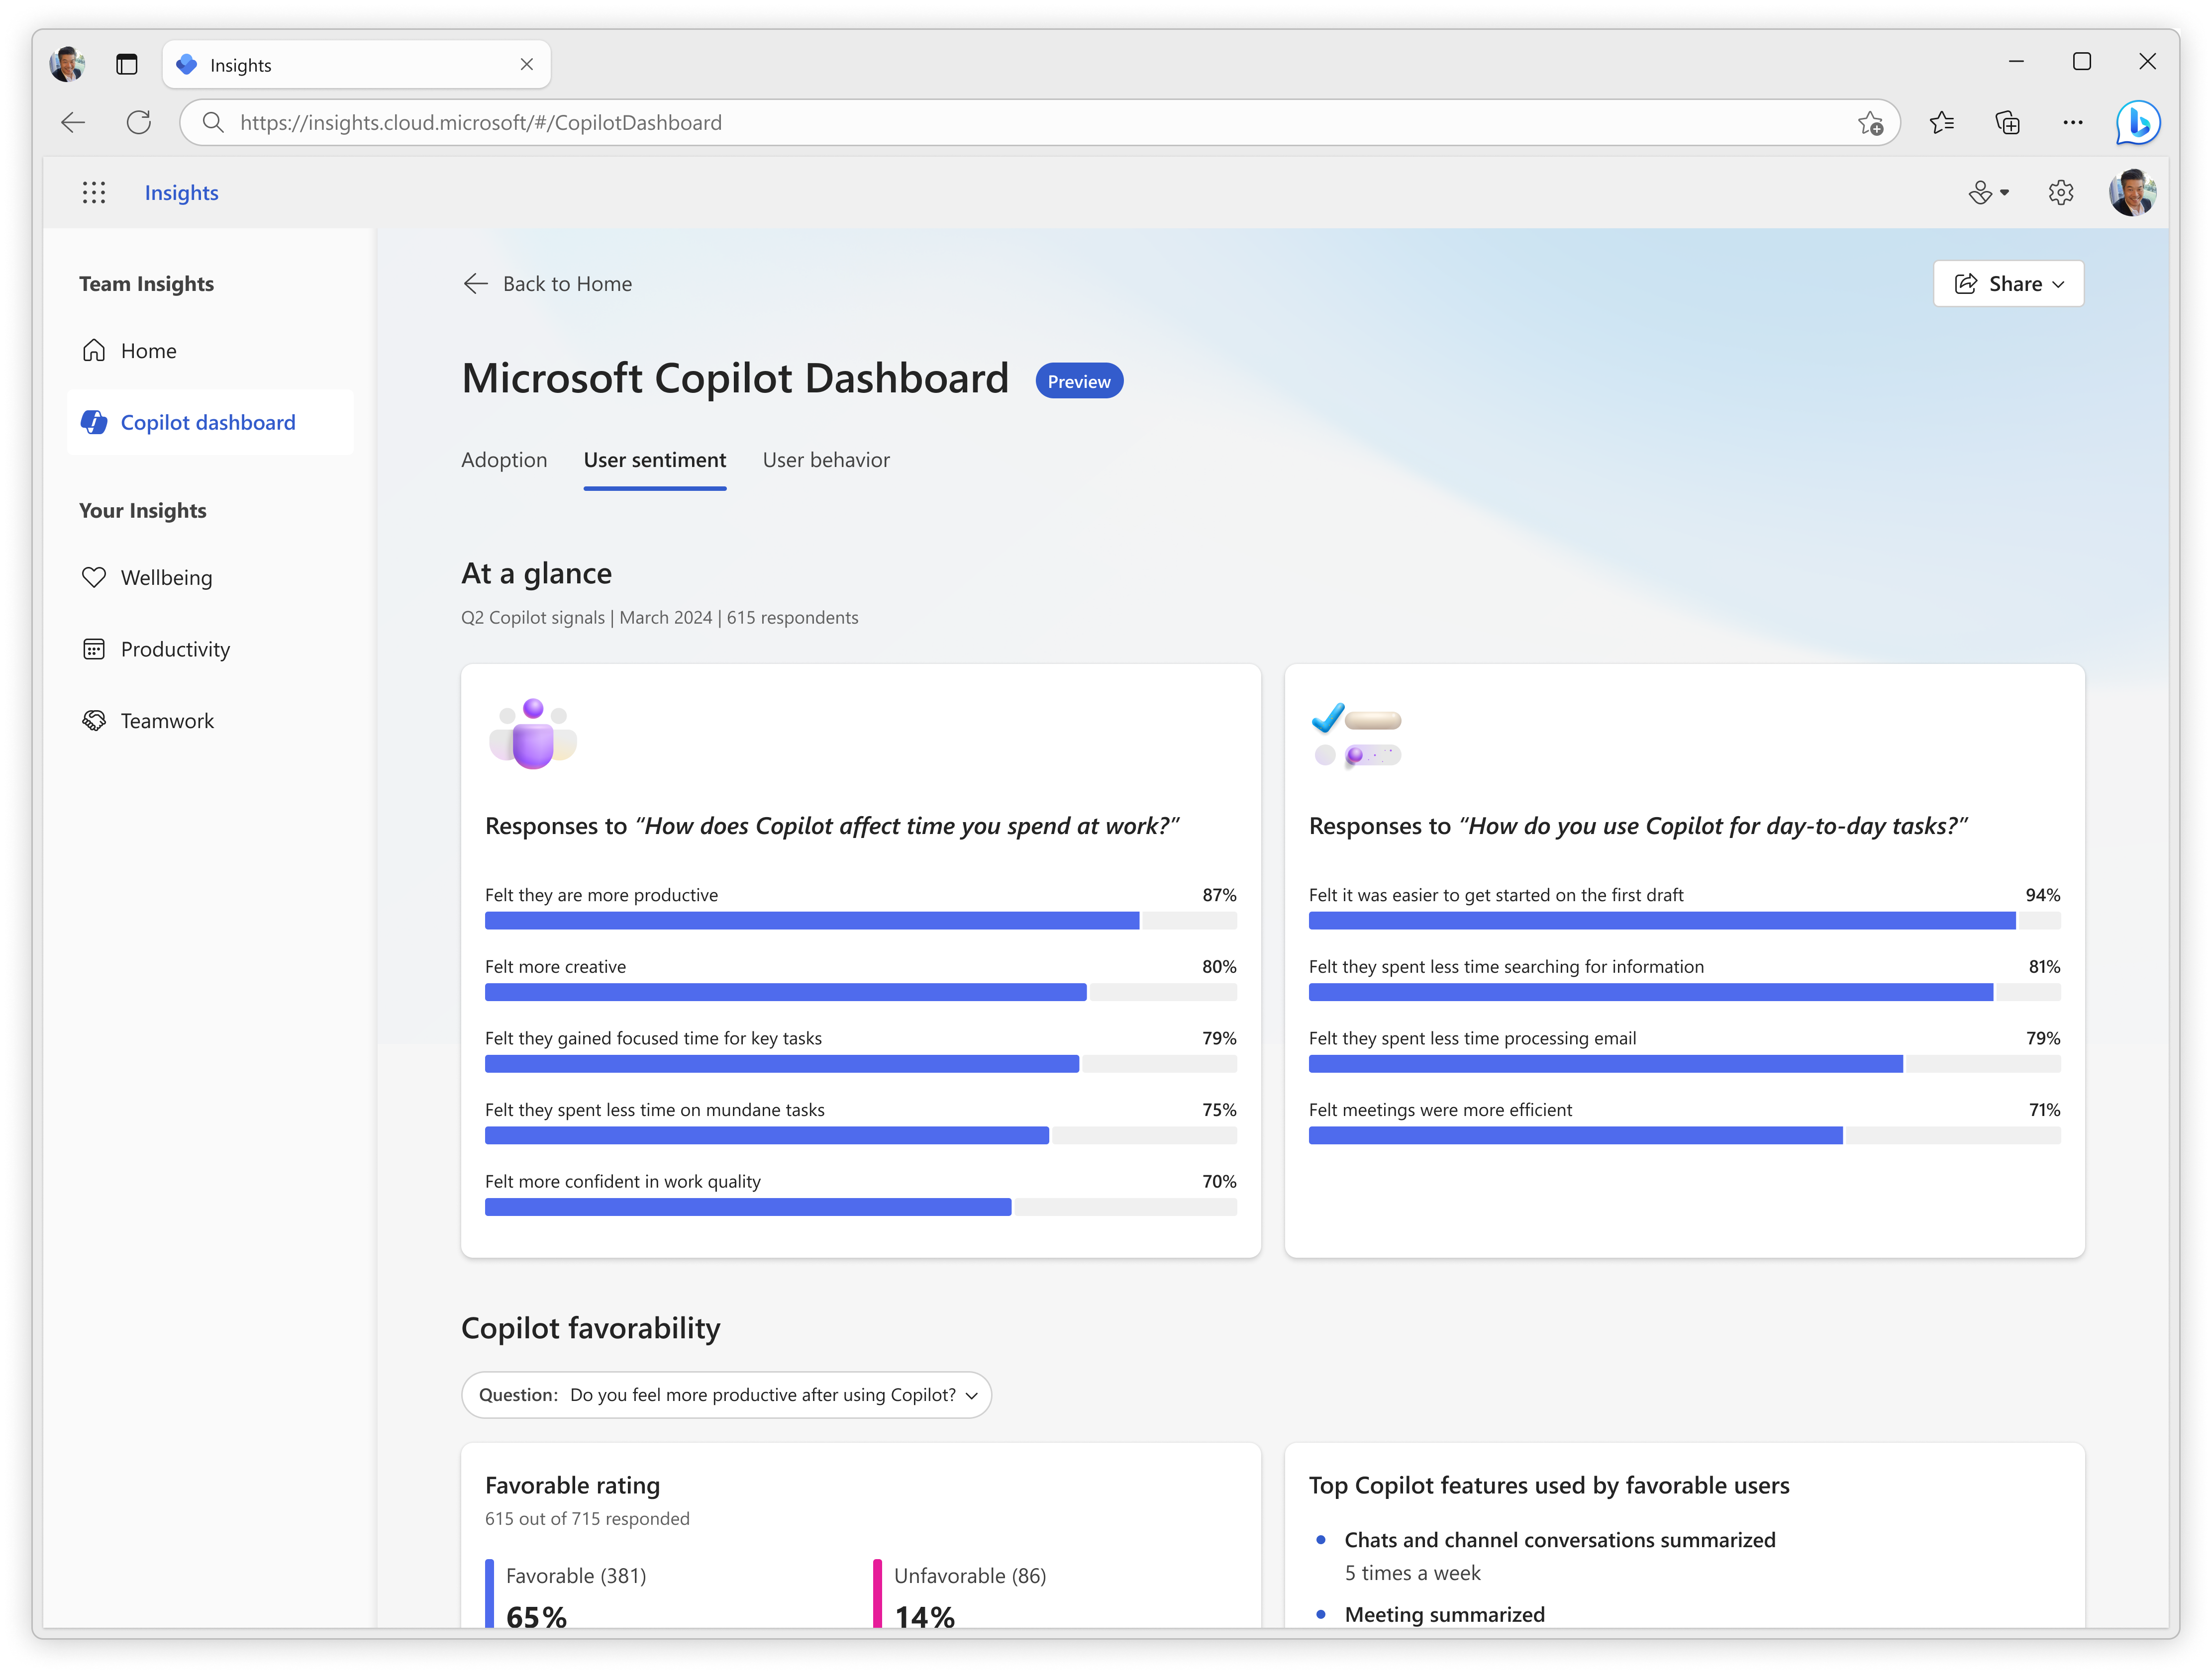
Analyze Copilot user sentiment
Understand employee sentiment about the benefits of using day-to-day, correlated with behavioral metrics.
Coming early CY24

Slide 28

Viva Learning for
AI transformation

Slide 29
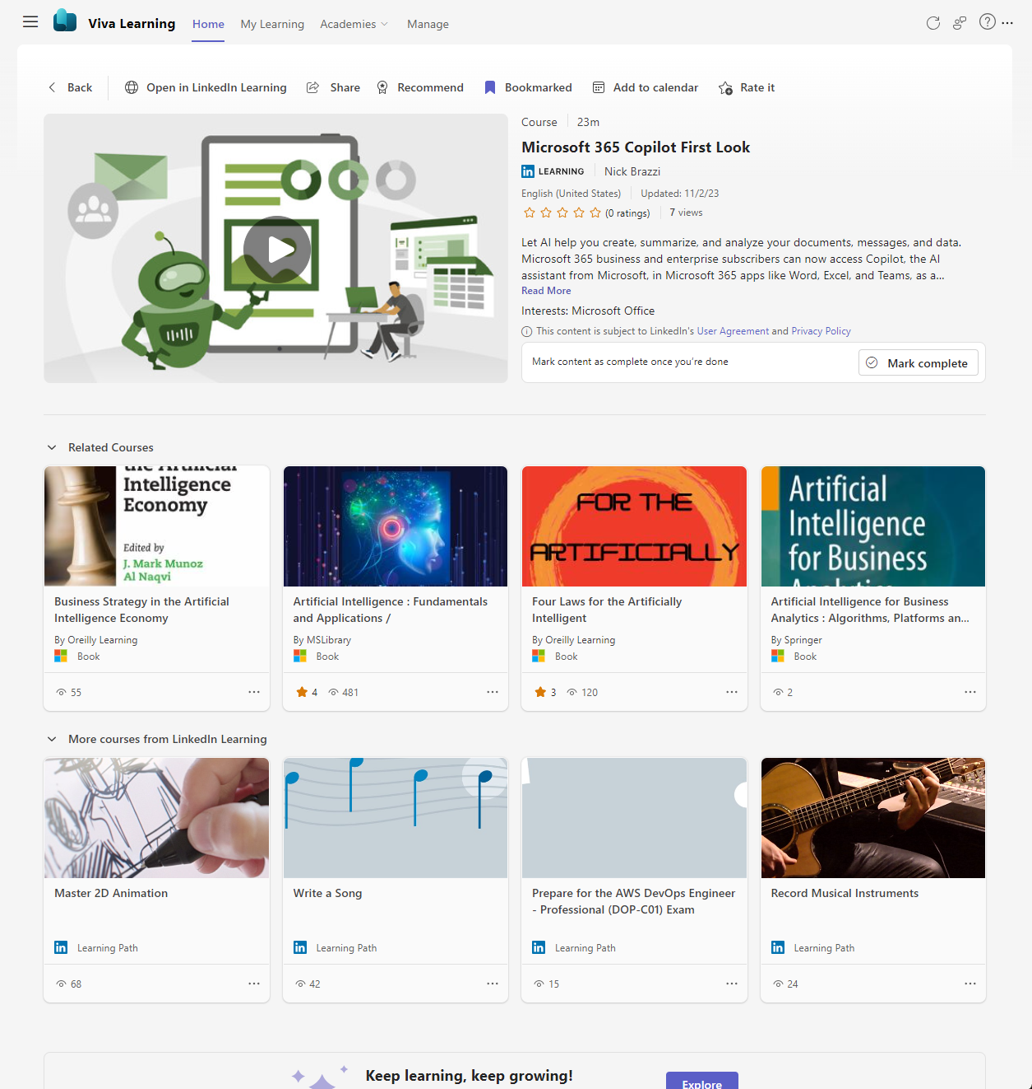
Supporting Copilot for Microsoft 365 adoption with Viva Learning
Drive engagement with pilot or general users in the right way
Learn about Copilot for Microsoft 365 in the flow of work
Curate Copilot learning content in Teams channels
Recommend Copilot content to colleagues and track reported completion progress
Share learning content in a Teams chat or email

Slide 30

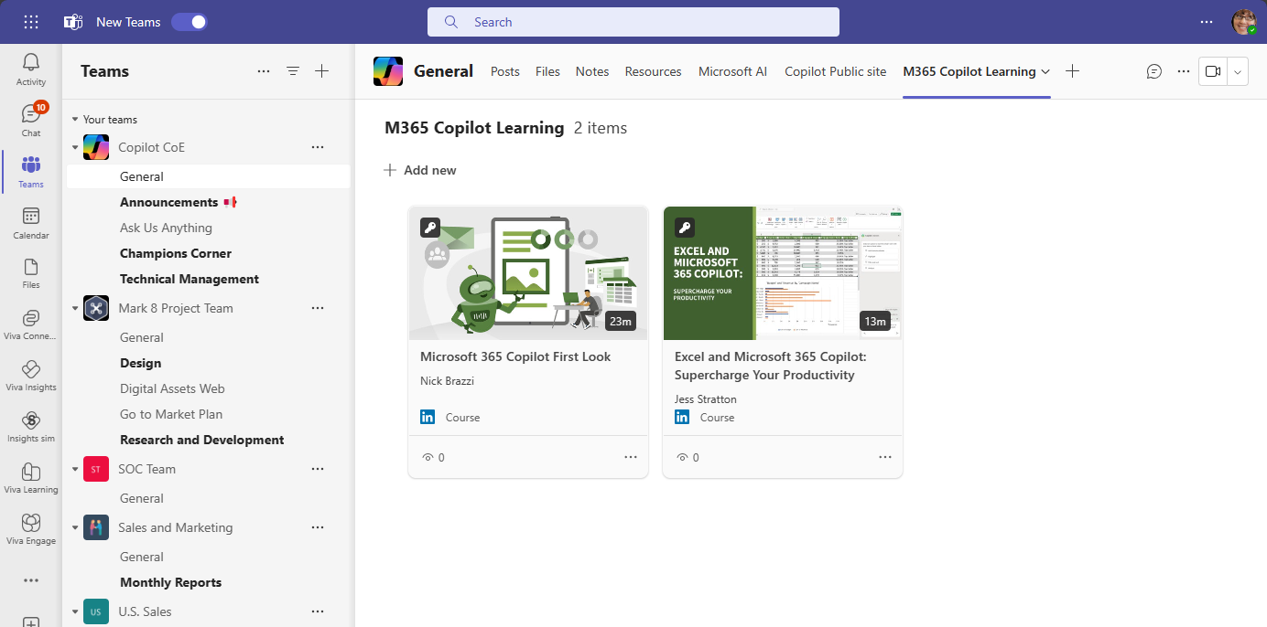
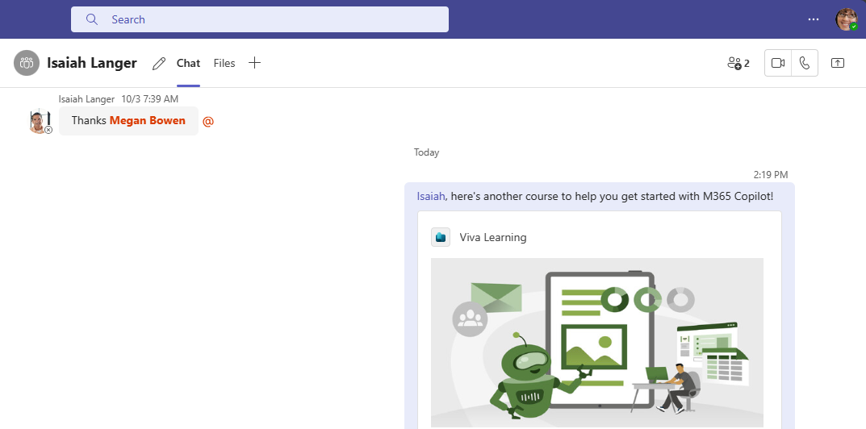
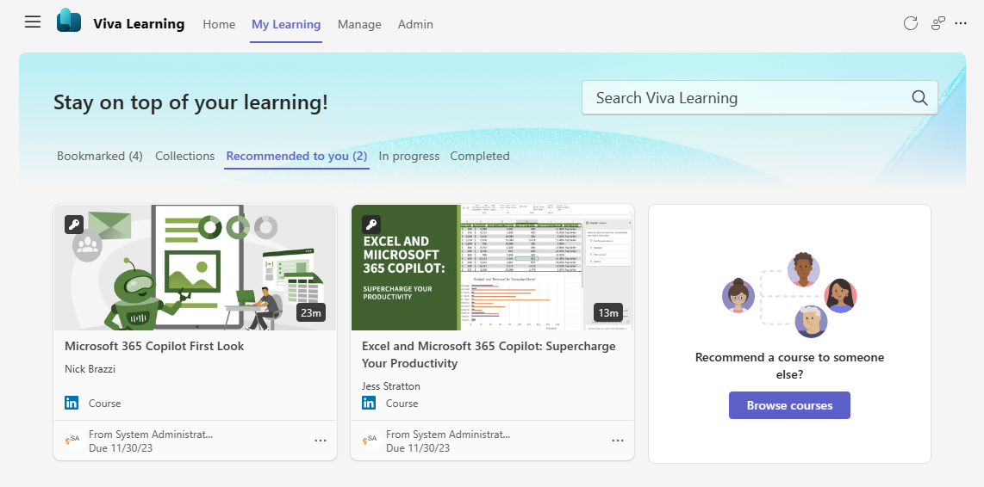
Curate, recommendc and share
Copilot learning content in Teams

Slide 31
Get started with your Copilot learning
Curate Copilot content
Curate Copilot learning content in Teams
Track course completion
Create Objectives and Key Results.
Ex: Use Copilot OKR template
Find and share learning
Users can find and share Copilot training with teammates through Teams or email
Recommend courses
Configure Copilot for Microsoft 365 team
structure under AI org
Complete
Copilot courses
Users receive notifications
of recommended courses
and view directly in Teams
or Viva Learning web
Measure adoption
View and report on
Viva Learning active
and engaged users

Slide 32

Viva Engage for
AI transformation

Slide 33
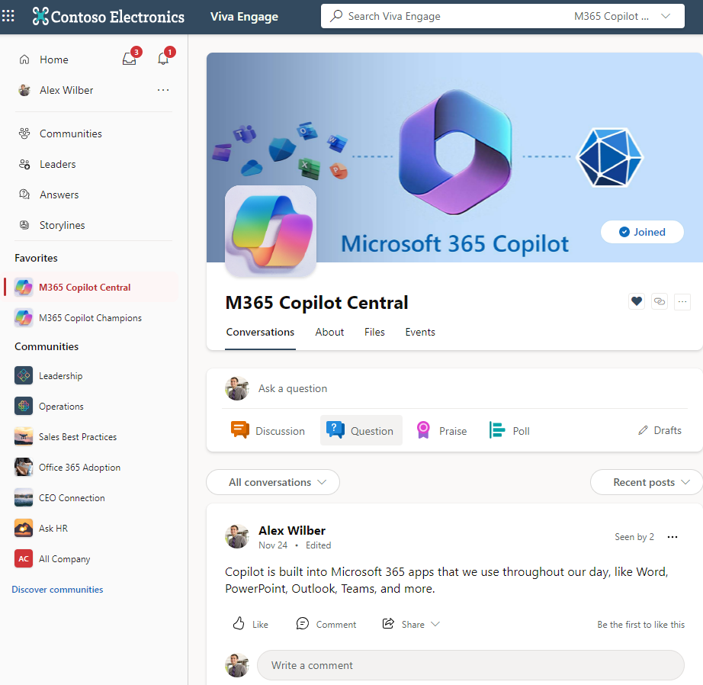
Get ready to soar with Copilot and Viva Engage!
Communities: Create Communities for Copilot for Microsoft 365.
Connect with coworkers in communities built around what Copilot can do.
Announcements: Keep everyone informed and engaged with announcements and notifications across web and mobile apps.
Conversations: Need assistance on features? Post conversations, questions, polls, and praise in a community or on your storyline.
Storyline: Post and share with your followers and others that can learn from your knowledge.
Leadership Corner: What are leaders doing with Copilot for Microsoft 365? Get to know your leaders, stay informed, attend their AMAs (Ask Me Anything), and follow them for updates.
Answers: A new experience for people to learn from each other by asking and answering questions. You can even build an FAQ from the best answers.
Virtual Events: Host a live video event including Viva Engage conversations and Q&A before, during, and after a Copilot for
Microsoft 365 event.
For additional guidance, leverage our best practices guide on using Viva Engage to launch Copilot for Microsoft 365.

Slide 34
Get started with Copilot for Microsoft 365 in Viva Engage
Plan and manage
Create Copilot user Communities
Rally employees around Copilot initiatives with Community collaboration
Use AI to create
and publish
Use AI-powered features in Viva Engage Copilot, which assists employees in creating engaging and inclusive posts, and AI suggested topics for Viva Answers
Search for answers
Use the search bar to quickly
find conversations, people, communities, and knowledge across your network for Copilot for Microsoft 365
Orchestrate and connect
Reach Copilot users with interactive messages that can extend across Outlook, Microsoft Teams, SharePoint, and mobile devices
Uncover helpful information through conversations happening across Copilot users
Follow champions
Discover and learn more from Champions and leaders. Follow people to exchange knowledge and ideas
Realize value
Measure engagement using conversation insights to understand the impact and reach with analytics

Slide 35
Thank You

