Slide 1

Host an AMA event
A step-by-step playbook for hosting ‘ask me anything’ events in Viva Engage
Updated May 2024

Slide 2
It’s time to Ask me Anything.
This playbook is a step-by-step guide that will walk you through the ins and outs of hosting an AMA.
There are three simple steps:
Prepare & Promote
Conduct the event
Reflect & Share out
We will cover best practices for before, during and after the event.

Slide 3
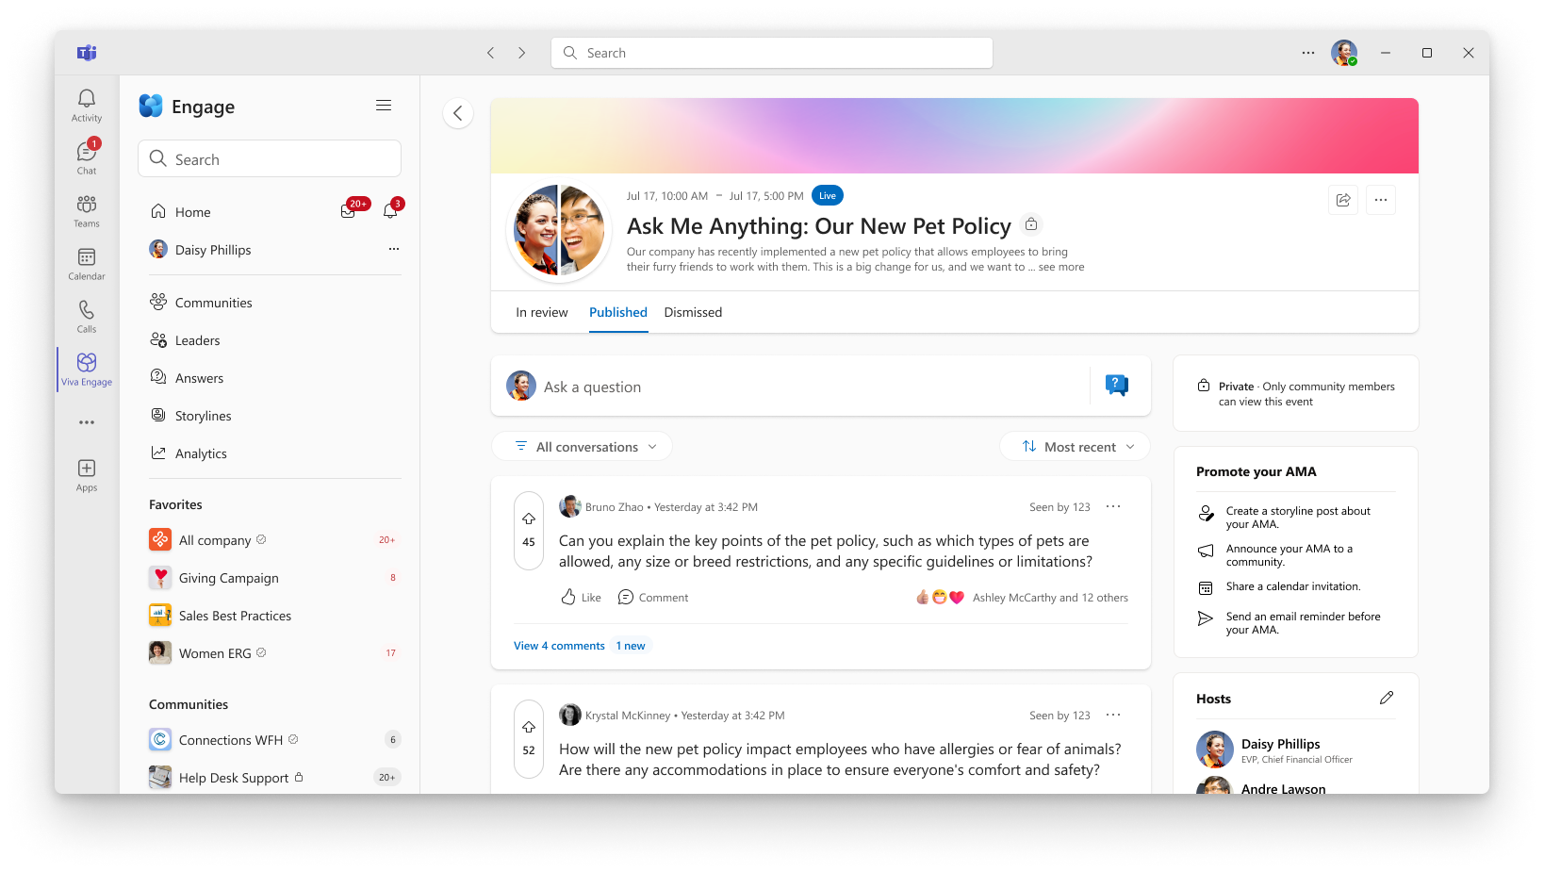
Ask Me Anything events provide space for conversational Q&A about top-of-mind topics to drive culture, clarity and connect people and information.
AMA events are most successful when they are around a specific topic.
Organizers can moderate questions as they come in the queue.
Questions can be upvoted by participants to help organizers and host understand top questions needing answers.
Organizers can customize the set up and experience of the AMA, including adding the ability for employees to ask anonymous questions.

Slide 4
Ask Me Anything events are question and answer events where…
Leaders and experts can…
Employees can…
Create
cohesive culture and drive clarity by fostering open line of communication with their employees
Seek
information from leaders and experts that helps them learn, grow, and make impact
Listen
to concerns, ideas, and questions from users across their organization
Connect
with coworkers and leaders/experts, fostering a stronger network
Share
expertise and knowledge with users across their organization
Notes:
Two sided marketplace …

Slide 5
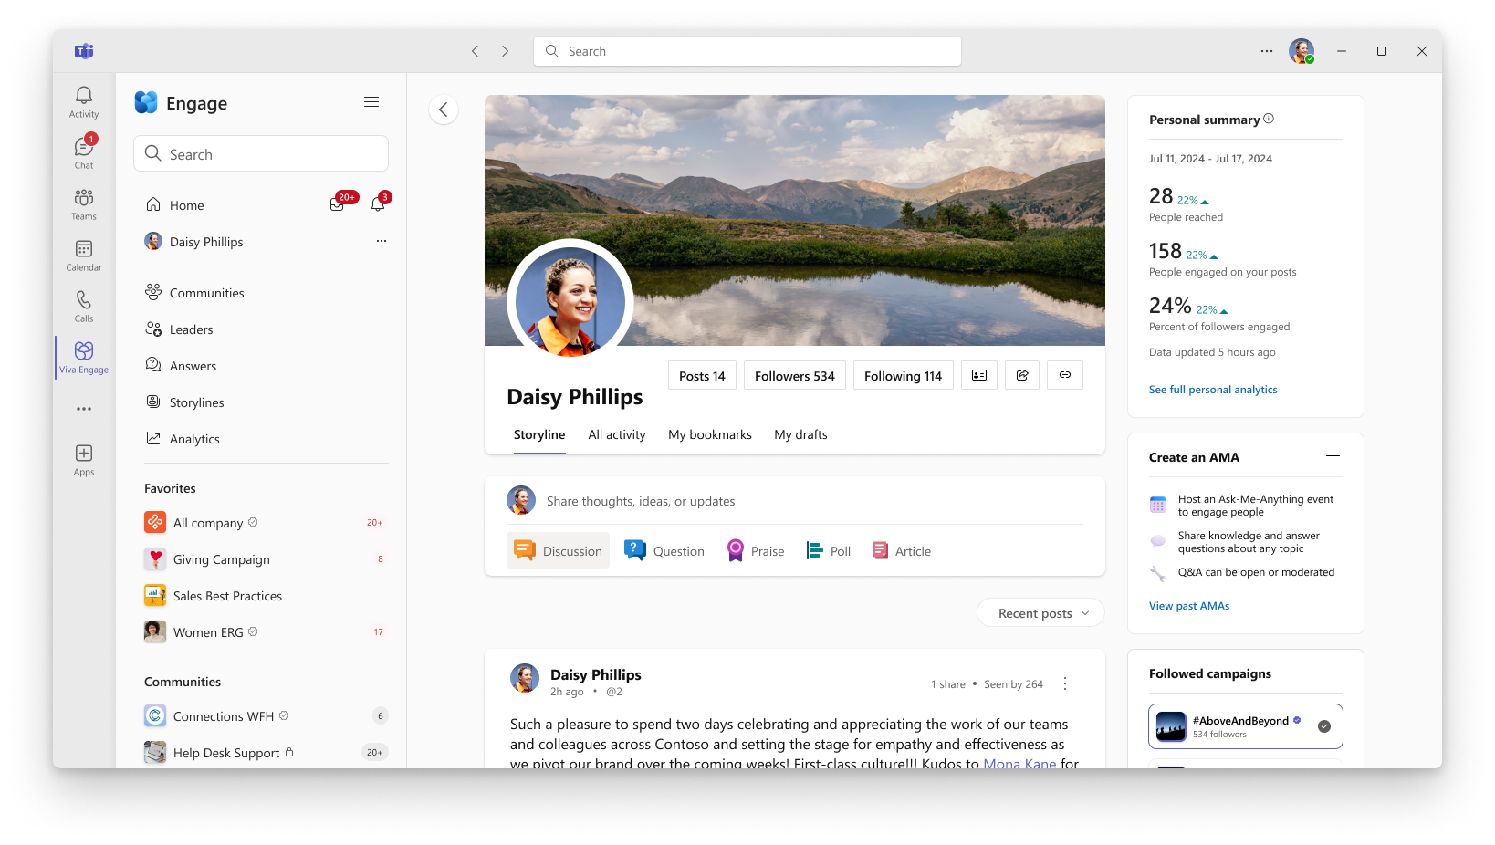
AMA Jobs
Connection
Organizers and participants can react, upvote, and comment on others published questions.
Moderation
Organizers can assign moderators to moderate questions as they come in the queue.
Customization
Organizers can customize experience to fit the needs of their event (i.e., anonymous questions, upvoting).

Slide 6
AMA Use Cases
Leadership Perspective
AMA for attendees to ask leaders about a re-org with answers on how to handle upcoming changes to the organization
Strategy update AMA to ask about how new strategy impacts investments
Campaign Experience AMA
Share Knowledge
Expert AMA on AI
Best Practices for Using Viva Engage AMA
AMA on Customer Engagement
All Hands & Townhalls (AMA + Video)
Gather questions for an upcoming Teams Q&A event BEFORE the event starts leveraging AMAs
Follow-up questions AFTER an event leveraging AMA
Personal Interest Conversations
Marathon Training AMA

Slide 7
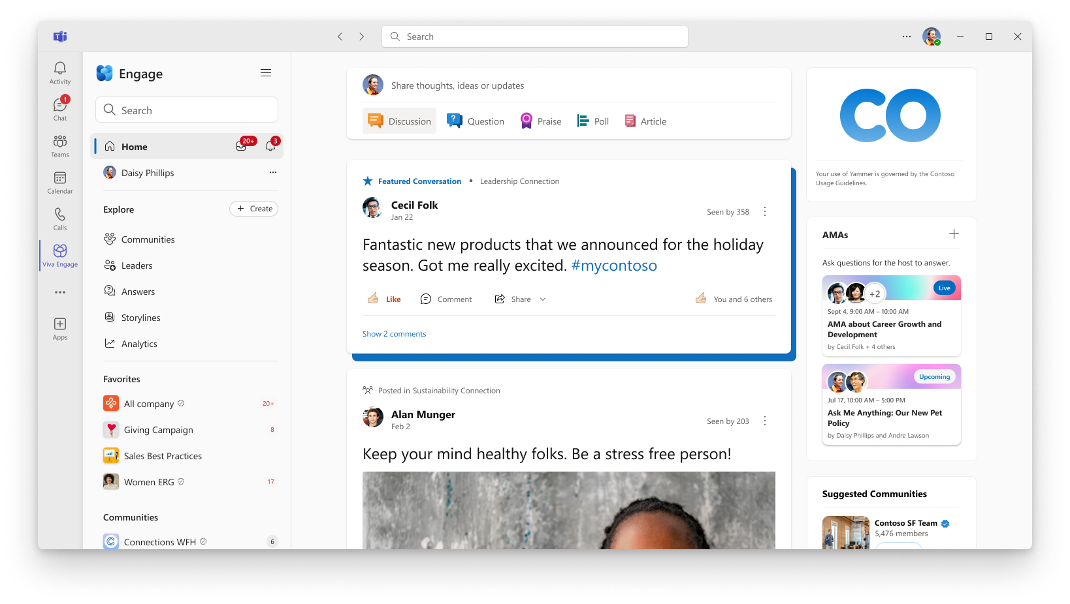
Discover AMAs from people and leaders you follow
Once an AMA is created, it will populate on the persons Storyline, on the Home Page for followers and leaders’ employees, and on Leadership Corner, if the AMA organizer is an identified leader.

Slide 8
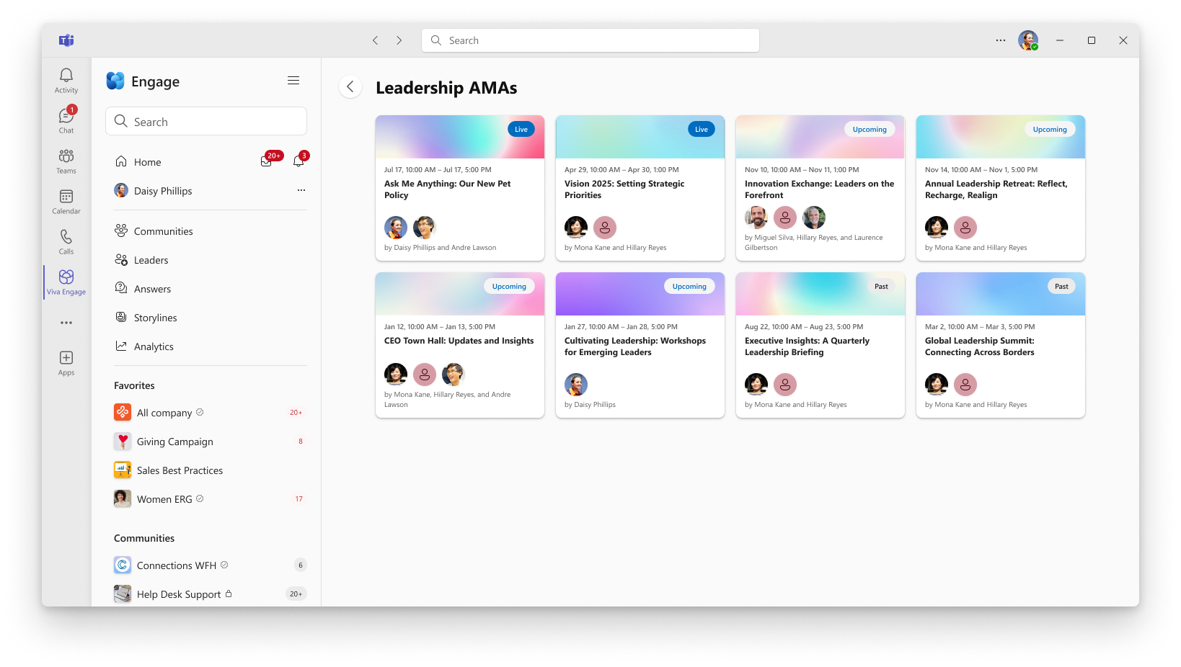
View Leaders AMAs
Live, upcoming and past AMAs will be listed so employees can easily view and participate in two-way conversations with leaders.

Slide 9
Step 1 -Prepare for the upcoming AMA
A major factor in a successful AMA is in the preparation.
In this section we will walk through a pre-event checklist, review the different roles you can assign, and explain various settings!

Slide 10
Create your AMA
Anyone can create an AMA from their storyline page.
Delegates can also create AMAs on their delegates behalf.
When an event is created if you are listed as a host or organizer, you will get an email notification informing you and providing guidance on how to remove yourself if needed.

Slide 11
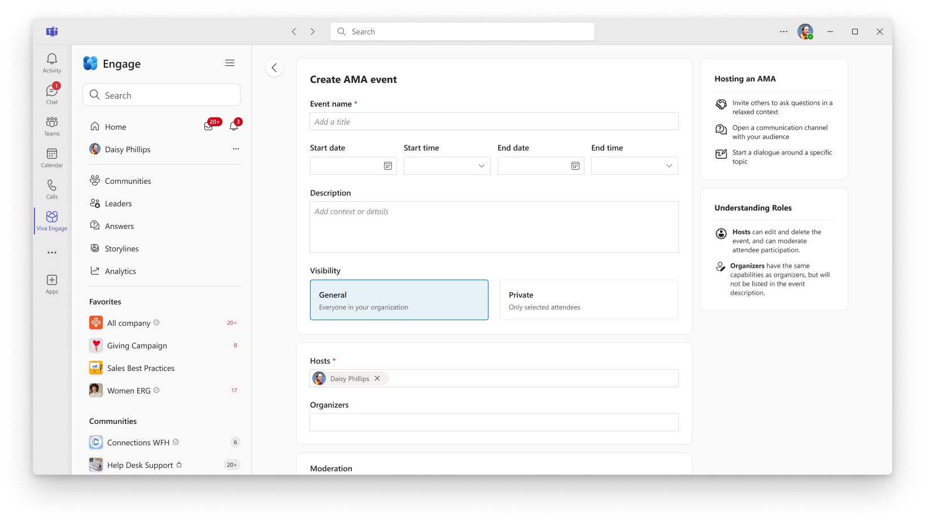
Set up your AMA
Enter details for the AMA
Select visibility for your event
Add hosts and organizers

Slide 12
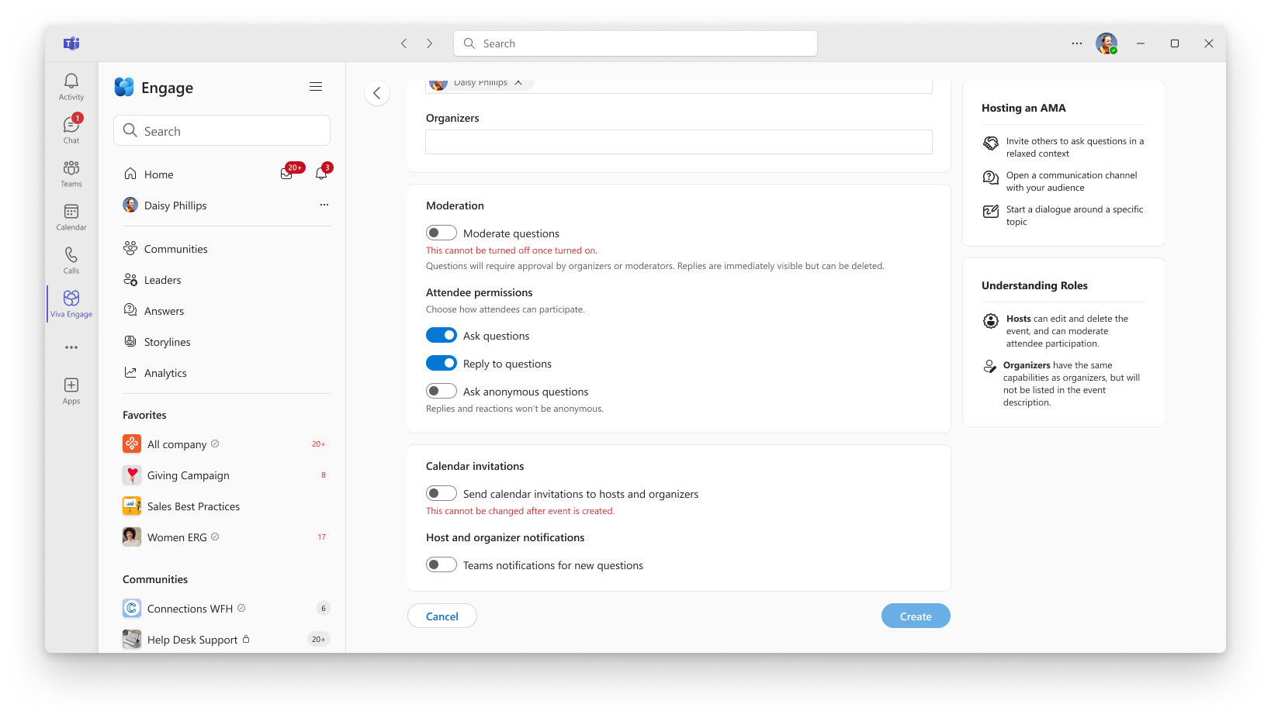
Customize your event
Moderation and engagement settings
Host and organizer notifications

Slide 13
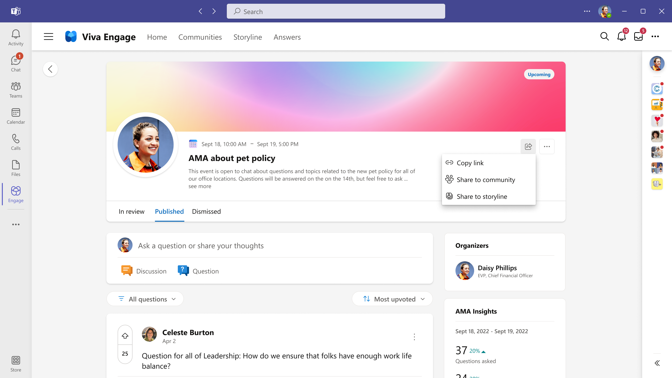
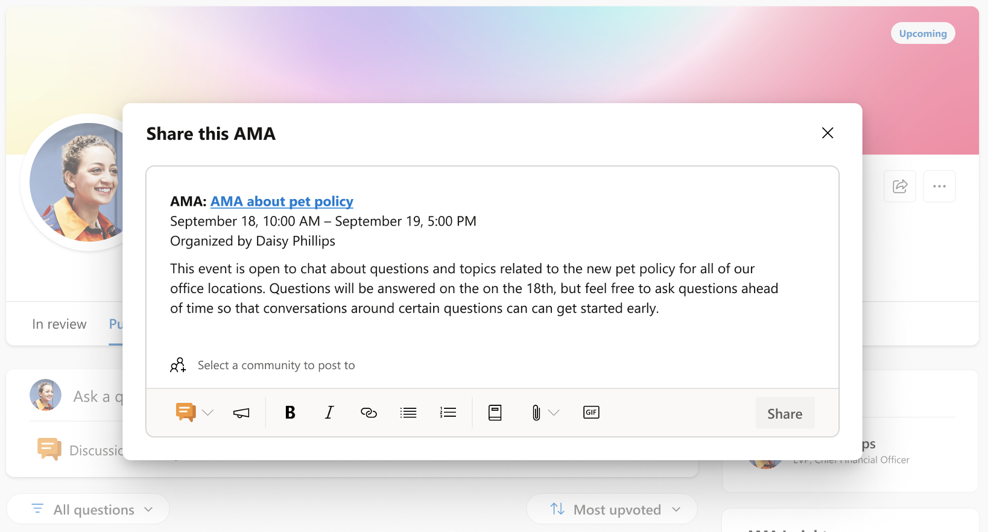
Share your AMA
A pre-populated post with all the details about your upcoming AMA can be shared to your storyline. Customize the message with additional text, images, or GIFs.
Leaders can use a storyline announcement to notify and encourage their audience and followers to attend.
Sharing your AMA before it starts is a good opportunity to provide guidance and set expectations on how attendees can participate!
Copy link or share
Post an announcement

Slide 14
Customize moderation and engagement
Setting | What does it do? | When should I use it?
Questions | Off = attendees are unable to post new question thread starters | This toggle is ‘on’ by default. Turn it off when the organizer is not accepting questions before or after the event.
Replies | Off = attendees are unable to reply to existing thread starters | This toggle is ‘on’ by default. Turn it off when moderating replies is a concern or you only want answers from the organizer.
Upvotes | Off = attendees are unable to upvote questions and sort by upvotes | This toggle is ‘on’ by default. Turn it off if do not want this additional engagement or you want to democratize attendees’ questions.
Anonymous posts | On = attendees are given the option to post anonymously in the question thread starter publisher | This toggle is ‘off’ by default. Turn it on if you want candid questions from attendees who may be uncomfortable asking if their identities were revealed.
Moderate questions | On = 3 tab experience that allows the organizer to review questions before publishing or dismissing | This toggle is ‘off’ by default. Once turned on, moderation cannot be turned off. Turn it on if you would like to review attendee questions before publishing for all attendees to see.

Slide 15
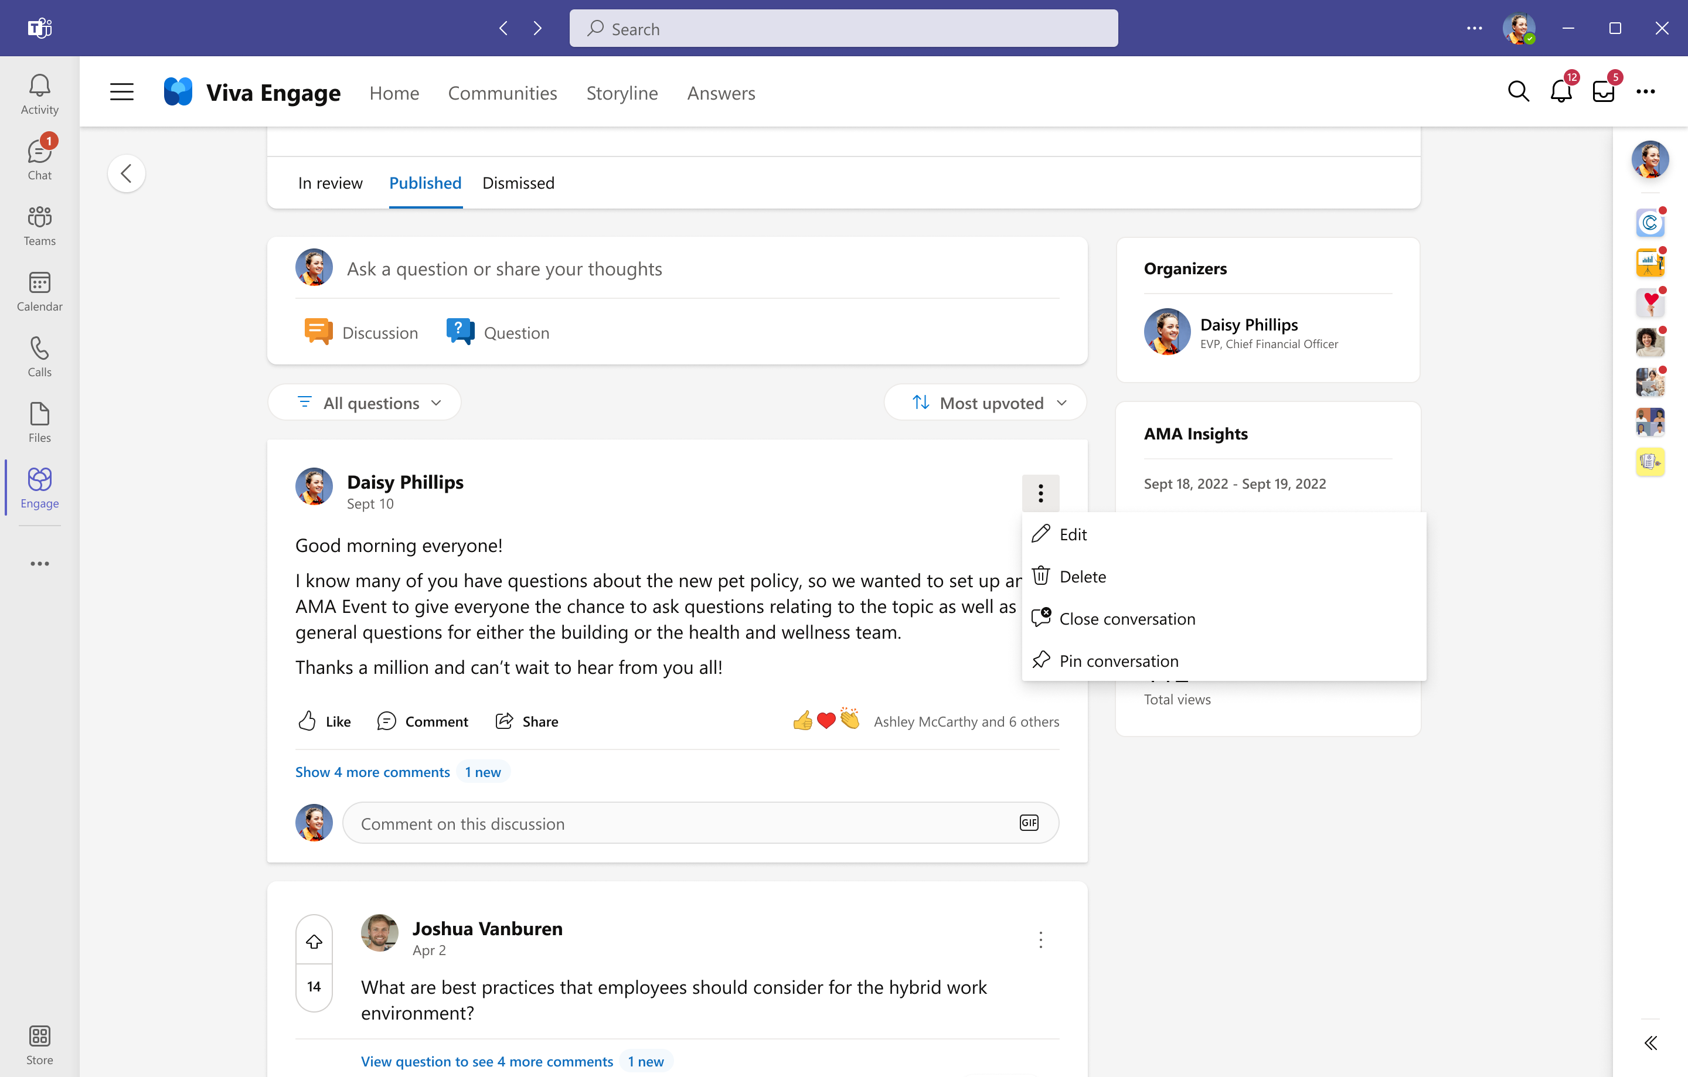
Post and pin a welcome message
Writing a welcome message before the event starts sets the tone and objectives of the event right from the start.
By pinning it at the top of the page, the message remains visible and accessible to everyone throughout the event.
Pin a welcome message to establish clear expectations for the event

Slide 16
AMA pre-event best practices
Create a storyline post about your AMA
Promote your AMA in a community
Create and share a calendar invitation
Send an email reminder and/or post a few days before your AMA
Kick-off the conversation in your AMA with a pinned post
Communicate to attendees how best to engage (i.e., using upvoting)

Slide 17
Additional Tips and tricks for hosting your first AMA
Set up a backchannel for your moderators to chat live while the Viva Engage conversation is happening. The organizers automatically receive a non-time blocking calendar invite, use this chat as the backchannel to manage the AMA.
Share direct links to the conversation before during and after the event.
Post date and time of the AMA in the Info section of a related community.
Set up leaders and their audiences ahead of time so that the conversations and the AMA can be discovered in employee’s Leadership Corner.
Determine and configure delegates before the AMA and plan for how they’ll assist the leader during the AMA.
Prepopulate a few posts using multiple browser windows to get the conversations started. This will allow you to quickly and easily add questions or replies.
Publish questions promptly so that audience can engage, react and reply to the questions.
Ask a question to engage your audience—try asking them an open-ended question about the topic being discussed.
Complex questions don’t need to be answered on the spot. Take note of the question, who asked it and address it later. Be sure to let them know it was a good question and will be answered later.
Share pictures of experts/leaders answering questions or behind the scenes to your storyline and share the success of the AMA.

Slide 18
Step 2 - It’s time to host AMA
It’s time for the action. Being prepared will help support the host and experts as well as ensure the conversation flows smoothly.

Slide 19
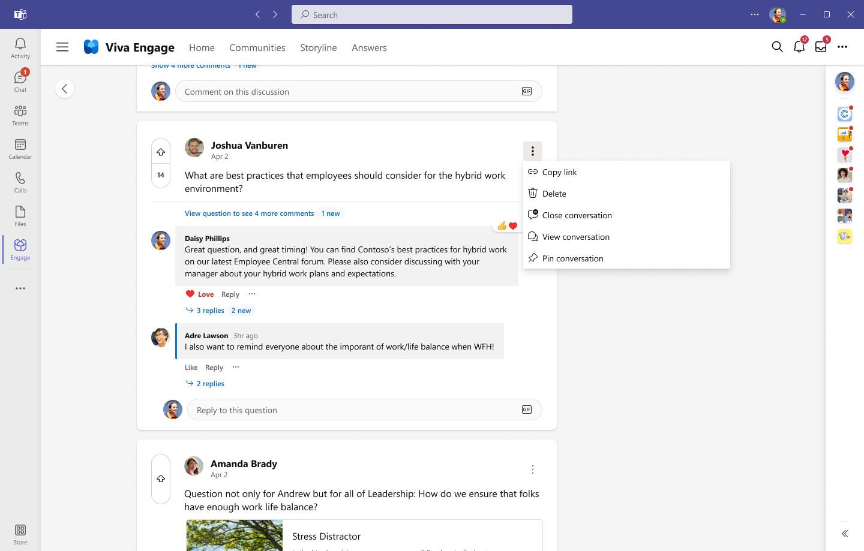
Manage conversations
Hosts and organizers can manage the flow of conversations within an AMA.
Delete question: remove the question from the feed
Close conversation: disable replies to only that question
Pin conversation: keep that question at the top of the feed.
Tip: If you don’t want any new replies or new questions after the AMA is over time, change the toggle for Replies and Questions in edit settings.

Slide 20
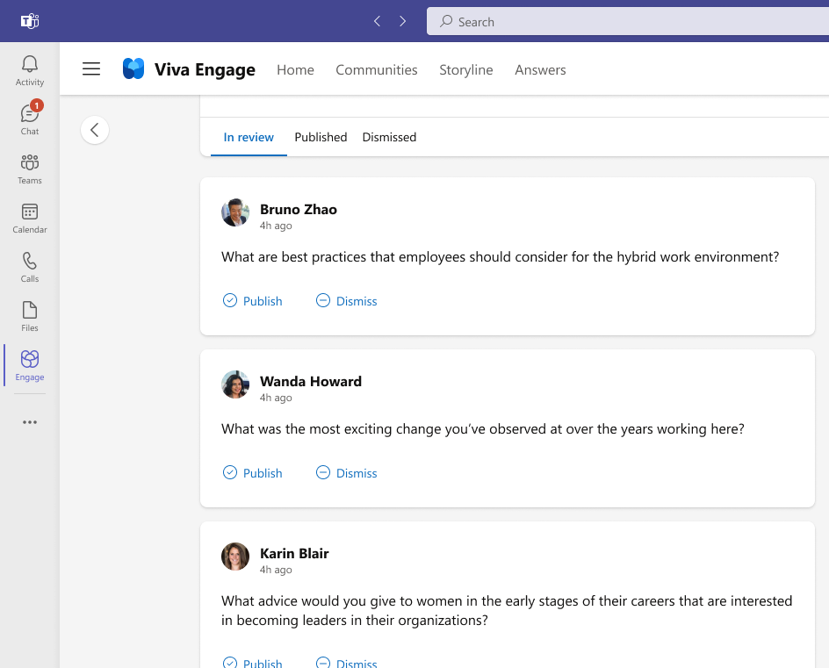
Moderation enabled for the AMA
If moderation is enabled, the organizer will be able to triage incoming questions.
In Review: When an attendee submits a question, it will be ’In review’, where the organizer can ‘Publish’ the question for all attendees to see, or ‘Dismiss’ the question to the ’Dismissed’ tab.
Dismissed: The organizer can ‘Restore’ the question back to the ‘In Review’ tab, or ‘Publish’ the question. Duplicate or off topic questions are often dismissed.
Published: Once a question has been published, all attendees and organizers will be able to view, reply, upvote, and react to the question.
Organizer can view and publish or dismiss incoming posts

Slide 21
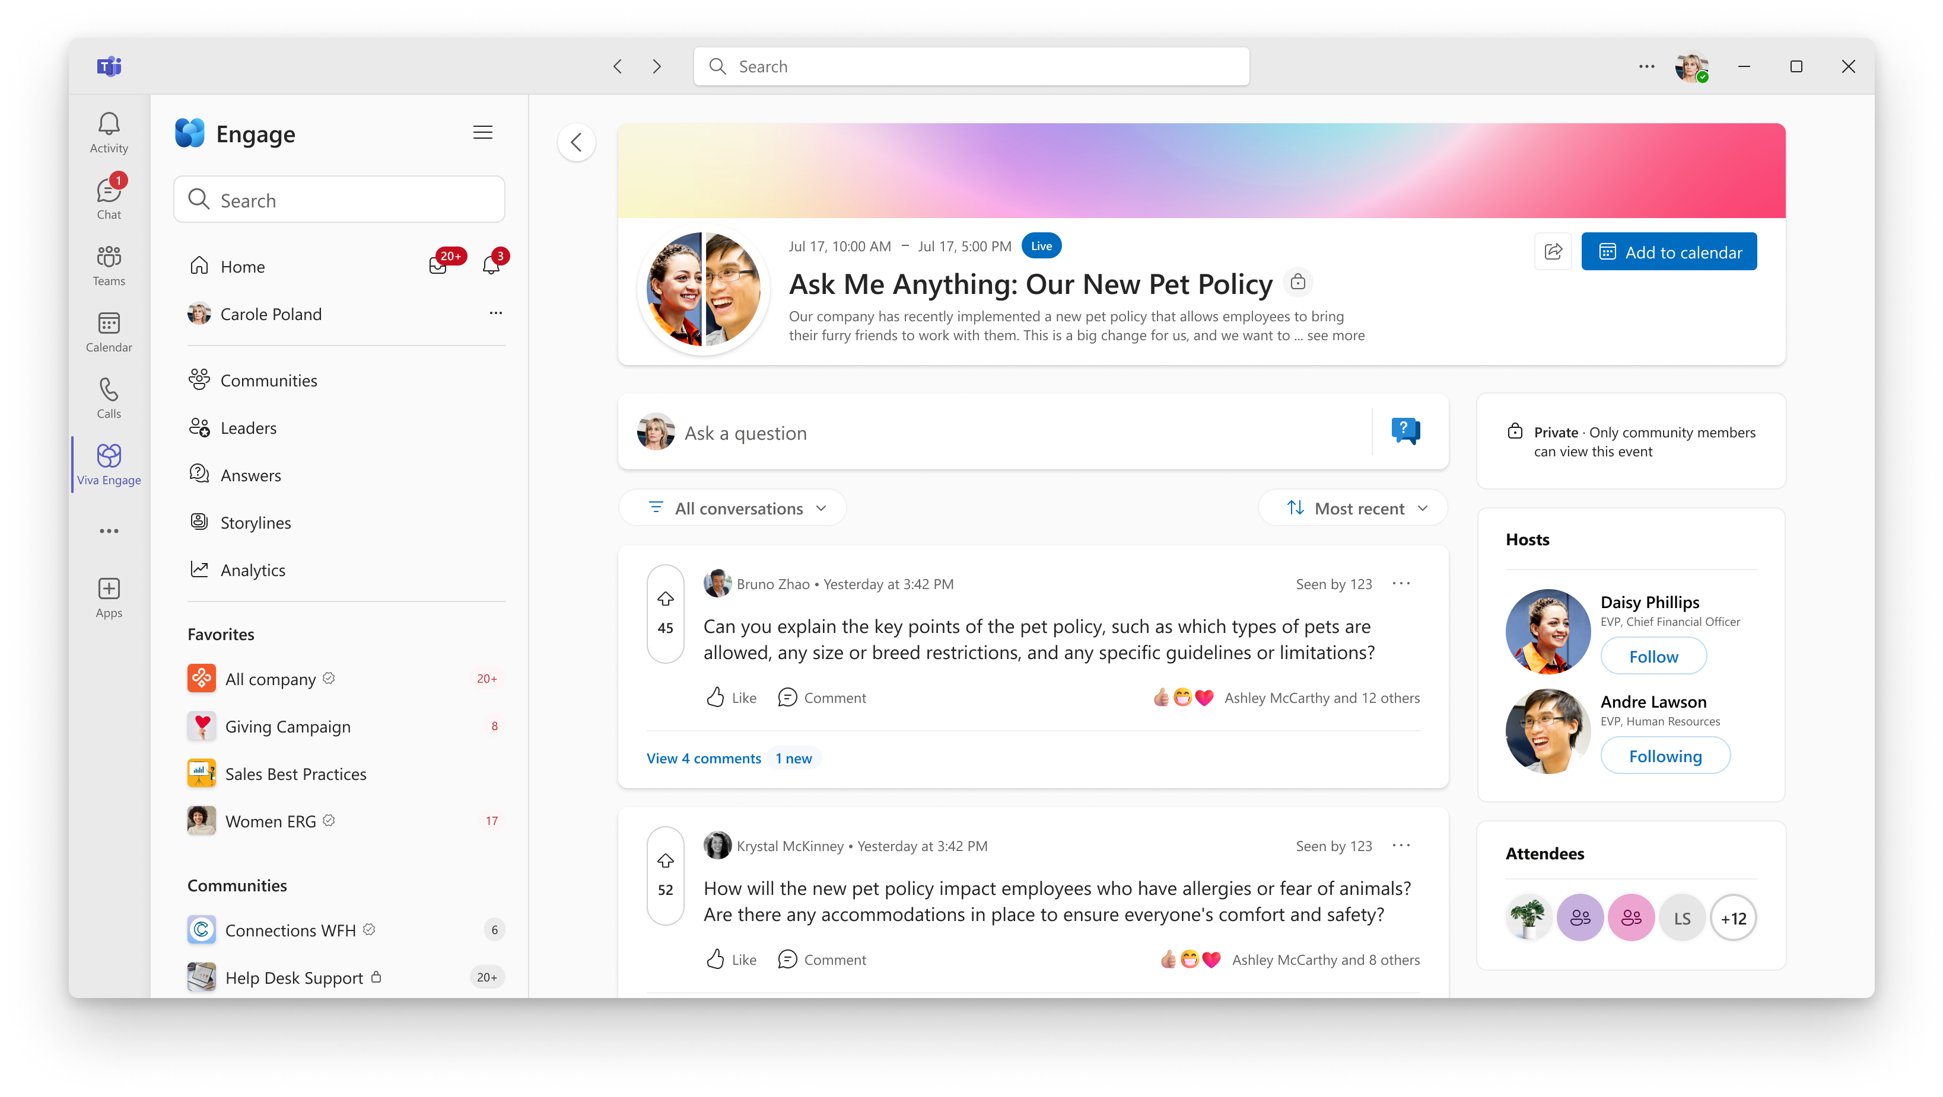
Moderation disabled for the AMA
If moderation is turned off, all questions will be immediately published and visible in the AMA.
Anyone can reply to published questions unless replies are disabled.

Slide 22
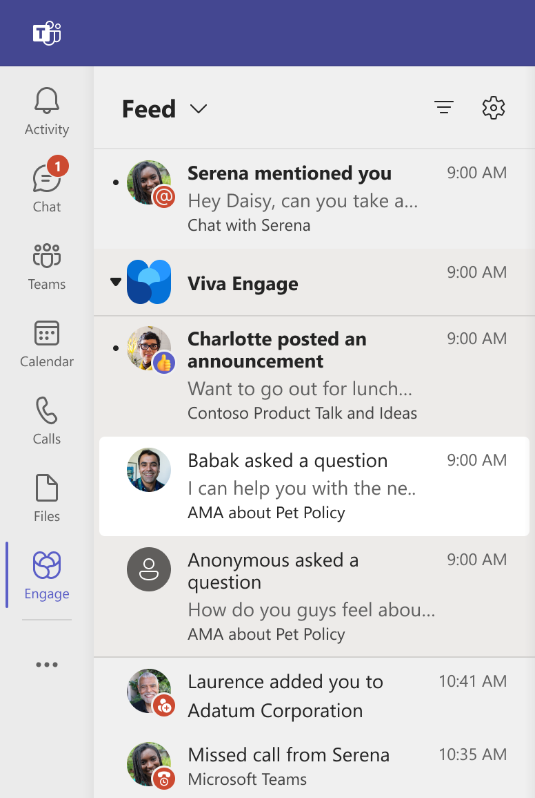
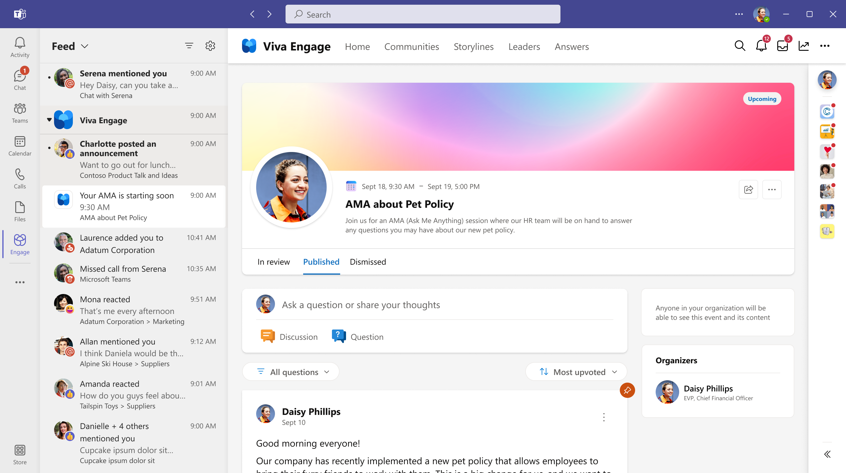
Notifications for AMA hosts and organizers
Note: notifications are off by default for hosts and organizers
New question
AMA is starting soon

Slide 23
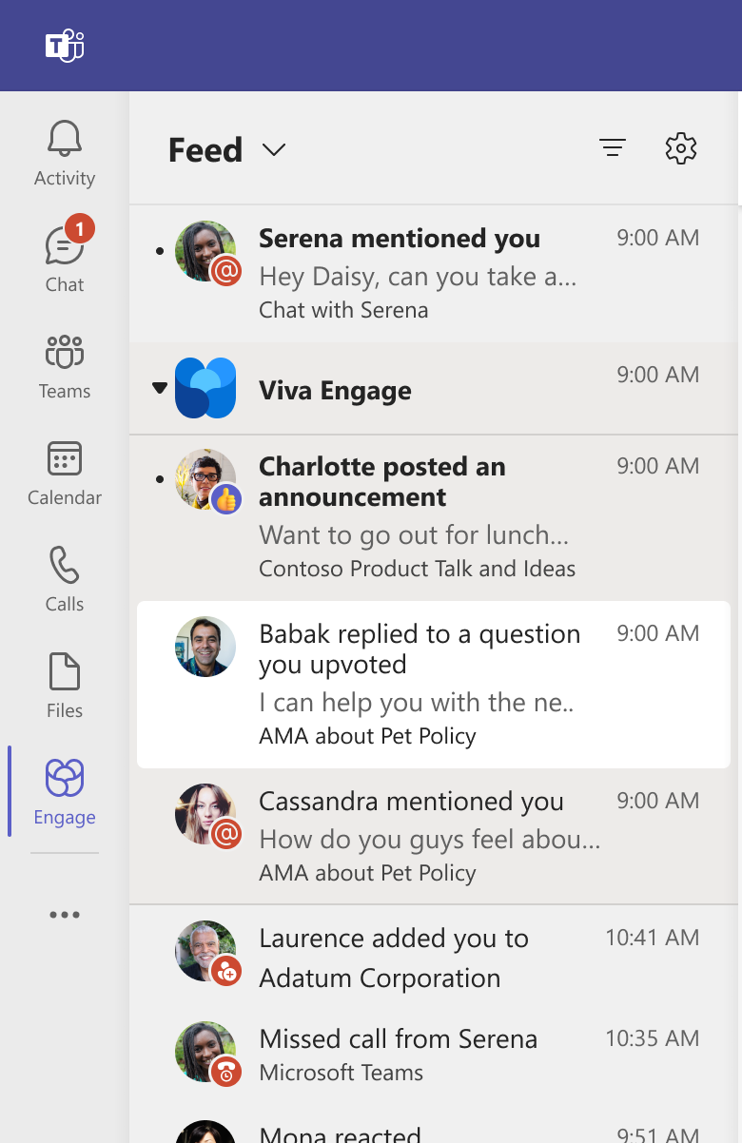
Notifications for participants
Replies to your question
Replies to a question you upvoted
Replies from the organizer
@mentions

Slide 24
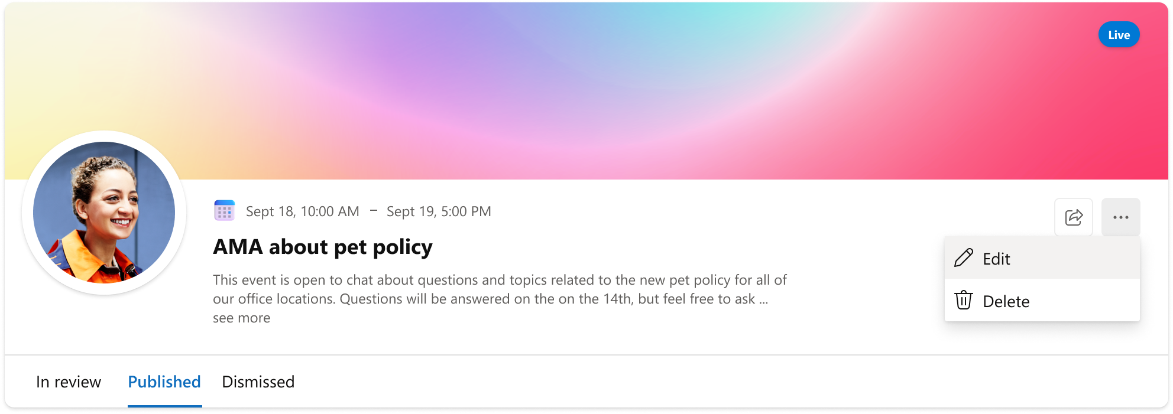
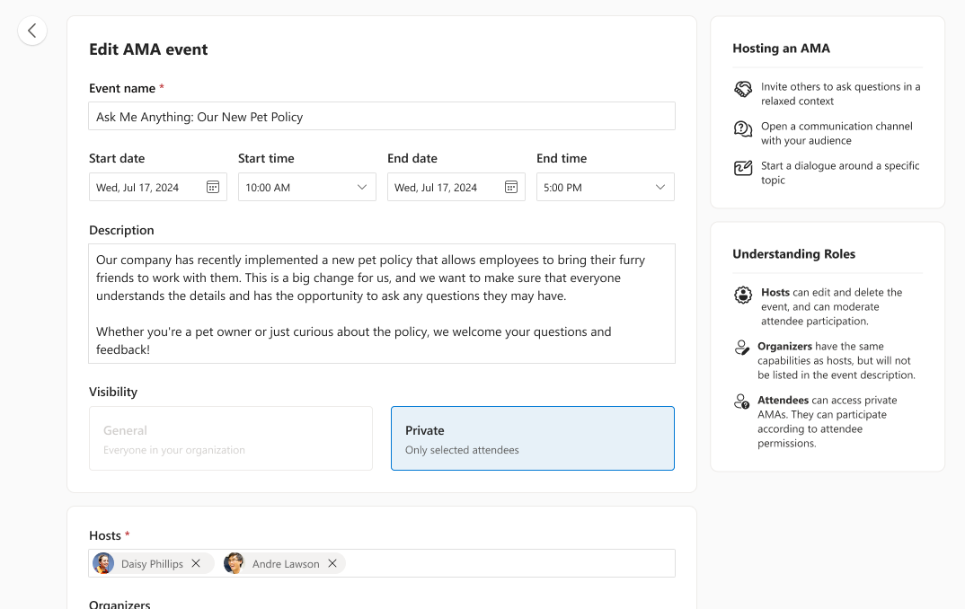
Edit or delete an AMA
Editing allows the organizer to adjust the event details and control settings at any time once the event has been created.
For example, after the allocated timeframe for the AMA is over, you can turn off Questions to disable new questions after the event time.
You can also Delete your AMA.

Slide 25
Step 3 – Measure the impact
One of the key benefits of AMA is the way it continues after the event has concluded.
People who attended live and those who wish to catch up can still benefit from the ideas, insights, and discussions.

Slide 26
Conversations after the AMA
Keep the conversation going
Not only do live attendees benefit from the conversation, but the discussion is also now captured and, much like a document, can be referenced and add value long after the actual event.
As part of the pre-event engagement with sponsors, the host and experts, be sure to emphasize the importance of the post-event conversation. Invite them to continue to participate, engage and reference the AMA as a ready resource for future learning.

Slide 27
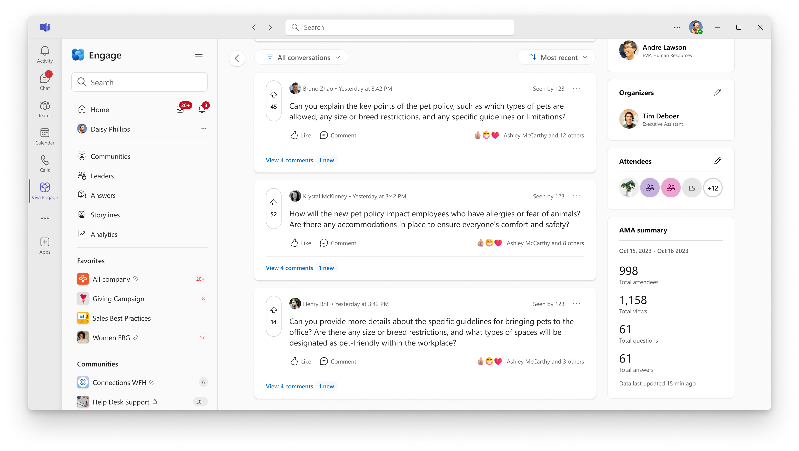
Event summary
Evaluating impact
At the bottom of the right of the event page there is an event summary that gives you some statistics on your event.
This can be used to assess areas of improvement for your next event as well as document and share out overall impact as needed.

Slide 28
AMA post-event best practices
Send out follow up and thank you communications to key sponsors, stakeholders and participants
Checkout AMA event summary
Send out an event survey to attendees
Make sure leaders or experts follow up with open questions
Capture some of the anecdotal highlights and conversations
Start planning your next AMA. Identify areas of improvement
Capture insights that relate to your campaigns KPIs or OKRs

Slide 29
FAQ
Who can create and engage with AMAs?​
  AMAs will be available to all users Viva Engage. Any user can create an AMA or ask questions and engage in an AMA that is discovered. AMAs are discoverable by all users within a network.​
Where does an AMA live in Viva Engage?
  The AMA event is attached to the organizer’s Storyline, but the AMA can be shared to a Community for higher engagement and visibility
Do the questions from the AMA flow to the organizer’s Storyline feed?​
  All conversations in an AMA event stays on the AMA event page. The questions do not flow to the Storyline feed.

Slide 30
FAQs continued
What is the format of an AMA?​
  An AMA is a text-based Q&A event and does not have a video component at this time, but they can be used to gather questions before an event with a live component.
How long should an AMA be?
  The AMA set-up allows you to choose any start/end time. You can set up an AMA that lasts for a few hours or week-long and beyond. Shorter AMAs that last for a few hours are great for more synchronous conversations, whereas longer AMAs allow for more flexibility across different time zones and more time for attendees to discovery the AMA and engage in the conversation.
What is a good topic/use case for an AMA?
  AMAs are a great way to address top-of-mind topics in the org. We have seen users host AMAs about company strategy, re-orgs, or casual topics like getting to know a new leader in an organization. Other uses for AMAs include a community/group specific AMA, or a subject matter expert AMA for knowledge sharing.
  AMAs can also be used to collect questions for a Q&A event, or after a meeting to address additional follow-up questions.

