Slide 1
Microsoft Copilot
Passport Campaign with Viva Engage

Slide 2

Create #MicrosoftCopilot Employee Passport Campaign
Corporate Communicators or community admins can create a #campaign in Viva Engage for employees to use to share their Copilot Passports!
Campaign hashtag: #MicrosoftCopilot
Description: Share your experiences, best practices and follow for news about the Copilot experience at <INSERT COMPANY NAME>
Select executive sponsors, select default publisher type and chose the color for your hashtag.
Upload cover photo and configure goal. Publish your campaign!
Sample Viva Engage post: ​​
​​
Pictures or it didn't happen 📸​​
Get in the pilot’s seat: In your favorite M365 app, select the Copilot icon, and make your workday So. Much. Simpler!​​
Grab your own downloadable passport <insert employee accessible link> that you can personalize with your picture and name, then add experience stamps as you explore Copilot!​​
Show off your Copilot skills by sharing your passport progress on your Viva Engage storyline with the hashtag #MicrosoftCopilot
<Attach sample passport image to your post>
⭐Encourage your Copilot Champions to go first!⭐
Sample #campaign cover photo.
Right click to save as photo and upload to your campaign in Viva Engage .

Slide 3
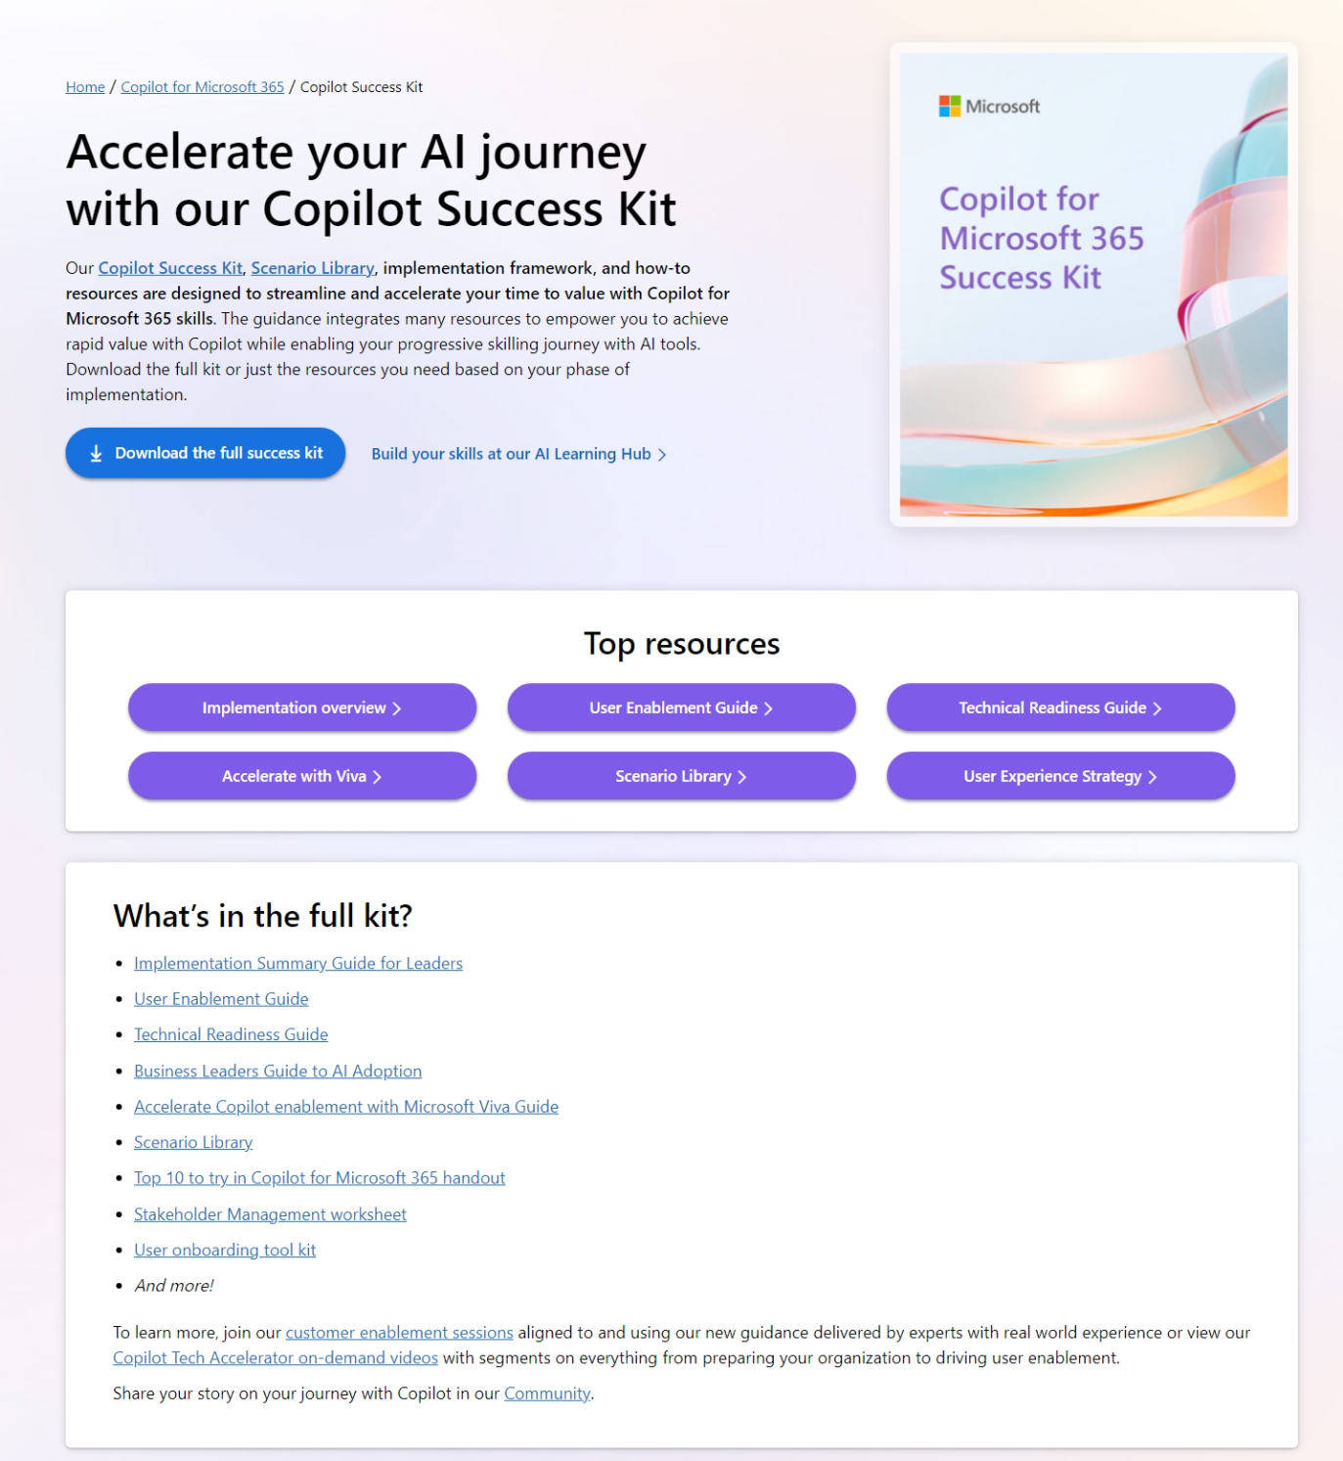
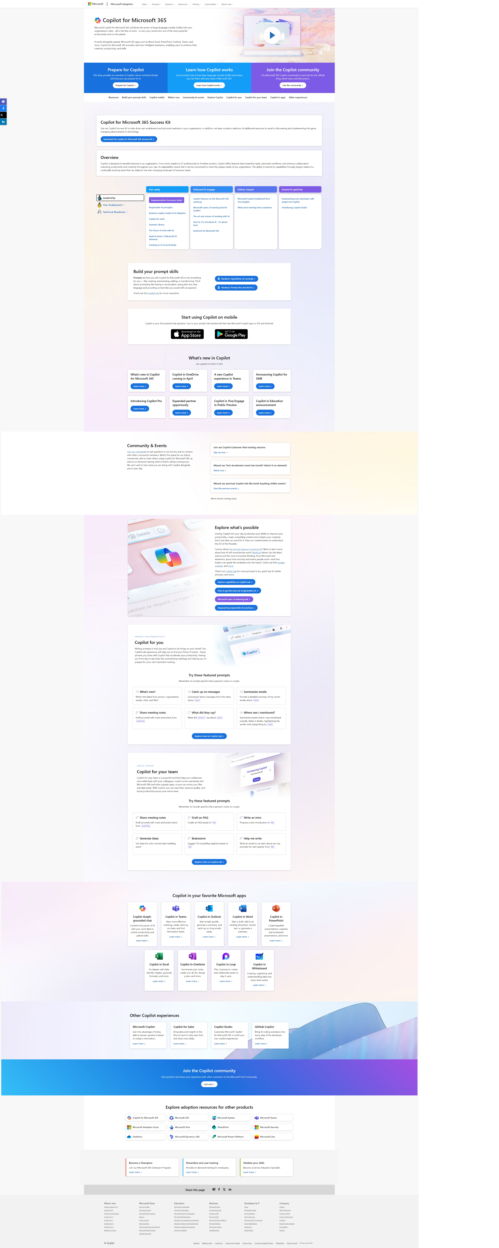

More Copilot resources on Microsoft Adoption
https://adoption.microsoft.com/copilot
Resources by role
Interactive Scenario Library
Product announcements and news
Links to other Microsoft sites
Guides for Small/Medium business, Copilot in Sales, Microsoft Viva, and more
Take the Class!
Earn your User Enablement badge & validate your skills with MS-4007 available today!
Notes:
Provides resources by role/area, such as leader, user enablement, and technical readiness, to help deploy, use, and scale Copilot.
Showcases what’s new in Copilot, such as Copilot for SMB, Copilot for Sales, Copilot for Microsoft 365, and more.
Invites users to explore what’s possible with Copilot, such as building prompt skills, creating content, joining the community, and using Copilot in different apps.
Offers links to other Copilot experiences, such as Copilot for Sales, Copilot Studio, and Microsoft Copilot.

Slide 4


Grab your Microsoft Copilot passport and document your adventure!
We’re adding to the fun while we explore all the goodness that Microsoft Copilot brings to our work (and non-work) lives.
Personalize your Copilot Passport from the next slide using the easy instructions provided to add your own picture and name—then get ready to fly with your new Copilot bestie!
Try Copilot for Microsoft 365 in a variety of apps, at Copilot.Microsoft.com, in Viva experiences, and any place you see the Copilot icon .
Then, grab the digital “stamp” for that experience and paste it in your passport.
Finally, inspire us all by saving your updated passport as an image and then sharing it to Viva Engage with #MicrosoftCopilot.
To learn more about the Copilot passport, check out our post
at <insert link here>

Slide 5
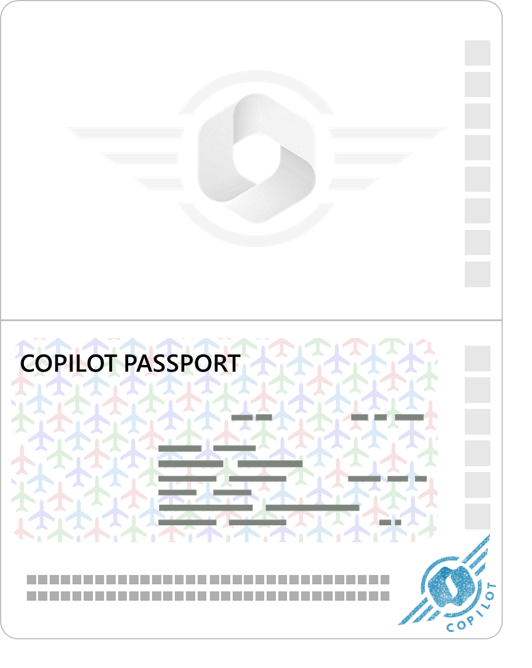

Personalize your Copilot Passport
and share it to Engage!
Note: The passport, photo, and Your Name Here elements are grouped.
Please don’t ungroup or move them.
Start by downloading
Please download and save a copy of this deck to your own location.
Personalize your passport
Add your name
Simply tap the Your Name Here text box and replace the text with your name.
Add your picture
Right-click on the current image > Change picture > This device > select a photo of you or your avatar. Voilà!
Add Copilot stamps
We’re on the honor system, here! Please make sure you try each Copilot experience before you add its stamp.
Copy and paste your stamps
Get your Copilot experience stamps on the next slide. Simply copy the image of the stamp you’ve earned after trying the Copilot experience, then paste it on the top portion of your own Copilot Passport Link to stamp slide. You’ll find extra blank pages for your passport at the end of these slides.
Prepare and share your passport
Create a picture of your updated passport
  Select your passport and everything on it by dragging your cursor from above top-left of your passport past the bottom-right.
  Right-click your passport, then select Save as picture.
  Save it to your own location.
Share your updated passport
  Share your passport image on Viva Engage with the hashtag #MicrosoftCopilot. Earn (imaginary) bonus points if you describe your experience and best practices. We can’t wait to celebrate your Copilot adventures!
Name Here

Slide 6





























Copy the stamp(s) you’ve earned
and paste it onto your Copilot passport

Slide 7
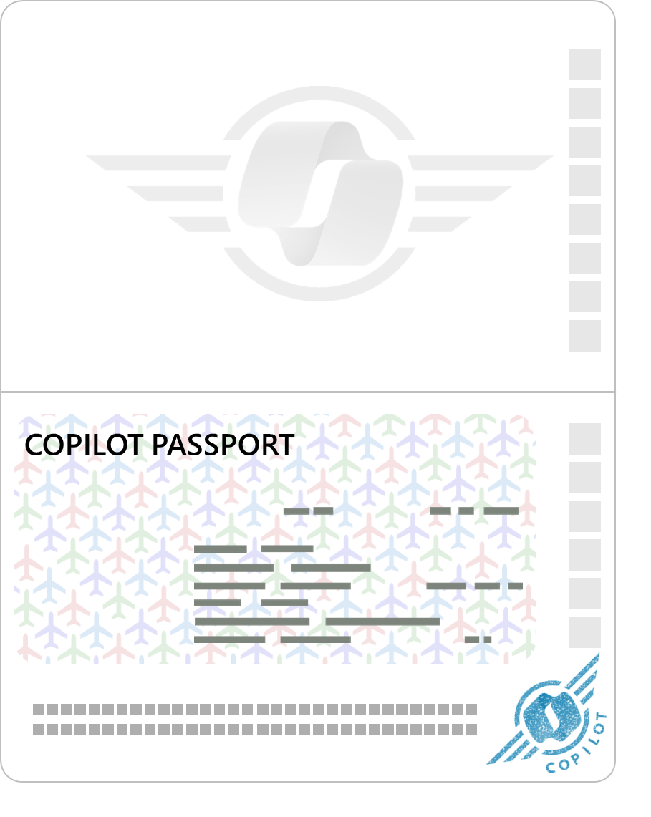


Sample
Your updated passport should look something like this once you’ve personalized it and added your experience “stamps”.
Save it as an image and then share it on Viva Engage with #MicrosoftCopilot!
Adele Vance

Slide 8
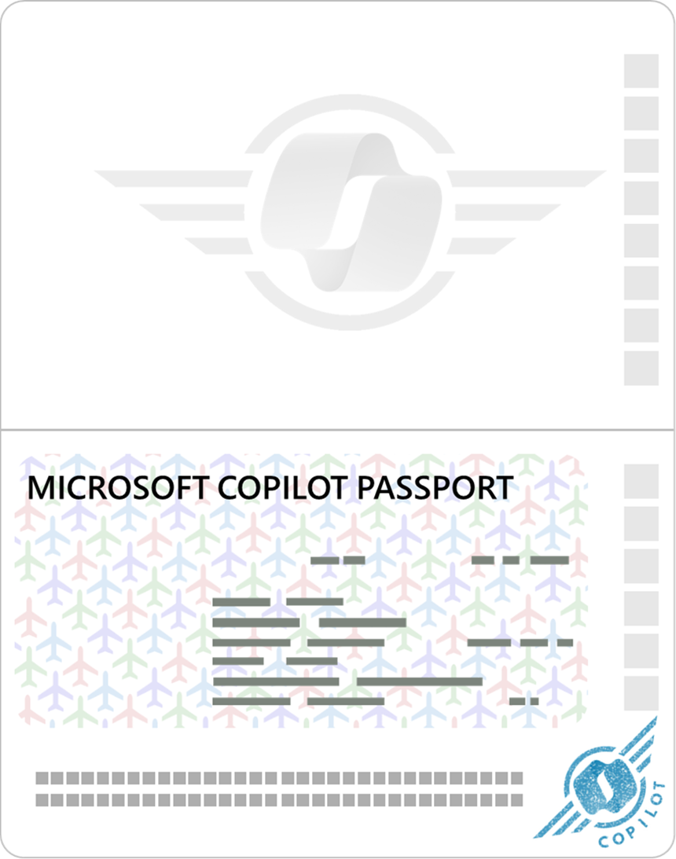

Extra blank passport pages!
Your Name Here

