Slide 1

Measuring and evaluation scientific disciplines impact based on CRIS system data
ІІІ International Conference "Open Science and Innovation in Ukraine 2024"
24-25.10.2024 Kyiv, Ukraine - Hanover, Germany (online)
Danica Zendulková, Slovak Centre of Scientific and Technical Information

Slide 2
Introduction
role of Slovak Centre of Scientific and Technical Information
provides information systems for R&D
supports the management and evaluation of R&D by methodological and analytical activities
high-quality data about research and development at the national level and in the required structure is essential
indicators for providing the necessary information for policymakers
setting the shares of individual scientific disciplines in the activities and results of science and research in Slovakia is important for:
allocating funds
determining priorities for science
forming science-related policies
case study: Life Sciences

Slide 3
Research process
methods:
bibliometrics,
scientometrics
identification of data sources
data usability analysis
suitable indicators, output reports
results
conclusions and recommendations

Slide 4





Definition of Life Sciences
Considering the existence of various classifications and code books: What belongs to Life Sciences?
Life sciences=biological sciences?
what about:
Medical science
Agriculture, forestry
Organic chemistry
Biotechnology?

Slide 5
Data sources
bibliographic databases (WoS, SCOPUS; Central Register of Evidence of Publication Activity of Universities )
information system SK CRIS
Research projects
Research organisations
Researchers
Research results
Research infrastructure
databases related to industrial property (patents, utility models, designs, and trademarks) on national level
statistical data

Slide 6
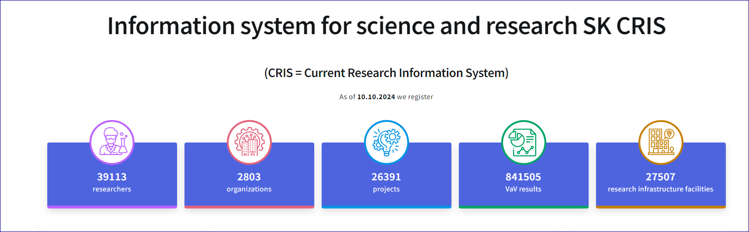
Content of SK CRIS
https://www.skcris.sk
the database has been built since 2000, the number of records is growing over the years

Slide 7
Selected Indicators (by SK CRIS)
Human Potential: Classification of academics from aspects of research field, expertise, specialisation etc.
R&D Institutions by scientific fields and their involvement to R&D Projects. Assessment of Competence to Perform Research and Development for private and state research organizations - a condition for the use of public resources.
Projects: Domestic and foreign research projects in various scientific fields
Women in Science: less than 30% of the world’s researchers are women (Unesco statistics). Response: new indicators
Publication (from WoS)

Slide 8
Results - Subjects
Scientific area | Number of Organisations: |  | Number of
 | Certified* | all | Researchers
NATURAL SCIENCES - Biological sciences | 28 | 59 | 712
IT - Bioinformatics | - | - | 1
Physical sciences - Biophysics | 2 | 6 | 29
Chemical sciences – Bioorganic chemistry | 1 | 1 | 11
-Biochemistry | 4 | 9 | 57
-Macromolecular chemistry | - | 1 | 56
-Organic chemistry | 8 | 9 | 42
Total (natural sciences excepting biological sciences | 15 | 26 | 196
ENGINEERING AND TECHNOLOGY – Medical engineering | 11 | 15 | 18
Environmental biotechnology | 2 | 6 | 9
Industrial biotechnology | 11 | 15 | 34
Total (Engineering and technology) | 24 | 36 | 61
MEDICAL SCIENCES | 79 | 188 | 2893
AGRICULTURAL SCIENCES – Veterinary sciences | 1 | 3 | 348
Biotechnology in agriculture | 6 | 14 | 39
Total (agricultural sciences) | 7 | 17 | 387
TOTAL | 153 | 326 | 4249
Organisations
and
Researchers
in the SK CRIS database
*Assessment of Competence to Perform Research and Development

Slide 9
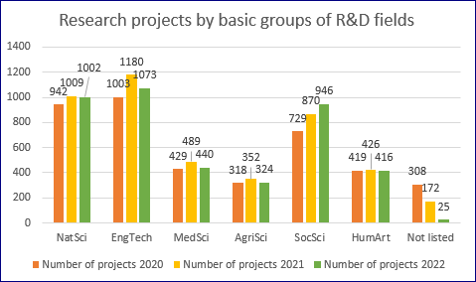
Results - Projects
More than 4200 research projects yearly
From that: 1025 in Life Sciences
Research area | Number of Projects
NATURAL SCIENCES - Biological sciences | 305
IT - Bioinformatics | 2
Physical sciences - Biophysics | 15
Chemical sciences – Bioorganic chemistry | 4
-Biochemistry | 24
-Macromolecular chemistry | 15
-Organic chemistry | 20
Total (natural sciences excepting biological sciences | 80
ENGINEERING AND TECHNOLOGY – Medical engineering | 14
Environmental biotechnology | 3
Industrial biotechnology | 16
Total (Engineering and technology) | 33
MEDICAL SCIENCES | 489
AGRICULTURAL SCIENCES – Veterinary sciences | 84
Biotechnology in agriculture | 34
Total (agricultural sciences) | 118
TOTAL | 1025

Slide 10
Women in research projects
Research area | Number of Projects | Number of Researchers | Out of This Women | Percentage Share
NATURAL SCIENCES - Biological sciences | 305 | 1356 | 842 | 62,09%
IT - Bioinformatics | 2
Physical sciences - Biophysics | 15
Chemical sciences – Bioorganic chemistry | 4
-Biochemistry | 24
-Macromolecular chemistry | 15
-Organic chemistry | 20
Total (natural sciences excepting biological sciences | 80 | 447 | 232 | 51,90%
ENGINEERING AND TECHNOLOGY – Medical engineering | 14
Environmental biotechnology | 3
Industrial biotechnology | 16
Total (Engineering and technology) | 33 | 160 | 71 | 44,38%
MEDICAL SCIENCES | 489 | 1820 | 1148 | 63,08%
AGRICULTURAL SCIENCES – Veterinary sciences | 84 | 383 | 239 | 62,40%
Biotechnology in agriculture | 34 | 209 | 116 | 55,50%
Total (agricultural sciences) | 118 | 592 | 355 | 59,97%
TOTAL | 1025 | 4967 | 3003 | 60,46%
Group of Sciences | Number of Projects | Number of Researchers | Out of This Women | Percentage Share
NatSci | 1009 | 3670 | 1744 | 47,52
EngTech | 1180 | 4122 | 1361 | 33,02
MedSci | 489 | 1820 | 1148 | 63,08
AgriSci | 352 | 1357 | 691 | 50,92
SocSci | 870 | 3430 | 1925 | 56,12
HumArt | 426 | 1567 | 805 | 51,37
Not listed | 172
Total | 4498 | 15966 | 7674
The share of women is highest in medical , veterinary and biological sciences.
Lowest proportion of women is in technical sciences

Slide 11
Results -Publications
Number of publications by R&D fields indexed in WoS, 2022[16]
Group of R&D fields | Number of publications | Percentage share
NATURAL SCIENCES | 3752 | 49,7 %
ENGINEERING AND TECHNOLOGY | 2298 | 30,44%
MEDICAL SCIENCES | 1475 | 19,54 %
AGRICULTURAL SCIENCES | 627 | 8,3 %
SOCIAL SCIENCES | 1170 | 15,5 %
HUMANITIES | 500 | 6,62 %
Total | 7 548
WoS Category | Number of publications
Biochemistry, Molecular Biology | 335
Public Environmental Occupational Health | 208
Medicine General Internal | 138
Neurosciences | 117
Oncology | 113
Microbiology | 104
Biology | 102
Veterinary Sciences | 97
Clinical Neurology | 93
Cardiac Cardiovascular Systems | 72
Endocrinology Metabolism | 72
Biophysics | 64
Genetic Heredity | 50
Publications by Frascati categories and the most frequent Life Science categories.
The WoS does not distinguish the gender of the author. We estimate the gender by the inflected surname and/or by the first name. Out of 200 authors of these publications displayed by the WoS user interface, are 60 women, which represents 30%.

Slide 12
Limitation
identify the fields of science that belong to the life sciences
selection of indicators : set of indicators for which we can obtain and evaluate the data
variability of data over time
incompleteness and insufficient quality of data in information systems and databases

Slide 13
Conclusion
significant representation of life sciences in science and research in Slovakia:
19% organisations from the Life Sciences
22.8 % projects from the Life Sciences and 36.7% of the number of involved researchers
Women in Life Sciences projects about 60 %
Such studies as ours one can help identify research trends, can help policy makers and researchers make informed decisions, and can help assess researchers, institutions, as well as performance of countries in scientific production and impact.

Slide 14
Thank you very much for your attention

