Slide 1
Scholarly Communication at a crossroad …
… on the past, present and future of the scholarly communication ecosystem
By Professor and Vice President of European Library Relations Charlotte Wien

Slide 2
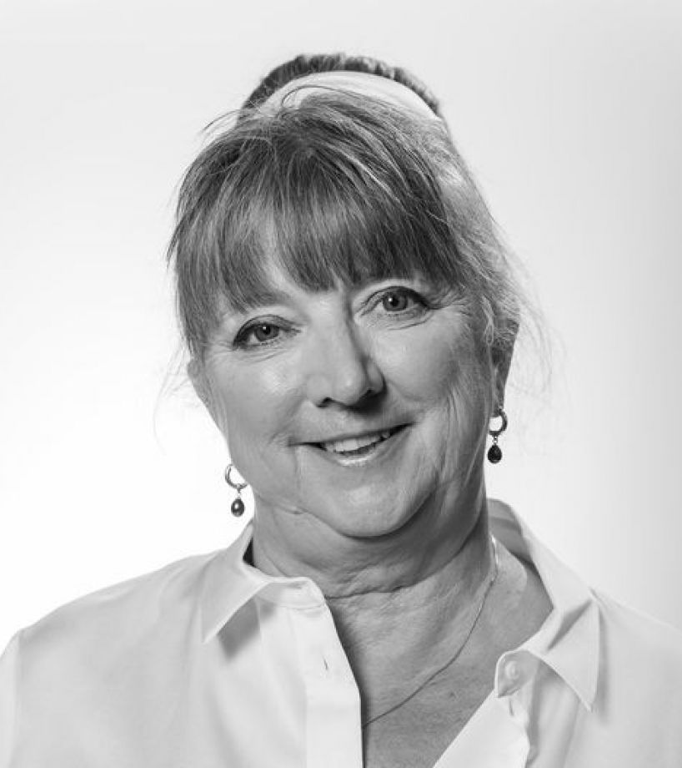
Introduction
Dr. Charlotte Wien
Professor of Scholarly Communication at Arctic University in Tromso
Vice President of European Library Relations
Role with Elsevier is to strengthen the relations between the European Library Community and Elsevier
Not selling
Former role: Librarian and professor at University of Southern Denmark

Slide 3
Agenda
25 years of Scholarly communication
Pause at the present
Facing the future

Slide 4



Scholarly communication ecosystem
The Libraries
The Researchers
The Publishing Industry
Balance
synergies
stability
  Inside
  Outside
Changes must be negotiated

Slide 5

Scholarly communication ecosystem
Disruption
External forces can cause imbalances.
Can lead to growth and new opportunities
Can also threaten the existence of the ecosystem.

Slide 6
The publishing industry
In just ’25’ years
  From
    Nerdy non-profitable business
  To
    Multibillion-dollar international business

Slide 7
The Digital transformation of the publishing industry
- Global Access
  ScienceDirect reaches worldwide audiences.
- Key Tools
  Scopus provides essential citation metrics
- AI Challenges
  Ensuring ethical, reliable AI content.
Integrity Focus
  Commitment to quality and researcher support.

Slide 8
The Research Libraries
In ’25’ years
From
Acquisition of printed literature
Physical loans
Focus on materials
To
Electronic subscriptions
Online access
New advanced services

Slide 9
Academia
In ’25’ years
From
Professionalism with focus on
‘Qualitative’ flexible assessment
To
NPM with focus on
‘Quantitative’ assessment

Slide 10
“Side effects”
Increased productivity
Increased cooperation
But also
  Predatory publishers
  Paper Mills
  Citation Cartels
  Gift authorships
  Questionable research practices
  Peer review crisis

Slide 11
Libraries and publishers have
the professional expertise
experience
the infrastructure
And we are
  able to provide quality services
Without us, researchers would
  Do the work themselves
  Find or invent some like us

Slide 12
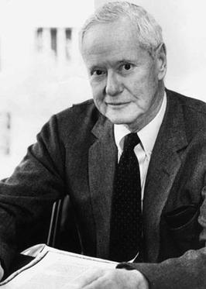
Robert K. Merton
CUDOs principles
Communism
Universalism
Disinterestedness
Organized Skepticism

Slide 13
CUDOs
C
U
Communism
Suggests that scientific knowledge should be considered a common good that benefits all of society, rather than a commodity that can be owned and sold for profit. In the context of academic publishing, this means promoting open access to research articles, data, and other scholarly outputs, as well as collaborative and cooperative approaches to research
Communism
Universalism
D
O
Disinterestedness
Organized Skepticism

Slide 14
CUDOS
C
U
Universalism
Holds that scientific knowledge should be evaluated based on its quality and merits, regardless of the social identity or background of the researcher. In the context of academic publishing, this means promoting diverse and inclusive representation in authorship and editorial decision-making and working to eliminate biases in peer review and evaluation processes.
Communism
Universalism
D
O
Disinterestedness
Organized Skepticism

Slide 15
CUDOs
C
U
Disinterestedness
Suggests that scientists should strive to be impartial and unbiased in their research, avoiding conflicts of interest and focusing solely on the pursuit of truth. In the context of academic publishing, this means promoting transparency in funding and disclosure of potential conflicts of interest, as well as ensuring editorial independence and avoiding the influence of commercial interests in publishing decisions.
Communism
Universalism
D
O
Disinterestedness
Organized Skepticism

Slide 16
CUDOs
C
U
Organized Skepticism
Holds that scientific knowledge is tentative and subject to revision based on new evidence and critical evaluation. In the context of academic publishing, this means promoting transparent and reproducible research practices, encouraging open peer review, and fostering a culture of continuous improvement and correction.
Communism
Universalism
D
O
Disinterestedness
Organized Skepticism

Slide 17
CUDOs
C
U
We should
Promote open access
Encourage diversity and inclusiveness
Ensure transparency
Support transparent and reproducible research practices
And foster a culture of continuous improvement and correction
Communism
Universalism
D
O
Disinterestedness
Organized Skepticism

Slide 18
E-mail: charlotte.wien@elsevier.com
Thank you

