Slide 1
Viva Goals 101

Slide 2
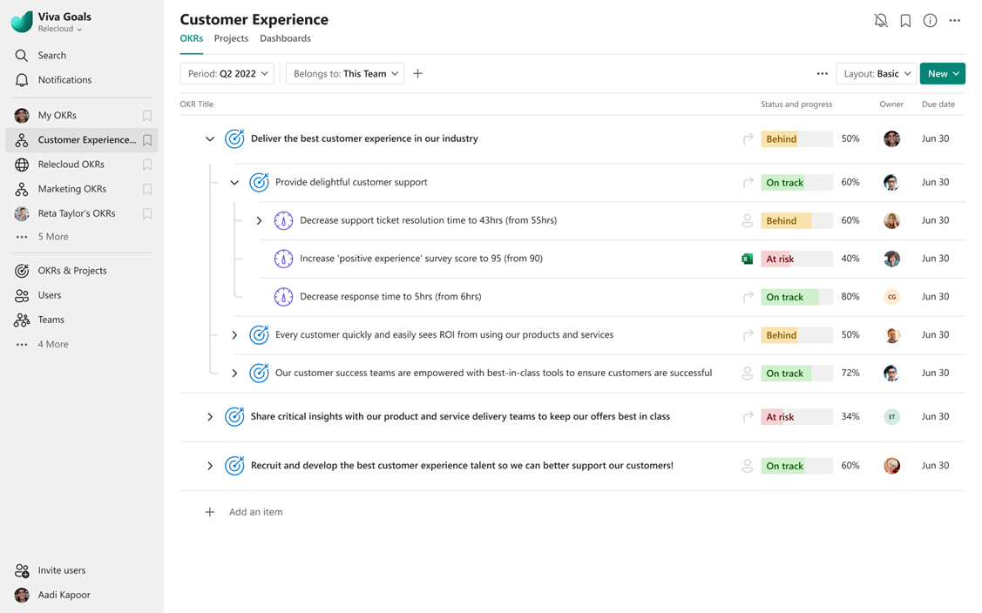
What is Viva Goals?
A goal and Objectives and Key Results (OKR) management solution designed to help leaders and teams create, manage, and track organizational goals.
Outcome-driven goals help teams align to strategic priorities and deliver measurable results.
Viva Goals provides a single, secure repository for goals across the organization, connecting team goals to employees’ daily work with easy-to-use updates, reporting, and integrations.

Slide 3



How Viva Goals helps, from strategy to execution
Connect employees to organizational goals with increased visibility and alignment
Manage, track, and share your team goals from one central, secure location
Bring goals into the flow of everyday work with integrations into your existing toolset

Slide 4
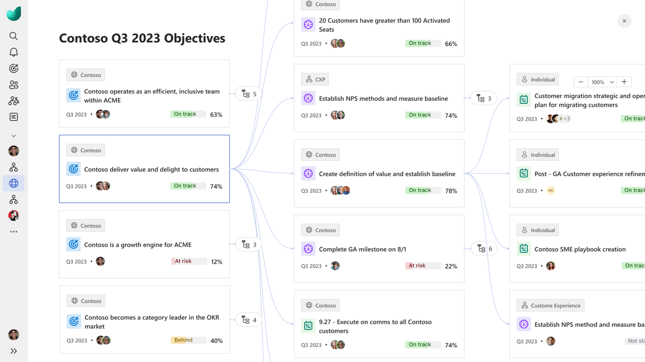
Connect employees to organizational goals with increased visibility and alignment
Empower employees to prioritize and focus on high-impact work with clear goals and metrics
Decrease friction and/or duplicative work with increased cross-organizational visibility and defined roles and responsibilities
Better understand alignment with hierarchical chart and alignment views

Slide 5
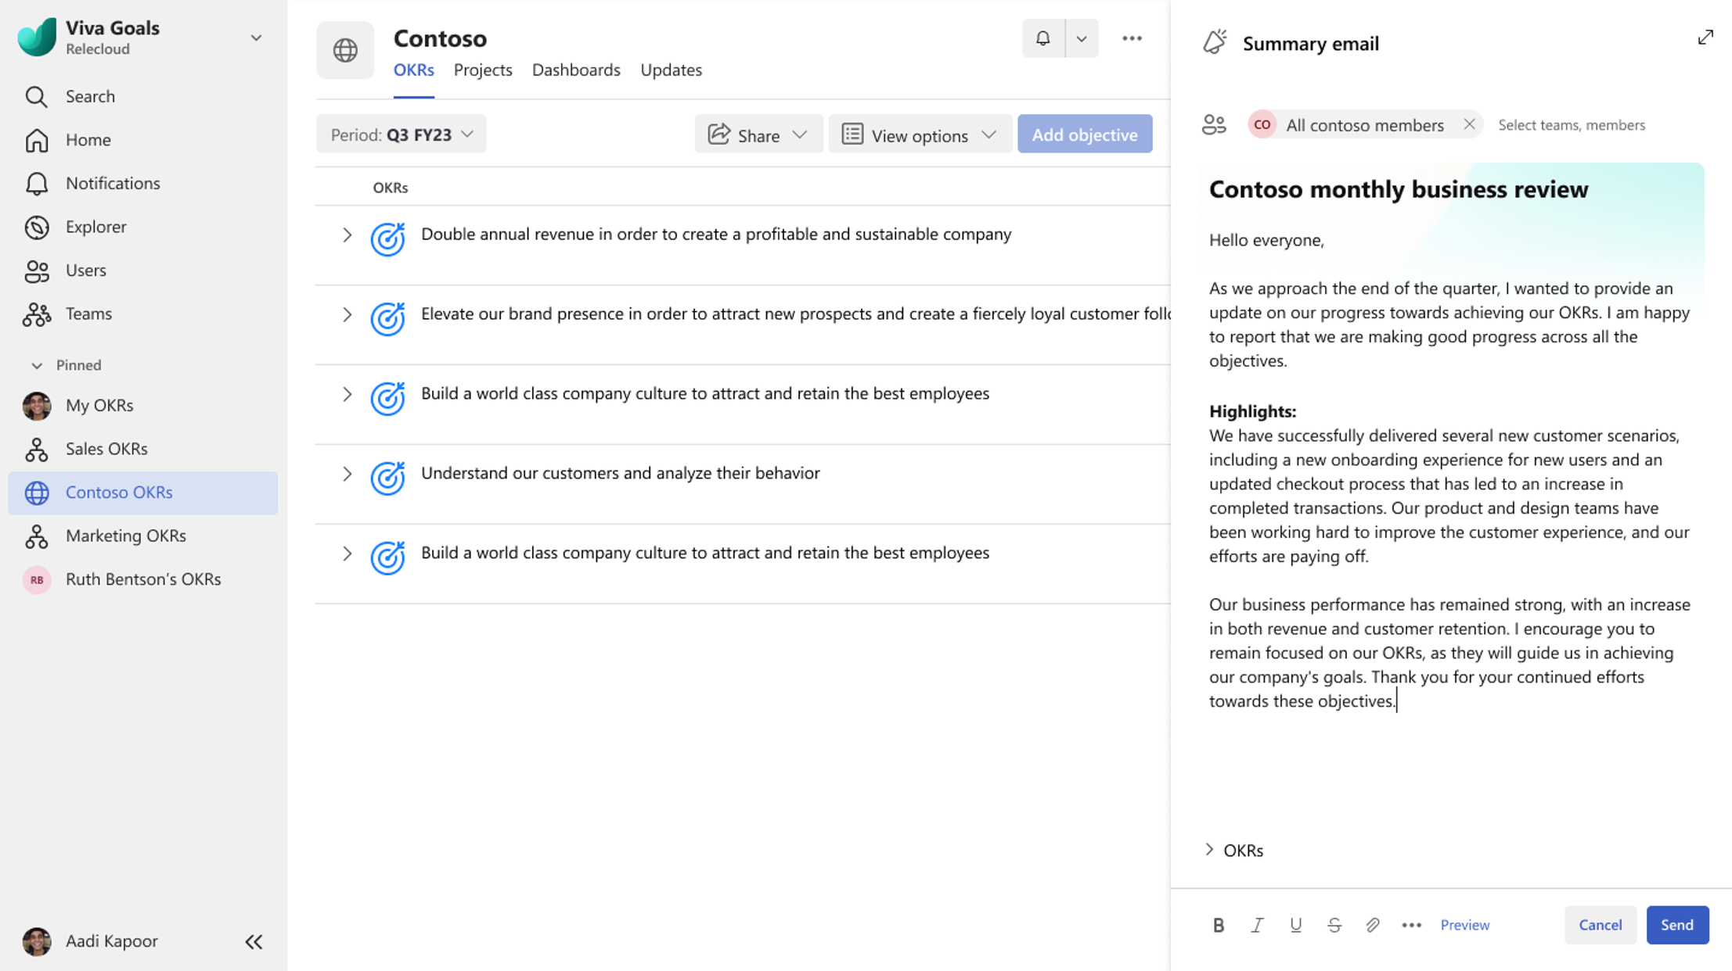
Manage, track and share your team goals from one central, secure location
Create, approve and review your team goals across your organization with the right rhythms of business
Share and broadcast your teams’ goals with easy export into PowerPoint, customizable dashboards and broadcasting feature to share in email
Protect your data with built-in security and data privacy controls
To learn more about Viva Goals Security and Compliance, please visit Microsoft Learn

Slide 6




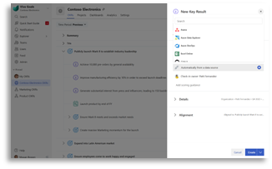




Bring goals into the flow of everyday work with integrations into your existing toolset
Access, check-in and communicate your goals via the Viva Goals app and within chat for Microsoft Teams
Automatically update your goals with data integrations into your performance, task and project management applications
Integrations include both Microsoft and non-Microsoft applications, see the full list here
Microsoft Power BI
Microsoft Project
+ data integrations into other business solutions

Slide 7

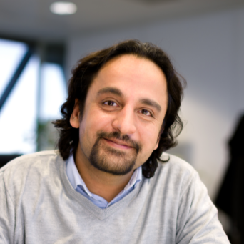

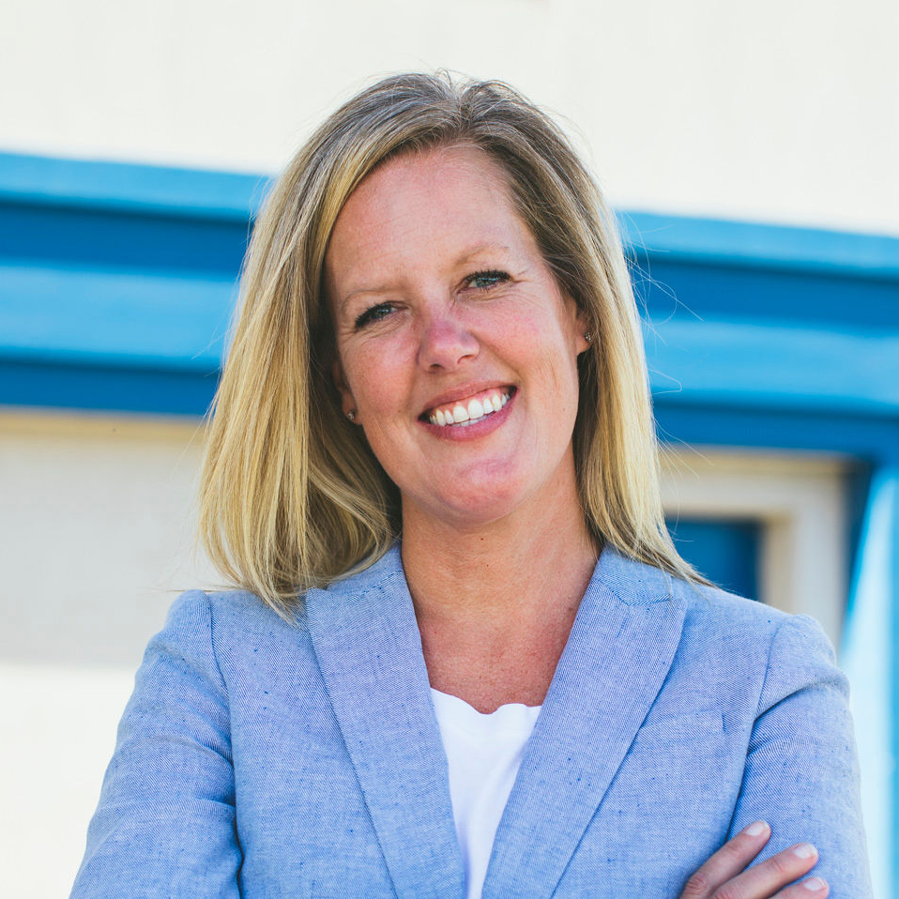


Assemble your team
Business Leader
Champion
Planning Manager
Goal Owner
Stakeholder
Tech Admin
Leader who drives company, group, or team strategy, creates and approves team / organizational goals, and reviews progress.
Central expert and axis that keeps programs on track and connected. Drive overall program and rhythm of business across the entire organization (or multiple teams).
Individuals and team managers who drive planning & tracking process on a given team. They ensure check-ins, reporting, and meetings follow prescribed rhythm of business.
Users who own goals and are accountable to drive and report progress on goals.
Users who engage with updates on progress of goals.
User who does the technical setup & responsible for managing the software and ensures licenses are assigned and security/compliance needs are met.
Recommended Training:
Viva Goals Quick Start
Typical titles: C-suite, Vice President, General Manager
Recommended Training:
OKR Leadership Program
Typical titles: Chief of Staff, Planning Lead, Strategy & Operations
Recommended Training:
OKR Leadership Program
Typical titles: Team Manager, Business Manager, Chief of Staff, Data Analytics Manager
Recommended Training:
Viva Goals Quick Start
Typical titles: Anything from Individual Contributor to Vice President or beyond
Recommended Training:
Viva Goals Quick Start
Typical titles: Anything from Individual Contributor to Vice President or beyond
Recommended Training:
Intro to Viva Goals (Admin)
Typical titles: IT Admin, Technical Operations

Slide 8
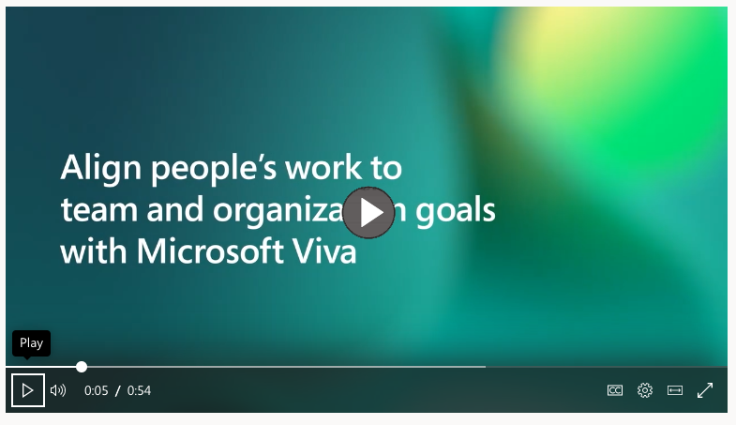
Video: Experience Viva Goals
Click here to view video

Slide 9
How Viva Goals is helping customers

Slide 10

Client testimonial from LEGO
“We are investing in OKRs and Viva Goals in order to leverage the OKR framework to support our journey to be value and outcome driven on the overall portfolio level, while leaving it to the agile teams to define the “what” and “how” when it comes to creating the value.”
Lars Fomsgaard Larsen
Product Manager & Digital Transformation Lead
LEGO

Slide 11


Greg Nixon
“I’m excited about the direction the Goals team is taking, as they build further integrations and context-specific assistance that will enable objective-setting, achievement and reflection to become a part of our regular rhythms and systems of work.”
Head of Information Technology & Security

Slide 12
How Microsoft deployed Viva Goals across Experiences & Devices

Slide 13





Experience & Devices org:
Getting aligned with Viva Goals
Goal: Better alignment across the organization
Onboard to Microsoft Viva Goals, coming from a mix of different planning approaches & OKR maturity levels
Target
audience
Microsoft’s “Experience and Devices” organization
(>45k employees WW)
Timing: 12-week effort
Aimed for a July 26, 2022 launch (aligned with E+D FY23 Annual Kick Off)
Launch Team: A Cross-LT effort
Executive Sponsor: Rajesh Jha (EVP E+D)
Included E+D Leadership Team, Communications, IT, and HR Support
Effort included OKR champs and an “OKR Enterprise Accelerator” project accelerator program

Slide 14



Experience & Devices org:
Four best practices from our learnings
1
2
Identify committed executive sponsor(s)
Delegate ownership and scale through local Viva Goals champions
Make sure you have enthusiastic leaders accountable for the success of the overall program — not just within individual teams.
Build a network of local OKR champions to evangelize the change and provide avenues for employees to get support.
3
4
Build a public timeline linked with key planning milestones
Communicate clear expectations and create community
Hold your team accountable and create a valuable sense of urgency.
Make sure what you are asking for is crystal clear at all points in the process.

Slide 15

Experience & Devices org:
Successful Adoption Outcomes
Increased focus on top priorities for leadership and employees
Better decision-making from visibility into OKR progress
Greater transparency across levels & teams
Stronger sense of purpose and alignment across teams
Read more about Microsoft use of Viva Goals for E&D:
Microsoft Customer Story-Clarity and Connection: How Microsoft uses Viva Goals to drive organization-wide impact

Slide 16
Experience & Devices org:
Successful Adoption Outcomes
“Viva Goals allows anyone in the organization to see what other people are working on. Individuals can see the importance of their contributions to their team. Leaders can see how their objectives are being implemented by teams throughout their organization and initiate discussions to keep the work on track.”
Jennifer Perret
Principal Group Program Manager
Microsoft

Slide 17
Do more with built-in Viva Goals integrations

Slide 18
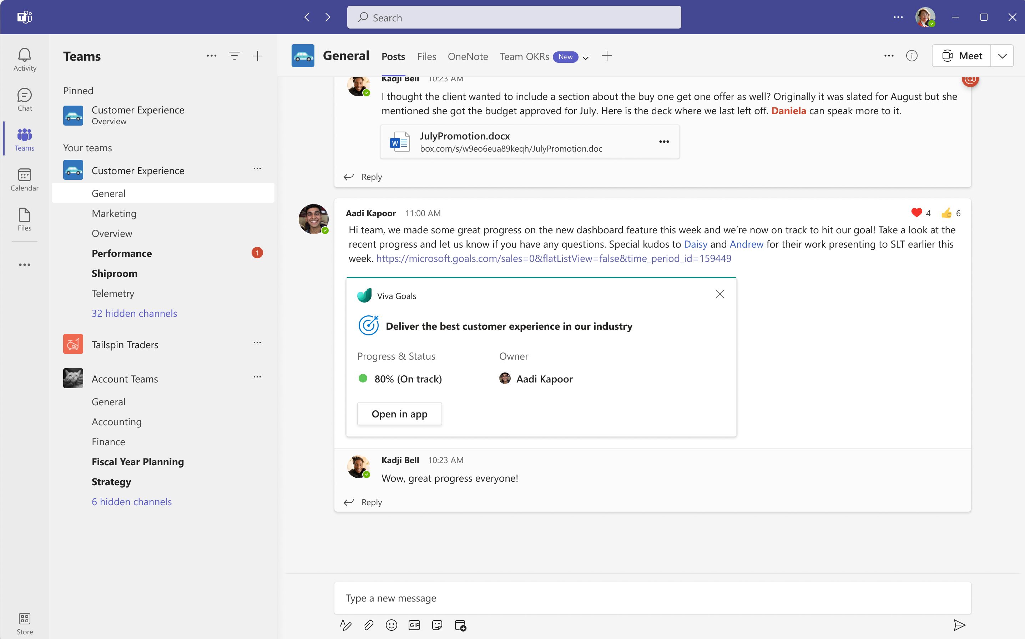
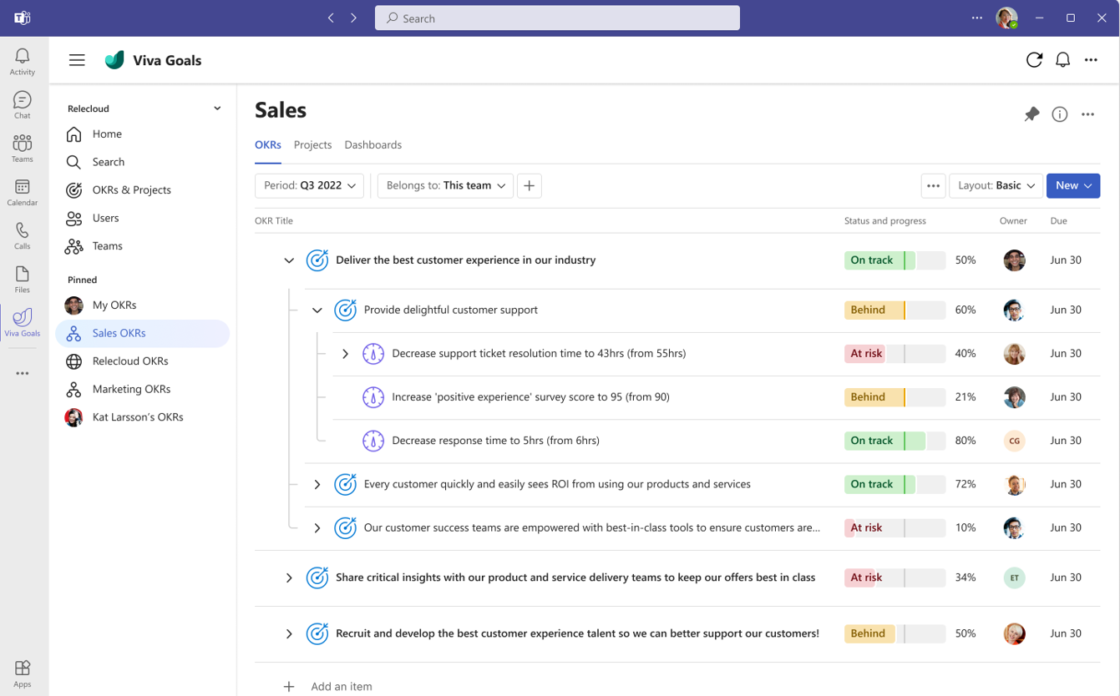
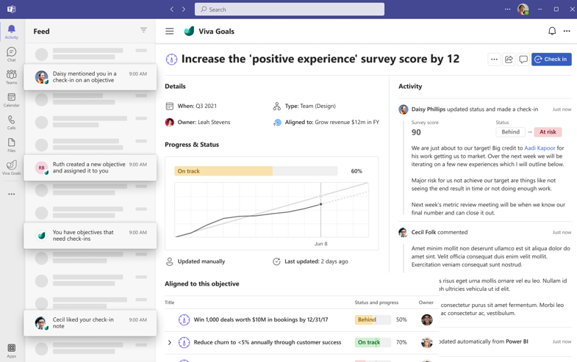
Viva Goals and Microsoft Teams Integration
Bring Viva Goals into your Microsoft Teams workflow
Create a collaborative Teams experience for purpose-driven teams to communicate effectively
Align and focus on the strategic priorities by pinning goals, toggling across departmental goals, and viewing in-app notifications
Provide richer admin experiences and dashboard capabilities where users ca present and author content within Teams
Release timing:
General Availability for web parity
More enhanced integrations coming in CY23

Slide 19
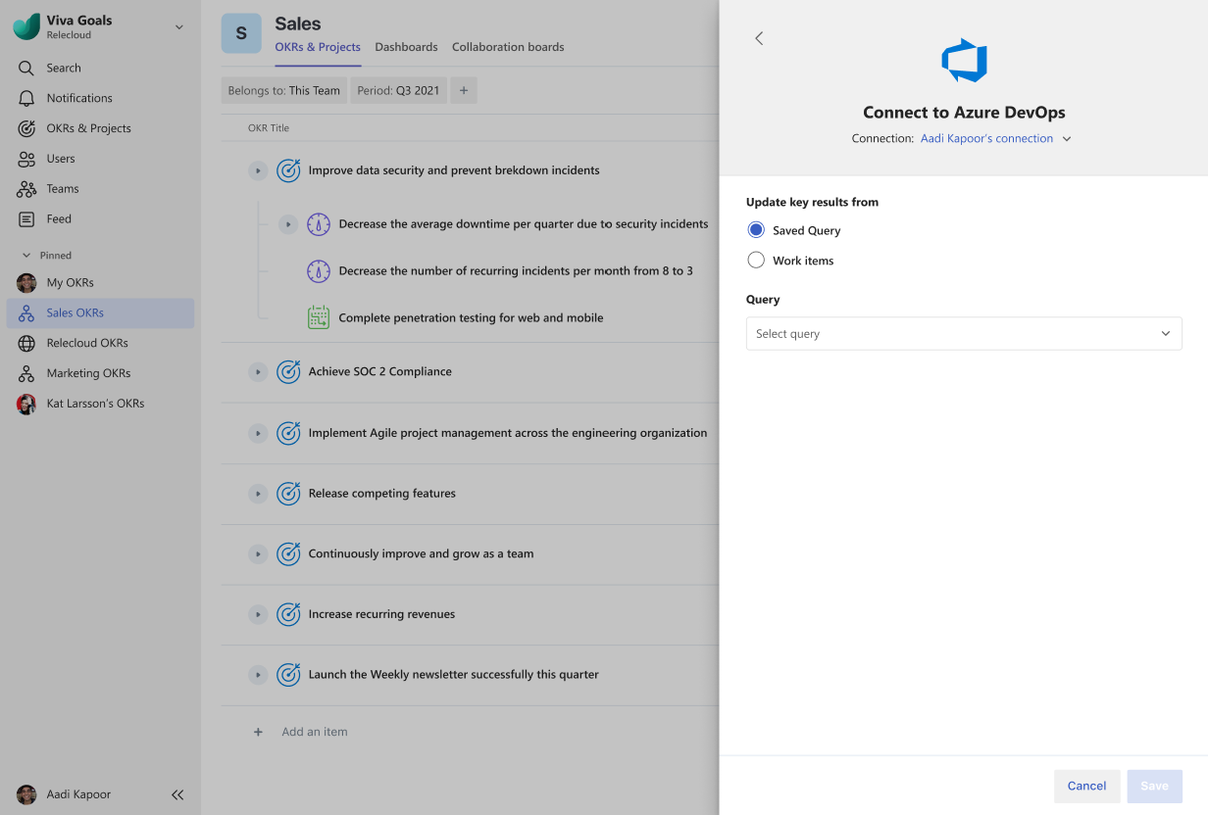
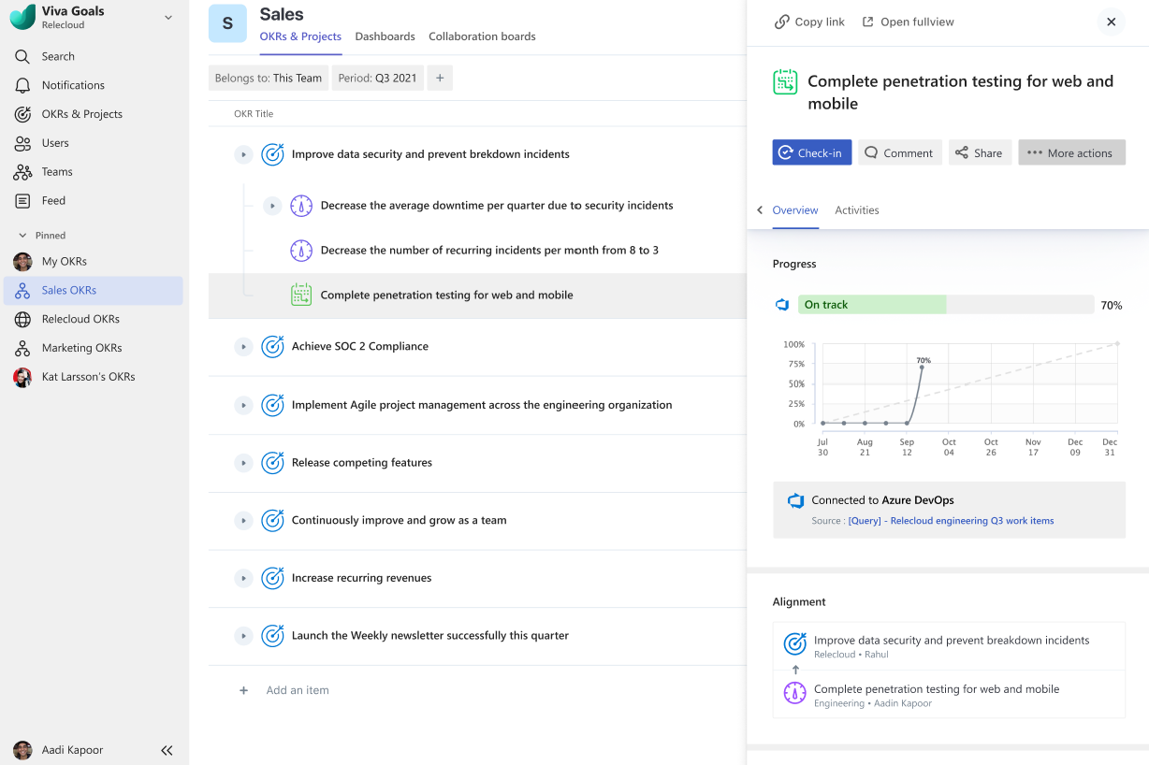
Viva Goals and Azure DevOps Data Integration
Engage in agile project management for initiatives
Connect shared queries and work items in ADO to Viva Goals within a single view in your Viva Goals environment
View automatic updates of Viva Goals Initiatives and Key Results as work items progress
Now Generally Available

Slide 20
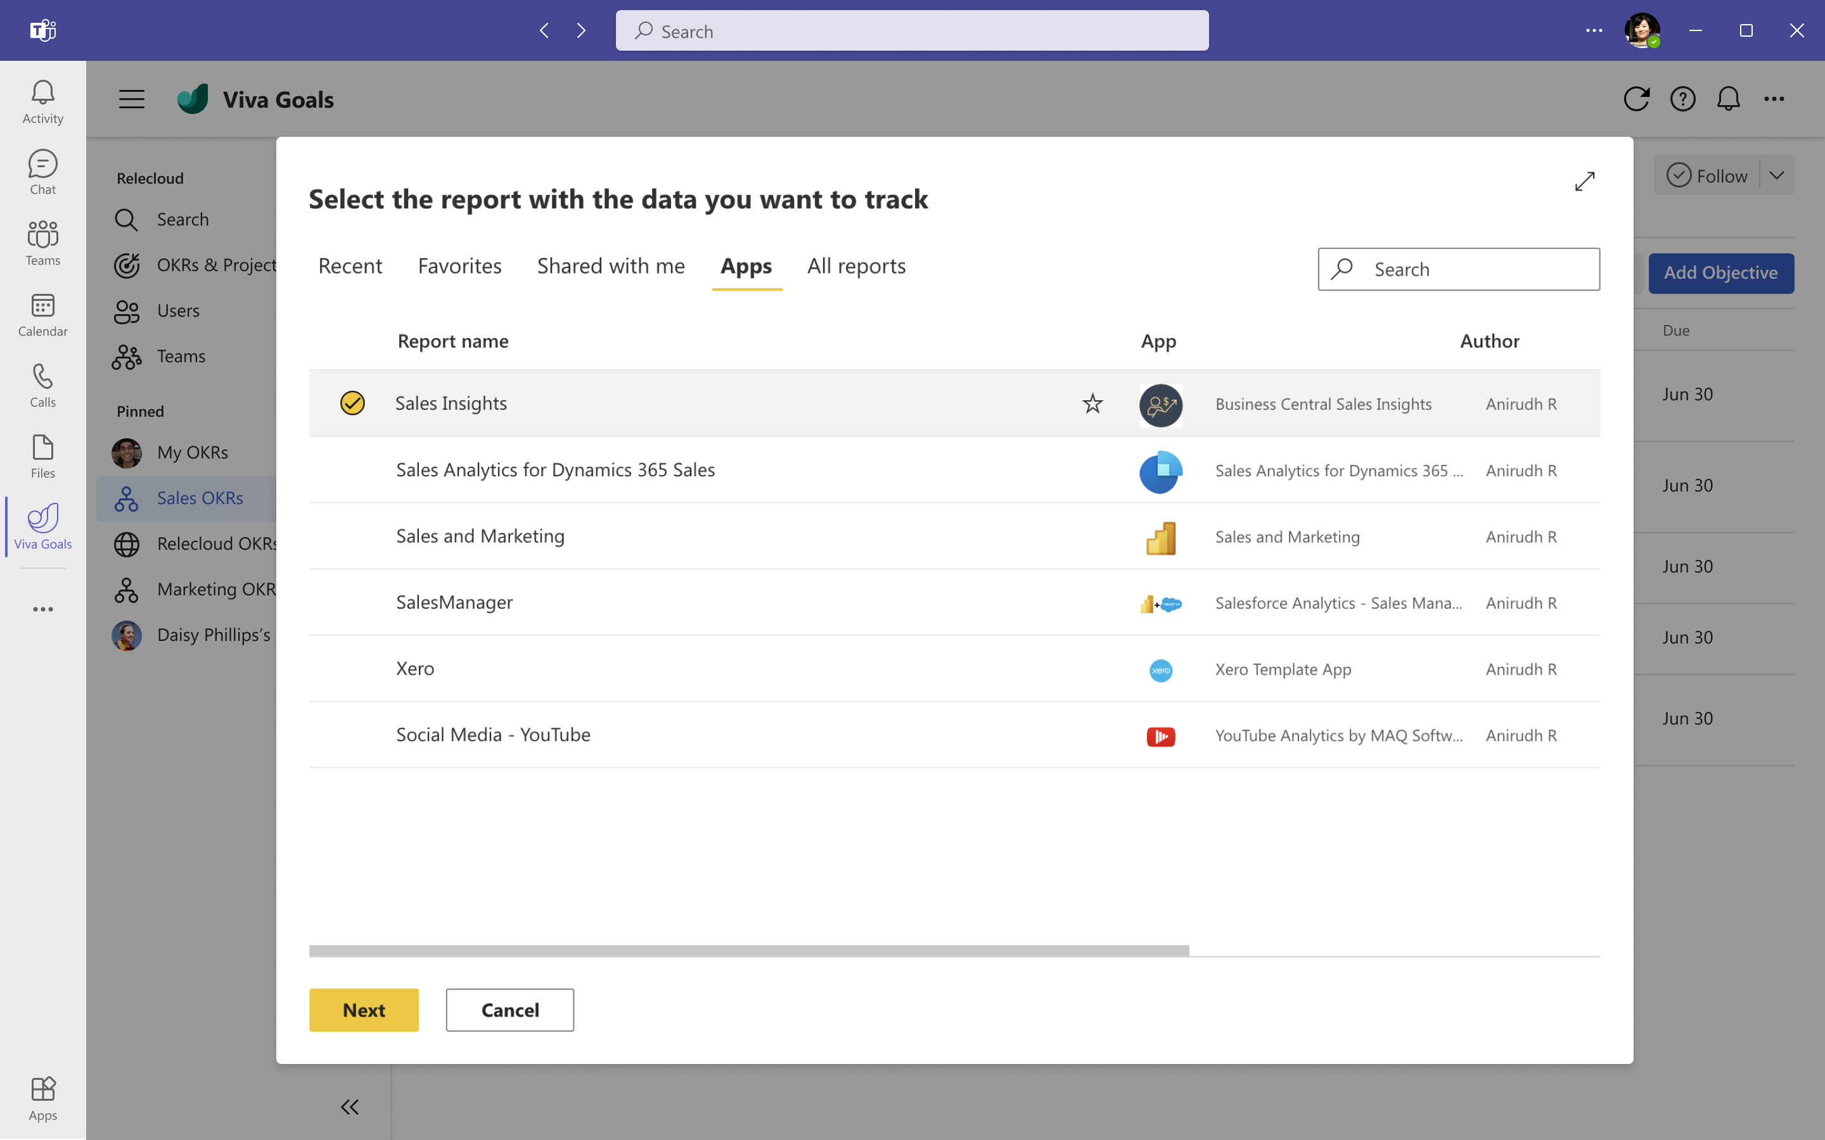
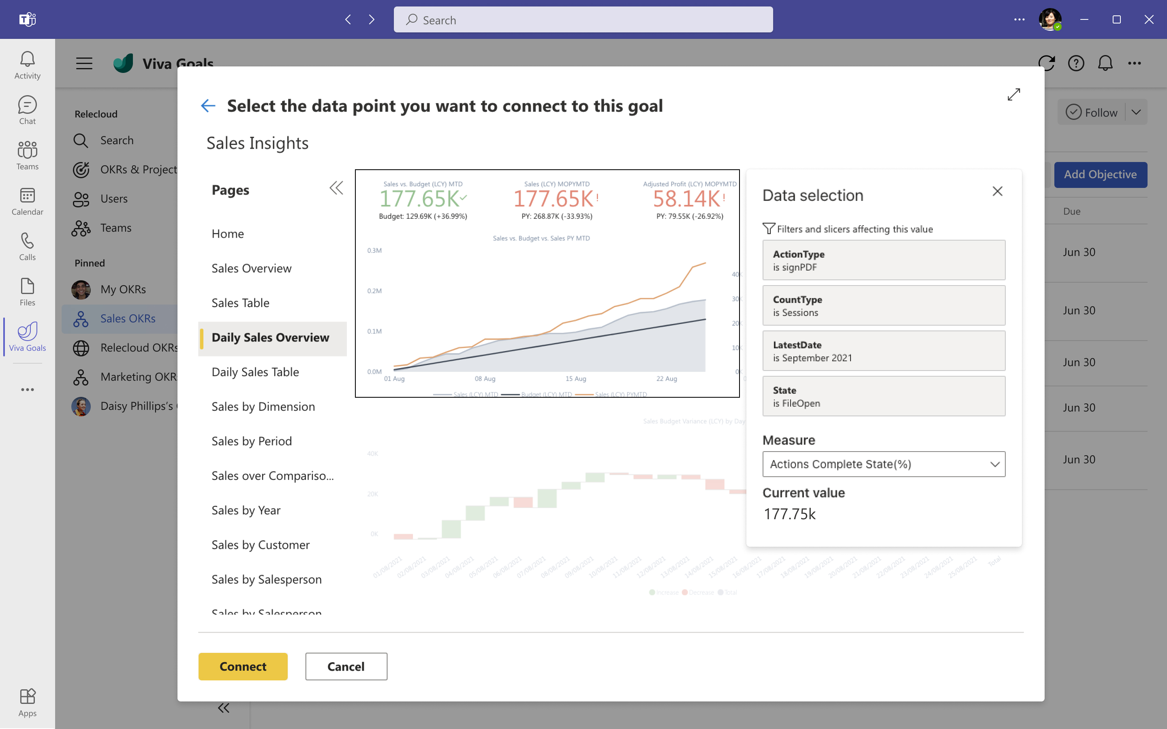
Viva Goals and Power BI Integration
Visualize the status of your OKRs with Power BI
Automatically update Key Results with data from Power BI
Quick one-click access to Power BI reports to make informed decisions
View the progress of your goals with powerful data visualization
Now Generally Available

Slide 21
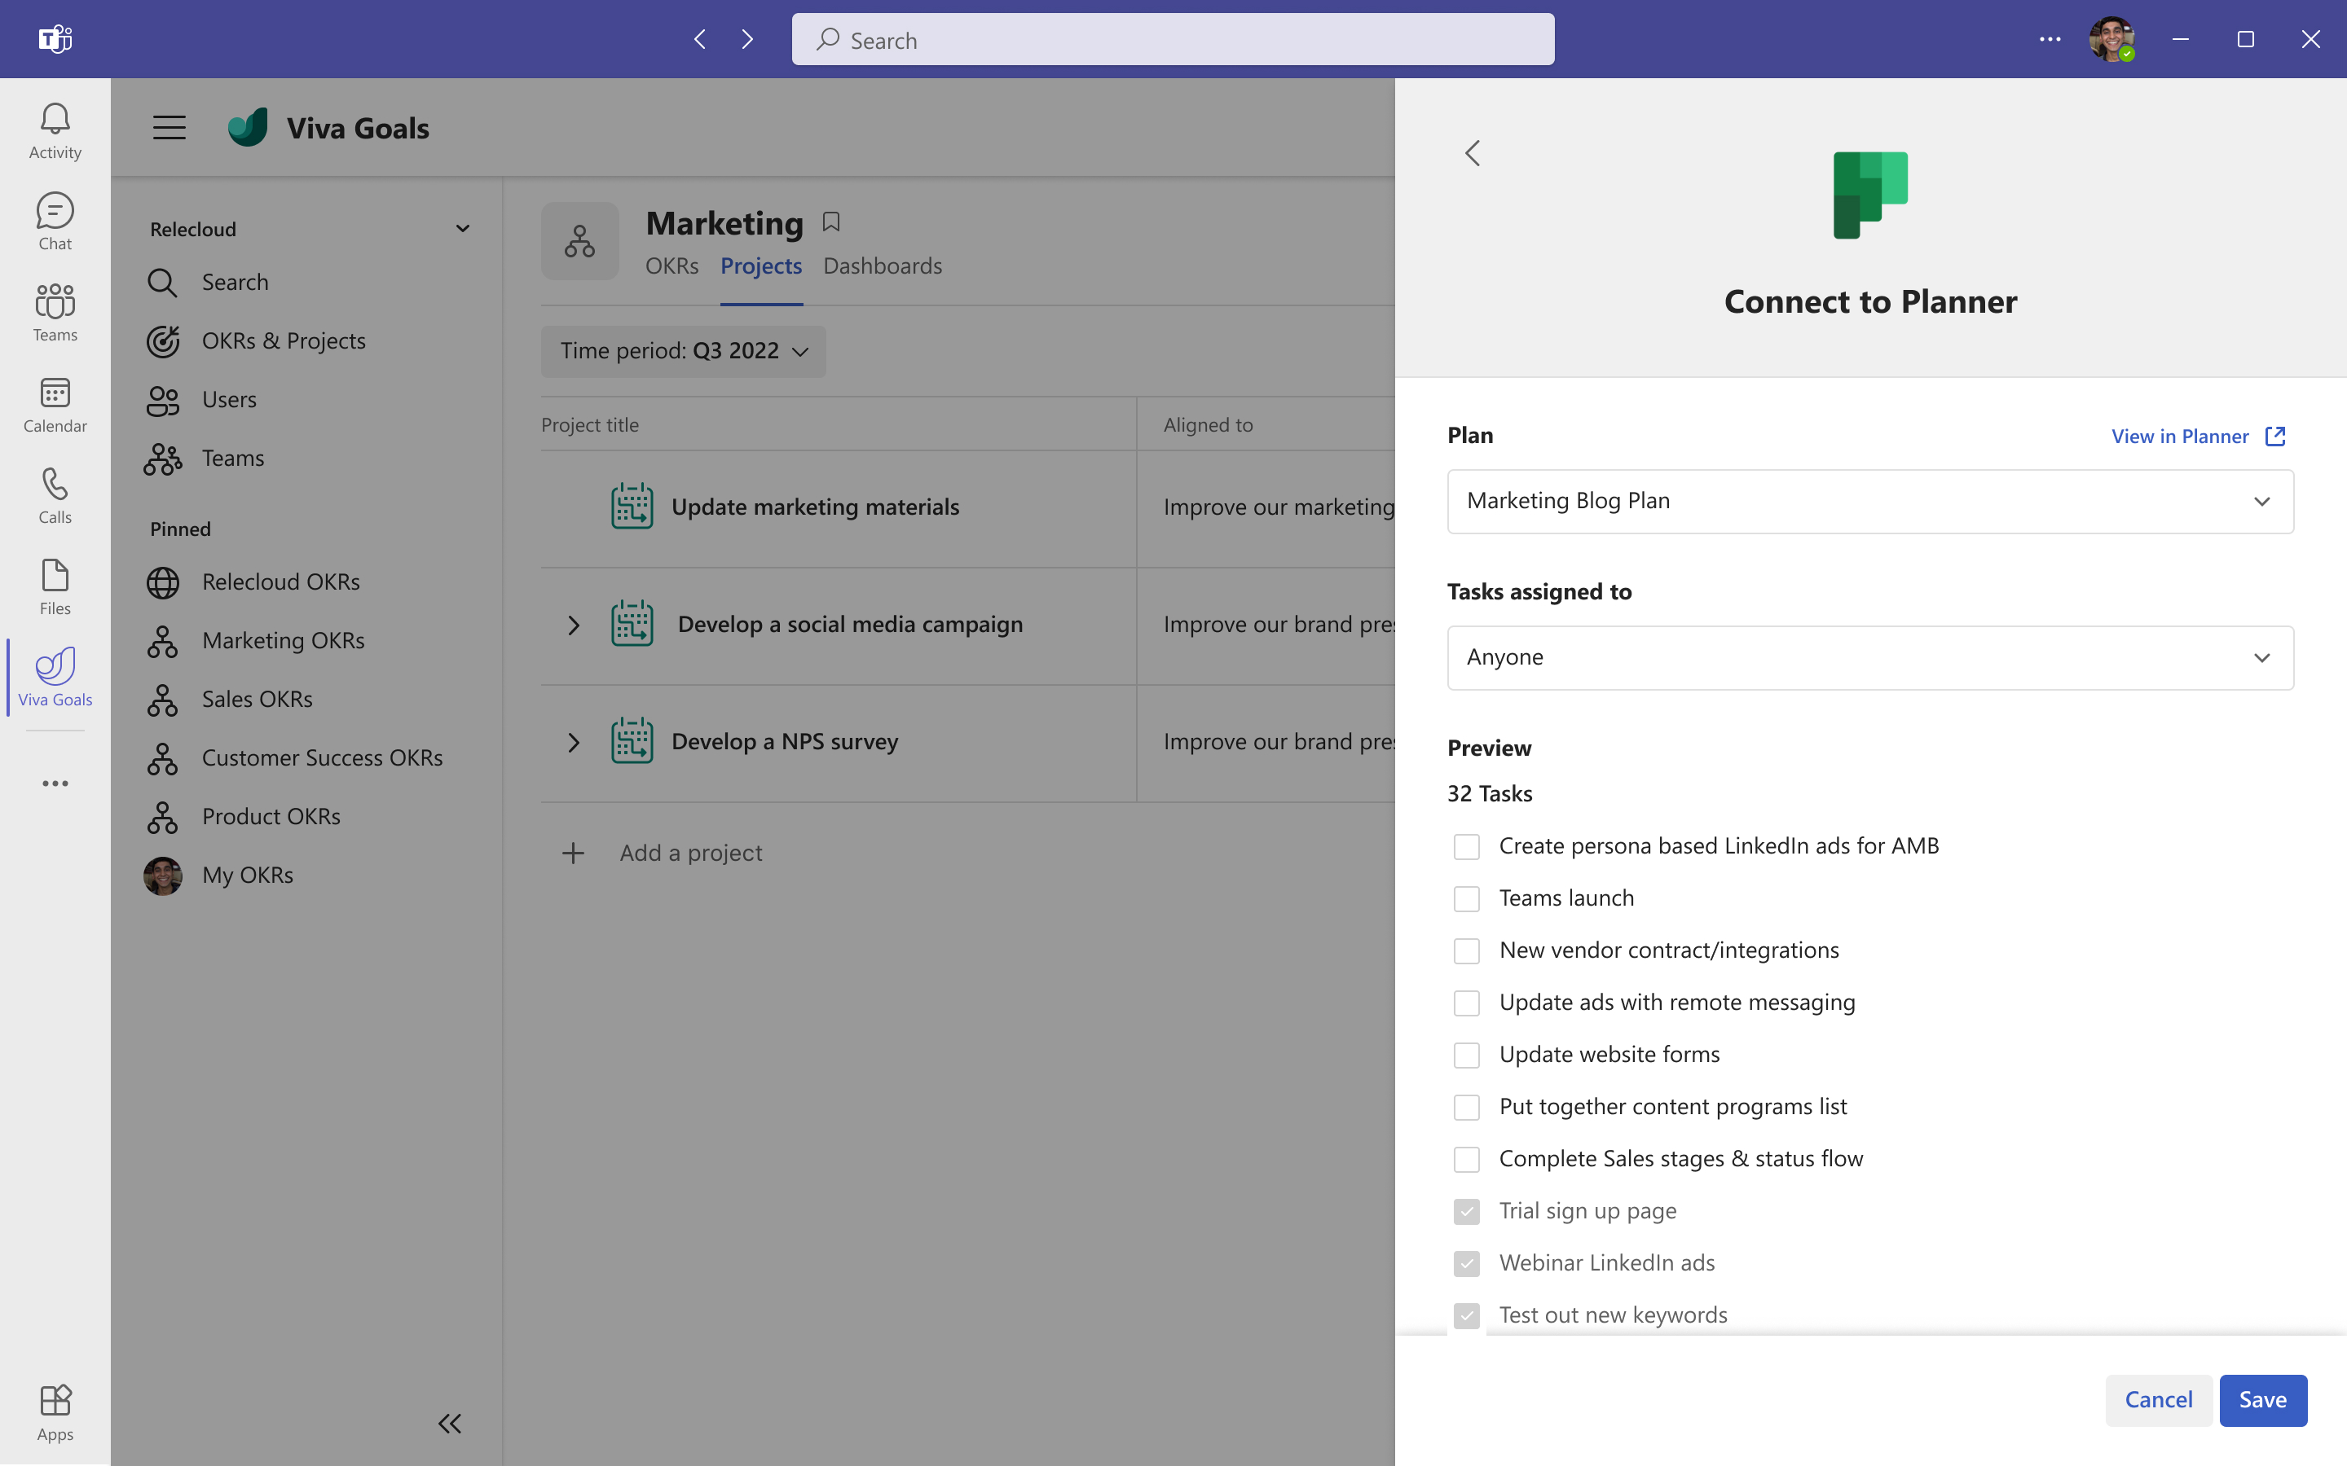
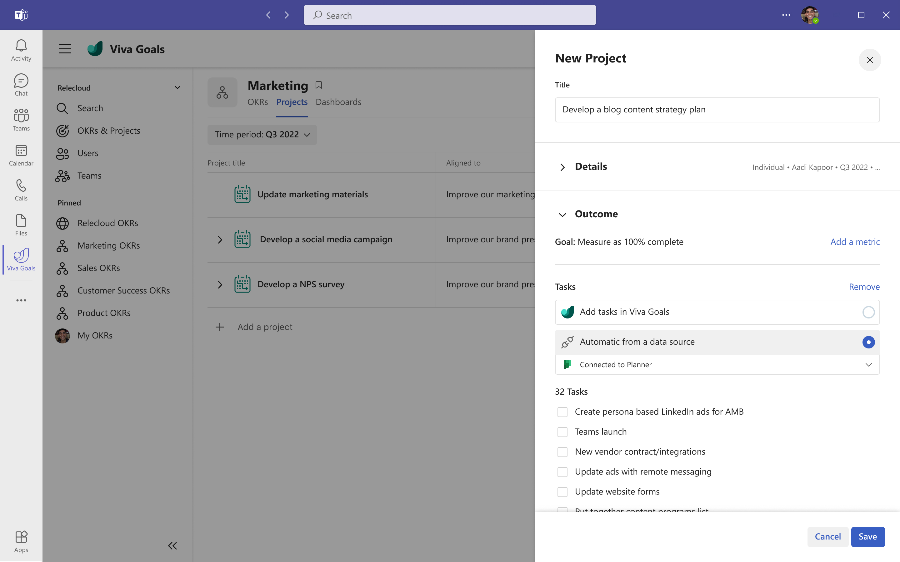
Viva Goals and Microsoft Planner Integration
Integrate task tracking in Microsoft Planner into OKR progress
Connect tasks to Viva Goals Initiatives and Key Results to maintain a single source of truth
Align the daily tasks to the bigger picture
Have the most up to date information with automatic progress check-ins as Tasks are completed in Microsoft Planner
Now Generally Available

Slide 22
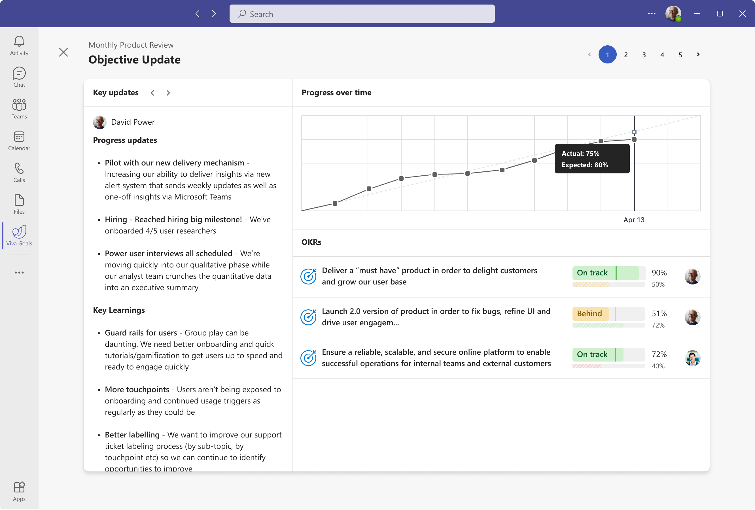
Experience Viva Goals for yourself
Want to see how Viva Goals can help you drive purpose, alignment and results?
Try our click-through demo here
Kick off a Microsoft Viva Trial
Engage a Viva or OKR partner (offerings at Microsoft AppSource)

Slide 23
Interested in learning more about Viva Goals?
Learn more
Check out the Viva Goals website
Get started from our Learn page
Learn skills to Become an OKR Champion
Discover best practices on the Adoption page
Other resources
Watch the Viva Goals Microsoft Mechanics video
Watch the Viva Goals with Microsoft Teams video
Read recent Viva Goals announcements
Read about Microsoft’s journey using OKRs

