Slide 1
Primo VE NDE Configuration
Yoel Kortick
Q4, 2025

Slide 2
Agenda
  Introduction
  Selecting a Color Theme
  Adding a Clickable Link for the Logo
  Updating Page Titles
  Using the Customization Package Manager
  Specific examples using the Customization Package Manager
2

Slide 3
Introduction

Slide 4
Introduction
This presentation will focus primarily on what’s new in Primo VE NDE configurations.
  Those configurations which existed in Primo VE and have not changed in the Primo VE NDE will not be the focus of this presentation.
  They may be mentioned in passing, but do not constitute the purpose of this presentation.
See also:
  Primo VE NDE User Interface Customization - Best Practices

Slide 5
Introduction
Branding the NDE UI
Primo VE offers many configuration options, some requiring little or no coding or development experience. The following sections describe each of these options.

Slide 6
Selecting a Color Theme

Slide 7
Selecting a Color Theme
The institution can quickly and easily change the color theme of a Primo view with no need to create a customization package.
The color schemes affect many elements in the NDE UI and adhere to the accessibility guidelines for color and contrast.
For an additional method (to what is now being shown here) for changing the color scheme, see Customizing a Color Theme.

Slide 8
Selecting a Color Theme
To select a color theme:
  Access “Configure Views”
  Edit the View
  Select the “Manage Customization Package” tab
  In the Color Theme - New UI section, select a color icon. Purple is the default color.

Slide 9
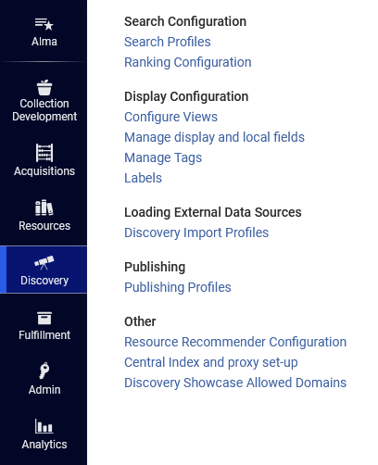
Selecting a Color Theme
Access “Configure Views”

Slide 10
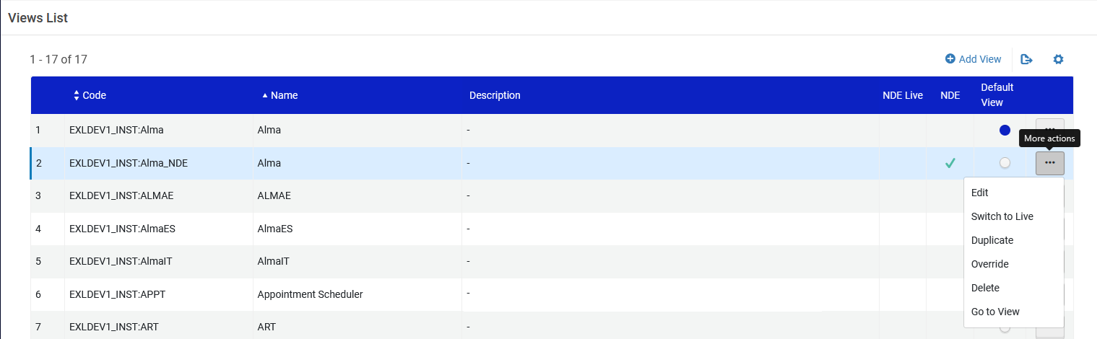
Selecting a Color Theme
Edit the View

Slide 11
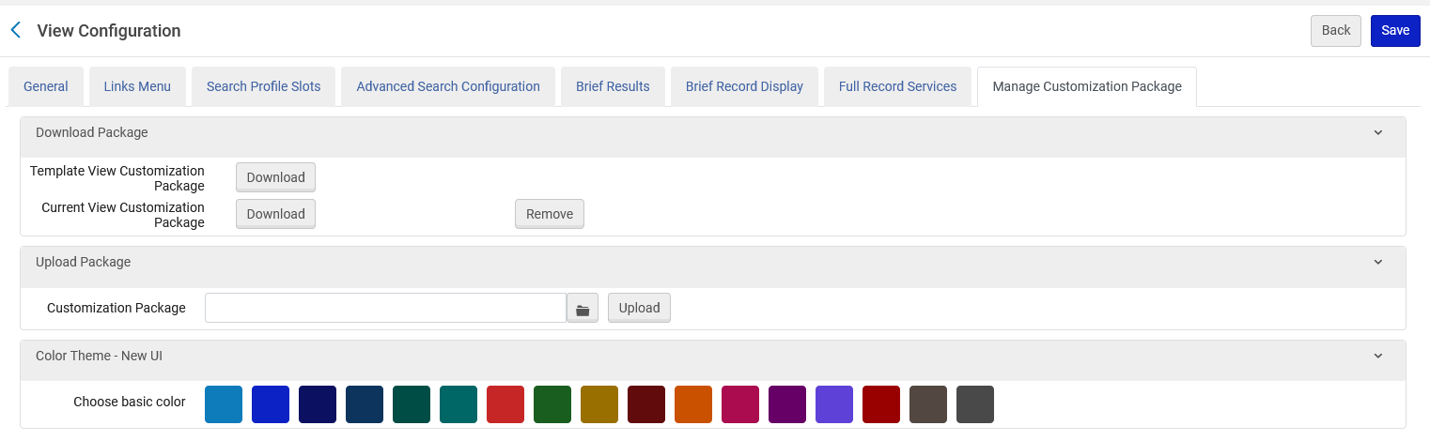
Selecting a Color Theme
Select the “Manage Customization Package” tab
This is new for Primo VE NDE

Slide 12
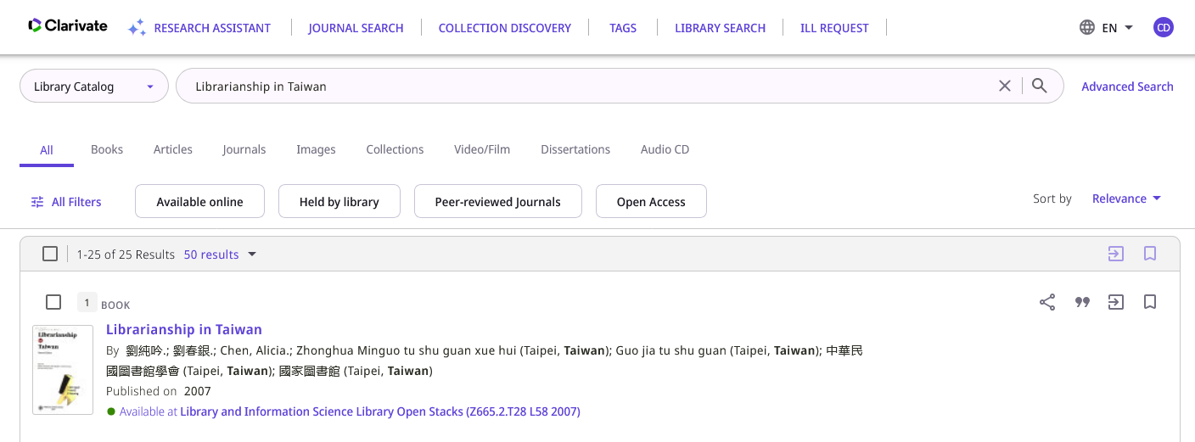
Selecting a Color Theme
Here is the “Before” color scheme in Primo VE NDE

Slide 13
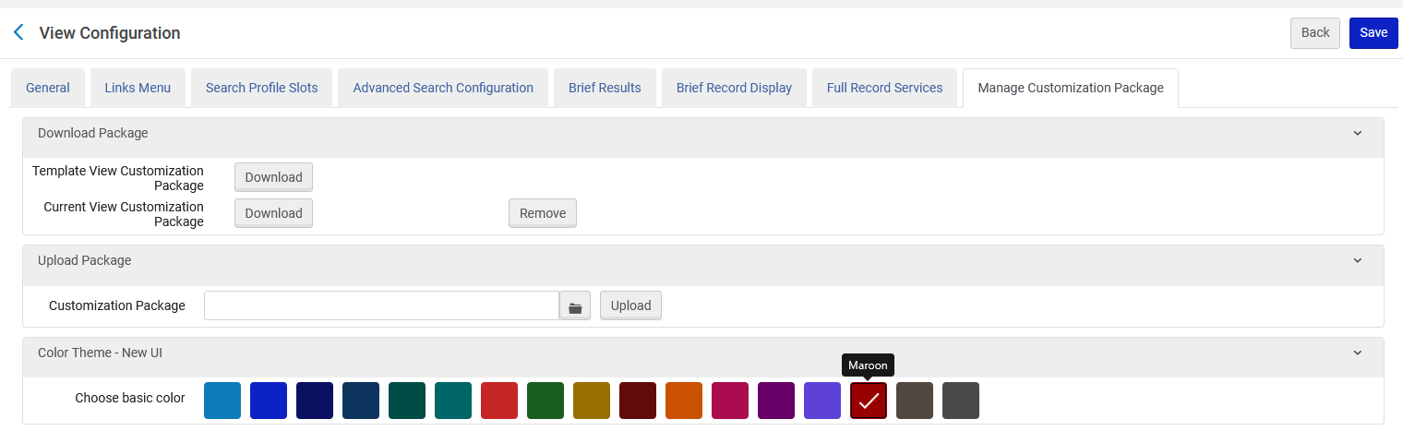
Selecting a Color Theme
In the Color Theme - New UI section, select a color icon. Purple is the default color. We will select Maroon.
We will select Maroon
Save when done

Slide 14
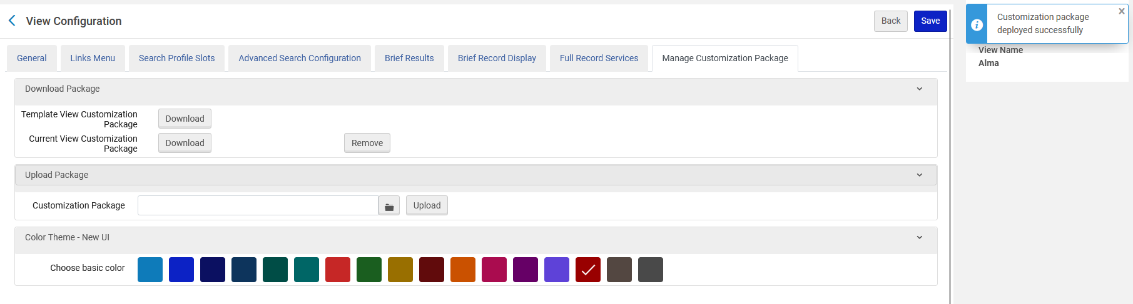
Selecting a Color Theme
After clicking “Save” the customization package is deployed successfully

Slide 15
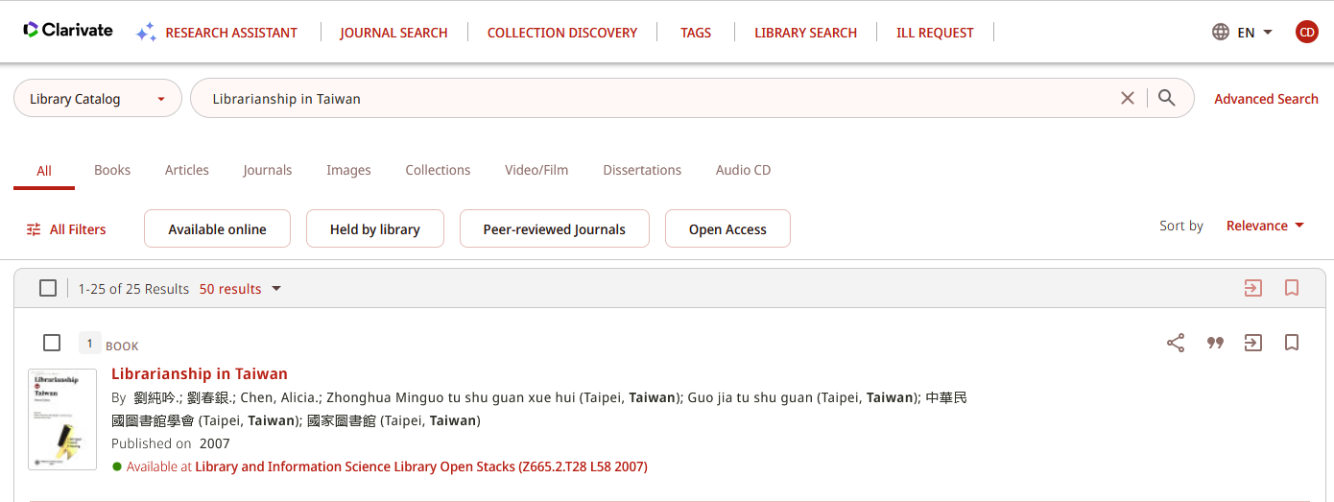
Selecting a Color Theme
The color has changed

Slide 16

Selecting a Color Theme
After
Before

Slide 17
Adding a Clickable Link for the Logo

Slide 18
Adding a Clickable Link for the Logo
The institution can quickly and easily specify a link that opens a page when users click the logo.
If no URL is configured, the Discovery home page is displayed when a user clicks the logo.

Slide 19
Adding a Clickable Link for the Logo
To add a clickable link for the logo:
  Access “Configure Views”
  Edit the View
  Select the “General” tab
  In the “Logo Clickable URL” field specify the redirection URL

Slide 20
Adding a Clickable Link for the Logo
Access “Configure Views”

Slide 21
Adding a Clickable Link for the Logo
Edit the View

Slide 22
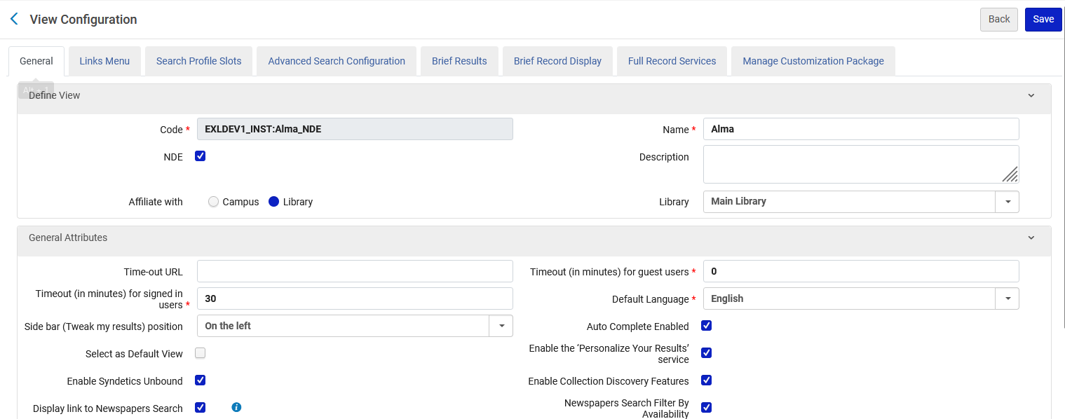
Adding a Clickable Link for the Logo
Select the “General” tab
Note that this is a partial screenshot of the “General” tab

Slide 23
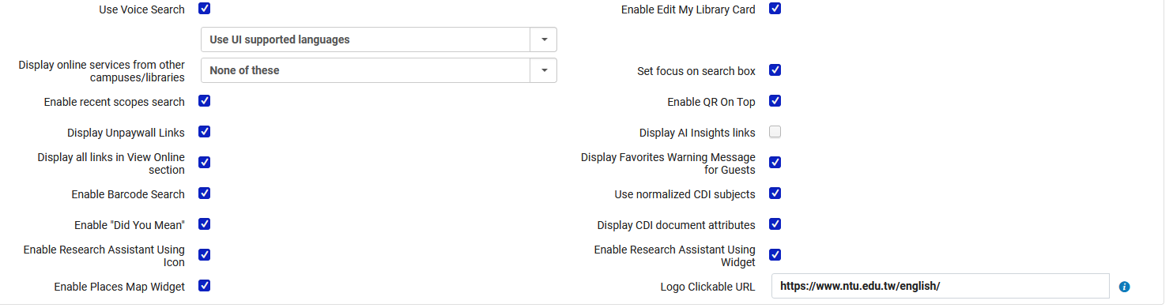
Adding a Clickable Link for the Logo
In the “Logo Clickable URL” field specify the redirection URL
The user will be redirected to https://www.ntu.edu.tw/english/ (The National Taiwan University)
Note that before the advent of Primo VE NDE the “Logo Clickable URL” field was in the “Manage Customization Package” tab in the “Upload Logo” section.

Slide 24
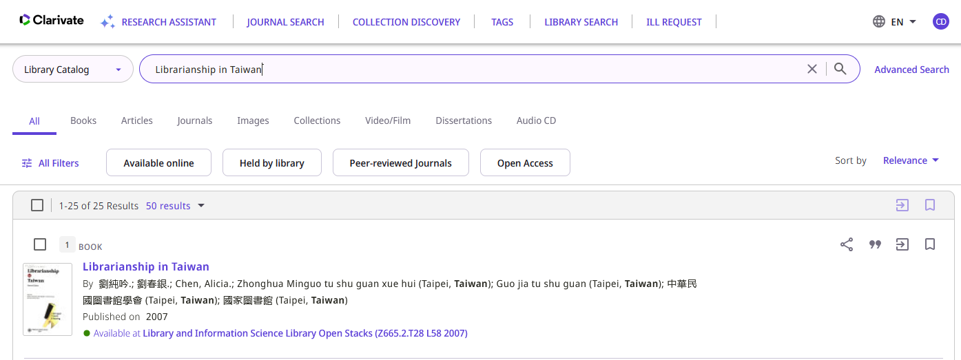
Adding a Clickable Link for the Logo
To test this the end user will now click the logo in primo VE NDE
End user in Primo VE NDE will click the logo

Slide 25
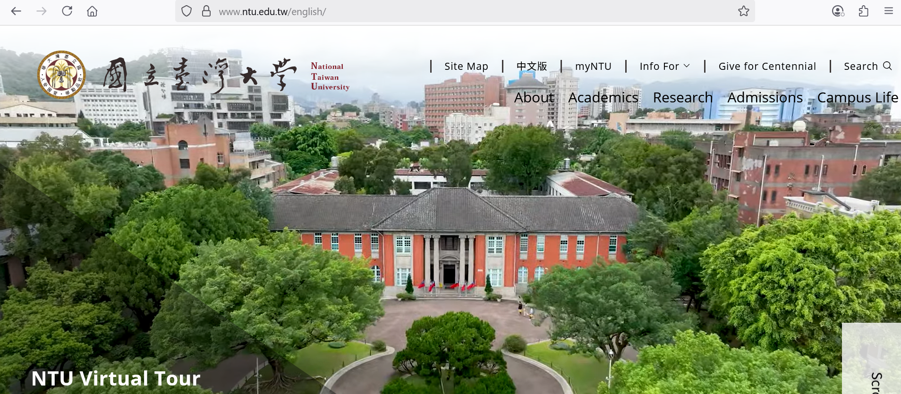
Adding a Clickable Link for the Logo
The end user is correctly redirected to https://www.ntu.edu.tw/english/ which is what we defined

Slide 26
Updating Page Titles

Slide 27
Updating Page Titles
The Header/Footer Tiles Labels code table allow the institution to customize the following titles in the NDE UI:
  main.title—Discovery
  main.description—Discovery - {{query}}
  nui.full.display.title—Primo by Ex Libris
  nui.brief.title—{{recordTitle}} - {{institutionName}}

Slide 28
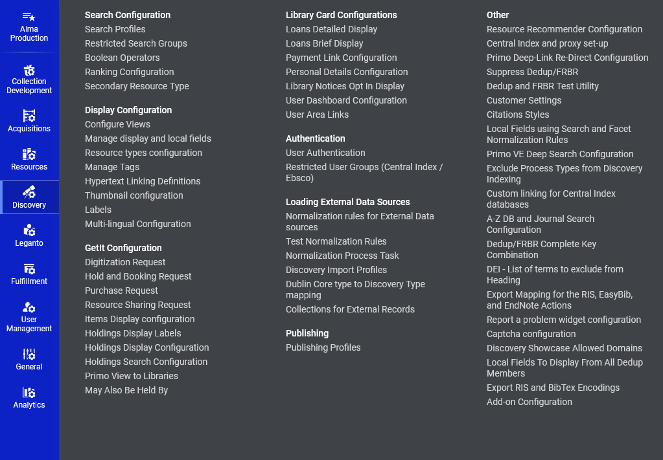
Updating Page Titles
The Header/Footer Tiles Labels code table is accessed at “Configuration > Discovery > Display Configuration > Labels”

Slide 29
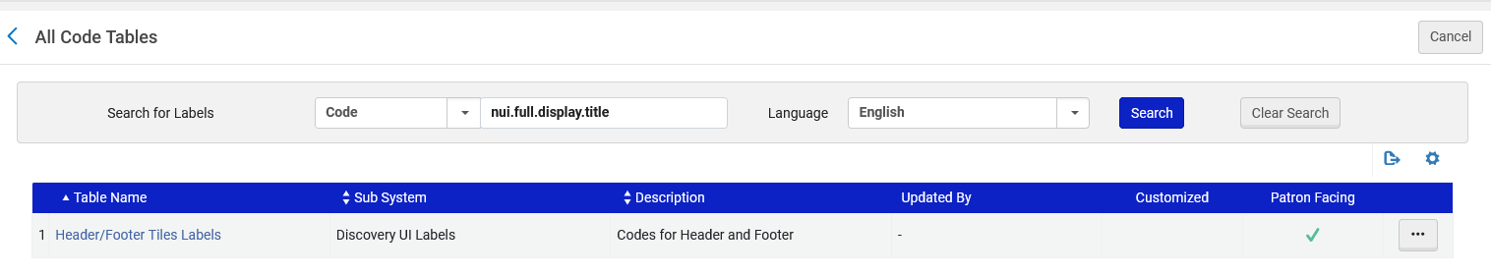
Updating Page Titles
We will now look at the Header/Footer Tiles Labels code table.

Slide 30
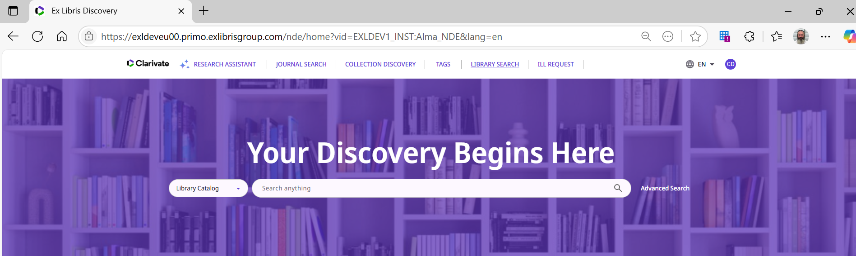
Updating Page Titles
If we begin using Primo and have not yet done any searches or other activities, then the page title is “Ex Libris Discovery”

Slide 31
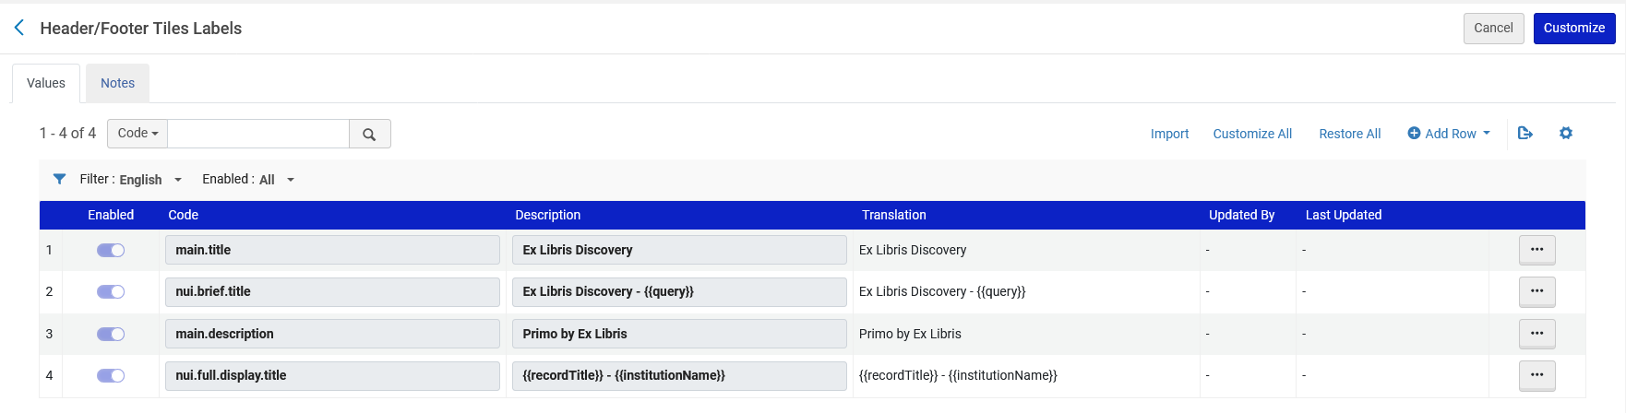
Updating Page Titles
The reason the page title is “Ex Libris Discovery” is because of this line we have in the Header/Footer Tiles Labels code table

Slide 32
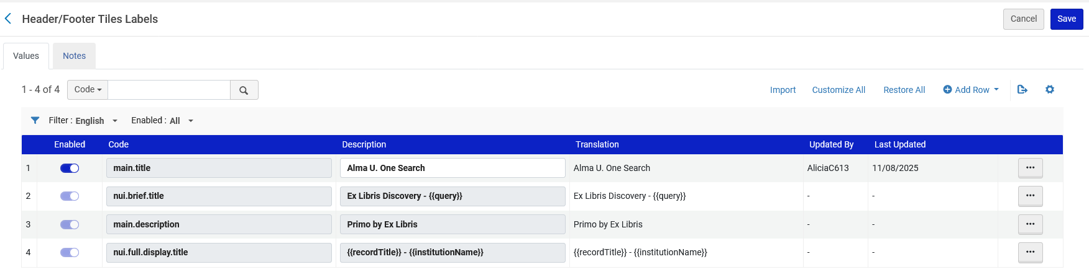
Updating Page Titles
Now we have changed the text from “Ex Libris Discovery” to “Alma U. One Search”

Slide 33
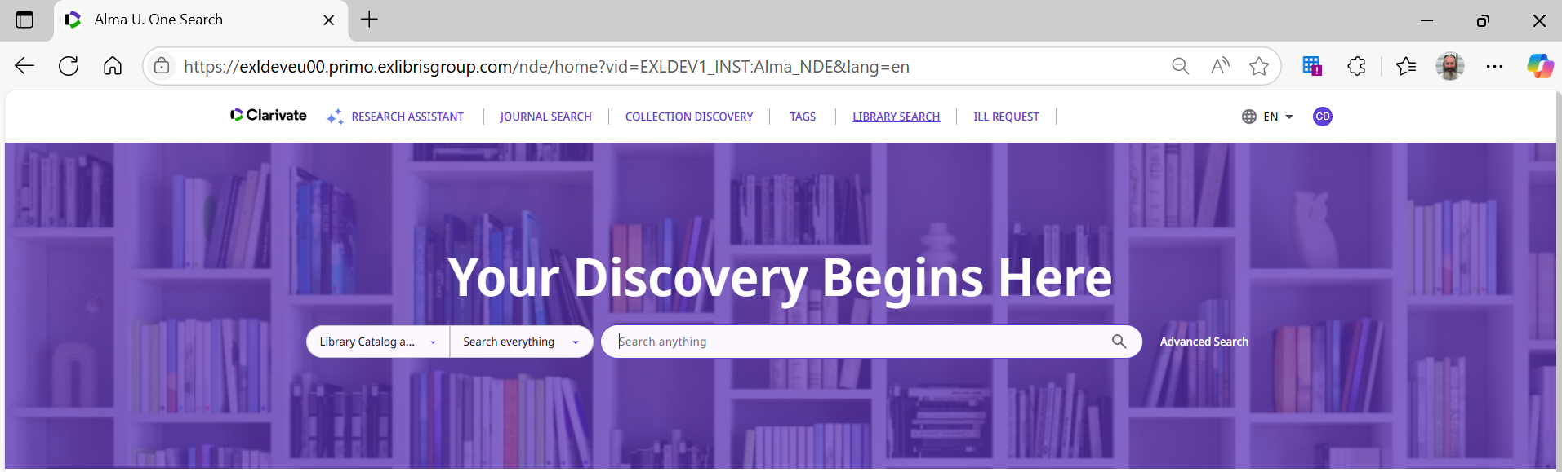
Updating Page Titles
We see the change in Primo VE NDE

Slide 34
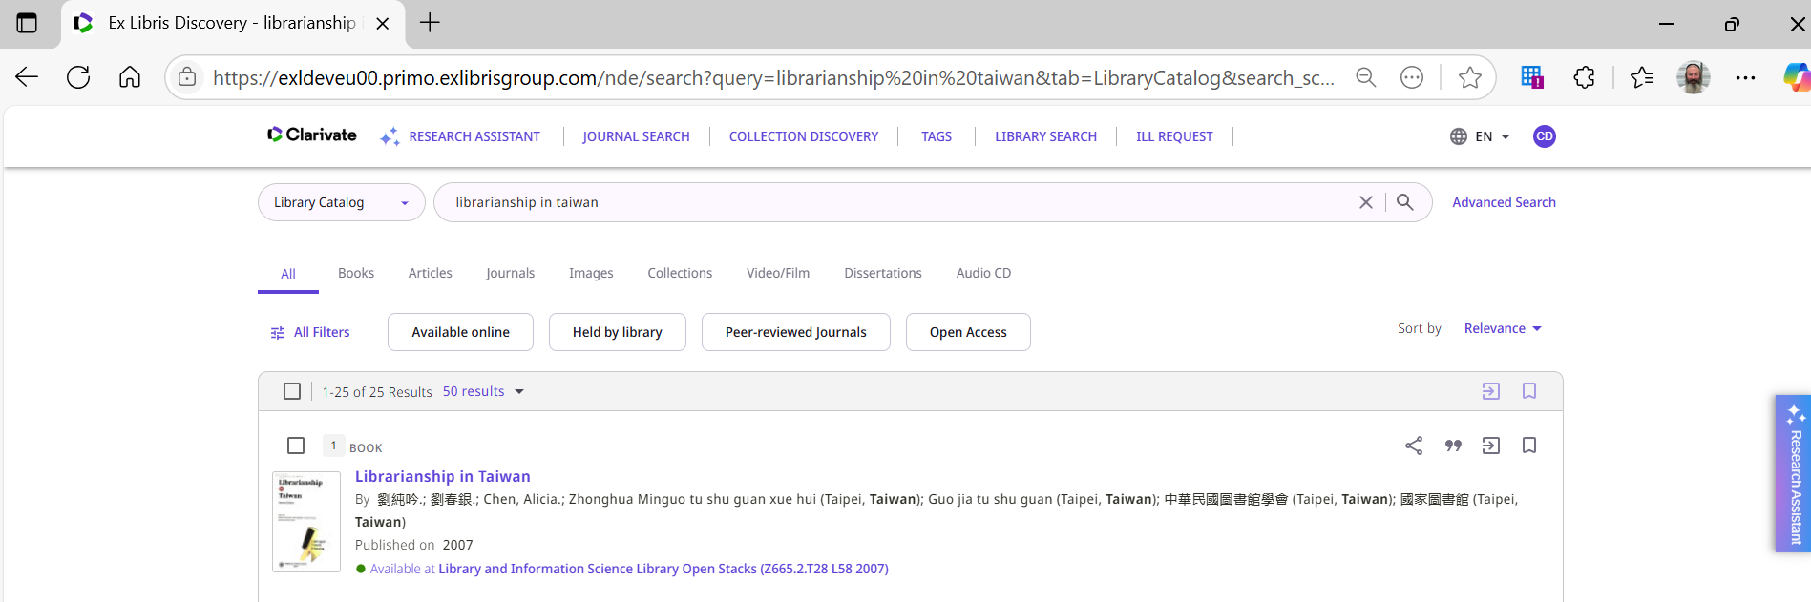
Updating Page Titles
If we search Primo VE NDE for “Librarianship in Taiwan” then the page title is “Ex Libris Discovery – librarianship in Taiwan”.

Slide 35
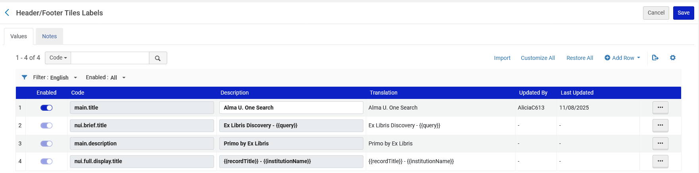
Updating Page Titles
The reason the page title is “Ex Libris Discovery – librarianship in Taiwan” is because of this line we have in the Header/Footer Tiles Labels code table

Slide 36
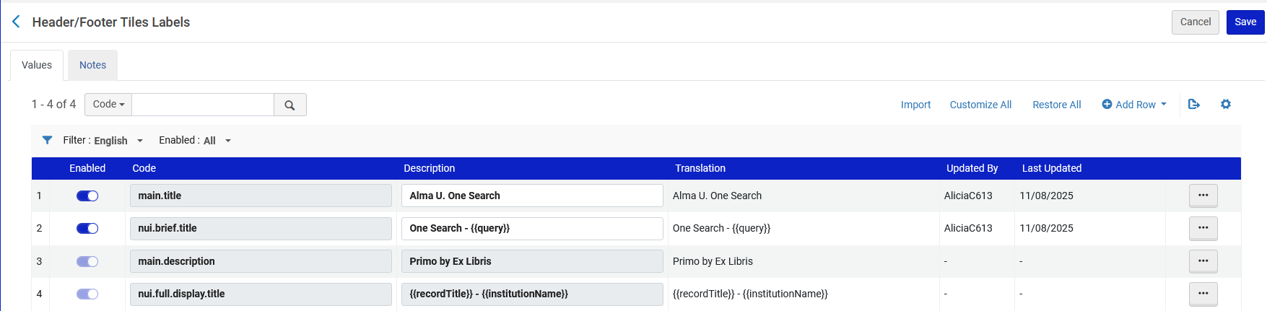
Updating Page Titles
Now we have changed the text from “Ex Libris Discovery - {{query}}” to “One Search - {{query}}”

Slide 37
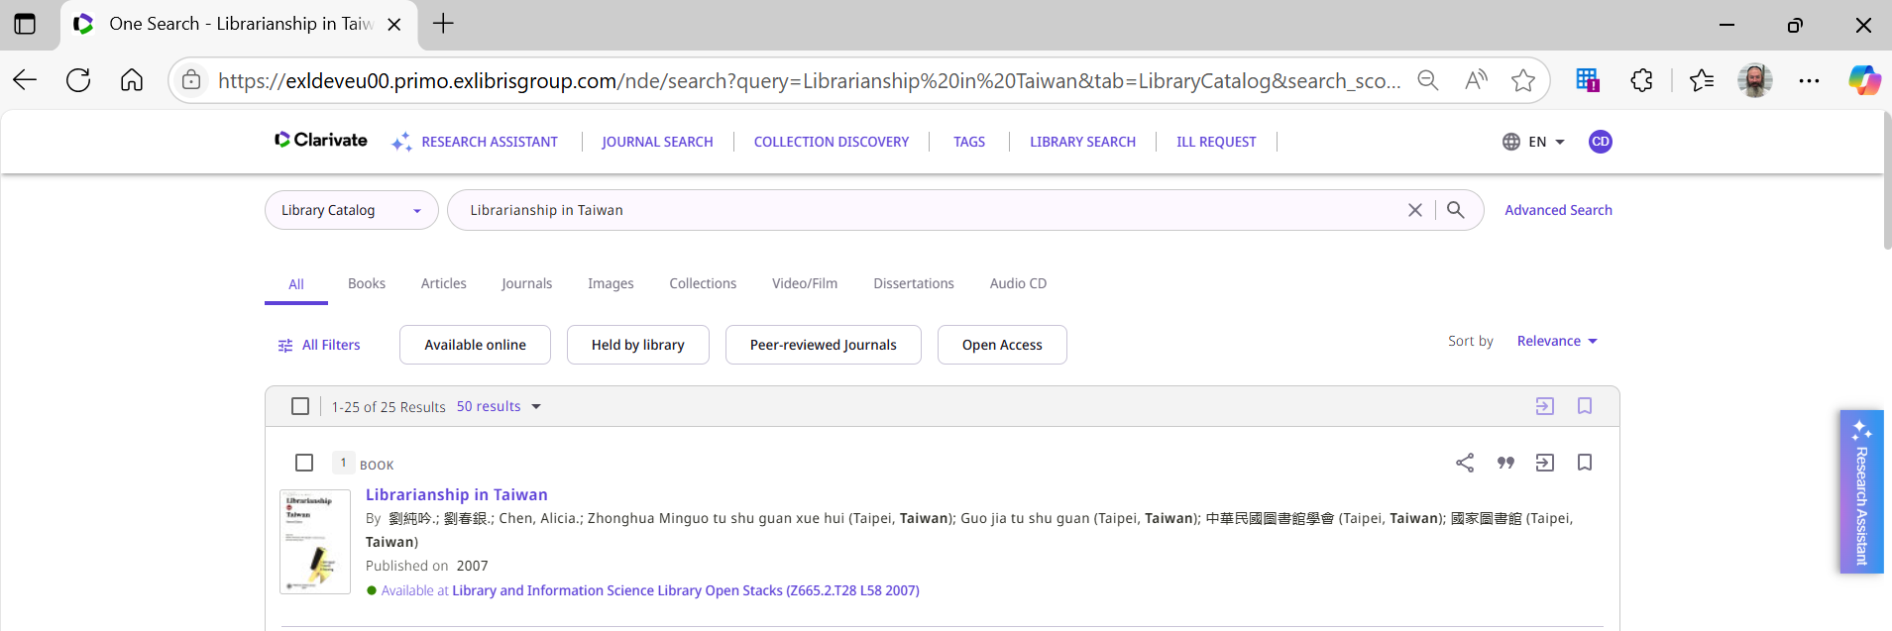
Updating Page Titles
We see the change in Primo VE NDE

Slide 38
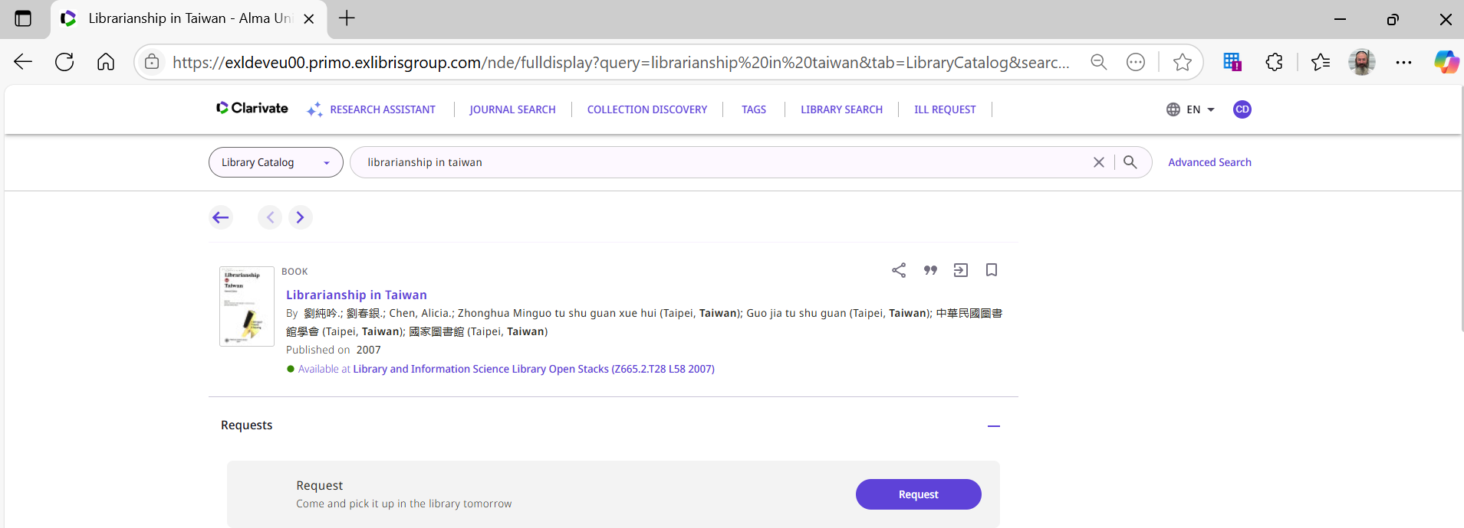
Updating Page Titles
If we click a search result title “Librarianship in Taiwan” to get to the full view, then the page title is “Librarianship in Taiwan – Alma University” (my institution name is ”Alma University”).

Slide 39

Updating Page Titles
The reason the page title is ““Librarianship in Taiwan – Alma University”” is because of this line we have in the Header/Footer Tiles Labels code table

Slide 40
Using the Customization Package Manager

Slide 41
Using the Customization Package Manager
The Manage Customization Package allows the institution to you upload and manage customization packages, enabling the branding and customization of Primo VE.
If no packages are loaded, the system uses the out-of-the-box configurations.

Slide 42
Using the Customization Package Manager
To access the Customization Package Manager:
  Access “Configure Views”
  Edit the View
  Select the “Manage Customization Package” tab
  Use the “Download Package” and “Upload Package” sections.

Slide 43
Using the Customization Package Manager
Access “Configure Views”

Slide 44
Using the Customization Package Manager
Edit the View

Slide 45
Using the Customization Package Manager
Select the “Manage Customization Package” tab
Use the “Download Package” and “Upload Package” sections.

Slide 46
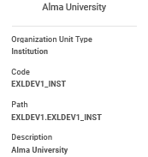
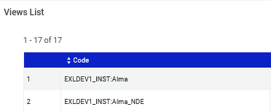
Using the Customization Package Manager
The Customization Package must be named as follows (and it will automatically get this name structure when downloaded): <institution_code>-<view_code>
In our example the institution code is EXLDEV1_INST and the view code is Alma_NDE
Therefore, the package is named EXLDEV1_INST-Alma_NDE.zip

Slide 47

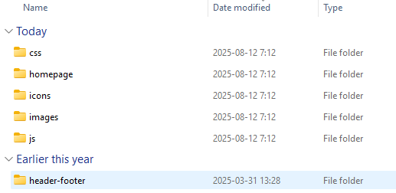
Using the Customization Package Manager
The Customization Package must contain a folder with the name of the package and then the following subfolders under EXLDEV1_INST-Alma_NDE\assets
These folders are described at Understanding the File Structure of a Customization Package

Slide 48
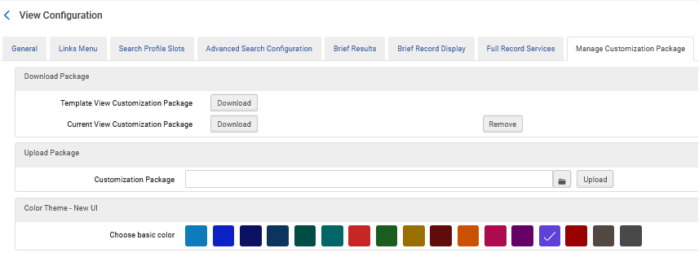
Using the Customization Package Manager
To create a customization package, click the “Download” button next to either “Template View Customization Package” or “Current View Customization Package”.
If this is the first time using the customization package, download the template package in the Download Package section. Otherwise, download the current package to ensure you use the latest version.
We will click “Download” next to “Template View Customization Package”

Slide 49

Using the Customization Package Manager
After clicking “Download” next to “Template View Customization Package” file “template_package.zip” has been downloaded
We will unzip the file

Slide 50
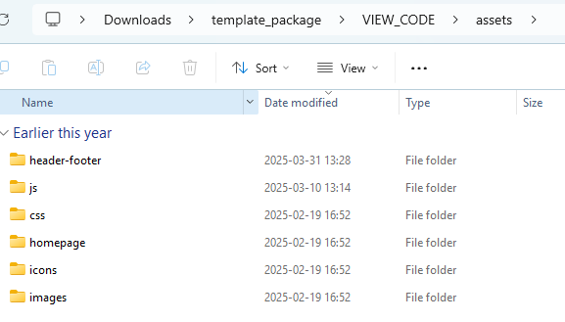
Using the Customization Package Manager
Under “template_package/VIEW_CODE/assets” we have the previously-mentioned six folders

Slide 51
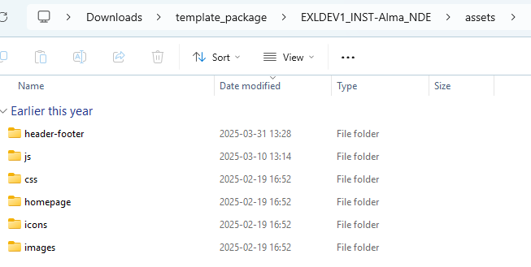
Using the Customization Package Manager
We have renamed the VIEW_CODE to the previously-mentioned correct format
We can now make changes to the folders, zip the package and reload it to Alma.

Slide 52
Specific examples using the Customization Package Manager

Slide 53
Specific examples using the Customization Package Manager
See Specific examples using the Primo VE NDE Customization Package Manager
For example:
  How to use the Primo VE NDE Customization Package to customize the library logo
  How to use the Primo VE NDE Customization Package to customize a color theme
  How to use the Primo VE NDE Customization Package to add headers and footers
  How to use the Primo VE NDE Customization Package to change the Homepage

Slide 54
Thank You

