Slide 1
Introduction to eForms
Workshop on eForms for reusers of TED data
27 September 2022
Karl Ferrand – TED unit – Publications Office of the EU

Slide 2
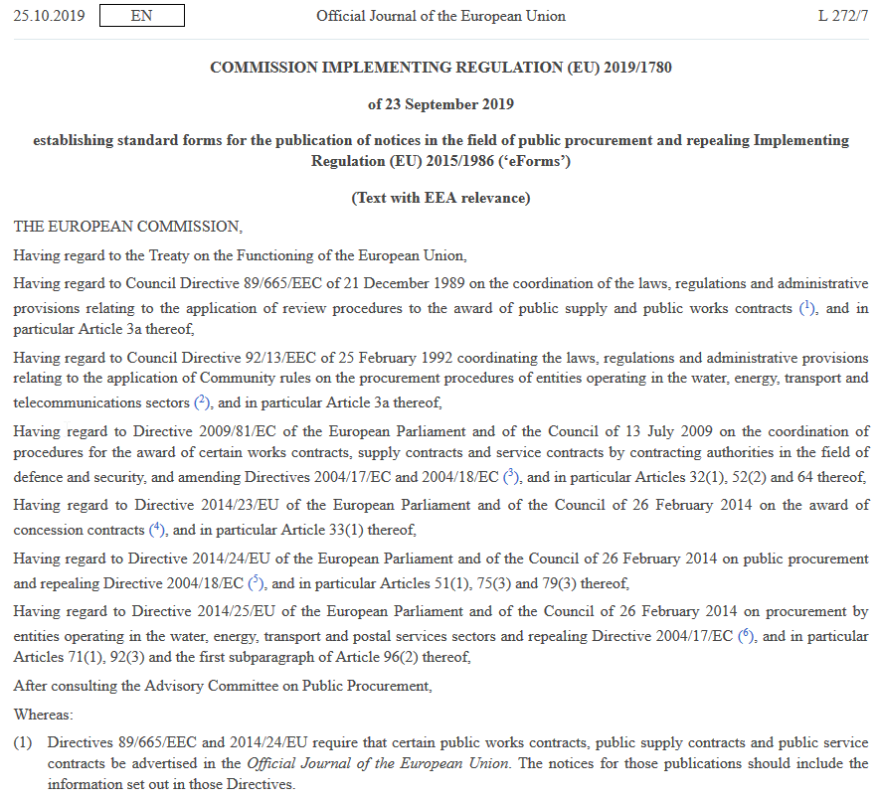
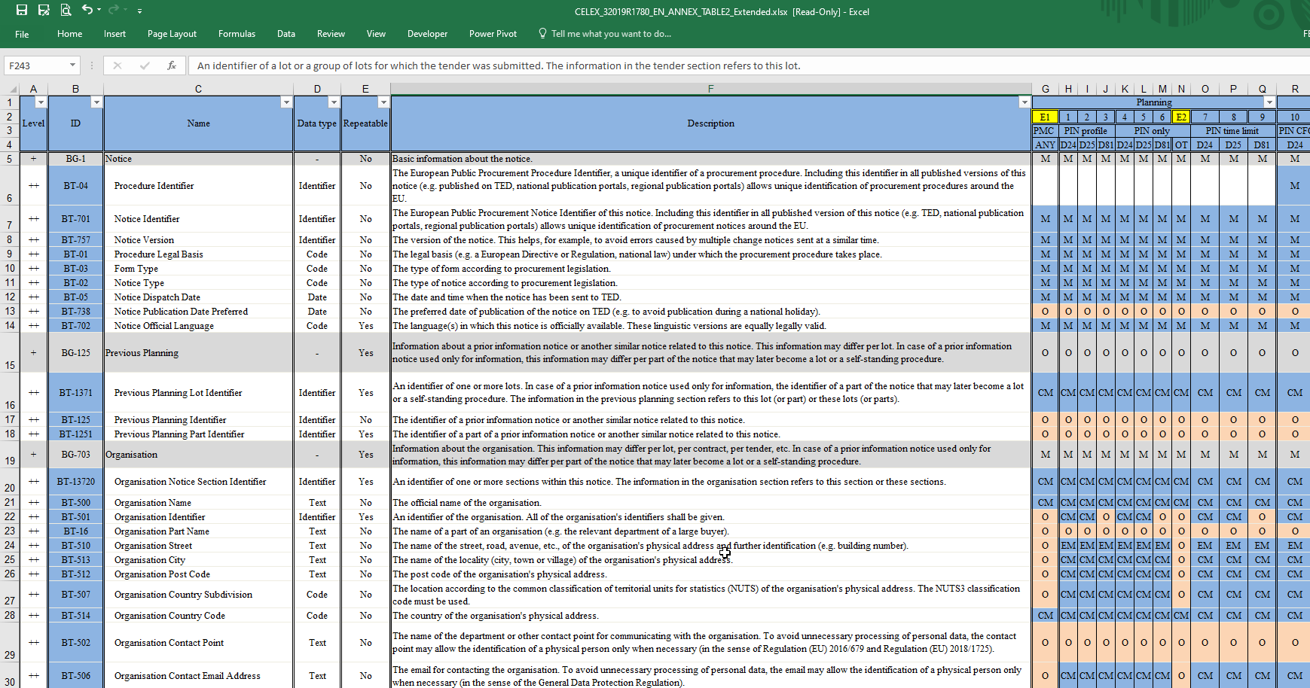
Why eForms?
Data-centered
More accurate information
Predefined lists of values
Well-established format of data
Possibility to collect information on many political priorities:
data on green, social and innovative procurement
More universal: use of an open standard for the eForms schema -> UBL (Universal Business Language)
eProcurement Ontology
https://single-market-economy.ec.europa.eu/single-market/public-procurement/digital-procurement/eforms_en

Slide 3
eForms timeline
23 September 2019: implementing regulation
Transition period: both formats allowed
14 November 2022: first eForms possible
25 October 2023: end of current TED-XML
Impact on Publications Office systems
New applications for reception, validation, processing, viewing, APIs
Current TED adapted for eForms
Summer 2023: TED 2.0

Slide 4
Future TED systems at EU Publications Office
Buyers
eNotices2
Internal
processing
(TED Monitor2022)
TED
Suppliers/users/reusers
eSenders
TED
Viewer2022
Central
Validation
Service
Software
Development
Kit
Developer portal
Reception
Production
Dissemination

Slide 5
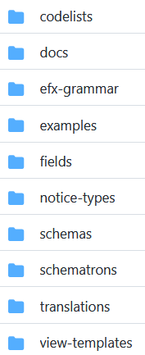
TED Docs and Software Development Kit
SDK: collection of resources, models and schemas for building eForms applications
https://github.com/OP-TED/eForms-SDK
Docs: FAQs, preview environment and documentation for each SDK version
https://docs.ted.europa.eu
XLST to convert TED-XML to eForms schema
https://github.com/OP-TED/ted-xml-data-converter

Slide 6
Next steps and issues
2022 update to eForms regulation – new business terms
Progressive move from current forms to eForms by eSenders and buyers
eForms in TED and API – new XML schema
Metadata-driven applications – adapt to SDK changes (schema etc.)
Semantic web service using eProcurement Ontology

Slide 7
Thank you for your Attention Any questions?
ted@publications.europa.eu

