Slide 1
eForms in TED portal
Workshop on eForms for reusers of TED data
27 September 2022
Carmelo Greco – TED unit – Publications Office of the EU

Slide 2
Agenda
Timeline – overview
TED portal adapted to support eForms – overview
Demo

Slide 3
Time line - overview
The preparation for the deployment in production is on-going
Expected date for going live: before the end of October 2022, but no later than 14/11/2022
Today
Prepare production environment
Go-live
TED Portal plus eForms
TED publishes only
current standard forms notices
TED publishes both
current standard forms and eForms
notices
Expected date for go-live:
before end of October 2022.
27/09/2022
14 November 2022

Slide 4
TED portal adapted to support eForms
TED users will be able to:
visualise and download both current standard forms and eForms notices in different formats (html, PDF, XML) and in different languages
eForms notices will be displayed via the TED Viewer 2022, while TED schema notices will be displayed via the current TED Viewer
Sections will differ between current standard forms and eForms notices
The ‘Data’ tab will not be available for eForms notices
eForms notices will have a detailed table of contents
search in both current standard forms and eForms notices
get automatic translation both for current standard forms and eForms notices (eTranslation service)

Slide 5
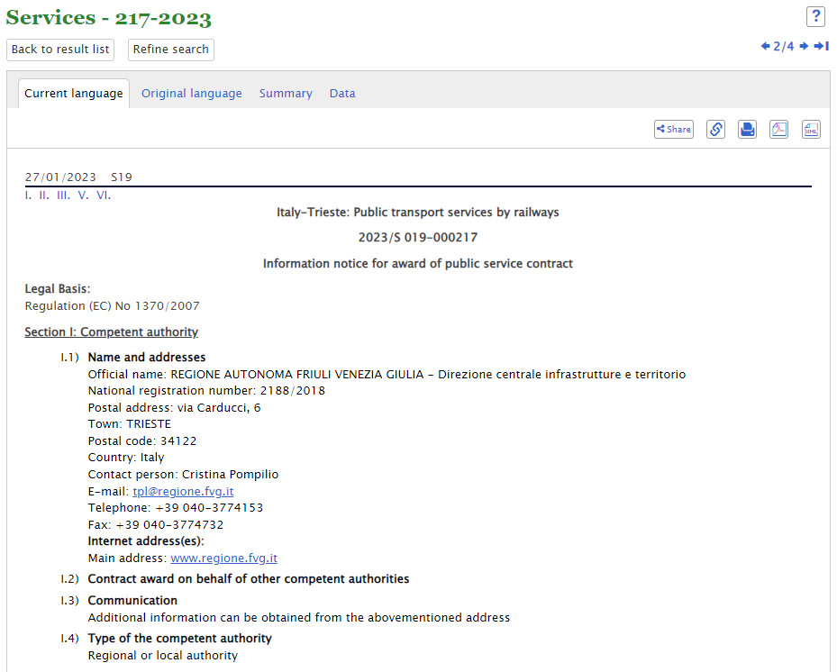
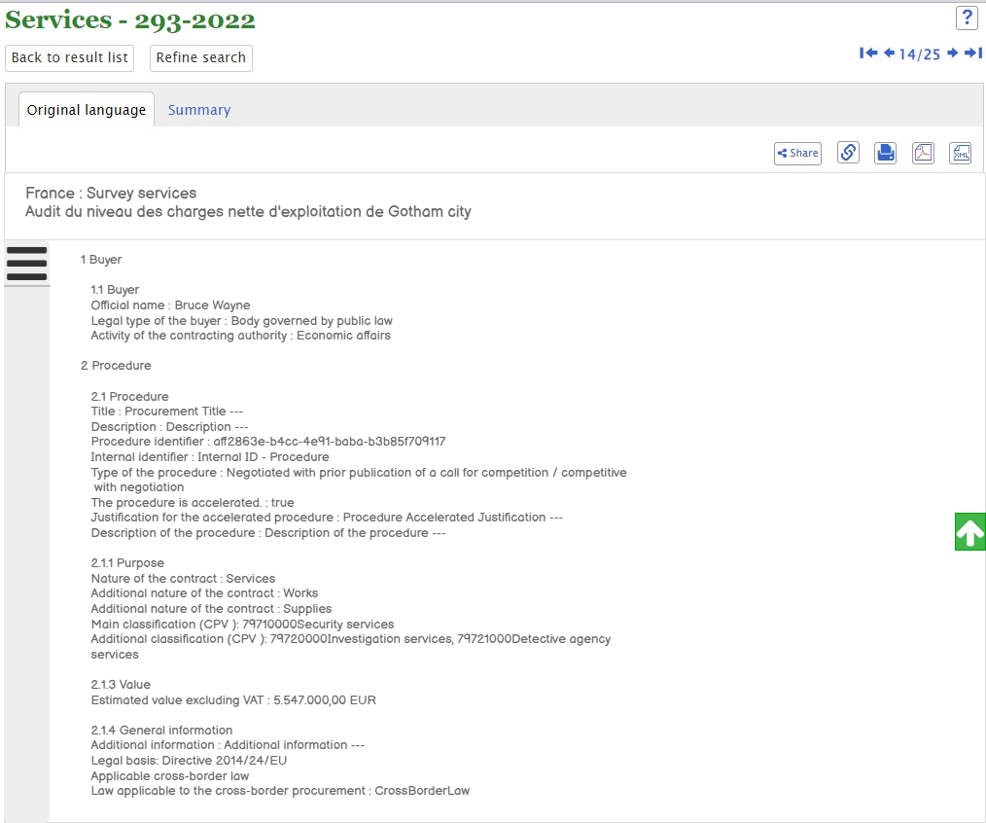
Visualisation of notices
Current standard notice
eForms notice

Slide 6
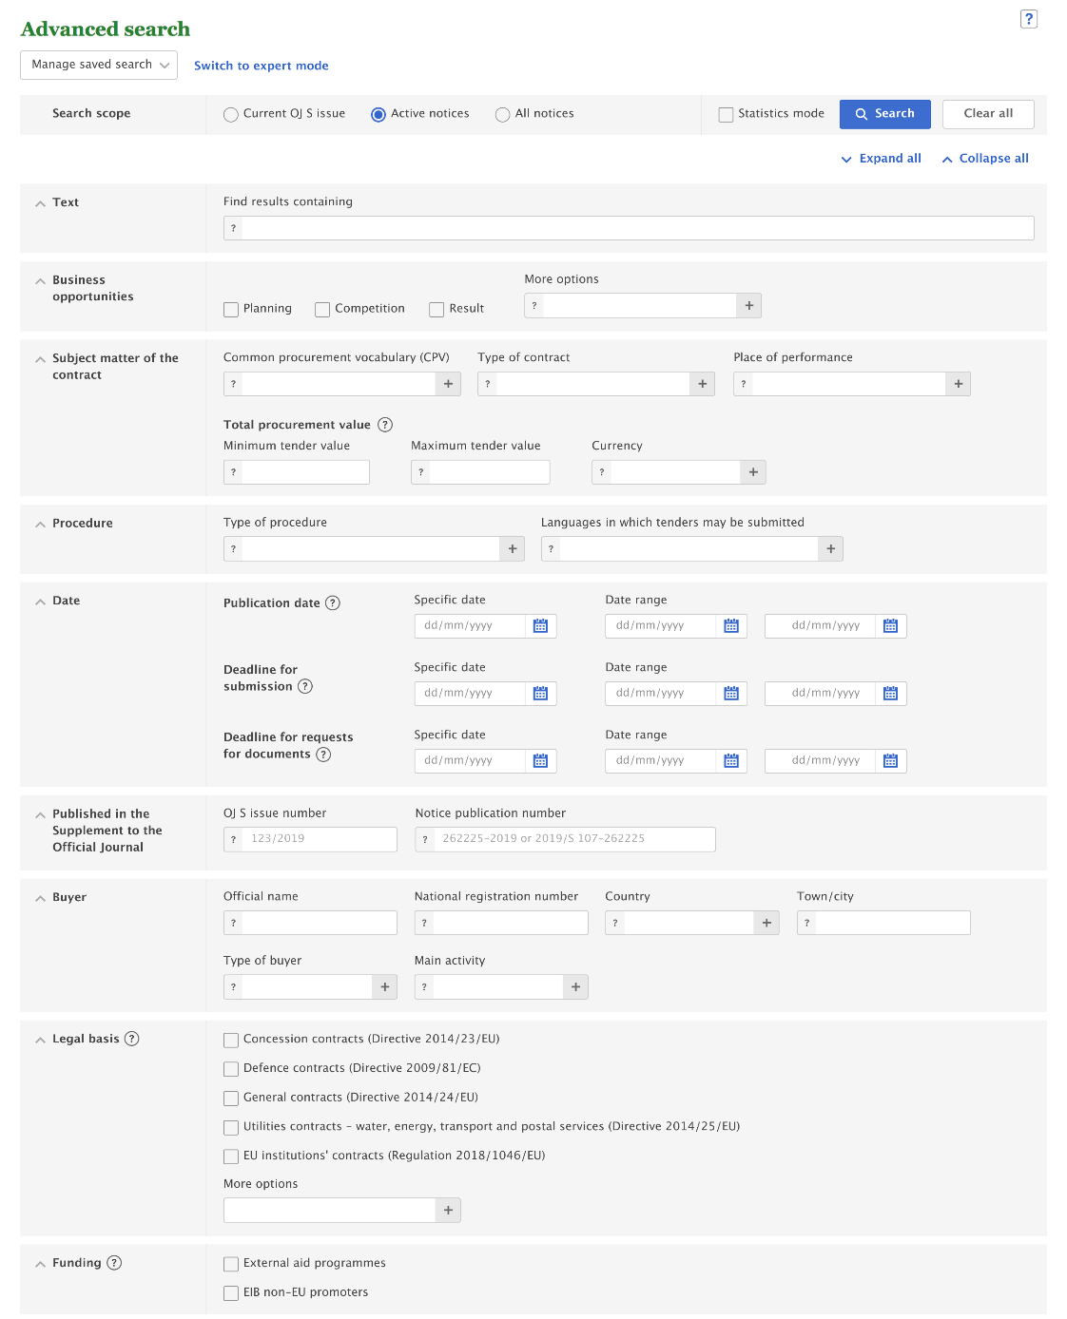
Changes in the advanced search
By default, search will be limited to the current search fields
Search codes will be based on the authority tables used for eForms (e.g. notice type, legal basis, buyer legal type, etc.)
eForms values will be added in appropriate fields
For Business opportunities, the search field “notice type” will be used instead of the field “document type”. Values will be those of the authority table notice-type on GitHub eForms-SDK.
‘Country’ and ‘Languages in which tenders may be submitted’: use of 3-letter code instead of 2-letter code
Place of performance values displayed in a new tree
Type of buyer tree enhanced with eForms values and list of international organisations
New “Funding” section to search for “External aid programmes” and “EIB non-EU promoters”
Saved advanced searches will be migrated

Slide 7
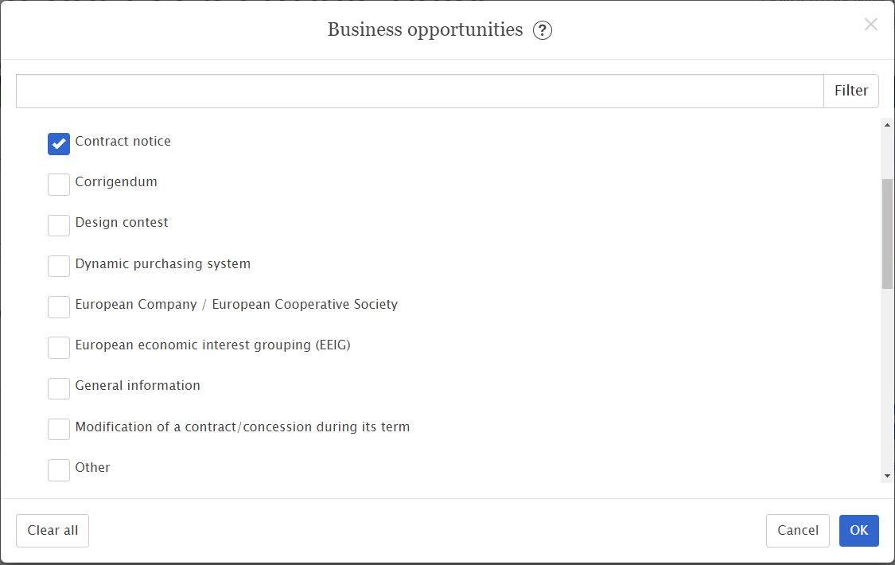
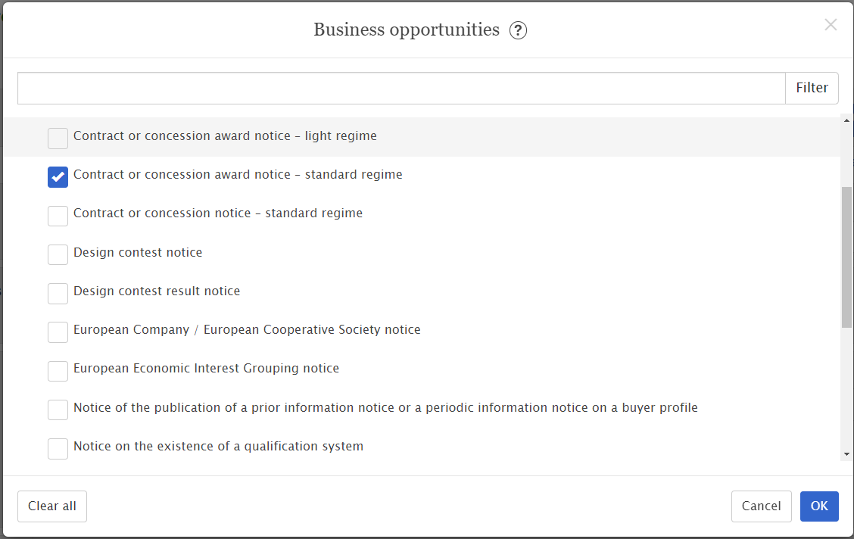
Advanced search – Business opportunities
Current
Expert query example: TED=[3]
Future
Expert query example: notice-type=[can-standard]

Slide 8
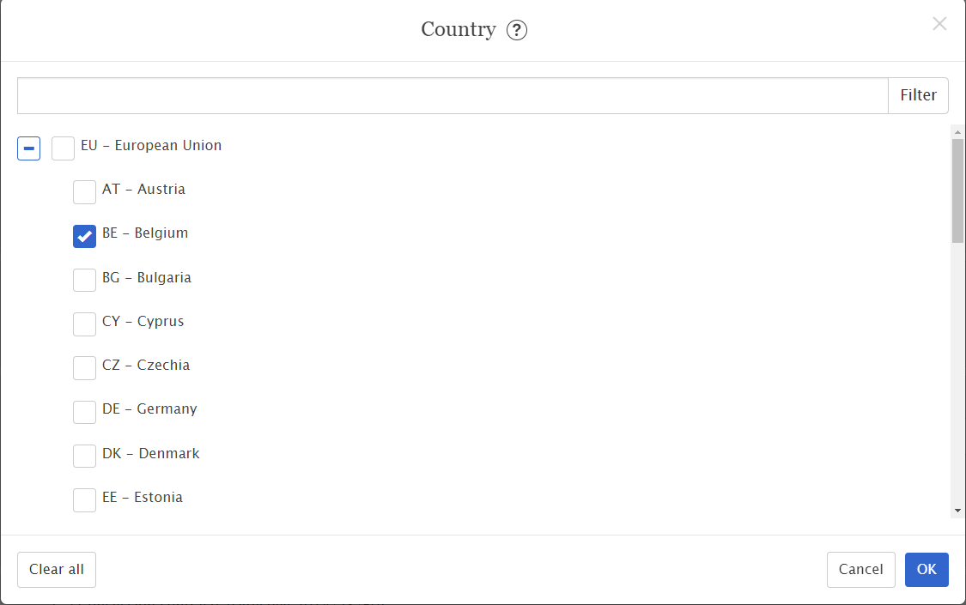
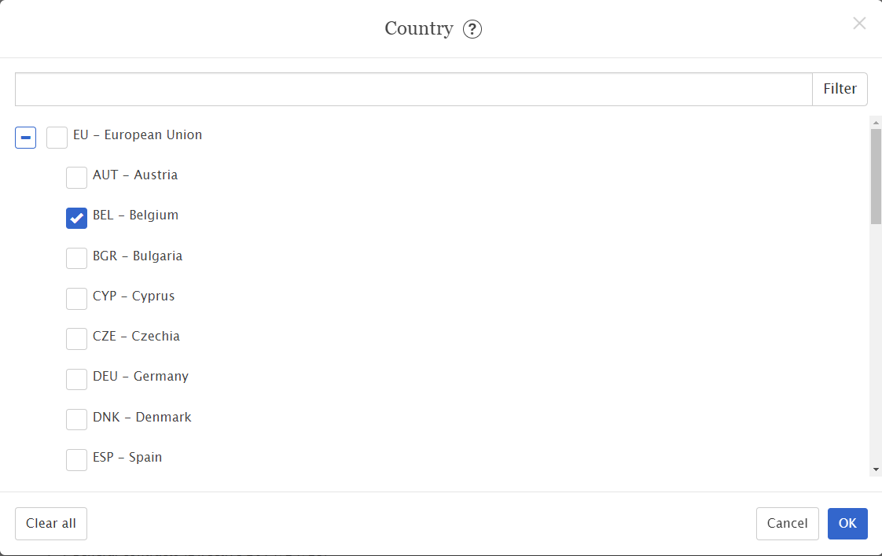
Advanced search – Country
Current
Expert query example: CY=[BE]
Future
Expert query example: CY=[BEL]

Slide 9
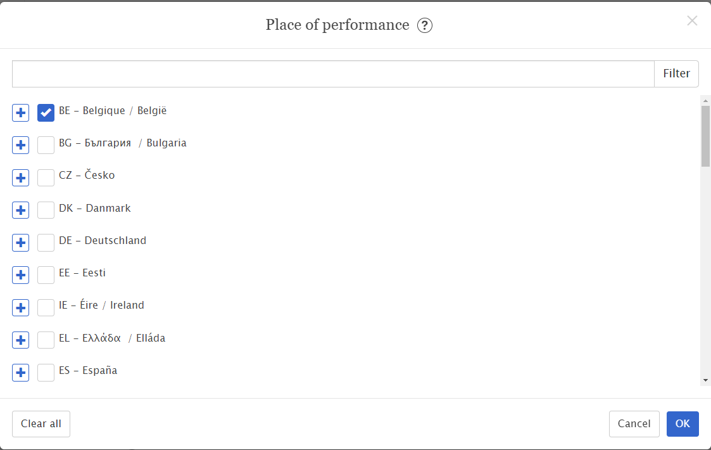
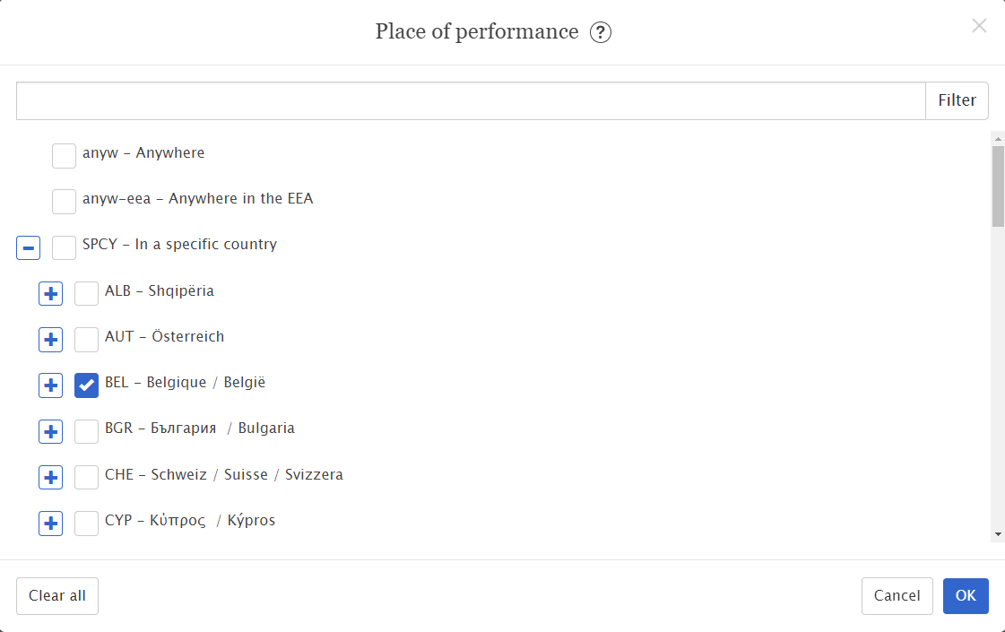
Advanced search – Place of performance
Current
Expert query example: RC=[BE]
Future
Expert query example: RC=[BEL]

Slide 10
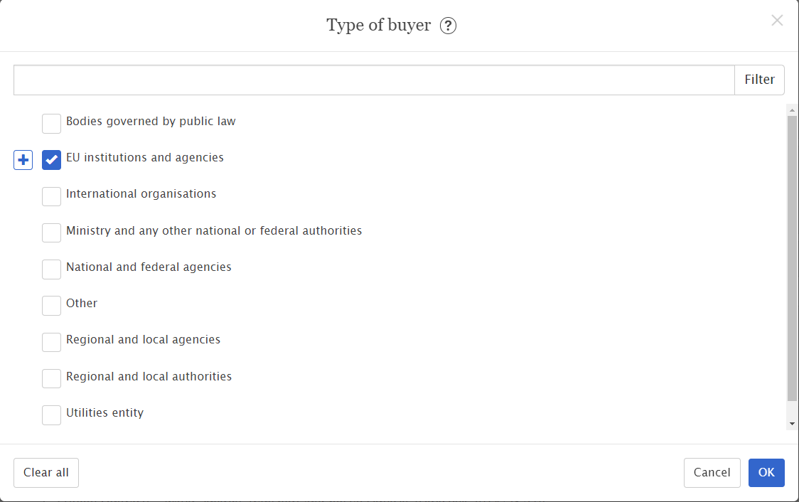
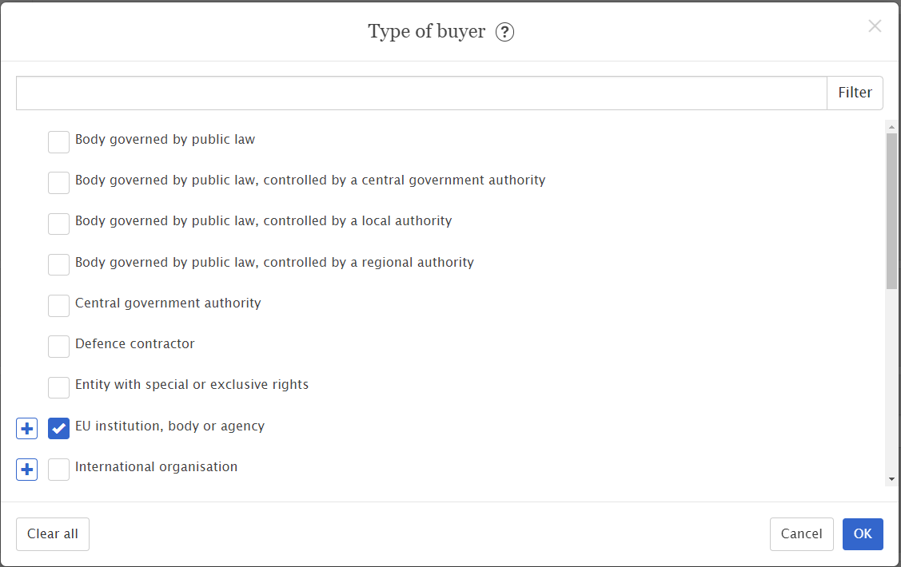
Advanced search – Type of buyer
Current
Expert query example: (HA=[BR or OP or CA or BI or EA or EC or ES or CR or BC or CL or PA or AG or AP or CJ or OB or FI])
Future
Expert query example: (AA=[eu-ins-bod-ag] OR HA=[AG] OR corporate-body=[CONSIL or EURSCHOOL or COR or OMB or EEAS or EDPS or COM or EPSO or EESC or CERT or EIF or ECHR or PUBL or EP or ECB or EIB or ECA or CURIA or FUSEN or EIT or EASO or SESAR or CFCA or EBA or EIOPA or ESMA or LISA or CDT or EASME or CEDEFOP or INEA or CPVO or SRB or OSHA or EPPO or ECDC or FCH or ECHA or CHAFEA or EDA or SKY or EFSA or IMI or EGSA or ECSEL or EUROFOUND or BBI or EIGE or S2R or EMSA or OAMI or EEA or CEPOL or EMEA or ERA or EMCDDA or FRONTEX or ETF or EUROPOL or FRA or EUROHPC or EUISS or EASA or EUSC or BEREC_OFFICE or EACEA or ACER or ERC or ENISA or REA or ELA or EURATOM or EUROJUST])

Slide 11
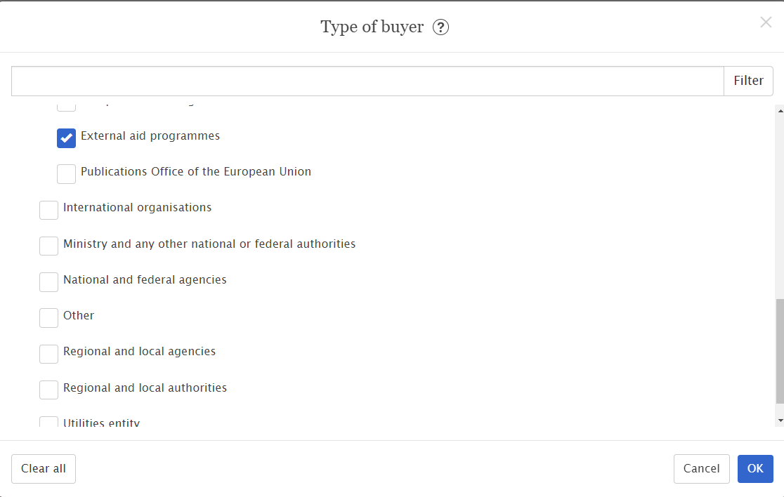
Advanced search – Funding
Current
External aid program: HA=[AP]
EIB non-EU promoters: there is no query available
Future
External aid program: funding=[external-aid-program]
EIB non-EU promoters: funding=[eib-non-eu-promoter]

Slide 12
Expert search
All current expert search fields will still be usable -> saved user queries will be maintained
Some codes will allow to find current standard form notices only:
TD (Type of document); AC (Award criteria); TY (Type of Bid); RP (Regulation); HA (Heading A / European Institutions); RN(document backward reference)
Some codes will allow to find eForms notices only:
award-criterion-type; notice-identifier; notice-version
Some new search fields will be used to find both standard form notices and eForms notices:
notice-type; corporate-body; funding

Slide 13
Browse by subject
Adapted to include both current standard forms and eForms notices

Slide 14
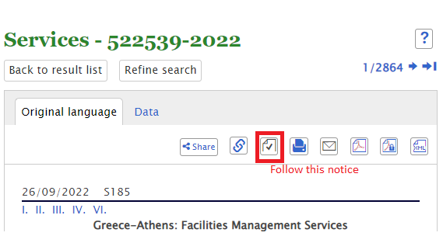
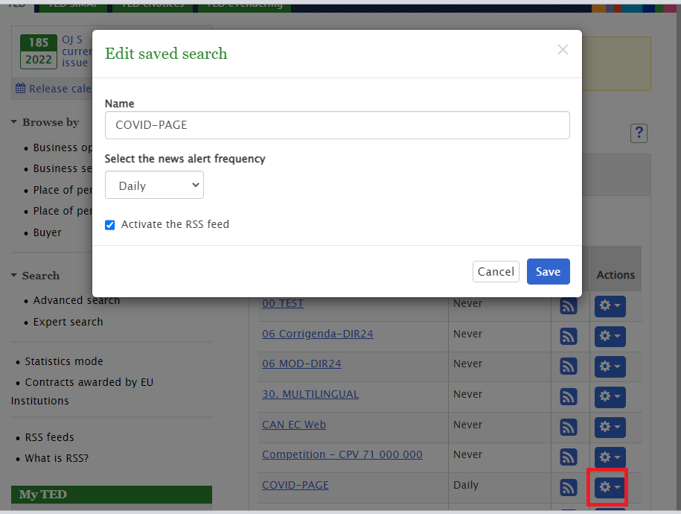
Notifications
The options to notify the users will still be available in both current standard forms and eForms notices
Option - Follow this notice:
This option sends a notification alert email to the user’s email address informing the user about any updates of the notice when notices related to this one are published.
Option – Search alert:
The user receives, at the defined periodicity an e-mail containing the 10 most recent notices that result from a specified saved search.

Slide 15
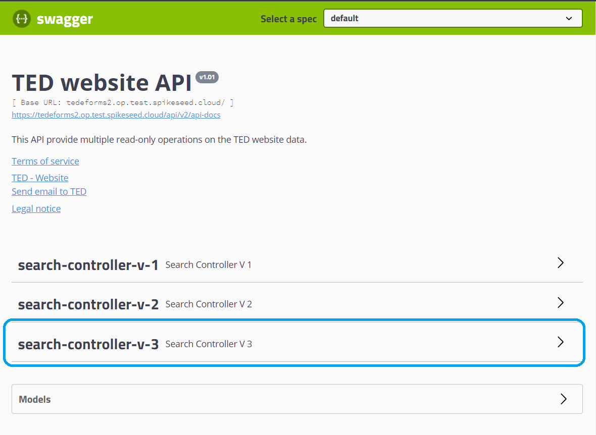
TED website API
A new version (v3) of the TED website API will replace the version v2 which will be discontinued.
The search controller (v3) will provide the operations to search and retrieve both TED Standard forms notices and eForms notices.

Slide 16
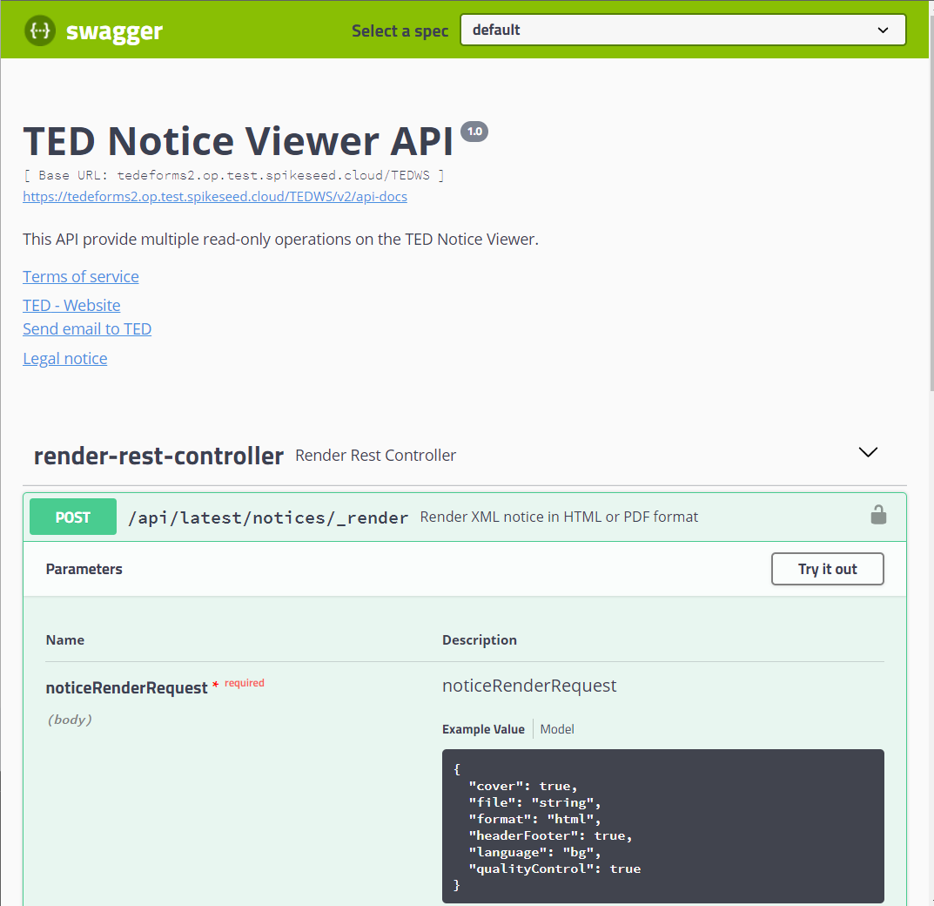
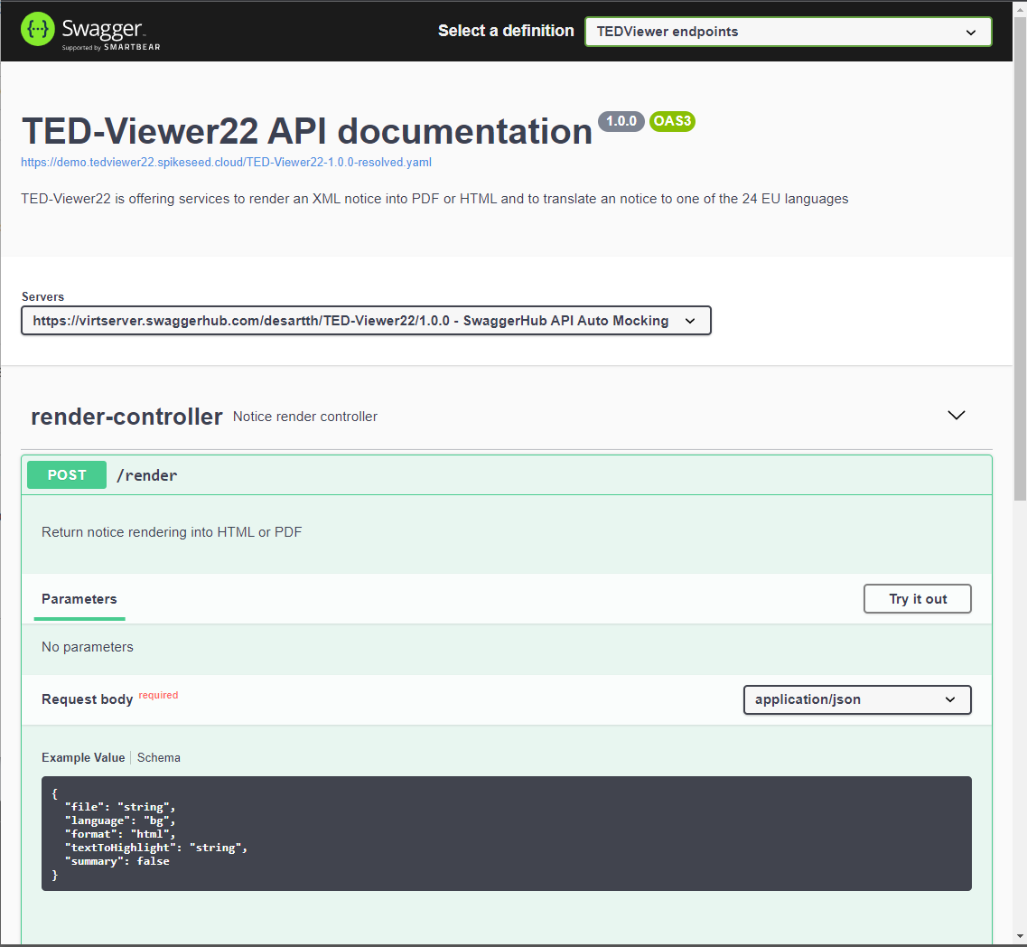
TED viewer – 2 API’s
TED Notice Viewer API will still provide operations to only render TED schema notices in various formats
TED Notice Viewer 2022 API will provide operations to only render eForms notices in various formats

Slide 17
Demo …

Slide 18
Any questions?
Please ask your question in the chat

