Slide 1
Retrieving notices from
TED portal
Workshop on eForms for reusers of TED data
18 October 2023
Carmelo Greco – TED and EU public procurement
Publications Office of the EU

Slide 2
Agenda
Download xml notices in bulk from the TED portal.
Download notices in any format using direct links.
Search API.
Demo.

Slide 3
Download xml notices in bulk. (1/5)
The user can download xml notices in bulk from the TED portal.
daily package: file containing all the notices in xml format for each day.
monthly packages: file containing all the notices in xml format for each month.
The FTP server is not available in the new TED portal.
The daily and monthly packages can be downloaded using HTTPS.
The user can download the packages using the user interface or using a direct link.
No need to sign in to download the daily or monthly packages.

Slide 4
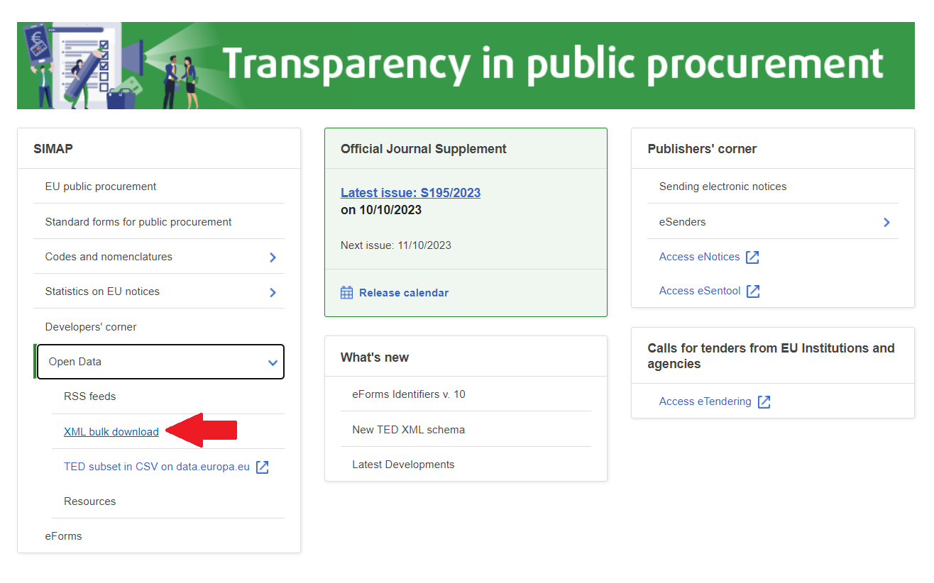
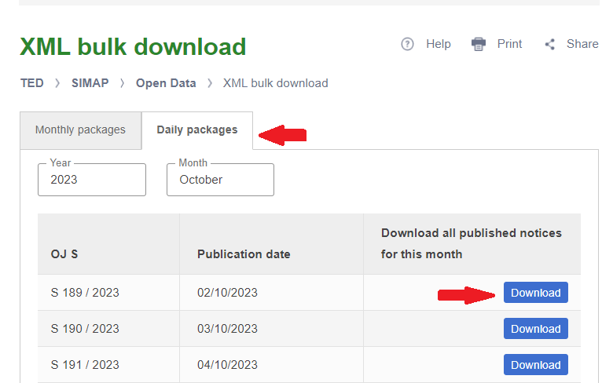
Download XML notices in bulk. (2/5)
Download package via user interface
From the Home page:
expand ‘Open Data’ from the menu SIMAP
click ‘XML bulk download’ to access the ‘XML bulk download’ page
From ‘XML bulk download’ page:
select the tab ‘Daily packages’ or ‘Monthly packages’
select the year and the month
navigate to the page to select the package
click Download button to download the package

Slide 5
Download XML notices in bulk. (3/5)
Download packages using a direct link
URL format for daily packages:
https://{ted-url}/packages/notice/daily/{yyyynnnnn}
where {yyyynnnnn} is the OJ S number
Example - Download the daily package of the OJ S 1 / 2023
https://gamma.tedv2.spikeseed.cloud/packages/daily/202300001
URL format for monthly packages:
https://{ted-url}/packages/notice/monthly/{yyyy-n}
where {yyyy-n} is the year and the month
Example - Download the monthly package of January 2023
https://gamma.tedv2.spikeseed.cloud/packages/monthly/2023-1

Slide 6
Download XML notices in bulk. (4/5)
File format of a daily package:
{yyyymmdd}_{yyyynnn}.tar.gz
Where {yyyymmdd} is the OJ S publication date and {yyyynnn} is the OJ S number
Example: daily package of the OJ S 1 / 2023
20230102_2023001.tar.gz
File format of a monthly packages:
{yyyy}_{mm}.tar.gz
Where {yyyy} is the year and {mm} is the month
Example: monthly package of January 2023
2023_01.tar.gz

Slide 7
Download XML notices in bulk. (5/5)
The XML packages contain XML files numbered in two ways:
for eForms notices the XML files have 8 digits followed by the year (e.g. 00654321_2022.xml)
for TED schema notices the XML files have 6 digits followed by the year (e.g. 123456_2022.xml)

Slide 8
Download notices in any format using direct links (1/4)
A user can download a notice using direct link in the formats listed below and in any EU official languages:
HTML
HTML download
Signed PDF
Non-signed PDF
XML
The format HTML download is a new feature compared to the current TED website.
Thanks to this , there is no need for an API on the TED portal to render a notice.
There will be only one API that can be used to render the eForms notices in PDF or HTML
Swagger UI link : https://viewer.ted.europa.eu/swagger-ui/index.html
For more information read on https://docs.ted.europa.eu/api/index.html

Slide 9
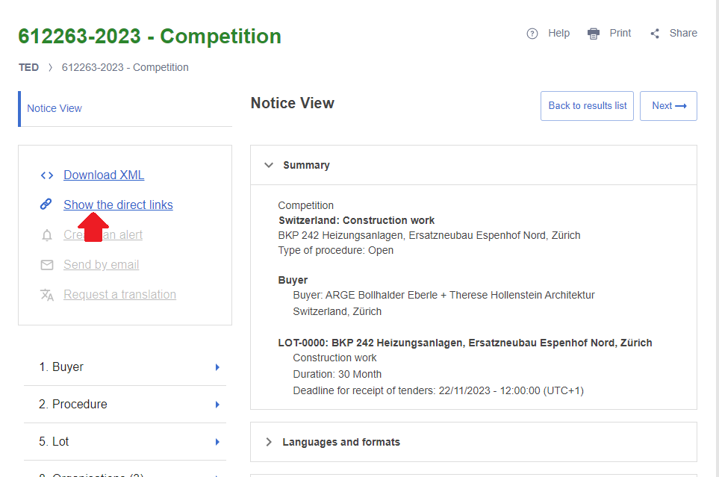
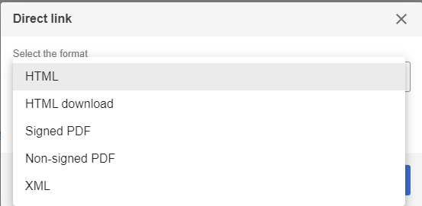
Download notices in any format using direct links (2/4)
A user can download a notice in xml, HTML or PDF format and in any EU official languages using direct link
From any notice view page:
click ‘Show the direct link’
A pop-up window lists the available formats of the direct links:
HTML
HTML download
Signed PDF
Non-signed PDF
XML
Note:
The 'Signed PDF' link is only displayed when the user interface is set to the official language of the notice

Slide 10
Download notices in any format using direct links (3/4)
Format of the URLs of the direct link:
https://{ted-url}/{lang}/notice/{publication-number}/{format}
where:
{lang} is the language
{publication-number} is the publication number
{format} can be :
html: to display the HTML download file
pdf: to download the notice as PDF
pdfs: to download the notice as signed PDF
xml: to download the notice as XML.
Direct link of the notice view page: https://{ted-url}/{lang}/notice/-/detail/{publication-number}
Backward compatibility with the current TED:
Example :
https://gamma.tedv2.spikeseed.cloud/udl?uri=TED:NOTICE:735065-2022:TEXT:EN:HTML
https://gamma.tedv2.spikeseed.cloud/en/notice/-/detail/735065-2022

Slide 11
Download notices in any format using direct links (4/4)
Example of direct link - Notice 564613-2023
HTML:
EN: https://gamma.tedv2.spikeseed.cloud/en/notice/-/detail/564613-2023
FR: https://gamma.tedv2.spikeseed.cloud/fr/notice/-/detail/564613-2023
HTML download:
EN: https://gamma.tedv2.spikeseed.cloud/en/notice/564613-2023/html
FR: https://gamma.tedv2.spikeseed.cloud/fr/notice/564613-2023/html
Non-signed PDF
EN: https://gamma.tedv2.spikeseed.cloud/en/notice/564613-2023/pdf
FR: https://gamma.tedv2.spikeseed.cloud/fr/notice/564613-2023/pdf
Signed PDF
https://gamma.tedv2.spikeseed.cloud/en/notice/564613-2023/pdfs

Slide 12
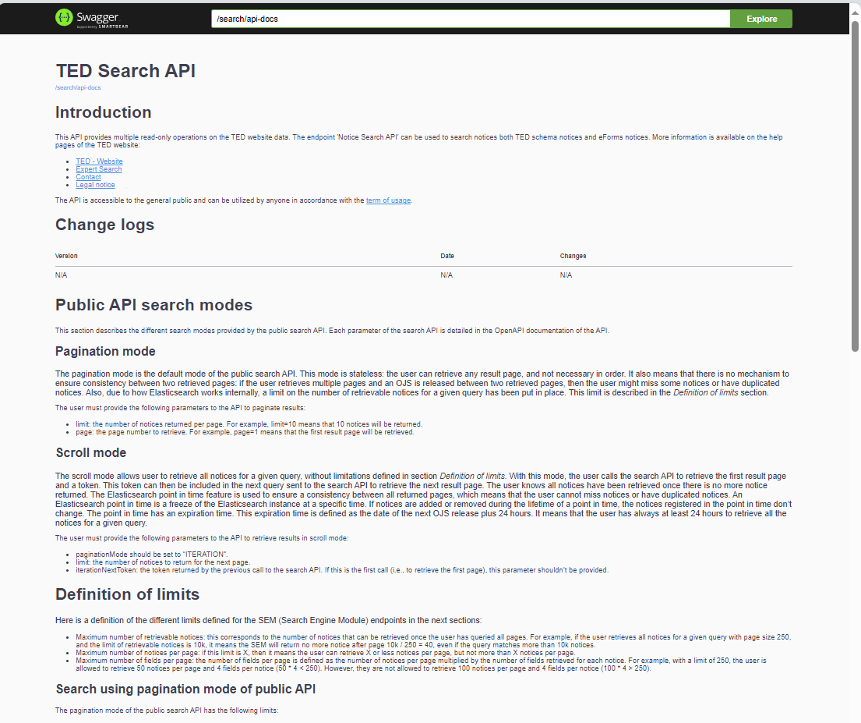
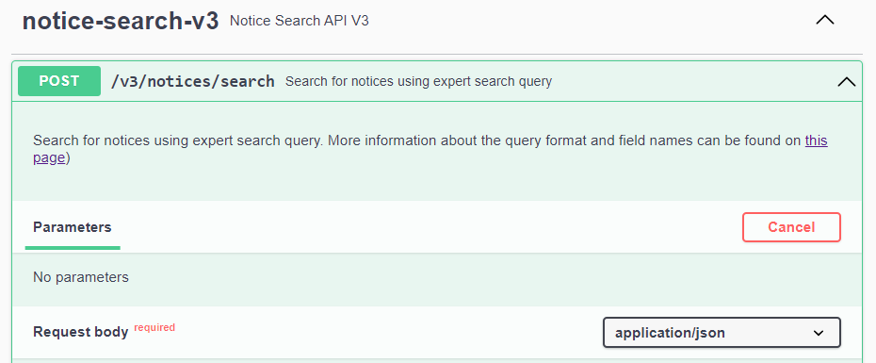
Search API (1/7)
Swagger UI - https://api.gamma.tedv2.spikeseed.cloud/swagger-ui/index.html
Request URL - https://api.gamma.tedv2.spikeseed.cloud/v3/notices/search

Slide 13
Search API (2/7)
The new search API is non-backward compatible
Two search modes:
Pagination mode: allows to retrieve up to 15000 notices for a given query, using pagination.
Iteration (scroll mode): allows to retrieve more notices
Response file:
Contains the total number of notices that match the search, and a list of results.
Each result contains the fields indicated in the request.
Each item contains the list of URLs for the various formats and languages in which the corresponding notice is available.

Slide 14
Search API (3/7)
Search mode – Pagination
Allows to retrieve up to 15000 notices for a given query, using pagination.
Limits:
Maximum number of retrievable notices: 15k.
Maximum number of notices per page: 250.
Maximum number of fields per page: 10k.
In case a limit is reached, the search API will return an error to the user

Slide 15
Search API (4/7)
Search mode – Iteration (scroll mode)
Allows to retrieve all notices for a given query, without limitations. With this mode, the user calls the search API to retrieve the first result page and a token. This token can then be included in the next query sent to the search API to retrieve the next result page.
Limits:
Maximum number of notices per page: 250.
Maximum number of fields per page: 10k.
In case a limit is reached, the search API will return an error to the user. There is no limit on the number of retrievable notices

Slide 16
Search API (5/7)
Request body of the notice search endpoint
query: Expert search query to filter and sort notices
fields: Fields to return for each notice
page: Result page number, used to paginate results
limit: Maximum number of returned notices, used to paginate results.
scope: Search scope
checkQuerySyntax: To check the syntax of the query.
paginationMode: PAGE_NUMBER or ITERATION
iterationNextToken: token returned by the previous call to the search endpoint to retrieve the next result page.

Slide 17
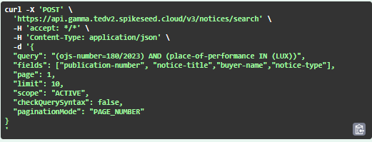
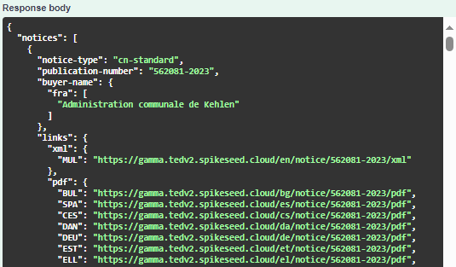
SEARCH API – Demo (6/7)
Search mode: pagination
Example - Find notices of the OJ S 18/2023 where the place of performance is Luxembourg; the result must contain the publication-number, the notice-title, the buyer-name and the form-type .
{
"query": "(ojs-number=180/2023) AND (place-of-performance IN (LUX))",
"fields": ["publication-number", "notice-title","buyer-name","notice-type"],
"page": 1,
"limit": 10,
"scope": "ACTIVE",
"checkQuerySyntax": false,
"paginationMode": "PAGE_NUMBER"
}

Slide 18
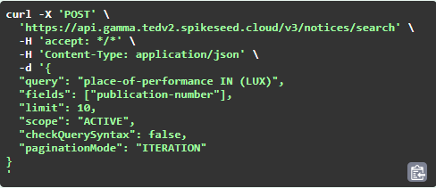
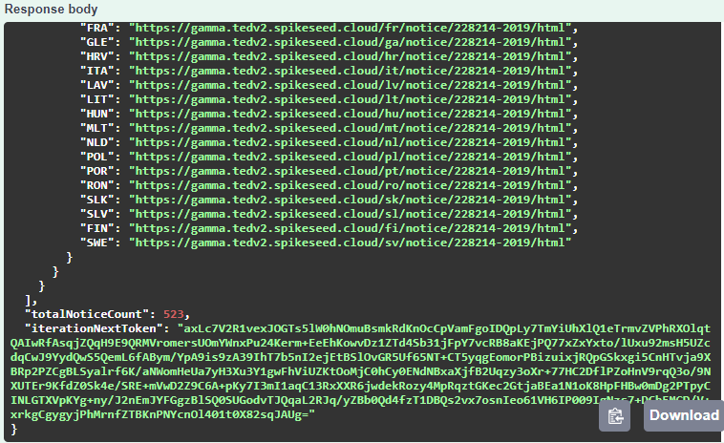
SEARCH API – Demo (7/7)
Search mode: iteration
Example - Find notices where the place of performance is Luxembourg; the result must contain the publication-number.
{
"query": "place-of-performance IN (LUX)",
"fields": ["publication-number"],
"limit": 10,
"scope": "ACTIVE",
"checkQuerySyntax": false,
"paginationMode": "ITERATION",
"iterationNextToken":null
}

Slide 19
THANK YOU

