Slide 1

EU Competitiveness and the MFF
Key findings and policy lessons
Daniel Gros/Director, Institute for European Policymaking, Bocconi University

Slide 2
Context and Scope
  EU growth has been disappointing. The Draghi report on competitiveness argues for bold action.
  Competitiveness is a core priority of the EU’s next Multiannual Financial Framework (MFF).
  The Commission identifies innovation, decarbonisation, and reduced dependencies as key elements of competitiveness.
  This briefing focuses how EU budgetary instruments have been instrumental in driving innovation-driven growth.

Slide 3
Incumbent bias
  The EU competitiveness gap mainly reflects weak performance in disruptive technologies (ICT, AI).
  Europe remains strong in ‘middle technologies’ (automotive, machinery).
  A large part of the budget for competitiveness involves industry in the formulation of work programs (Pillar II of HE) or financing (Jus), IPCEIs and Chips Act. This creates a risk of a bias towards incumbents and incremental innovation.

Slide 4
Leveraging Private Investment
  High leverage instruments create the illusion of impact with limited EU budget resources.
  Small (relative) EU contributions reduce influence on project selection and additionality.
  InvestEU and EFSI claims of hundreds of billions mobilised should be treated cautiously.

Slide 5
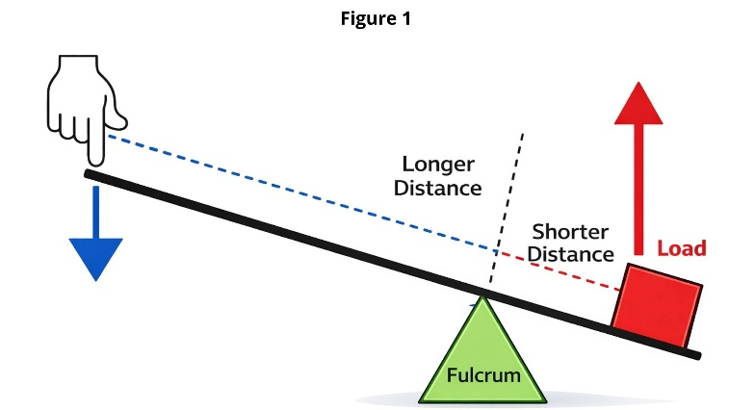
Leverage in Physics applied to economics
Physics standard: A small force, the finger at the long end of the lever, can lift a heavy force (red block at the short end). Corollary: even a strong force a the short end can only exercise a weak force at the long end.
Analogy: small budget guarantee can move large amounts, but only with little force (influence).

Slide 6
InvestEU – Small budget big impact? Main Concerns
  Very high multipliers (claimed 14 times) imply low implicit subsidies (around 6–7%).
  Stagnant EIB and EIF balance sheets not compatible with claims of massive mobilisation (hundreds of billions, also for EFSI).
  Market failures claimed but not documented or defined in impact assessment.

Slide 7
Horizon Europe, biggest budget item – Mixed Performance
  Pillar I (Excellent Science) performs well. But only indirect impact on competitiveness.
  Pillar II large collaborative projects show weak long-term impact on firms, especially for collaborative projects. Large beneficiaries obtain hundreds of projects and significant share of overall budget. JUs have built-in conflicts of interest.
  Pillar III (EIC) more promising but governance needs strengthening.

Slide 8
Chips Act and IPCEIs: not budgetary instrument, more competition policy
  Only national money, formally within EU framework.
  Chips Act: Primarily benefits national champions for mature-node semiconductor production used in automotive. No cross-border element.
  IPCEIs some cross-border element, but project selection dominated by incumbents (also no EU money).
  Both: industry capture and misalignment with disruptive innovation goals.

Slide 9
STEP and the limits of Repackaging
  STEP mainly aligns existing programmes rather than adding new resources.
  Sovereignty Seal can redirect ERDF funding towards advanced technologies.
  Impact depends on effective reprogramming by Member States and regions.

Slide 10
Key Policy Lessons for the Next MFF
  High leverage does not guarantee high impact; quality matters more than volume.
  Reduce reliance on incumbent-driven instruments.
  Strengthen support for disruptive innovation and single-recipient schemes.

