Slide 1

FINANCING COMPETITIVENESS IN THE eU
One year after the Draghi Report
Judith Arnal- Senior Research Fellow at Elcano Royal Institute and CEPS

Slide 2
OVERVIEW OF PUBLIC AND PRIVATE FINANCING CONSTRAINTS
Public financing constraints | Private investment bottlenecks
EU budget structurally small (≈1% of EU GDP) and insufficiently aligned with strategic priorities. | High household savings not channelled into productive investment, leading to slower wealth accumulation.
Spending still concentrated in cohesion and agriculture, limiting resources for innovation and competitiveness. | Fragmented capital markets: no single supervisor, no unified rulebook, divergent post-trade systems.
Fragmentation across 50 spending programmes undermines scale and impact. | Divergent insolvency and tax regimes hindering cross-border capital flows.
Administrative complexity and slow access to EU funds delaying implementation. | Excessive reliance on bank-based financing ill-suited for innovative, high-growth firms.
Low risk appetite of the EU budget and implementing partners, limiting crowding-in of private investment. | Underdeveloped second and third-pillar pension systems reducing the supply of long-term patient capital.
NGEU repayment cliff from 2028 reducing effective EU spending capacity without new own resources. | Structural impediments preventing the expansion of equity and venture capital markets across the EU.

Slide 3
Main financing recommendations in the Draghi report
Public-side reforms | Private-side reforms
Establish a Competitiveness Pillar in the next MFF to concentrate resources on strategic projects. | Transform ESMA into a genuine single supervisor with full regulatory and supervisory powers.
Simplify and consolidate EU funding programmes, supported by a single interface for project promoters. | Move towards centralised market infrastructures, including a single Central Counterparty (CCP) and a consolidated Central Securities Depository (CSD).
Increase EU risk-taking capacity through a larger InvestEU guarantee. | Expand and standardise second-pillar pension schemes to channel long-term savings into capital markets.
Extend the EIB’s mandate to allow direct equity investment and higher risk-taking in strategic technologies. | Revive the securitisation market through targeted prudential and transparency adjustments.
Develop new forms of common funding for European public goods, support regular issuance of common safe assets and strengthen fiscal rules | Complete the Banking Union with a country-blind jurisdiction for cross-border banks.

Slide 4
Alignment of Commission proposals with Draghi’s recommendations (public-side reforms)
Category | What the Commission proposes | Alignment with Draghi | Assessment
Competitiveness Pillar (ECF) | Creation of a ECF consolidating 14 programmes under a single framework with four thematic windows and a joint rulebook with Horizon. | Largely aligned: Draghi called for a consolidated Competitiveness Pillar and for reducing fragmentation across programmes. | Positive structural step, but risks of new internal silos and coordination failures. Impact depends on governance.
Simplification and single interface | Reduction from 52 to 16 programmes; Single Rulebook; single digital entry point; creation of NRPPs consolidating 21 programmes across cohesion, PAC, fisheries, migration and social policy. | Partially aligned: Draghi emphasised simplification and a single interface, but not the degree of renationalisation implicit in the NRPPs. | Directionally positive, but governance concerns persist. Performance-based logic risks repeating RRF shortcomings; regional authorities risk marginalisation; potential dilution of cohesion policy.
Increasing EU risk-taking capacity (InvestEU guarantee) | Single EU budgetary guarantee for internal policies; flexible guarantee envelope (EUR 17–70bn); unified toolkit for grants, equity, loans, guarantees and procurement; integrated technical rules. | Conditionally aligned: Draghi called for greater EU risk-taking capacity, but the constraint lies in implementation and risk appetite rather than in budgetary availability. | Architecture is sound, but effectiveness depends on whether implementing partners overcome risk aversion and deploy guarantees in higher-risk sectors.
EIB mandate and higher risk-taking | Removal of the 250% gearing ratio; expansion of financing ceilings; strategic prioritisation of high-tech sectors; unified ECF rulebook for EIB Group instruments. | Partially aligned: Draghi recommended revisiting the EIB’s mandate and increasing its risk-taking capacity. The statutory step helps but remains limited by Treaty constraints. | Meaningful operational improvement but still bound by Article 309 TFEU. Alignment will depend on strategic guidance.
Size of the MFF and fiscal framework | Nominal 40% increase to EUR 2 trillion; but real size broadly unchanged once NGEU interest excluded; no new common borrowing; new own resources, but some could put competitiveness at risk. | Not aligned: Draghi called for a significant expansion of EU-level fiscal capacity and for stronger, predictable fiscal rules. Neither materialises in the proposal. | Ambition is overstated. The EU budget remains structurally small; no NGEU-style financing; fiscal rules weakened through defence escape clauses.

Slide 5
Alignment of Commission proposals with Draghi’s recommendations (pRIVATE-side reforms)
Category | What the Commission proposes | Alignment with Draghi | Assessment
ESMA as a single supervisor | Expands ESMA’s direct supervision; stronger coordination of large asset managers; governance reform (Executive Board, funding model); enhanced convergence/enforcement toolkit. | Partially aligned, but reforms remain limited to selected segments and rely heavily on national authorities. | Meaningful structural step, but far from the SEC-style centralisation envisaged by Draghi; effectiveness depends on implementation and national cooperation.
Centralised market infrastructures | Removes duplicative requirements; harmonises rules for trading venues, CSDs and asset managers; new pan-European market operator licence; improved passporting; T2S settlement requirement; strengthened open access and direct broker access. | Partially aligned: improves interoperability and reduces fragmentation, but does not pursue the deeper consolidation of infrastructures advocated by Draghi. | Advances integration and efficiency but remains constrained by a decentralised architecture.
Second-pillar pension schemes | Auto-enrolment recommendation; expansion of pension tracking systems and dashboards; revision of IORP II to support consolidation and diversified portfolios; reforms to PEPP to increase accessibility and scale; clarification of prudent person principle. | Broadly aligned: supports Draghi’s objective of expanding long-term savings, but pensions remain a Member State prerogative. | Positive directionally, but impact depends on national uptake; cannot deliver the systemic expansion Draghi envisaged.
Reviving securitisation | Targeted amendments to simplify the 2019 framework, remove undue barriers and reduce complexity; aim to increase issuance and investment, free bank balance sheets and boost lending to households and firms. | Largely aligned, though ultimate scale depends on market behaviour and supervisory attitudes. | Pragmatic and timely, but impact contingent on investor appetite and bank willingness to use the tool.
Completing the Banking Union | No new proposals; EDIS remains blocked; ESM Treaty (common backstop to SRF) not fully ratified. | Not aligned: Draghi’s call for a country-blind jurisdiction and full Banking Union remains unmet. | Banking Union is effectively stalled, leaving a major structural gap in the EU financial architecture.

Slide 6
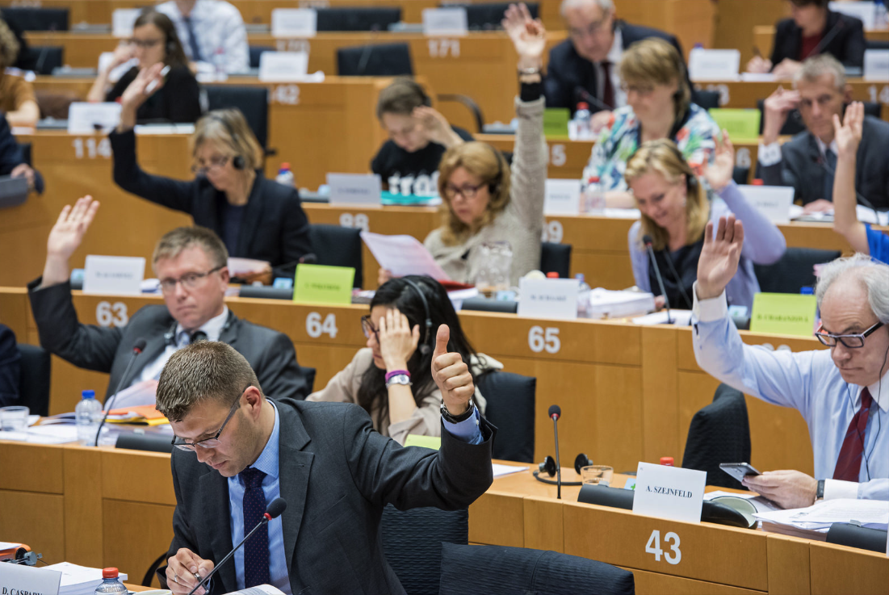
OTHER ASPECTS TO CONSIDER BEYOND DRAGHI’S REPORT
The report does not address the potential role of differentiated integration or enhanced cooperation mechanisms as tools for advancing capital markets integration or fiscal capacity among willing Member States, an approach that could unlock progress where unanimity proves elusive.
The report pays relatively limited attention to the role of genuinely integrated corporate tax bases and “good” own resources –such as a BEFIT‑type common base or well‑designed green levies.
The report touches only briefly on the political economy of implementation –in particular the tension between a more centralised industrial policy narrative and the need to preserve competition, state‑aid discipline and trust in EU‑level institutions– which will be critical for sustaining any expanded financing architecture over time.

