Slide 1

IAP GLOBAL WEBINAR ON
COUNTERING VACCINE HESITANCY
Biljana Gjoneska
IAP YPL Alumni Steering Committee
Macedonian Academy of Sciences and Arts

Slide 2
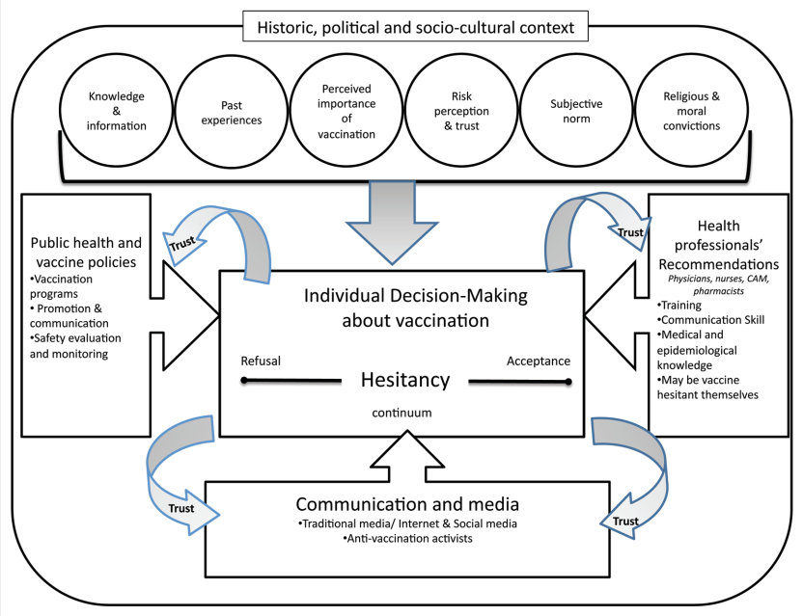
VACCINE HESITANCY
CONCEPTUAL MODEL
Dubé, E., Laberge, C., Guay, M., Bramadat, P., Roy, R., & Bettinger, J. A. (2013).
Vaccine hesitancy: An overview. Human vaccines & immunotherapeutics, 9(8), 1763-1773.

Slide 3
VACCINE HESITANCY IN TIME OF COVID-19
ADAPTED CONCEPTUAL MODEL
Public Health &
IDENTITY
POLITICS
Health
science
POPULISM
Distrust in medical authorities
Dis
Dis
Dis
Communication & Media
INFODEMIC
Dis
BASED UPON: Dubé, E., Laberge, C., Guay, M., Bramadat, P., Roy, R., & Bettinger, J. A. (2013).
Vaccine hesitancy: An overview. Human vaccines & immunotherapeutics, 9(8), 1763-1773.

Slide 4
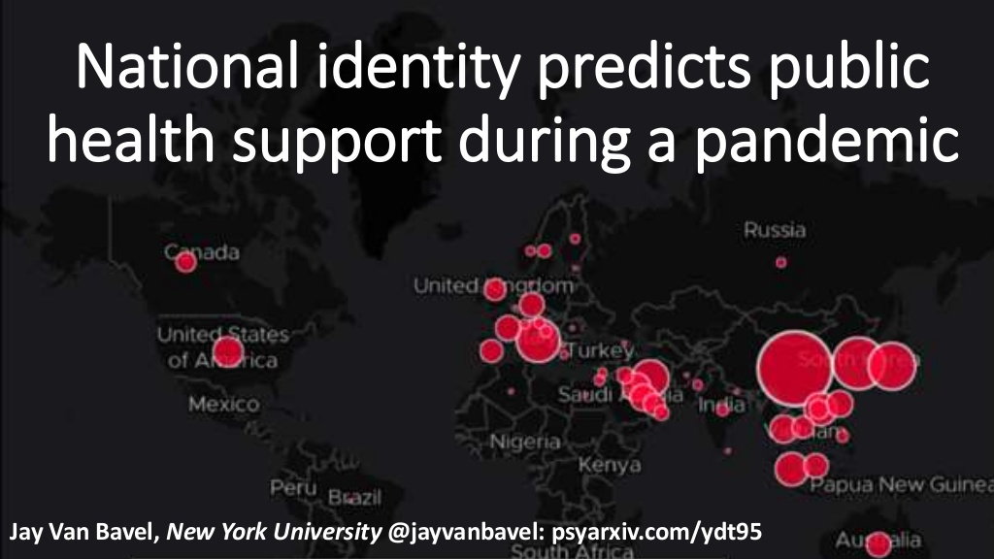
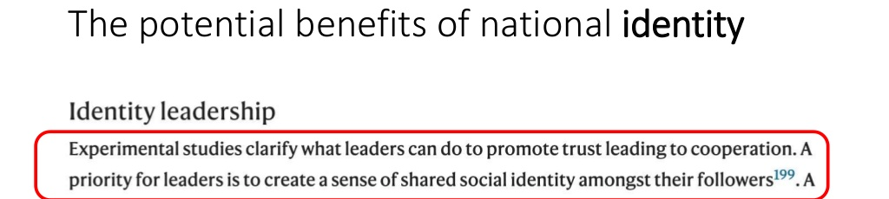
VACCINE HESITANCY IN TIME OF COVID-19
Public Health
& IDENTITY
POLITICS
Van Bavel, J. J., Cichocka, A., Capraro, V., Sjåstad, H.,
Nezlek, J. B., Alfano, M., ...Gjoneska B.,... & Zwaan, R.
National identity predicts public health support during a global pandemic. Nature communications (under review)
Van Bavel, J. J., Baicker, K., Boggio, P. S., Capraro,
V., Cichocka, A., Cikara, M., ... & Willer, R. (2020).
Using social and behavioural science to support COVID-19 pandemic response. Nature human behaviour, 4(5), 460-471.

Slide 5
VACCINE HESITANCY IN TIME OF COVID-19
IAP Working Group for “Improving scientific input to global policymaking”. (2019). Merit-based academies in the 21st century: A think Piece. IAP.
Gjoneska, B., Camacho Toro, R., Simic, N., Solymosi, K., Abu Douleh, A., Chies Santos, A.,.. Jambrak, A. (2020). S.O.S. Booklet for global young scholars: Facing the scientific and ethical challenges of the modern age. GYA/IAP Young Researchers Leadership Workshop in the Framework of the World Science Forum 2019.
❍
MEDICAL ACADEMIC ELITES
Health
science
POPULISM
Distrust in medical authorities
TRUTH-SPEAKING SOVEREIGNTY
DECISION MAKING SOVEREIGNTY

ORDINARY PEOPLE
Finkel, E. J., Bail, C. A., Cikara, M., Ditto, P. H., Iyengar, S., Klar, S., ... & Druckman, J. N. (2020). Political sectarianism in America. Science, 370(6516), 533-536.
Mede, N. G., & Schäfer, M. S. (2020).
Science-related populism: Conceptualizing populist demands toward science. Public Understanding of Science, 29(5), 473-491.

Slide 6
VACCINE HESITANCY IN TIME OF COVID-19
CONTENT
FALSE
DAMAGING
INTENTION
MISINFORMATION
Inaccuracies
DISINFORMATION
Fake news
Conspiracy theories
MALINFORMATION
Hate speech
INFORMATION DISORDER
&
VACCINE HESITANCY
MEDIA ECOSYSTEM
Wardle, C., & Derakhshan, H. (2018). Thinking about ‘information disorder’: formats of misinformation, disinformation, and mal-information.
Ireton, Cherilyn; Posetti, Julie. Journalism ‘fake news’ & disinformation. Paris: UNESCO, 43-54

Slide 7
CONSPIRACY THEORIES & VACCINE HESITANCY
PSYCHOLOGICAL FACTORS
EXISTENTIAL
Feeling safe in
one’s environment
EPISTEMIC
Understanding
one’s environment
SOCIAL
Maintaining a
positive image of
oneself & ingroup
Douglas, K. M., Sutton, R. M., & Cichocka, A. (2017).
The psychology of conspiracy theories. Current directions in psychological science, 26(6), 538-542.

Slide 8
CONSPIRACY THEORIES & VACCINE HESITANCY
PSYCHOLOGICAL FACTORS
PERSONALITY
TRAITS
NEUROTICISM vs
EMOTIONAL STABILITY
OPENNESS
NARCISSISM
COGNITIVE
STYLES
INTUITIVE vs
ANALYTIC THINKING
COGNITIVE BIASES &
LOGICAL FALLACIES
SOCIETAL
WORLDVIEWS
MANICHEAN REGARD
‘ANOMIE’ & DISTRUST
RADICAL POLITICS
Lantian A, Wood M, & Gjoneska B. (2020).
Personality traits, cognitive styles, and worldviews associated with beliefs in conspiracy theories. In: M. Butter & P. Knight(eds).
Routledge Handbook of Conspiracy Theories. 155-167. Abingdon: Routledge (26 Feb 2020)

Slide 9
PREVENTION
“Psychological Inoculation”
PREEMPTIVE DEBUNKING
PRIORITIZATION
“Psychological Triage”
TARGETING & SELECTION
TREATMENT
“Truth sandwiches”
EFFECTIVE DEBUNKING
STRATEGIES TO COUNTER MISINFORMATION
van der Linden, S., Roozenbeek, J., & Compton, J. (2020).
Inoculating Against Fake News About COVID-19. Frontiers in Psychology, 11, 2928.

Slide 10
IMPROVING VACCINE COMMUNICATION
&
FIGHTING MISINFORMATION
CHOOSE
YOUR BATTLES
GO
PRIVATE
↑
Assess level of hesitancy
→
Accept emotive aspects

Ask questions

Find common ground
TAKE IT
STEP BY STEP
ESTABLISH LEGITIMACY
ACTIVE LISTENING APPROACH

State what is true

Don’t overload with info
⬧
Ask for source of info
▪
Refer to experts
Lewandowsky et al (2021).
The COVID-19 Vaccine Communication Handbook.
A practical guide for improving vaccine communication
and fighting misinformation

Slide 11
COUNTERING VACCINE HESITANCY

TAILOR THE MESSAGE

EXPLAIN HOW INTERNET WORKS
◻
HELP UNDERSTAND
STATISTICAL INFORMATION

PRACTICE INOCULATION
Lewandowsky et al (2021).
The COVID-19 Vaccine Communication Handbook. A practical guide for improving vaccine communication and fighting misinformation

Slide 12
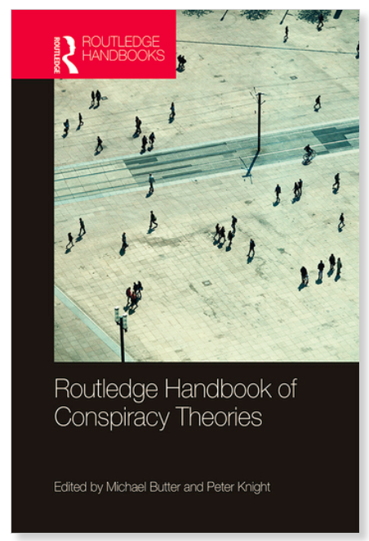
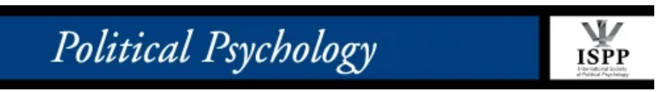


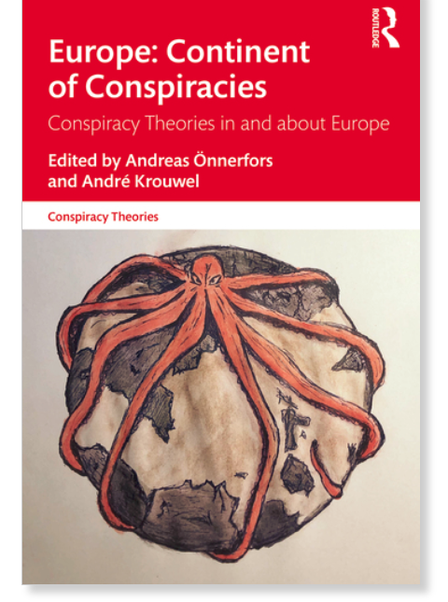

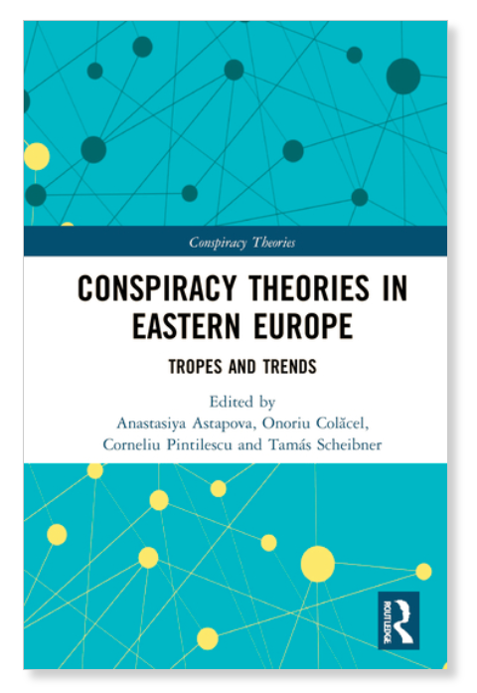
SPECIAL THANKS
E
U
C
OST
COMPACT
ROUTLEDGE HANDBOOK OF CONSPIRACY THEORIES
Peter Knight,
University of Manchester, UK
Michael Butter
University of Tübingen, DE
Anthony Lantian
Paris Nanterre, FR
Michael J. Wood
University of Manchester, UK
PICOM
PROJECT
IAP
YPL
ALUMNI
Investigating the links between cultural values and belief in conspiracy theories: The key roles of collectivism and masculinity.
IAP PRESIDENCY
IAP SECRETARIAT
Peter McGrath
Muthoni Kareithi
Sabina Caris
Giovanni Ortolani
Conspiracy Mentality and Political Orientation across 23 countries (under review)
Roland Imhoff
Jais Adam-Troian
Karen M. Douglas
Olivier Klein
Michal Bilewicz
Aleksandra Cichocka
Jan-Willem van Prooijen
Robbie M. Sutton
Andre Krouwel
Iris Žeželj
Jasna Milošević
Giuseppina Porciello
Maria Serena Panasiti
Michael Schepisi
CONSPIRACY THEORIES IN AND ABOUT EUROPE
Andreas Önnerfors
Uppsala University, SE
André Krouwel
Vrije University, NL
Nebojša Blanuša
University of Zagreb, CR
ALUMNI STEERING COMMITTEE
Juan Carlos Nuñez-Enriquez
Atiya Mosam
Jaifred Lopez
Suraj Bhattarai
Dipendra Khatiwada
Mary Ashinyo
Omary Chillo
Taopheeq Rabiu
CONSPIRACY THEORIES IN EASTERN EUROPE
Corneliu Pintilescu
Romanian Academy
of Sciences, RO
André Krouwel
Vrije University, NL

