Slide 1


How to tackle mis- and disinformation?
IAP Global Webinar on Countering Vaccine Hesitancy
Tuesday 23 March 2021
Herman Wasserman

Slide 2
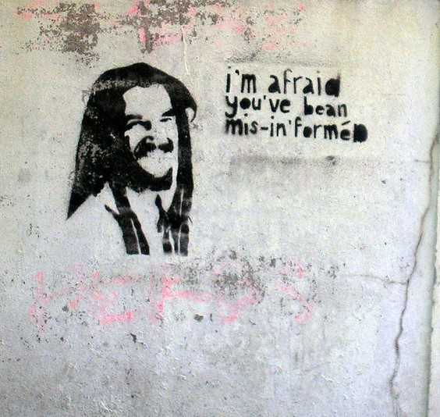
Overview
What is mis- and disinformation?
Why and how does it spread?
How can we counter it?

Slide 3
What is mis- and disinformation?
Unesco definitions:
Disinformation: Information that is false and deliberately created to harm a person, social group, organisation or country
Misinformation: Information that is false but not created with the intention of causing harm
Mal-information: Information that is based on reality, used to inflict harm on a person, social group, organisation or country.
Infodemic (WHO): overabundance of information – some accurate and some not – that makes it hard for people to find trustworthy sources and reliable guidance when they need it. In this situation, misinformation and rumors appear on the scene, along with manipulation of information with doubtful intent. In the information age, this phenomenon is amplified through social networks, spreading farther and faster like a virus.

Slide 4
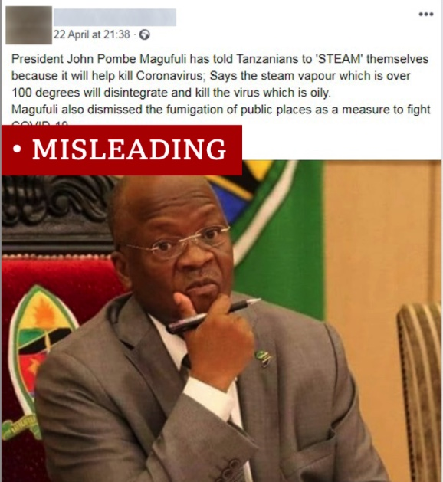
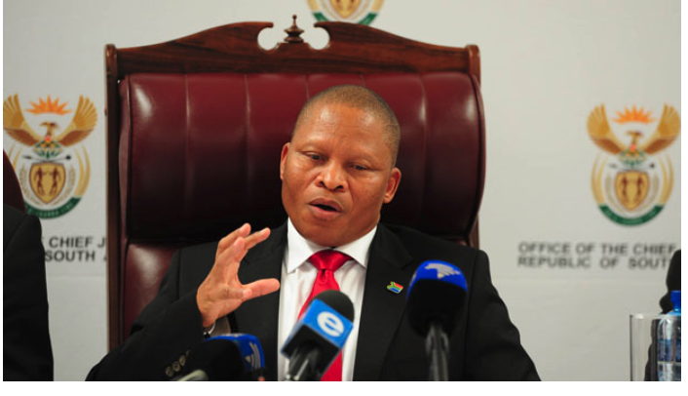

Some examples
Combination of conspiracy theories about vaccinations with already circulating disinformation on Covid-19: potential for anti-vaccination “superstorm”
Misinformation: Social media platform design encouraging quick scrolling, inaccurate reading
Disinformation: Videos warning people about ‘Bill Gates vaccines’ to be tested in Africa, ‘change your DNA’, CNN logo ‘Penis injection hoax’
Malinformation: Incomplete or poorly informed reporting about pause in vaccine trials
Amplified by people in power
“If there be any [COVID-19] vaccine that is the work of the devil meant to infuse 666 in the lives of the people, meant to corrupt their DNA … may it be destroyed by fire.” South Africa’s chief justice, Mogoeng Mogoeng

Slide 5
Why and how do mis- and disinformation spread?
For false news to make an impact, it has to be shared. Why do people consume and share?
Feeds on anxieties, stereotypes, uncertainty, bias – if people do not know who to trust or where to get accurate information, disinformation has a foothold
Social context, view of authority, trust in media – all important factors
Study of motivations within context important step in countering disinformation
WHO guidance : Formal research e.g. surveys, also social media listening and analysis – understand rumours, conspiracy theories, perceptions and motivations towards vaccines
Some parts of the world - very low acceptance rates. Low rates of COVID-19 vaccine acceptance were reported in the Middle East, Russia, Africa and several European countries. (South Africa: less than two-thirds (64%) will accept vaccine)

Slide 6
Why and how does mis- and disinformation spread?
Example:
Previous research of African media users:
high likelihood to share misinformation, even knowingly
users employ variety of cues to determine veracity (agency)
motivations to share depends on topic (e.g to duty to warn others ‘just in case’, or ‘for fun’)
the political use of humour plays an important role – history of alternative communication forms (‘pavement radio’) in contexts of repression, state control of media

Slide 7
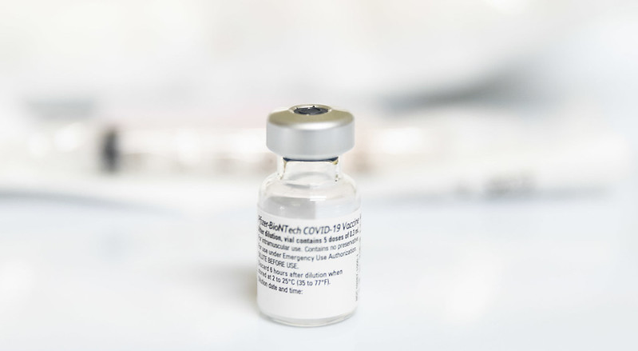
How do we counter it?
Different types of responses:
Identification responses (debunking, fact-checking, investigative)
Aimed at production and distribution environment (legislative – e.g. criminalization, policy, counter-disinfo campaigns)
Aimed at production and distribution mechanisms (curatorial, algorithmic, demonetization, e.g. accuracy check reminders, label inaccurate or disputed claims, stop searches for ‘vaccines’)
Aimed at target audience rather than denier (ethical, educational, empowerment ): Technique rebuttal identifying common and “topic rebuttal” (attack plausibility of disinformation with facts)

Slide 8
How do we counter it?
Establish motivations, causes, perceptions: surveys, social media listening, qualitative work, social media network analysis to establish influencers
Appeal to dominant motivations:
E.g. civic responsibility - enlist help to spread correct information, show dangers of amplifying misinformation.
‘Fun’, gamify, develop memes etc

Slide 9
How do we counter it?
Not top-down, one-directional communication – esp when people already are skeptical of authority.
Create spaces for dialogue, discussion, Q&A
Engage civil society, faith communities, family networks or groups
Uphold freedom of expression
Counter bad information with good information – but establish efficacy within context (issues of trust, access, mode of delivery)

Slide 10

Thank you
herman.wasserman@uct.ac.za
Disinfoafrica.org

