Slide 1


Roadmap for the accelerated implementation of the Doha Programme of Action

Slide 2

Overview
Serves as a tool for least developed countries, development partners, the United Nations system and other stakeholders including the private sector and civil society, to navigate the Programme of Action
Prepared in close consultation with the IACG on LDCs
35 priority targets across the six key action areas of the DPoA as quick win initiatives
Linkages with SDGs highlighted
The Roadmap incorporates the Five Key Deliverables
The Roadmap sets out indicators and milestones for monitoring and reviewing progress at the mid-term in 2026 and at the end-term of the Doha Programme of Action
It is a living document, and regular updates are envisaged
Notes:
These targets are specific to least developed countries, and if pursued effectively, they can accelerate progress on SDG targets.
The milestones help LDCs, development partners and the United Nations system to assess progress made towards the targets. The milestones 2026 and beyond are based on Programme of Action targets

Slide 3

Roadmap sections
PART I: PROGRAMME OF ACTION AND KEY STAKEHOLDERS
Key focus areas for action
Key stakeholders and their roles
PART II: PRIORITY TARGETS, ACTIONS AND KEY DELIVERABLES
Priority targets
Five key deliverables
Stakeholder actions, indicators of success, and milestones for the next decade
PART III: MAINSTREAMING, MONITORING AND REVIEW
Mainstreaming the programme of action
Monitoring and review
Mid-term and end-of-term review
CONCLUSION
Annex A: Private sector, parliaments and youth commitments
Annex B: Contribution of the United Nations system and international and regional organizations

Slide 4
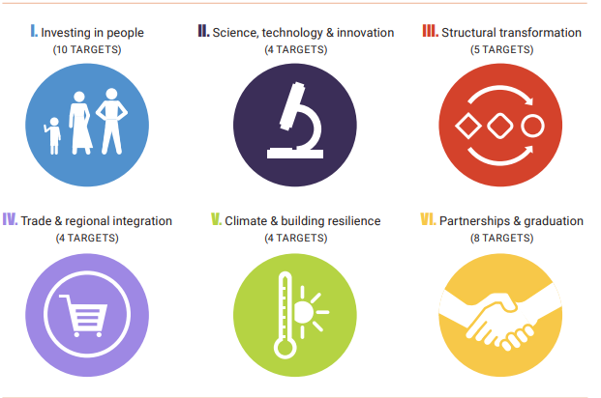
35 LDC specific targets complementary to SDGs

Slide 5
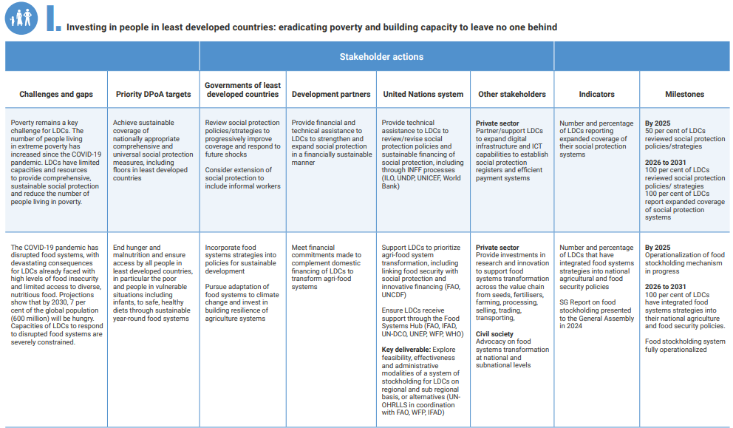
Sample: Stakeholder actions, indicators of success, and key milestones for the next decade

Slide 6
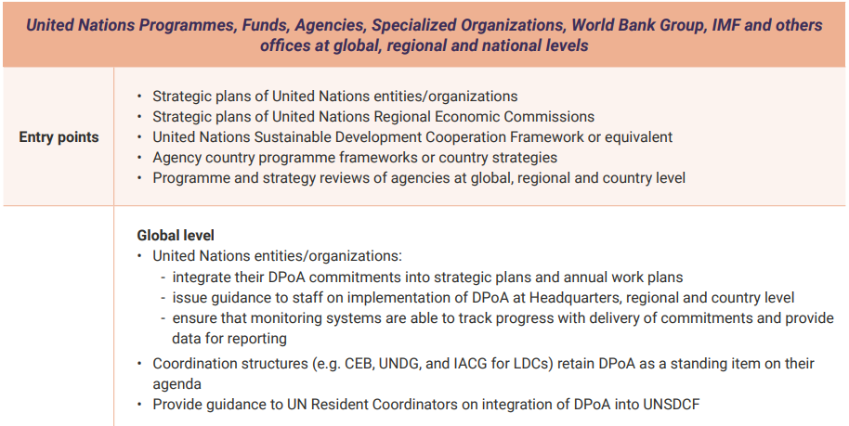
Mainstreaming the DPoA by LDCs, dev. partners and stakeholders

Slide 7
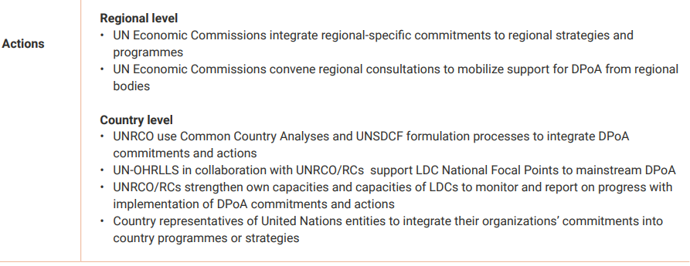
Mainstreaming the DPoA by UN (cont.)

Slide 8
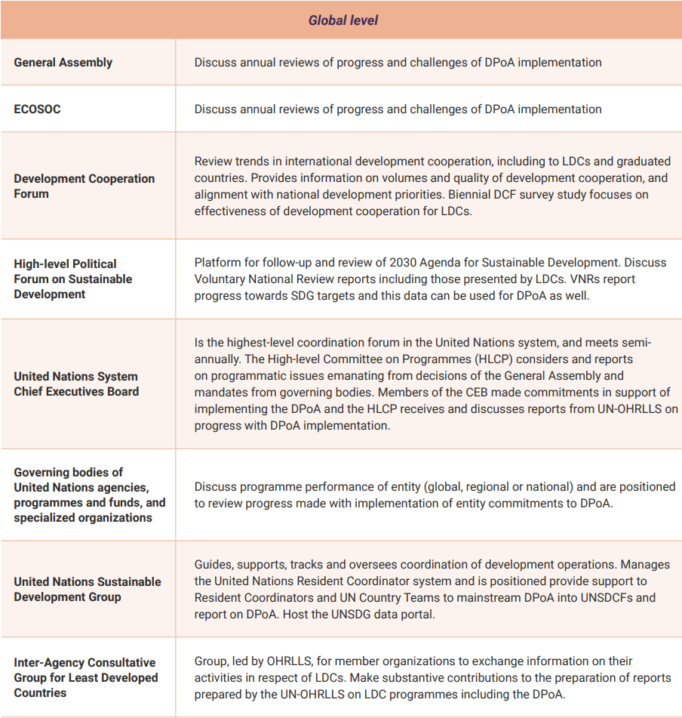
Monitoring and review mechanisms, selected (cont.)

Slide 9
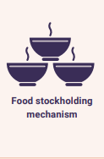




5 Key Deliverables
5 Key Deliverables

Slide 10
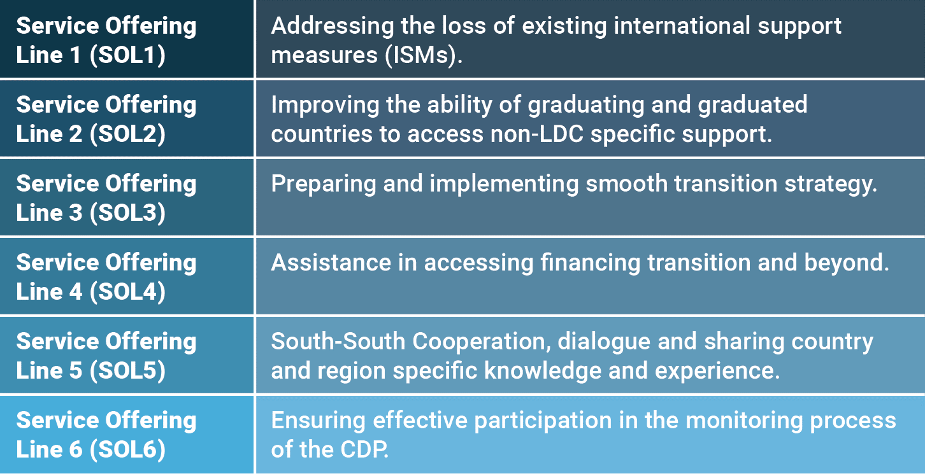
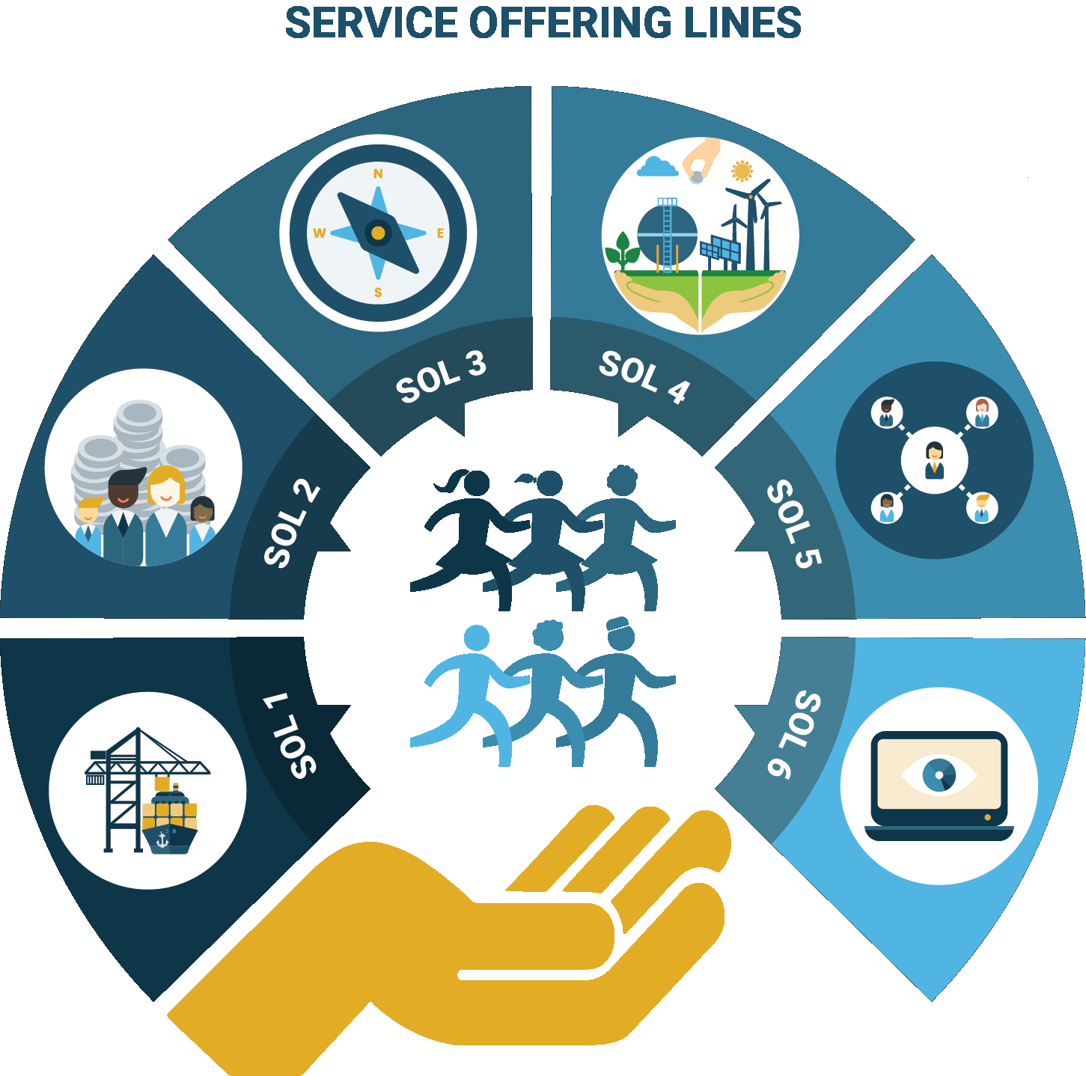
iGRAD Service Offering Lines (SOLs)

Slide 11
International Investment Support Center
Provide financial and technical support for project preparation and contract negotiation
Advisory support for investment-related dispute resolution
Access to information on investment facilities
Improving enabling environment
Risk insurance and guarantees such as through the Multilateral Investment Guarantee Agency

Slide 12
Food stockholding mechanism for LDCs
Emergency stocks
National food reserves
Virtual versus physical stocks
An emergency import finance facility
Governance
A small Secretariat will be established to manage the day-to-day operations of the FSM
The FSM will operate under the supervision of a Steering Committee

Slide 13
Online University
Policy support for distance education and open learning
Ensure special access for the poorest and those in vulnerable situations
Support course design and curriculum development
Facilitate global recognition and accreditation to international standards
Create a virtual network of educational institutions within and beyond the LDCs
Bring scale and sustainability to the education system

Slide 14
Crisis mitigation and resilience building mechanism
Strengthening adaptation capacity in LDCs – to date 23 LDCs have submitted NAPs and 15 are at various stages of NAP
Strengthened multi-hazard early warning systems in LDCs -61 percent of LDCs reported have national risk reduction strategies while 46 per cent have multi-hazard early warning system
Strengthened financial resilience in LDCs. LDCs policymakers will have increased knowledge of key vulnerabilities related to financial resilience as well as recommendations to overcome them.

Slide 15
Conclusions
The United Nations system and development partners need to prioritise support to LDCs to strengthen their statistical capacities in order to generate the high-quality reliable data needed for measuring and tracking progress of the SDGs.
UN-OHRLLS continues to strengthen the capacities of National Focal Points, including through guidelines for mainstreaming the DPoA, building capacities of National Focal Points to monitor and evaluate implementation of the DPoA and coordinate follow-up actions.
RCs and UN country teams may ensure that the DPoA is firmly embedded in the UNSDCF and support their government partners to mainstream the Programme of Action.

Slide 16


Thank you!

