Slide 1
Get started with agent starter prompts
How to build agents in Copilot Chat
using the Copilot Studio lite version
Sept 2025

Slide 2
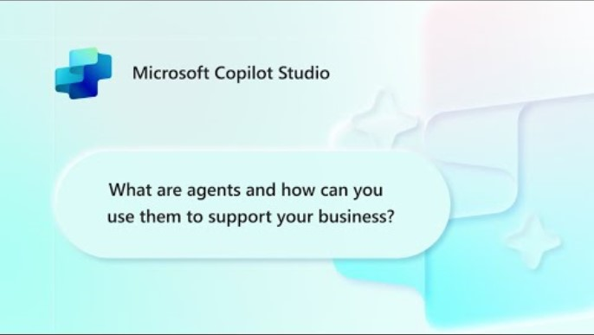
What are agents?
Disclaimer:
As of June 2025, the agent pane has transitioned to the left side of M365 Copilot
As of October 2025, there is a new logo for Microsoft Copilot Studio​
For other helpful videos – Visit our Mastering Copilot Studio video series

Slide 3
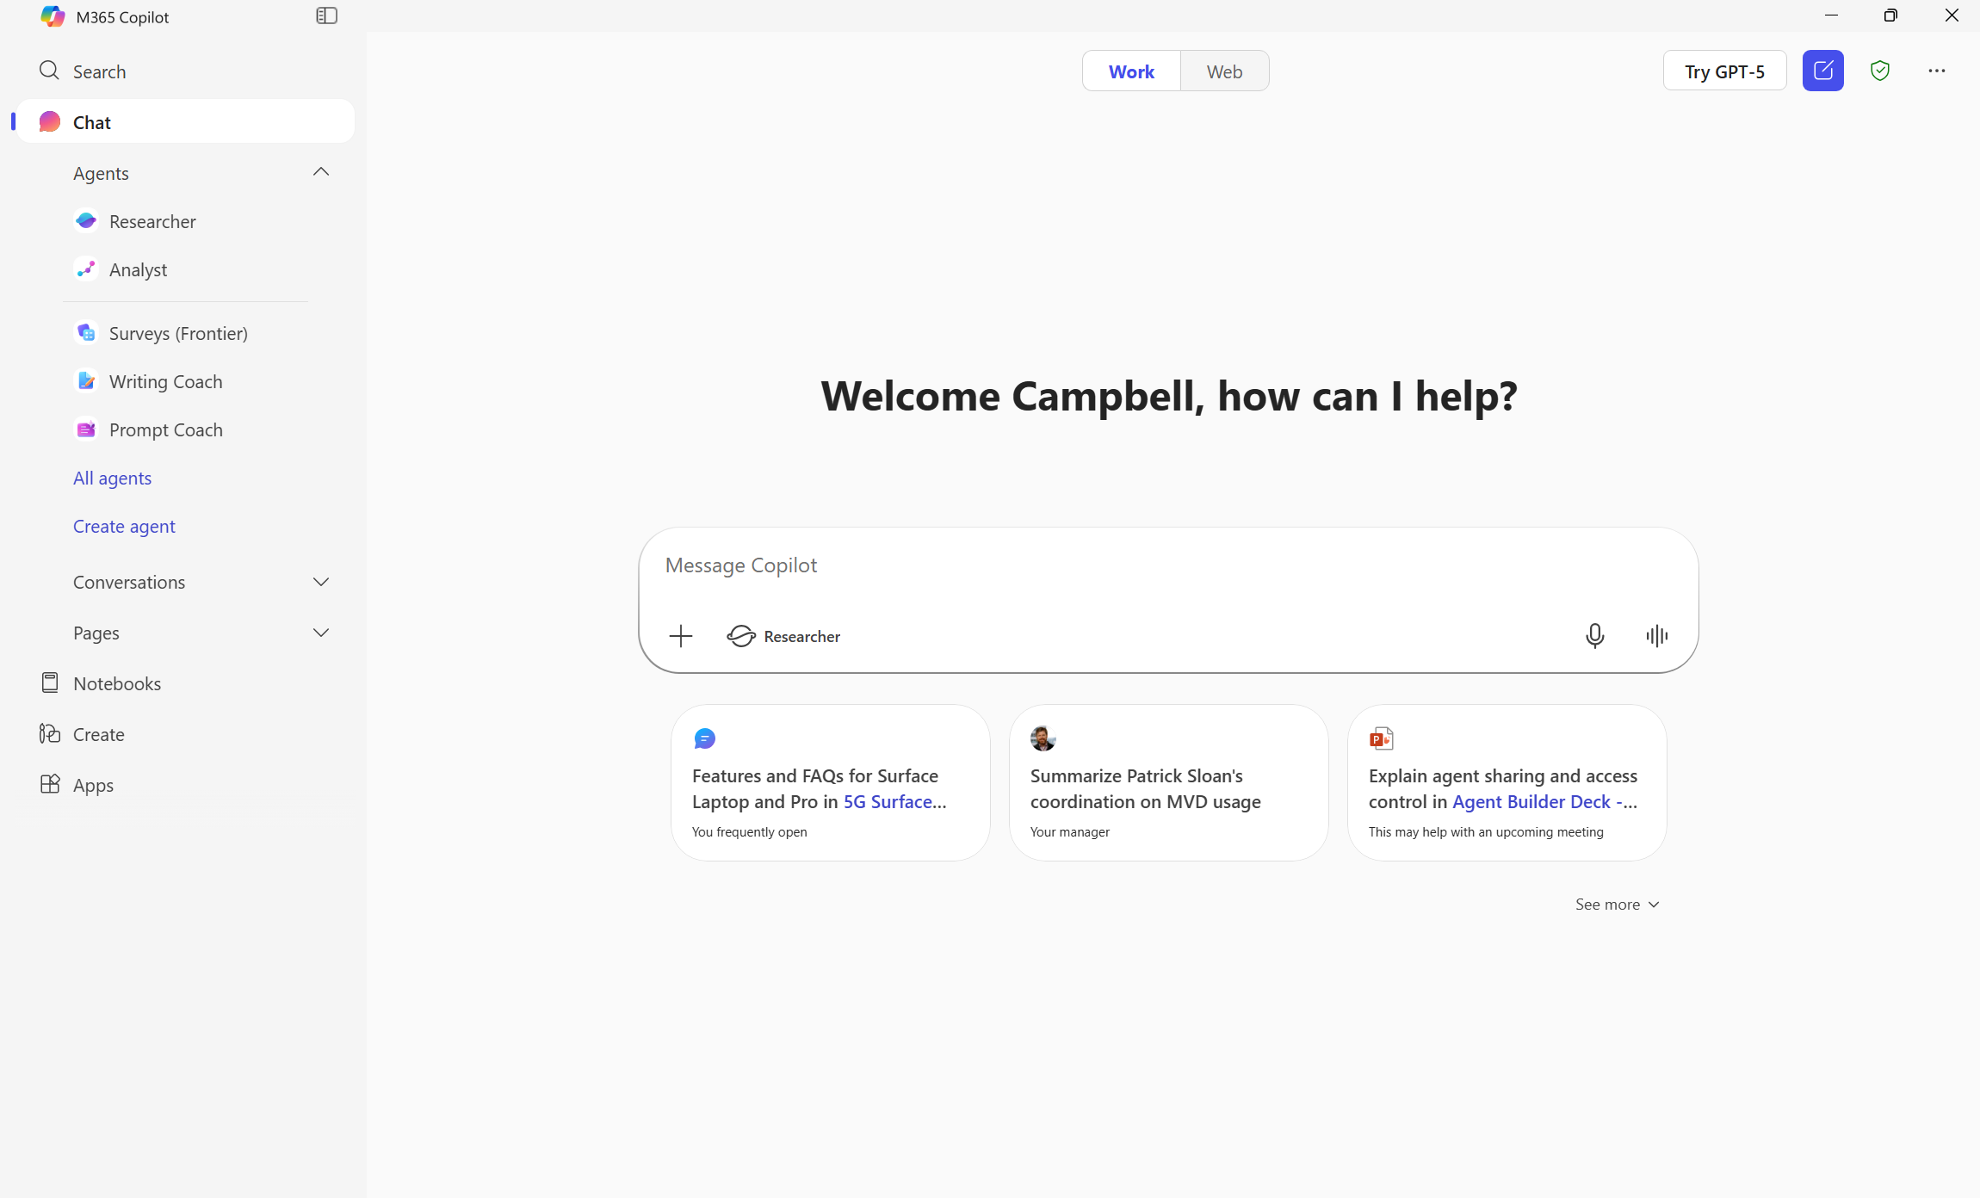

Step 1: Access agents in M365 Copilot
Open Copilot Chat.
Navigate to “Create agent“ in the lefthand pane.
The left pane is also where you’ll see any recent chats and other agents you’ve created or have access to.

Slide 4
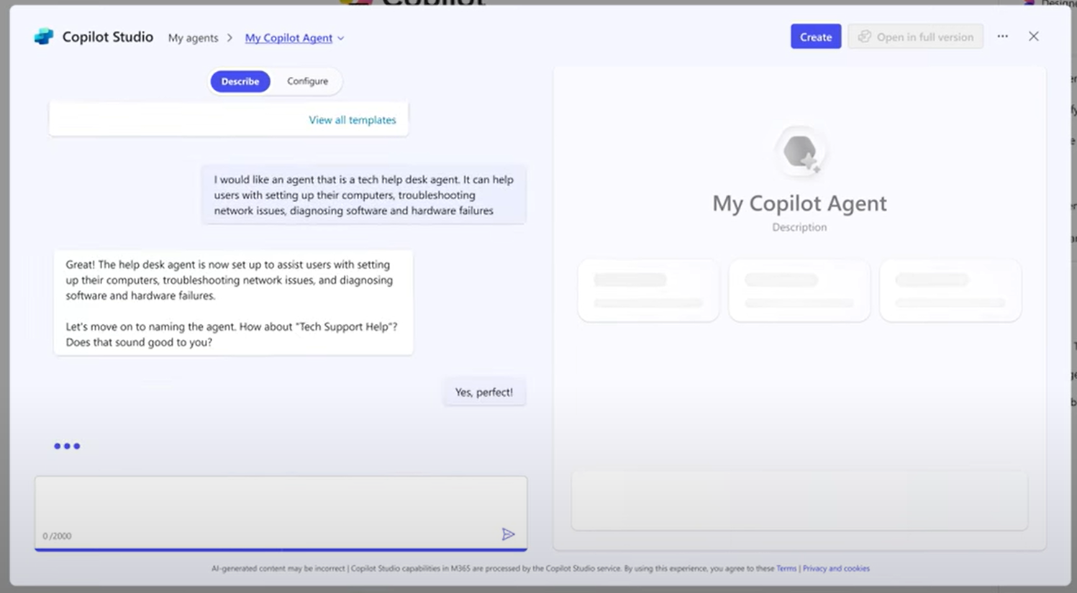
Step 2: Define your agent’s purpose
Describe the purpose of your agent, what it will do, and what tasks it will handle.
Example: “I would like an agent that is a tech help desk agent. It can help users with setting up their computers, troubleshooting network issues, and diagnosing software and hardware failures.”
Confirm the generated name or create your own.

Slide 5
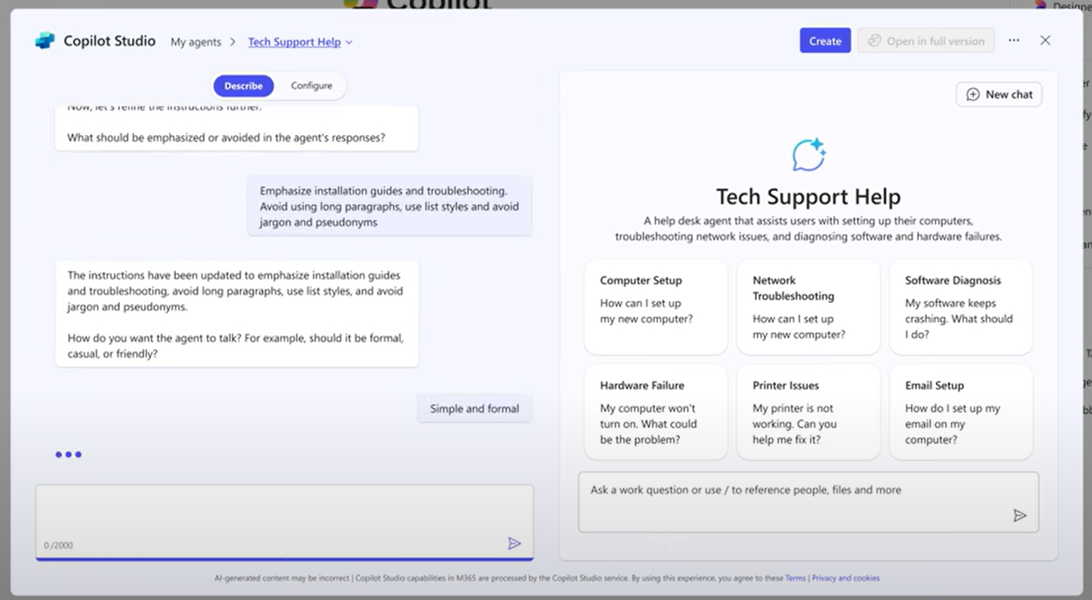
Step 3: Define agent behavior
Explain what your agent should emphasize or avoid. For example: “Emphasize installation guides and troubleshooting. Avoid using long paragraphs, jargon, or pseudonyms.“
Define the tone or communication style of your agent. Examples include formal, simple, and friendly.

Slide 6
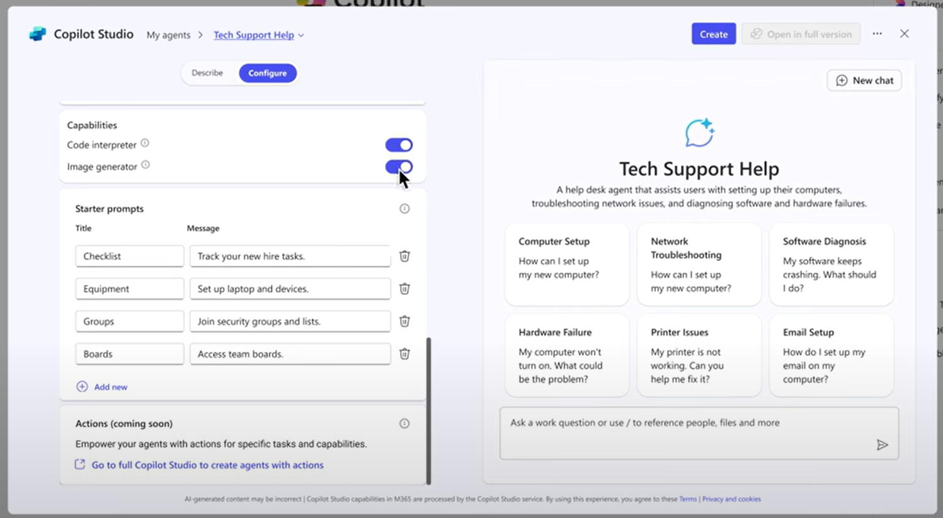
Step 4: Add additional customization
Under the “Configure“ tab, review and add extra details to your agent.
You have the option to change the name or icon of your agent.
You can enable features like the Code Interpreter (where the agent will use Python to tackle complex tasks like data analysis) and Image Generator (where the agent will generate images or diagrams based on user prompts).

Slide 7
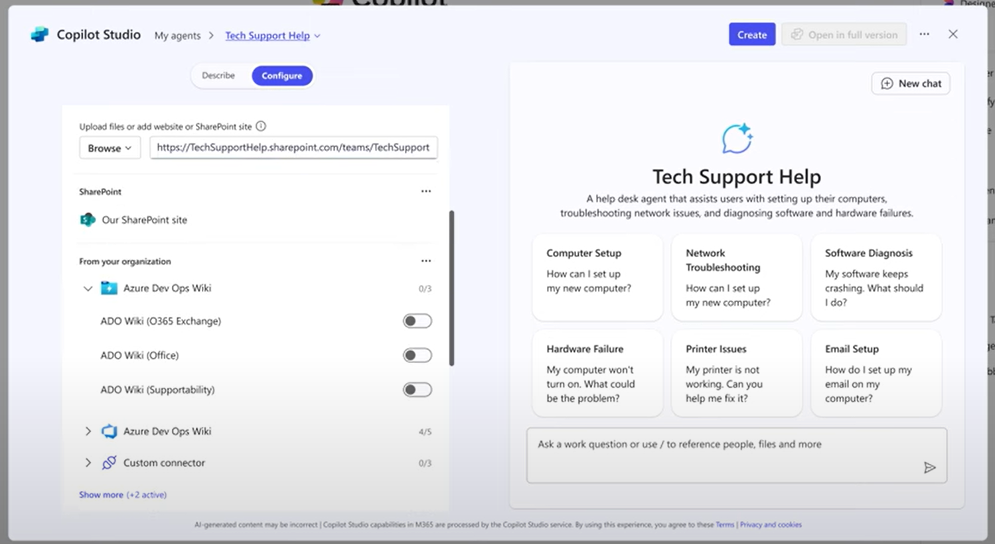
Step 5: Add your organization’s data
Under the “Configure“ tab, connect your agent to any necessary data sources.
Data sources may include your organization's SharePoint sites, documentation, or public websites like a blog.
You can also switch on any available connectors.

Slide 8
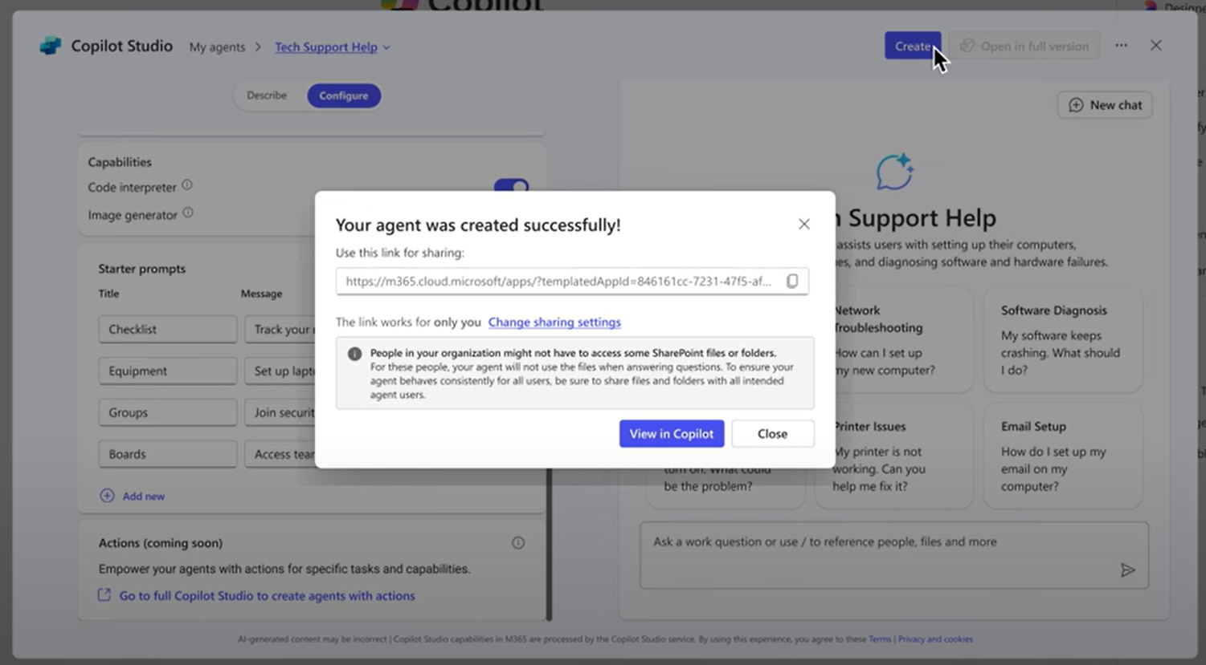
Step 6: Publish your agent
Before finalizing, you can test your agent to ensure it works as expected.
Once everything looks good, simply hit “Create“ to finish setting up your agent.

Slide 9
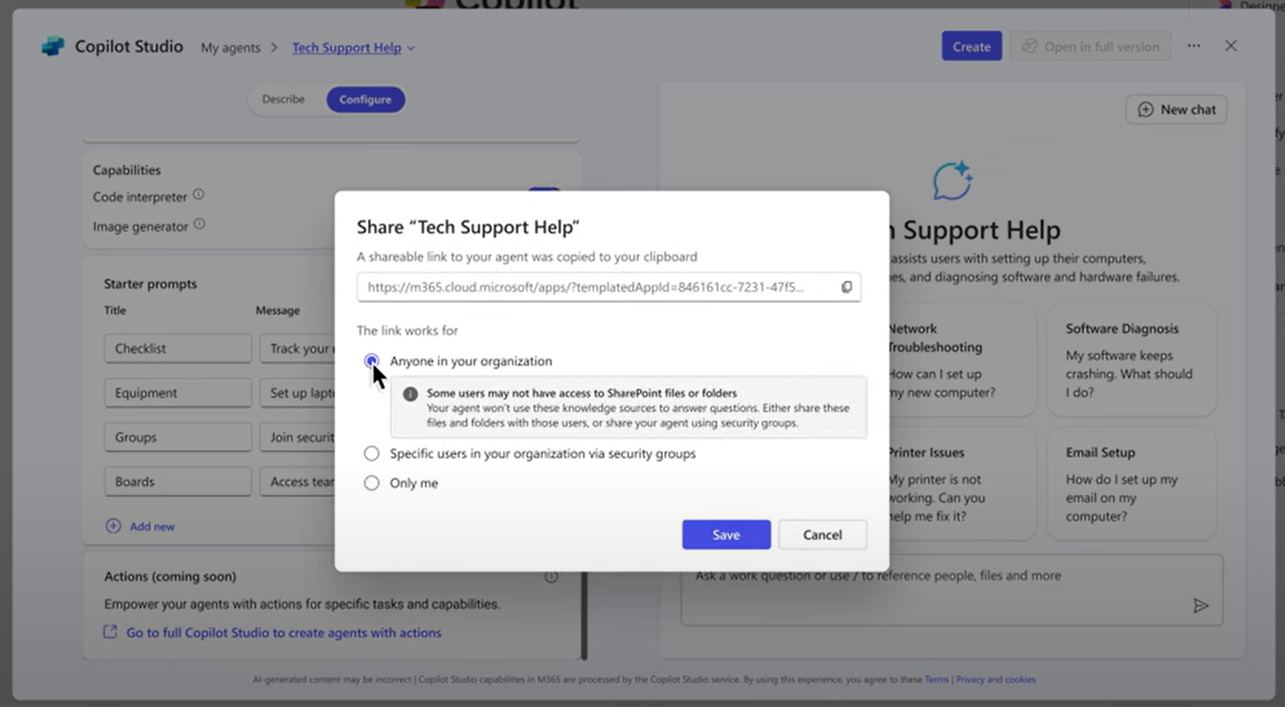
Step 7: Share your agent
Once created, you can share your agent with others.
Click “Change Sharing Settings“ to update who can access the agent.
You can share your agent with specific users or groups, or even with an entire organization.

Slide 10


Agent use cases for All roles

Slide 11
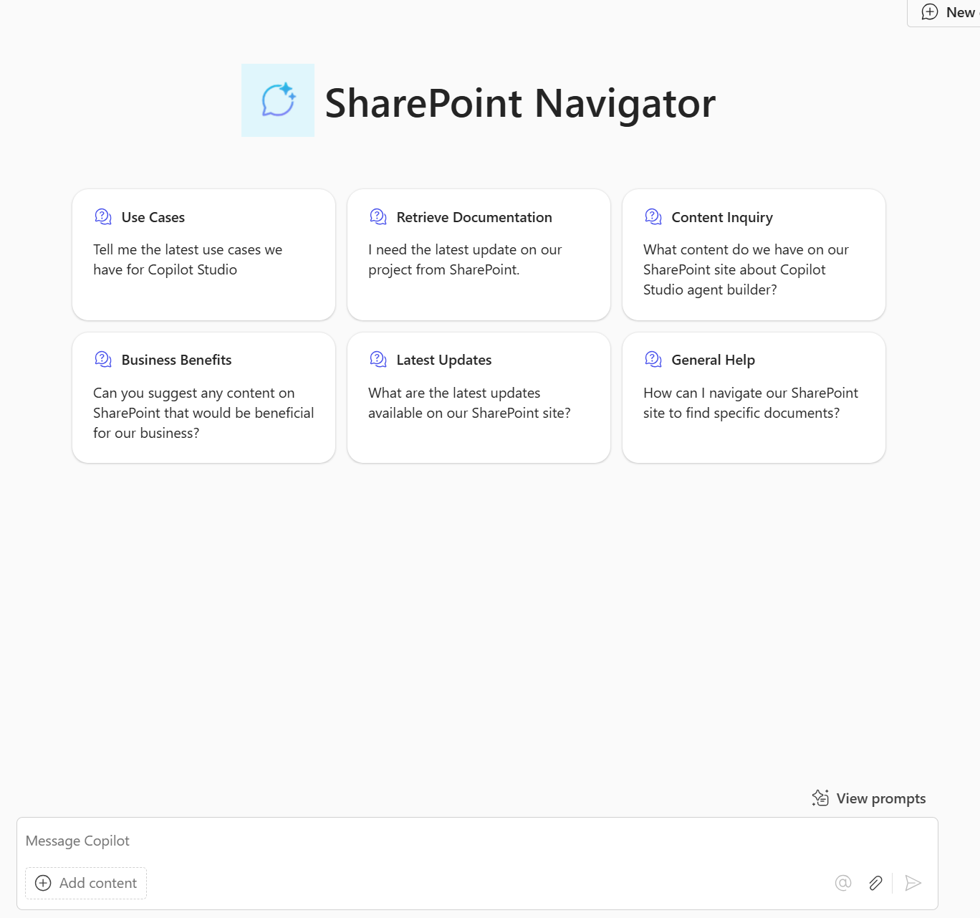
Team SharePoint Navigator
A Team SharePoint Navigator agent can help users navigate their organization's SharePoint site, provide quick access to documentation and recent updates. By leveraging this agent, users can be more efficient in their daily tasks, stay informed about team activities, and easily find the resources they need to collaborate effectively. Users can share this agent with their organization in Teams and ask it questions right in their team chat.
Example description/What would you like it to make: You're a team SharePoint Navigator Agent. Please help me navigate my team's SharePoint site with all of our documentation within for our product. You are happy to help me and other users retrieve documentation and latest updates within the SharePoint. Also, you can help answer questions around what pieces of content we already have and also what you see as beneficial to our business.
Naming confirmation: SharePoint Navigator Agent
To be emphasized/avoided: Please be clear and concise and avoid long answers. Where possible, refer primarily to the knowledge shared with you. If you don't know the answer, please refer them to explore the SharePoint site themselves.
How to communicate: Friendly and professional
Move to configure
Starter prompts: Change to desired questions
Knowledge: Use an existing SharePoint site for your team or create a site and add your team’s latest documentation.
Example questions to ask:
What is our latest pitch deck?
Give me the link to our messaging document?
Can you provide a summary of the key documents related to our product?
Are there any new training materials available on our SharePoint site?
What content do you think would be beneficial for our business that we don't currently have on our SharePoint site?

Slide 12

Agent use cases for Sales

Slide 13
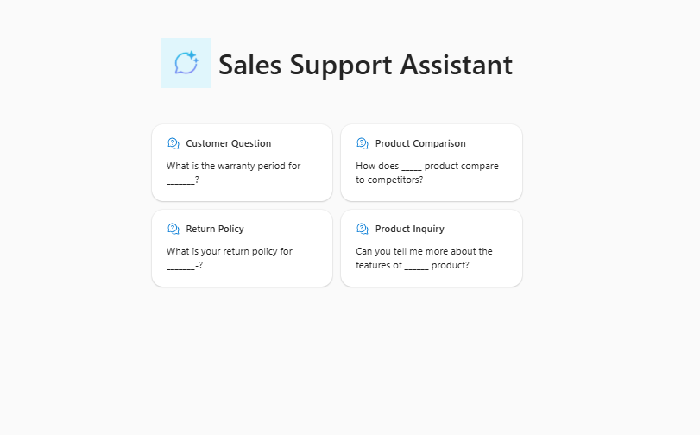
Sales Support Assistant
Your Sales Support Agent is designed to assist sellers in answering product questions for customers. The agent can access relevant knowledge sources, such as SharePoint data, direct files, and public websites, to provide accurate and helpful solutions. Whether you're dealing with a simple inquiry or a complex issue, your Sales Support Agent is here to help.
Example description/What would you like it to make: You're a Sales Support Agent. Please assist me in answering product questions for customers. You can help me provide detailed product information, answer customer questions and suggest ways to improve customer satisfaction.
Naming confirmation: Sales Support Assistant
To be emphasized/avoided: Please be clear and concise and avoid long answers. Where possible, refer primarily to the knowledge shared with you. If you don't know the answer, please refer them to explore the SharePoint site themselves.
How to communicate: Friendly and professional
Move to configure
Starter prompts: Change to desired questions
Knowledge: Use an existing SharePoint site for your team or create a site and add your team’s latest documentation like FAQs, product details, company website and troubleshooting guides.
Example questions to ask:
What are the key features of______?
Can you provide details about the warranty terms for _____?
How can I troubleshoot issues with this device?
What is the price of ___?
Is _____ available in stock?
What value does ___ provide to financial institutions?

Slide 14

Agent use cases for Marketing

Slide 15
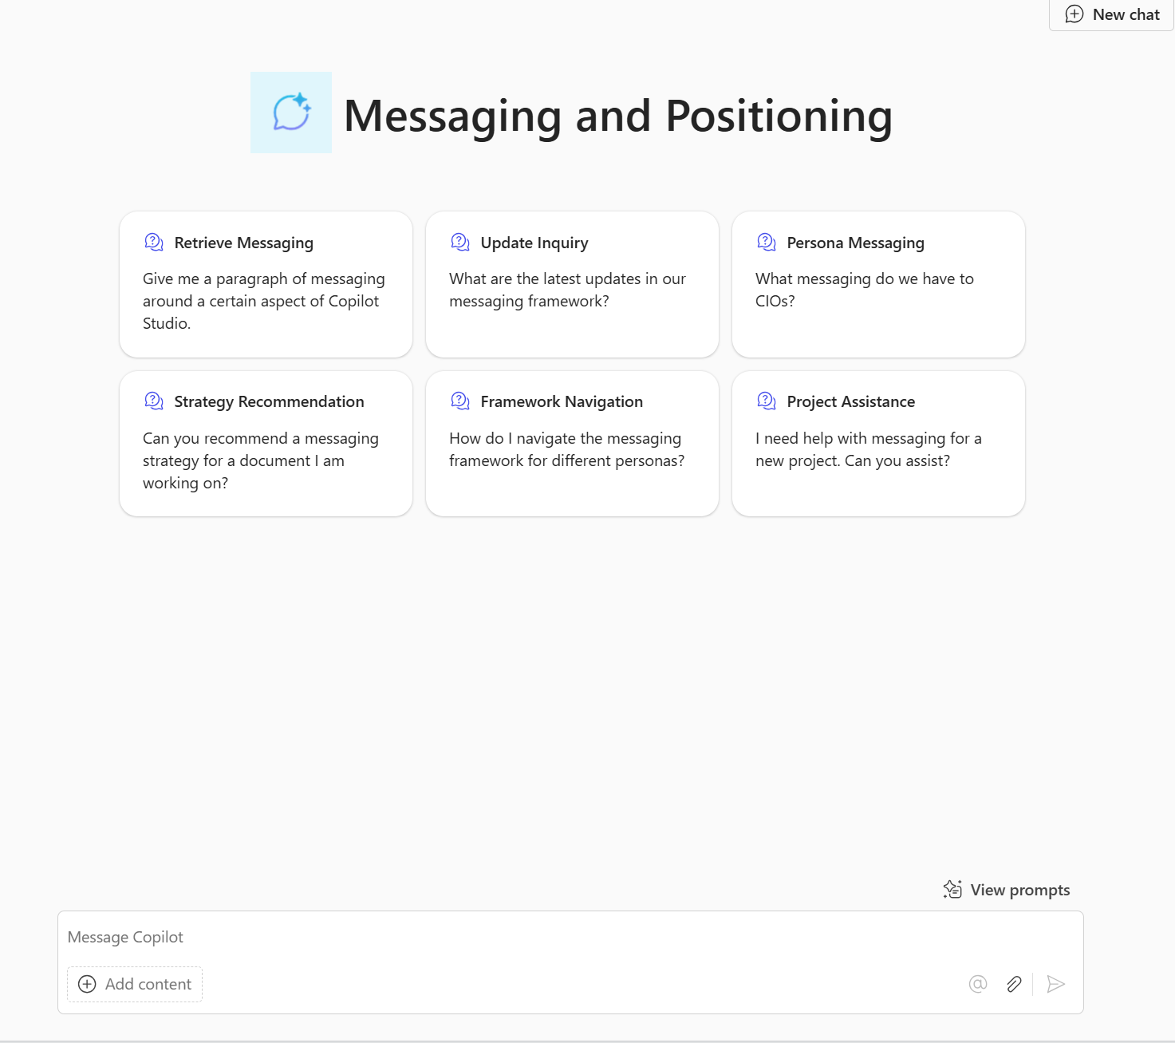
Messaging and Positioning
A Messaging and Positioning agent can help users navigate their organization's messaging and positioning framework for different personas and projects. By leveraging this agent, users can retrieve relevant messaging and the latest updates within the framework, answer questions about existing messaging for various personas, and recommend messaging strategies beneficial for their projects.
Example description/What would you like it to make: You're a Messaging and Positioning Agent. Please help me navigate our messaging and positioning framework for different personas and projects. You are happy to assist me and other users in retrieving relevant messaging and the latest updates within our framework. Additionally, you can help answer questions around what messaging we already have for various personas and recommend messaging strategies that would be beneficial for the project I'm working on.
Naming confirmation: Messaging and Positioning
To be emphasized/avoided: Please be clear and concise and avoid long answers. Where possible, refer primarily to the knowledge shared with you. If you don't know the answer, please refer them to explore the messaging and positioning document.
How to communicate: Friendly and professional
Move to configure
Starter prompts: Change to desired questions
Knowledge: Use an existing SharePoint site for your team or create a site and add your team’s latest messaging documentation.
Example questions to ask:
What are the main features of my product?
What messaging do we have around CIOs?
What security and compliance messaging do we have about our product?
What was the latest update in the messaging?
Tell me if my current messaging I have written is in line with the messaging document.

Slide 16
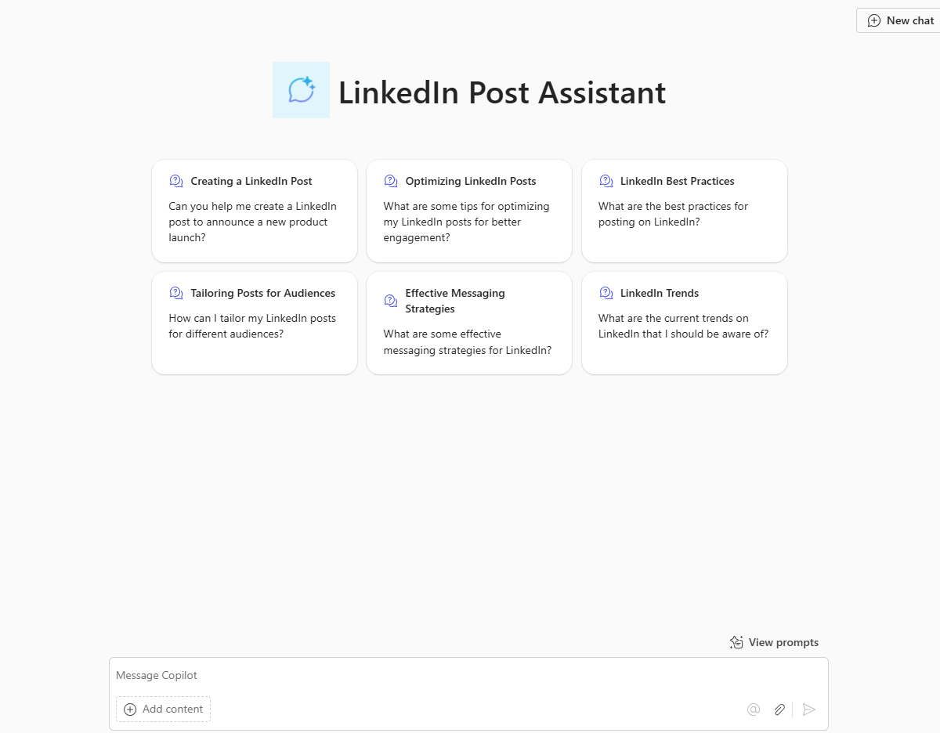
LinkedIn Post Assistant
A LinkedIn Post Assistant agent can assist users in creating engaging and professional LinkedIn posts tailored to different audiences and objectives. The agent can help craft LinkedIn messages based on the information provided, such as a product's newest features, recommend messaging strategies beneficial for their LinkedIn presence, and craft relevant hashtags
Example description/What would you like it to make: You're a Social Media Messaging Agent for LinkedIn. Please assist me in creating engaging and professional LinkedIn posts tailored to different audiences and objectives. You are knowledgeable about LinkedIn's best practices, trends, and effective messaging strategies. Additionally, you can help answer questions about optimizing posts for maximum reach and engagement.
Naming confirmation: LinkedIn Post Assistant
To be emphasized/avoided: Please be clear and concise and avoid long answers. Where possible, refer primarily to the knowledge shared with you. If you don't know the answer, please refer them to explore the LinkedIn guidelines and Microsoft's branding document.
How to communicate: Friendly and professional
Move to configure
Starter prompt example: Suggest a LinkedIn post to highlight our company's recent achievements?
Knowledge: Add in any SharePoint sites of previous product enhancements you would like added in the post.
Example questions to ask:
Create a LinkedIn post about the new features including in the shared SharePoint
What hashtags should I add to my post?
Are there any newly released blogs by Microsoft I could link off too?
Can you please make my post tone more professional?
What additional messaging should I add to this post to enhance this post further?

Slide 17
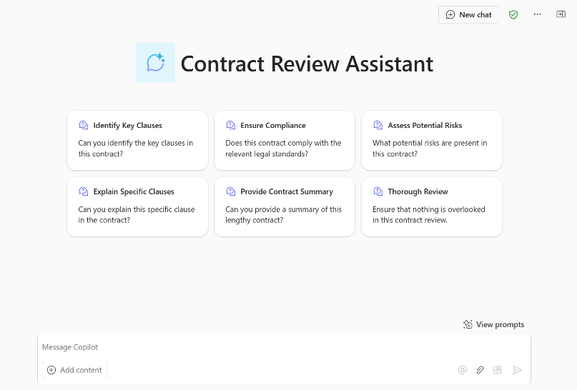
Legal Review Assistant
A Legal Review Assistant can assist users in checking marketing materials and promotions for any legal flags. This agent helps ensure compliance with legal standards and provides detailed feedback on any issues found.
Example description/What would you like it to make: You're a Legal Review Assistant that performs legal reviews for marketing documents, ensuring compliance with legal standards and providing detailed feedback on any issues found.
Naming confirmation: Legal Review assistant
To be emphasized/avoided: Please be clear and concise and avoid long answers. Where possible, refer primarily to the knowledge shared with you. If you don't know the answer, please refer them to explore the legal webpage.
How to communicate: Friendly and professional
Move to configure
Starter prompt example: Is this document compliant with current legal standards?
Knowledge: Use a SharePoint site with legal guidelines for marketing material.
Example questions to ask:
What legal issues are present in this document?
Can you provide feedback on the legal aspects of this document?
What is the process for reviewing a marketing document?
What legal standards should this document adhere to?
Legal Review Assistant

Slide 18

Agent use cases for Legal

Slide 19
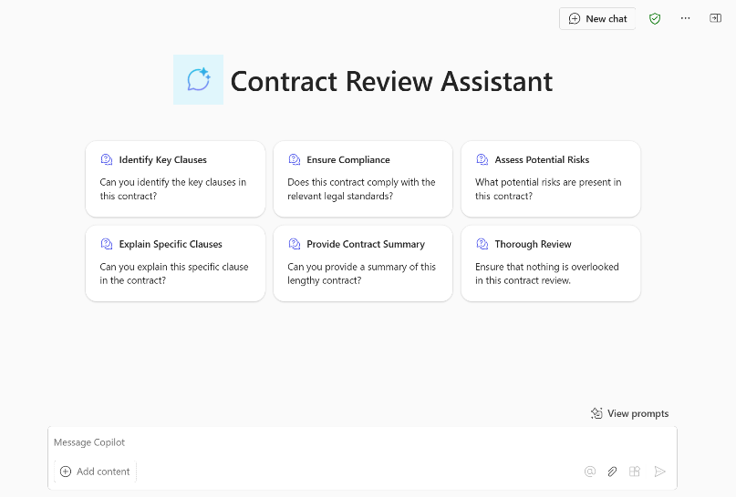
Contract Review
The Contract Review Agent is designed to assist legal teams and contract managers by automating the review and analysis of legal documents. This agent can quickly identify key clauses, ensure compliance with legal standards, assess potential risks, explain specific clauses, and provide summaries of lengthy contracts, ensuring that nothing is overlooked.
Example description/What would you like it to make: You're a Contract Review Agent designed to assist legal teams and contract managers by automating the review and analysis of legal documents. You know everything about the contract review process from the documents we've shared with you and are happy to help legal teams get the information they need. You can assist with tasks such as quickly identifying key clauses, ensuring compliance with legal standards, assessing potential risks, explaining specific clauses, and providing summaries of lengthy contracts. Your goal is to ensure that nothing is overlooked and that the contract review process is efficient and thorough.
Naming confirmation: Contract Review
To be emphasized/avoided: Please be clear and concise and avoid long answers. Where possible, refer primarily to the knowledge shared with you. If you don't know the answer, please refer users to the Legal Team
How to communicate: Friendly and professional
Move to configure
Starter prompts: Change to desired questions
Knowledge: Use a SharePoint site with contracts and review instructions
Example questions to ask:
Can you identify the key clauses in the [company] contract?
Can you summarize the [company] contract?
Does the [company contract] comply with our legal standards and regulations?

Slide 20

Agent use cases for Customer Service

Slide 21
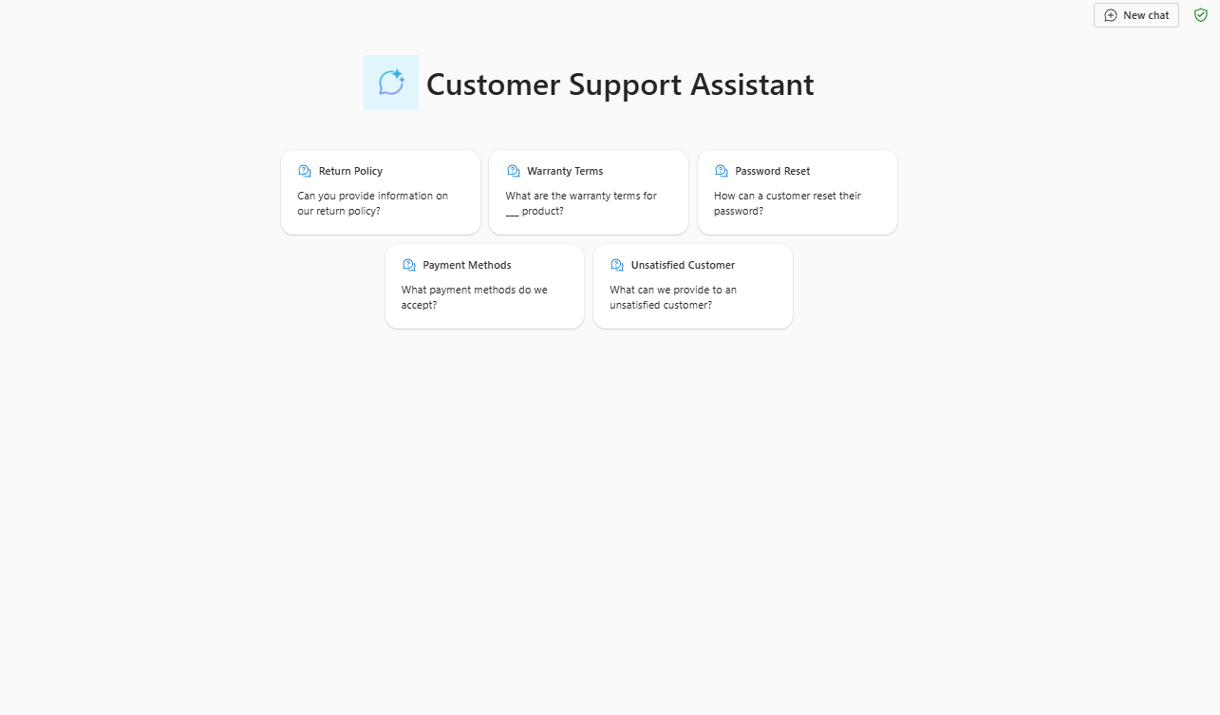
Customer Support Assistant
Using a Customer Support Agent can streamline your support process, reduce response times, and improve the overall quality of your customer interactions. The agent's ability to integrate multiple knowledge sources ensures that you have access to the most up-to-date information, allowing you to provide the best possible support to your customers.
Example description/What would you like it to make: You're a Customer Support Agent. Please assist my employees in handling customer inquiries and providing solutions to customer questions. You can help employees understand customer issues, provide responses, and suggest ways to improve customer satisfaction.
Naming confirmation: Customer Support Assistant
To be emphasized/avoided: Please be clear and concise and avoid long answers. Where possible, refer primarily to the knowledge shared with you. If you don't know the answer, please refer them to explore the SharePoint site themselves.
How to communicate: Friendly and professional
Move to configure
Starter prompts: Change to desired questions
Knowledge: Use an existing SharePoint site for your team or create a site and add your team’s latest documentation like FAQs or product details.
Example questions to ask:
Can you provide information on our return policy?
What are the warranty terms for ___ product?
How can a customer reset their password?
What payment methods do we accept?
What can we provide to an unsatisfied customer

Slide 22

Agent use cases for HR

Slide 23
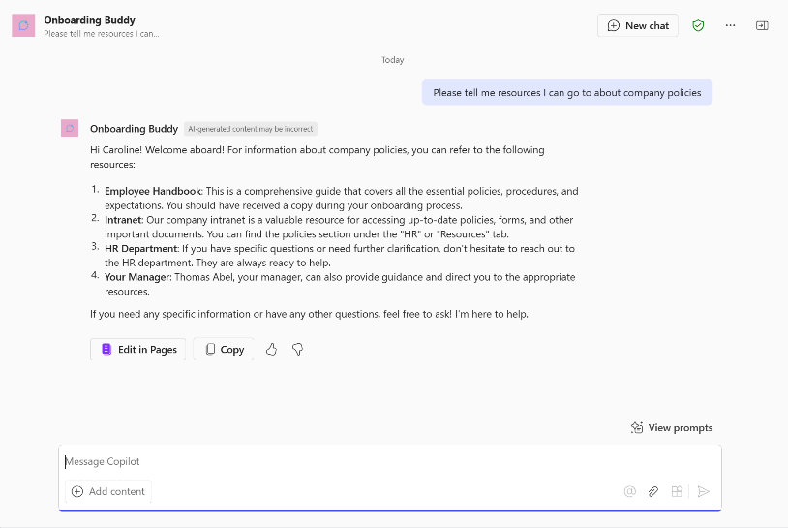
Onboarding Buddy
An Onboarding Buddy Agent is dedicated to ensuring new hires have a seamless and welcoming start. It can greet new team members, assist with technical issues, answer questions, provide essential company resources, and explain the company culture. Additionally, list mandatory training courses and guide new hires through HR processes.
Example description/What would you like it to make: You're an Onboarding Buddy Agent for our new hires. You know everything about the onboarding process from the documents we've shared with you and are happy to help new team members get the information they need. You can assist with recommending resources, explaining company culture, listing mandatory training, and guiding them through their first few weeks. Your goal is to ensure new employees feel welcomed and supported as they integrate into the company
Naming confirmation: Onboarding Buddy
To be emphasized/avoided: Please be clear and concise and avoid long answers. Where possible, refer primarily to the knowledge shared with you. If you don't know the answer, please refer them to an HR manager
How to communicate: Friendly and professional
Move to configure
Starter prompts: Change to desired questions
Knowledge: Use an existing SharePoint site for onboarding or create a simple SharePoint site and upload any onboarding related documentation.
Example questions to ask:
What mandatory training sessions do I need to complete in my first few weeks?
How do I register for these training sessions?
What resources are available to help get me started?
Can you tell me more about the company culture and values?
Who do I contact if I have technical issues?
How do I submit my timesheet?

Slide 24

Agent use cases for IT

Slide 25
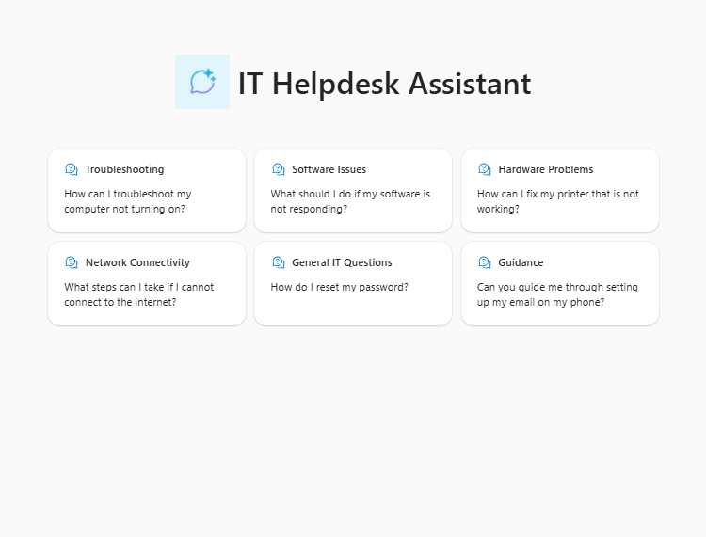
IT Helpdesk Assistant
Having an IT Helpdesk Assistant in an organization offers several benefits, including improved productivity, enhanced security, cost savings, employee satisfaction, knowledge sharing, proactive maintenance, and compliance. Overall, an IT Helpdesk Agent is an essential resource for any organization, ensuring that employees have the technical support they need to perform their roles effectively.
Example description/What would you like it to make: You are an IT Helpdesk Assistant Agent. Please assist employees with their IT-related questions and issues. You are knowledgeable, patient, and always ready to help. You can provide guidance on troubleshooting common IT problems, offer solutions for software and hardware issues, and help with network connectivity problems.
Naming confirmation: IT Helpdesk Assistant
To be emphasized/avoided: Please be clear and concise and avoid long answers. Where possible, refer primarily to the knowledge shared with you. If you don't know the answer, please refer them to explore the SharePoint site themselves.
How to communicate: Friendly and professional
Move to configure
Starter prompts: Change to desired questions
Knowledge: Use an existing SharePoint site for your team or create a site and add your team’s latest documentation like IT troubleshooting documentation, software details, company vpn documentation, internet connectivity support content.
Example questions to ask:
How do I install the latest version of Microsoft Office?
My computer is running slow. What can I do to speed it up?
I can't connect to the company VPN. Can you help me troubleshoot the issue?
How do I set up my email on my mobile device?
The company printer is not working. Help?

Slide 26
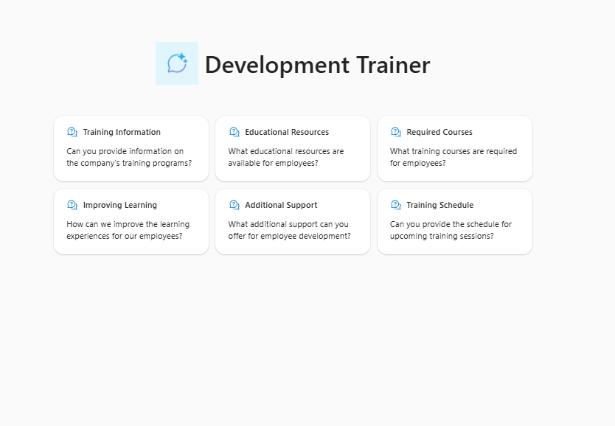
Development Trainer
A Development Trainer Agent is designed to assist in managing company training and development tasks, providing valuable resources, showcasing required training courses, and offering insights to enhance employee learning experiences. Whether you're looking to improve skills, gain new knowledge, or track development progress, your Development Trainer Agent is here to help.
Example description/What would you like it to make: You're a Development Trainer Agent. Please assist me in providing company training information. You can help me find educational resources, showcase training courses required, and suggest ways to improve learning experiences for employees.
Naming confirmation: Development Trainer Agent
To be emphasized/avoided: Please be clear and concise and avoid long answers. Where possible, refer primarily to the knowledge shared with you. If you don't know the answer, please refer them to explore the SharePoint site themselves.
How to communicate: Friendly and professional
Move to configure
Starter prompts: Change to desired questions
Knowledge: Use an existing SharePoint site for your team or create a site and add your team’s latest documentation like company training requirements and timelines, training manuals, educational materials and education HR policies.
Example questions to ask:
What are the mandatory training courses I need to complete for my role?
How often do I need to complete compliance training?
What is our company's policy on assisting with my education budget?
How can I apply for financial assistance for external training programs?
Are there any recommended websites or platforms for professional development?

Slide 27
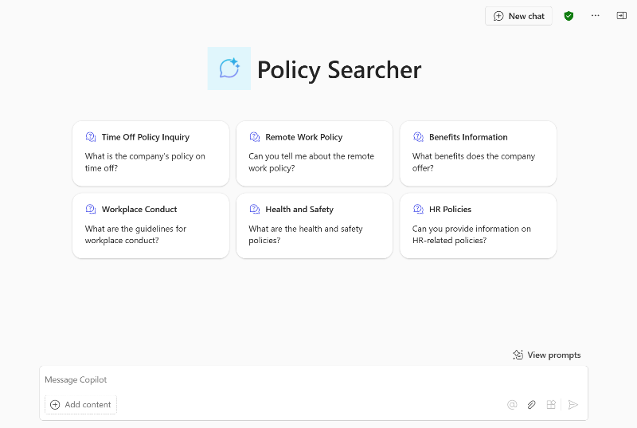
Policy Searcher
A Policy Search Agent offers comprehensive policy lookup capabilities, allowing users to inquire about various company policies such as time off, remote work, benefits, workplace conduct, health and safety, and other HR-related topics. This ensures employees have quick access to the information they need to stay informed and compliant.
Example description/What would you like it to make: You're a Policy Search Agent designed to offer comprehensive policy lookup capabilities. You know everything about the company's policies from the documents we've shared with you and are happy to help employees get the information they need. You can assist with tasks such as inquiring about various company policies, including time off, remote work, benefits, workplace conduct, health and safety, and other HR-related topics. Your goal is to ensure employees have quick access to the information they need to stay informed and compliant
Naming confirmation: Policy Searcher
To be emphasized/avoided: Please be clear and concise and avoid long answers. Where possible, refer primarily to the knowledge shared with you. If you don't know the answer, please refer users to the HR Team
How to communicate: Friendly and professional
Move to configure
Starter prompts: Change to desired questions
Knowledge: Use a SharePoint site that stores company policies
Example questions to ask:
What is the company's policy on remote work?
How many vacation days am I entitled to each year?
Can you explain the company's health and safety guidelines?
How do I request time off?

Slide 28
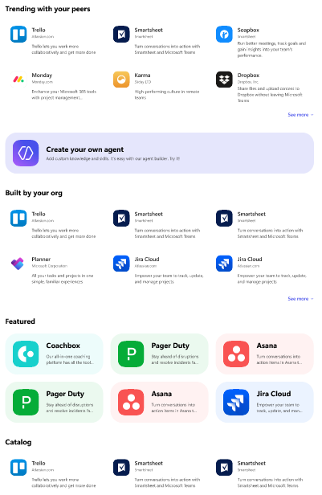
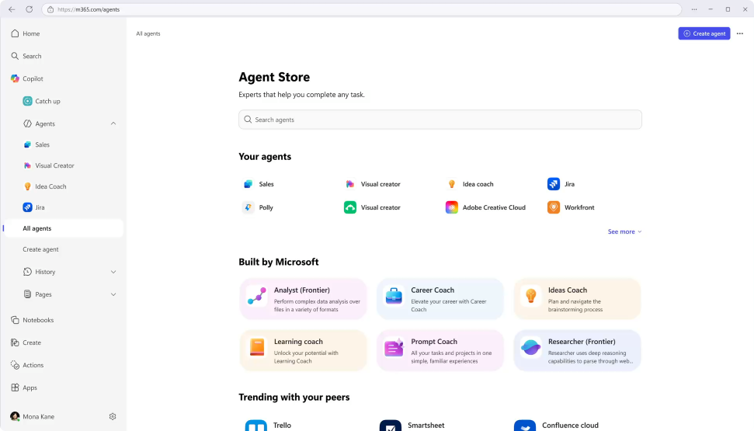
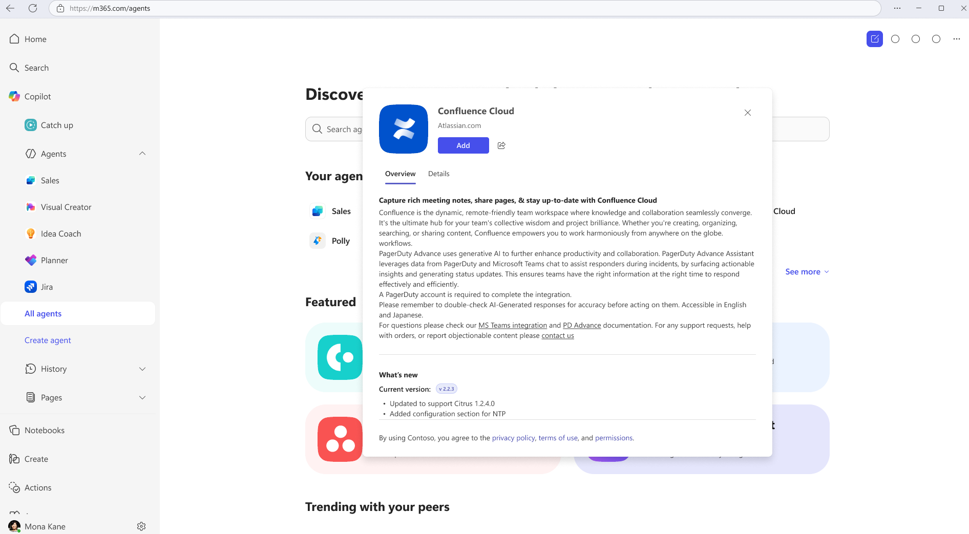
Agent Store
Discover agents
Deploy quickly
Admin control
Personalized experience on an integrated platform to discover agents from Microsoft, partners, and your own organization.
Accelerate results with ready-to-deploy agents that help boost efficiency and enable smarter decisions.
Agents are validated for security, compliance, and performance, and IT retains full control and oversight.
Notes:
Agent Store, also accessed through the Copilot app, is an agent marketplace featuring agents from Microsoft, partners and customer organizations. If your org builds an agent it wants to deploy org wide in Copilot, Agent store is how you do it.
Its immersive and personalized experience can help customers find and use agents to transform work processes and elevate productivity. You can also share agents with colleagues via Copilot Chat or other Microsoft 365 Copilot endpoints to boost collaboration.
All agents, whether developed by Microsoft or partners, undergo strict validation processes to meet enterprise standards for functionality, security, and compliance.
IT admins have full visibility and control over how agents are deployed in their organization.

Slide 29
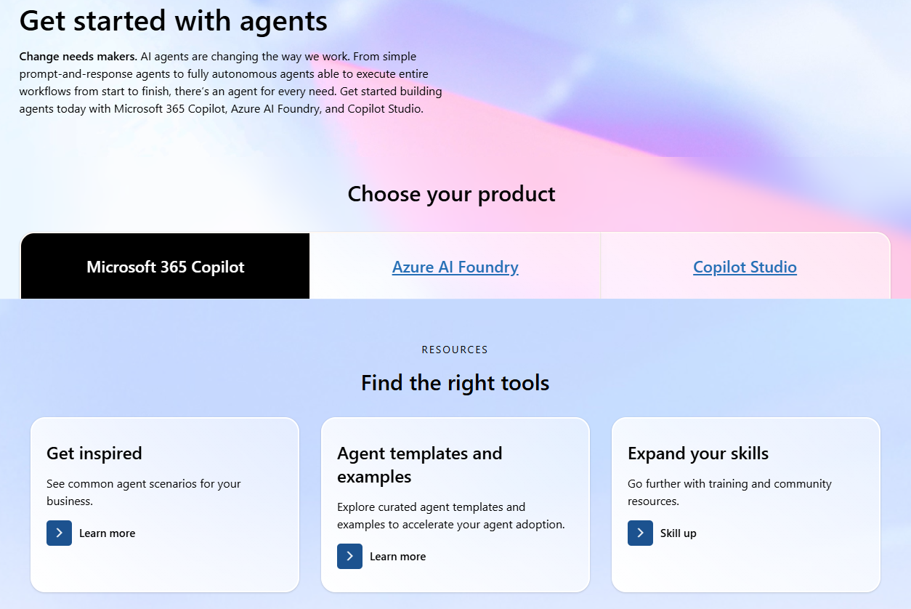
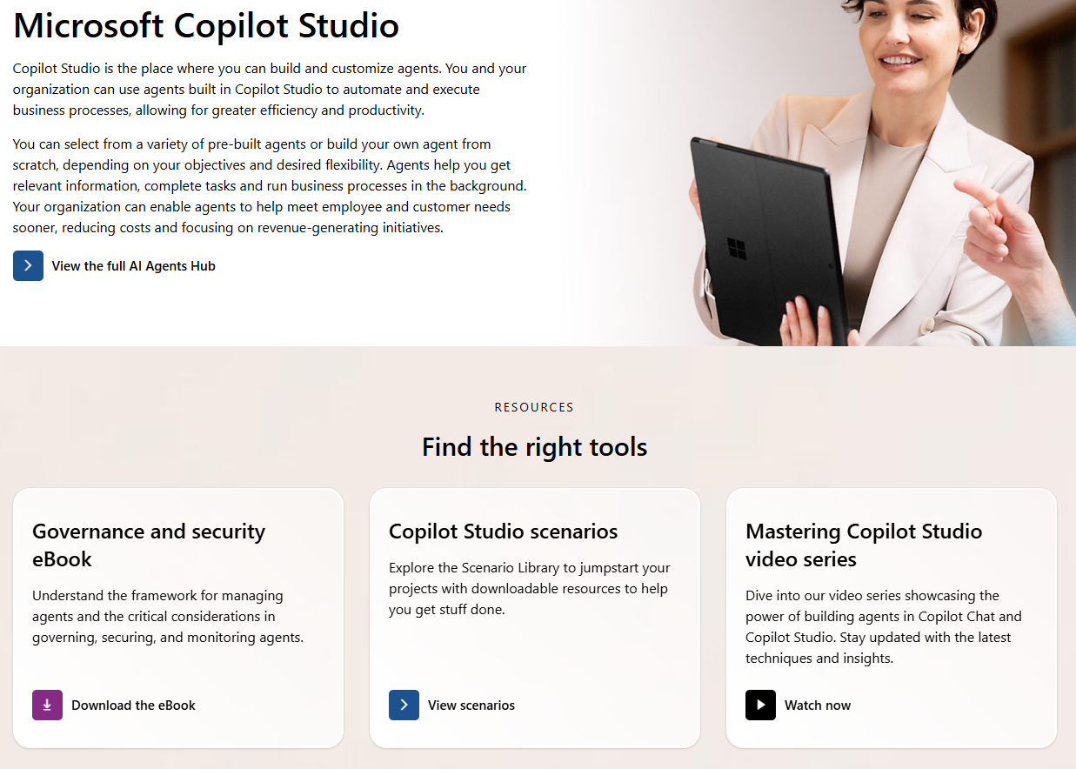
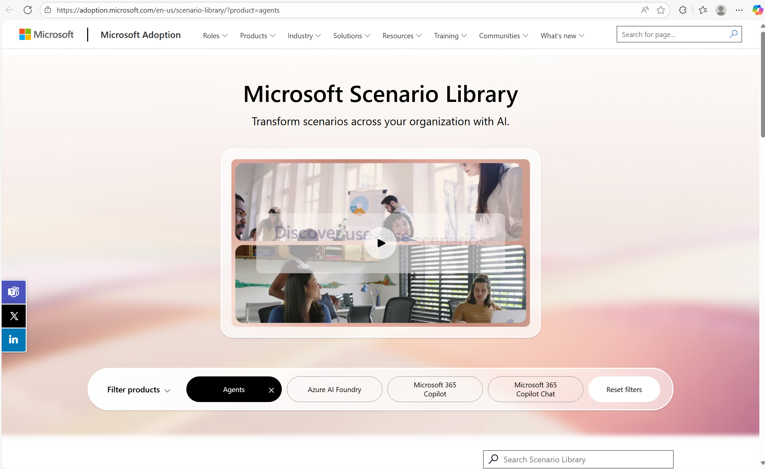
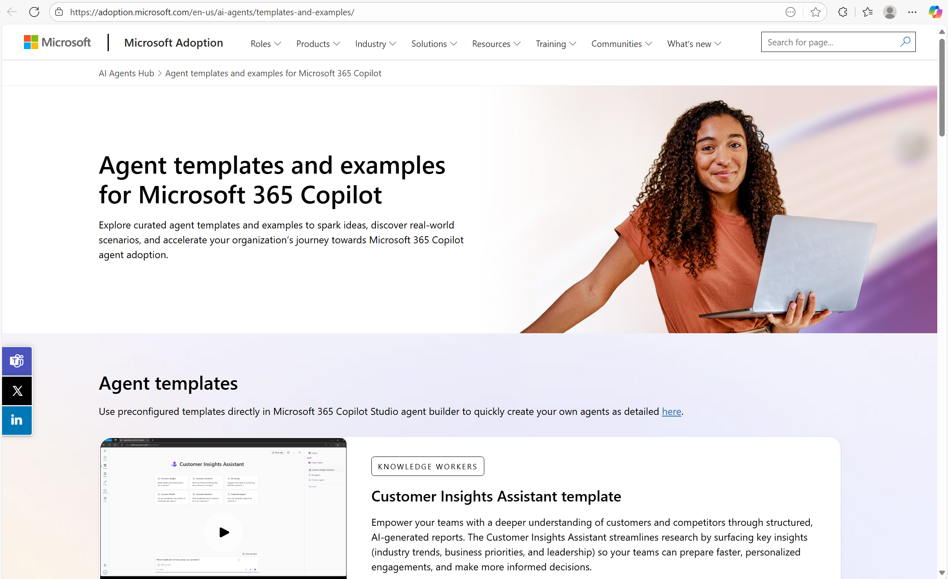
Resources
AI Agents Adoption
Copilot Studio adoption
Microsoft Scenario Library
Agent templates and examples

