Slide 1
Copilot Dashboard with Microsoft Viva Insights
Measuring business value of Copilot
Jan 2025

Slide 2

Implementation overview
Microsoft 365 Copilot
Get ready
Onboard & engage
Deliver impact
Extend & optimize
User Enablement Workstream
Complete User Enablement Strategy training
Define user experience and feedback strategy
Design and deploy training and engagement community (Community of Practice/Champion Platform)
Launch employee communications and Champion program
Onboard executives and user cohorts
Deliver user Champions and support staff training
Review success measures and user survey results
Conduct feedback and reporting analysis
Deliver extended training and adoption support
Identify additional optimization scenarios
Iterate user experience strategy
Gather and amplify success stories
Extend to new high value scenarios
Deliver business process transformation with Copilot Studio, plugins, and connectors
Drive group and cross-organizational productivity and innovation
Understand custom line of business opportunities
Secure exec sponsorship, create AI Council, and define RAI principles
Identify success owners, Champions, and early adopter cohorts
Detail high value scenarios and personas
Be intentional with assignment and concentrate seats
Define success criteria, KPIs, and success measurement plan
User Enablement
Technical Readiness Workstream
Ensure appropriate Data Security controls are in place
Prepare your organization for Microsoft 365 Copilot with setup guide: deploy Microsoft 365 apps, if needed; assign licenses
Assign permissions by role to provide access to the Microsoft 365 Copilot usage report
Establish service management plan
Analyze Microsoft 365 Copilot usage reports and the Microsoft Copilot Dashboard to observe user adoption, retention, and engagement
Design, build, and publish plugins to deliver unique experiences
Build your own custom agents
Perform the Microsoft 365 Copilot Optimization Assessment
Address data security, governance, and data access questions
Build shared Microsoft 365 Copilot implementation plan with User Enablement team
Technical Readiness

Slide 3
Accelerate AI workforce transformation with Microsoft Viva
Get ready
Onboard & engage
Deliver impact
Extend & optimize
Use the Copilot Dashboard to prepare for Copilot rollout
Use Copilot Dashboard to understand usage and adoption
Use Copilot Academy to train employees on critical AI skills
Develop communities to promote peer-to-peer best practice sharing and support your Copilot champions.
Use Copilot Dashboard to measure Copilot impact on workplace behaviors
Develop an employee app to connect your workforce to the information, resources, and tasks they need to succeed with Copilot
Get started with included capabilities
(Available with your Microsoft 365 Copilot license)
Use templatized survey tools to gather feedback and identify obstacles to adoption
Create and track goals for Copilot deployment and adoption
Run iterative AI communication campaigns on Copilot launch and use cases
Advanced Copilot reports with data beyond 28 days and more customization options to track adoption and usage
Measure business value of Copilot with pre-built templates and ability to connect third party data (e.g CRM, Finance)*
Gather survey feedback, insights, and user sentiment throughout the AI journey
Update progress against goals and inform all stakeholders with one-click broadcast
Share success stories and visualize communication campaign performance across channels
Capture Q&A and connect employees to solutions and experts
Employee survey tools to understand feedback and sentiment on Copilot impact and use cases
Accelerate with premium features
(Available with a Viva license)
* Currently in private preview

Slide 4
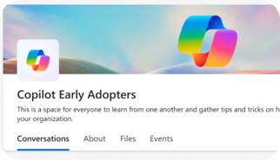
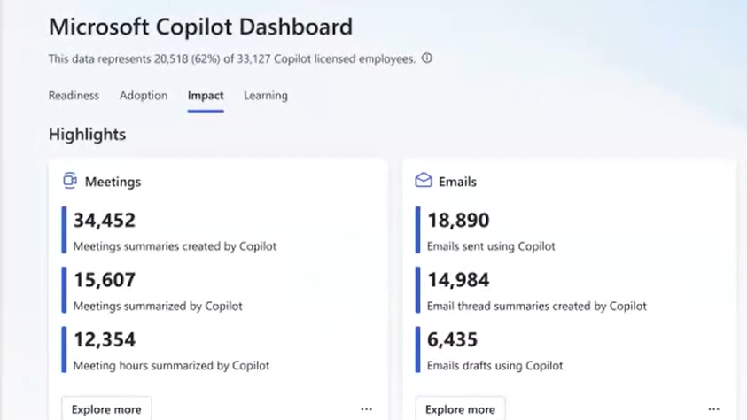
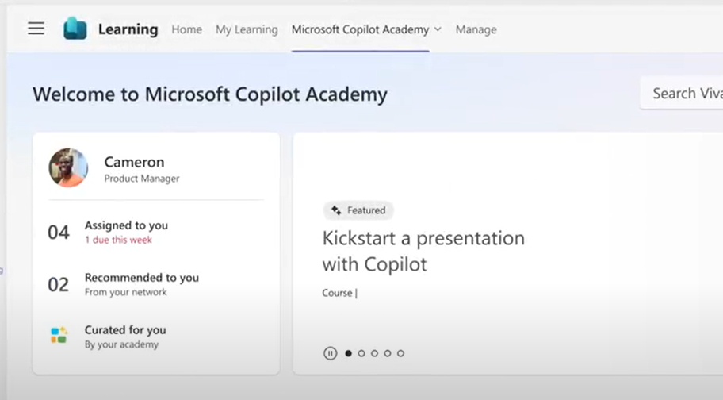

Accelerate your AI workforce transformation
Communications
Measurement
Skilling
Copilot Communities to facilitate user enablement
Share best practices
Access company announcements
Seek support from peers and IT
Copilot Analytics for ROI and impact assessment
Copilot Dashboard for leaders
Viva Insights for customizable analysis
Copilot business impact reports
Copilot Academy for user skill development
Curated learning paths
Hands-on prompt guidance
Content created by Microsoft experts
aka.ms/CopilotCommunities
aka.ms/CopilotAnalytics
aka.ms/CopilotDashboard
aka.ms/CopilotAcademy
Powered by Microsoft Viva
Notes:
Microsoft Viva can help accelerate your AI transformation in three areas:
Copilot communities, powered by Microsoft Viva Engage, facilitate user enablement, providing a Community of Practice for users to share their success stories and celebrate others’, ask questions, and find more training.
The Copilot Dashboard, powered by Microsoft Viva Insights, provides analytics and data on usage, as well as impact reports.
The Copilot Academy from Microsoft Viva Learning can be accessed in Teams, right in the flow of work, for user skill development and training.

Slide 5
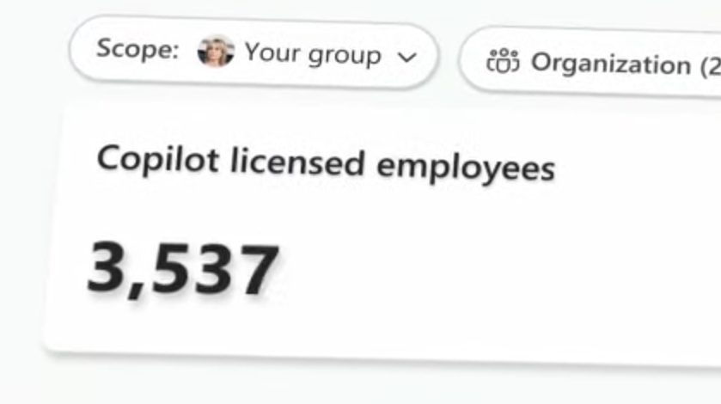
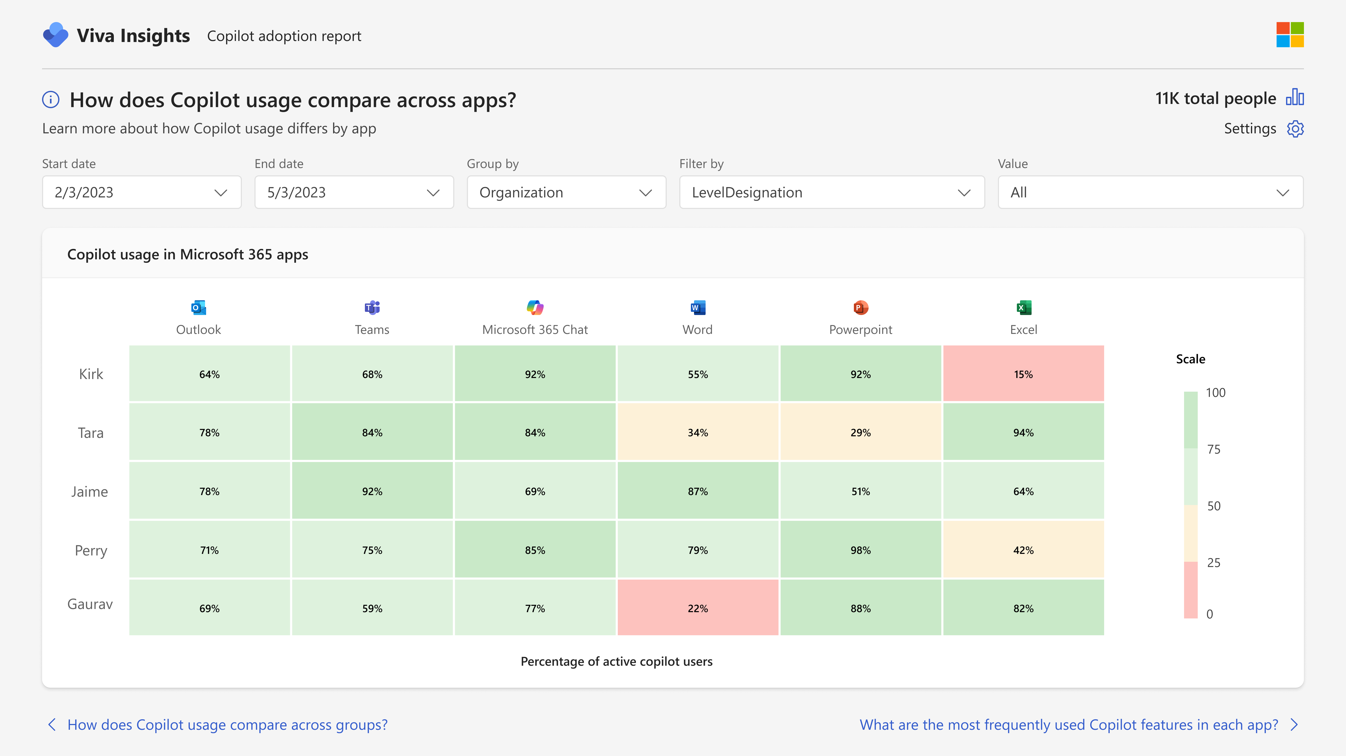
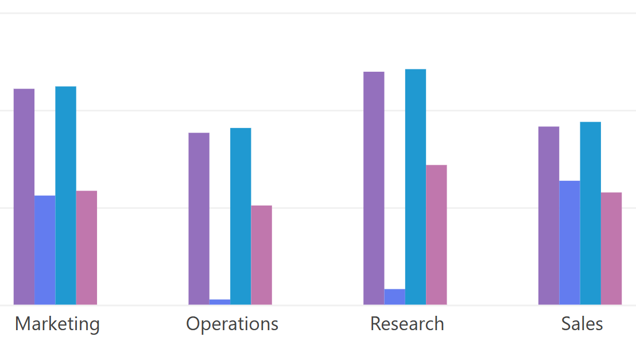
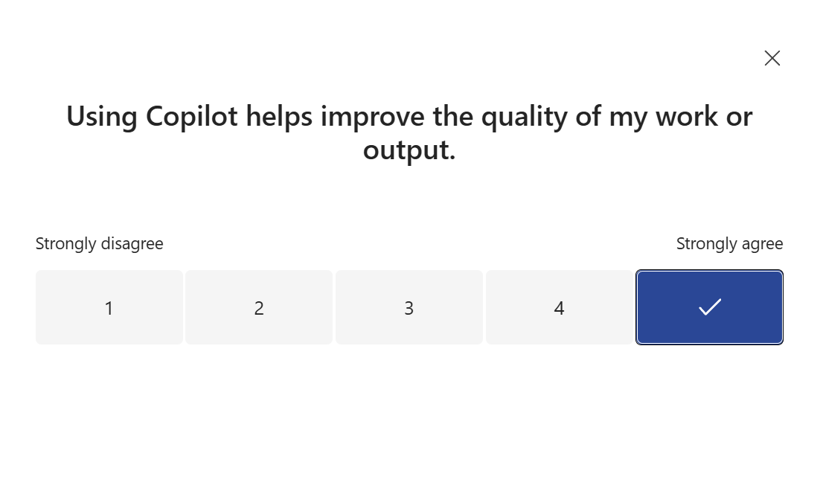

Measure impact, realize AI value
Measurement
Plan & monitor your deployment
Measure & analyze
Combine usage & outcome data
Human stories &
real-world impact
Core analysis
Extended analysis
Custom analysis
Gather stories & sentiment
Measure usage
Measure impact
Slice by org structure
Make informed decisions
Pre-built report templates
Enhanced metrics
Deeper org-structure insights
Dynamic date slicing
Build custom ROI analysis dashboards
Integrate with org outcome data e.g. customer service
Gather feedback on the Copilot experience across the org
Collect use cases relevant to your business case
Track feedback & sentiment over time
Microsoft 365 Copilot
Viva Insights Premium
Viva Insights Premium
Viva Glint
Viva Pulse
Available with your Microsoft 365 Copilot license
Available with Microsoft Viva licences

Slide 6








Leverage your existing Viva capabilities or Viva licensed features
Experience areas | Viva apps | Features | Included with Microsoft 365 | Included with Microsoft 365 Copilot | Included with Viva license
Communication | Viva Connections | Viva Connections Dashboard, Feed, Resources, and Teams app | ● |  | ●
 |  | Multi-instance support (up to 10 instances) |  |  | ●
 | Viva Engage | Communities, Conversations, Storyline, Live events | ● |  | ●
 |  | Copilot Communities |  | ● | ●
 |  | Copilot, Leadership Corner, Campaigns, AMAs, Storyline delegate posting, advanced analytics, Multitenant Organization, Answers |  |  | ●
 | Viva Amplify | Campaign management, multi-channel publishing, advanced analytics |  |  | ●
 |  | Copilot Deployment Kit to to onboard Copilot users. |  |  | ●
Skilling | Viva Learning | Viva Learning app in Teams with access to MS Learn and 300+ LinkedIn Learning courses | ● |  | ●
 |  | Copilot Academy to develop the skills to utilize Copilot experiences effectively |  | ● | ●
 |  | LMS and 3P learning provider integration, collections, learning paths, academies, add to calendar, Copilot in Viva Learning |  |  | ●
 |  | Skills in Viva** |  |  | ●
Measurement | Viva Insights | Viva Insights app in Teams with personal insights and experiences | ● |  | ●
 | Viva Insights | Copilot Dashboard to measure Copilot readiness, adoption, and impact |  | ● | ●
 |  | Advanced Copilot reporting capabilities to create to create custom reports and measure business impact* |  | ● | ●
 |  | Analyst workbench to customize and tailor premium organizational reports |  | ● | ●
 | Viva Pulse | Create, distribute, and customize team surveys, review reports & initiate post survey actions |  | Viva Pulse Copilot templates included | ●
 | Viva Glint | Employee engagement surveys, employee lifecycle surveys, customizable dashboards, benchmarks, actionable recommendations |  |  | ●
 | Viva Goals | Creation and management of Objectives and Key Results (OKRs), workflows and dashboard, Project and task integration, data integrations |  |  | ●

Slide 7
Available with your Microsoft 365 Copilot license

Slide 8
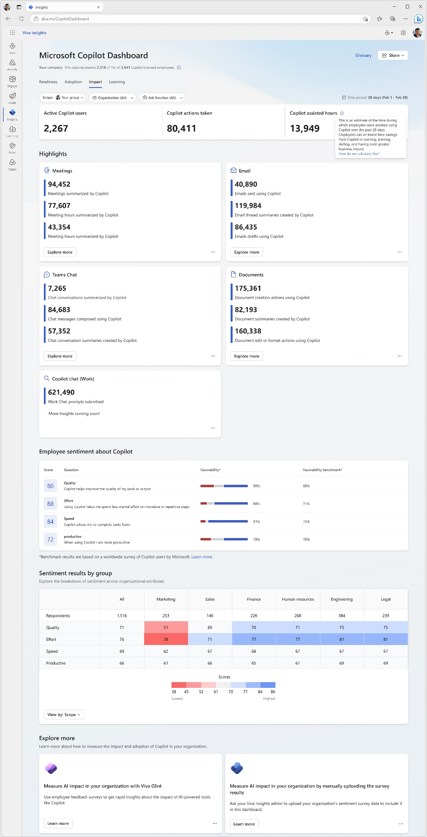
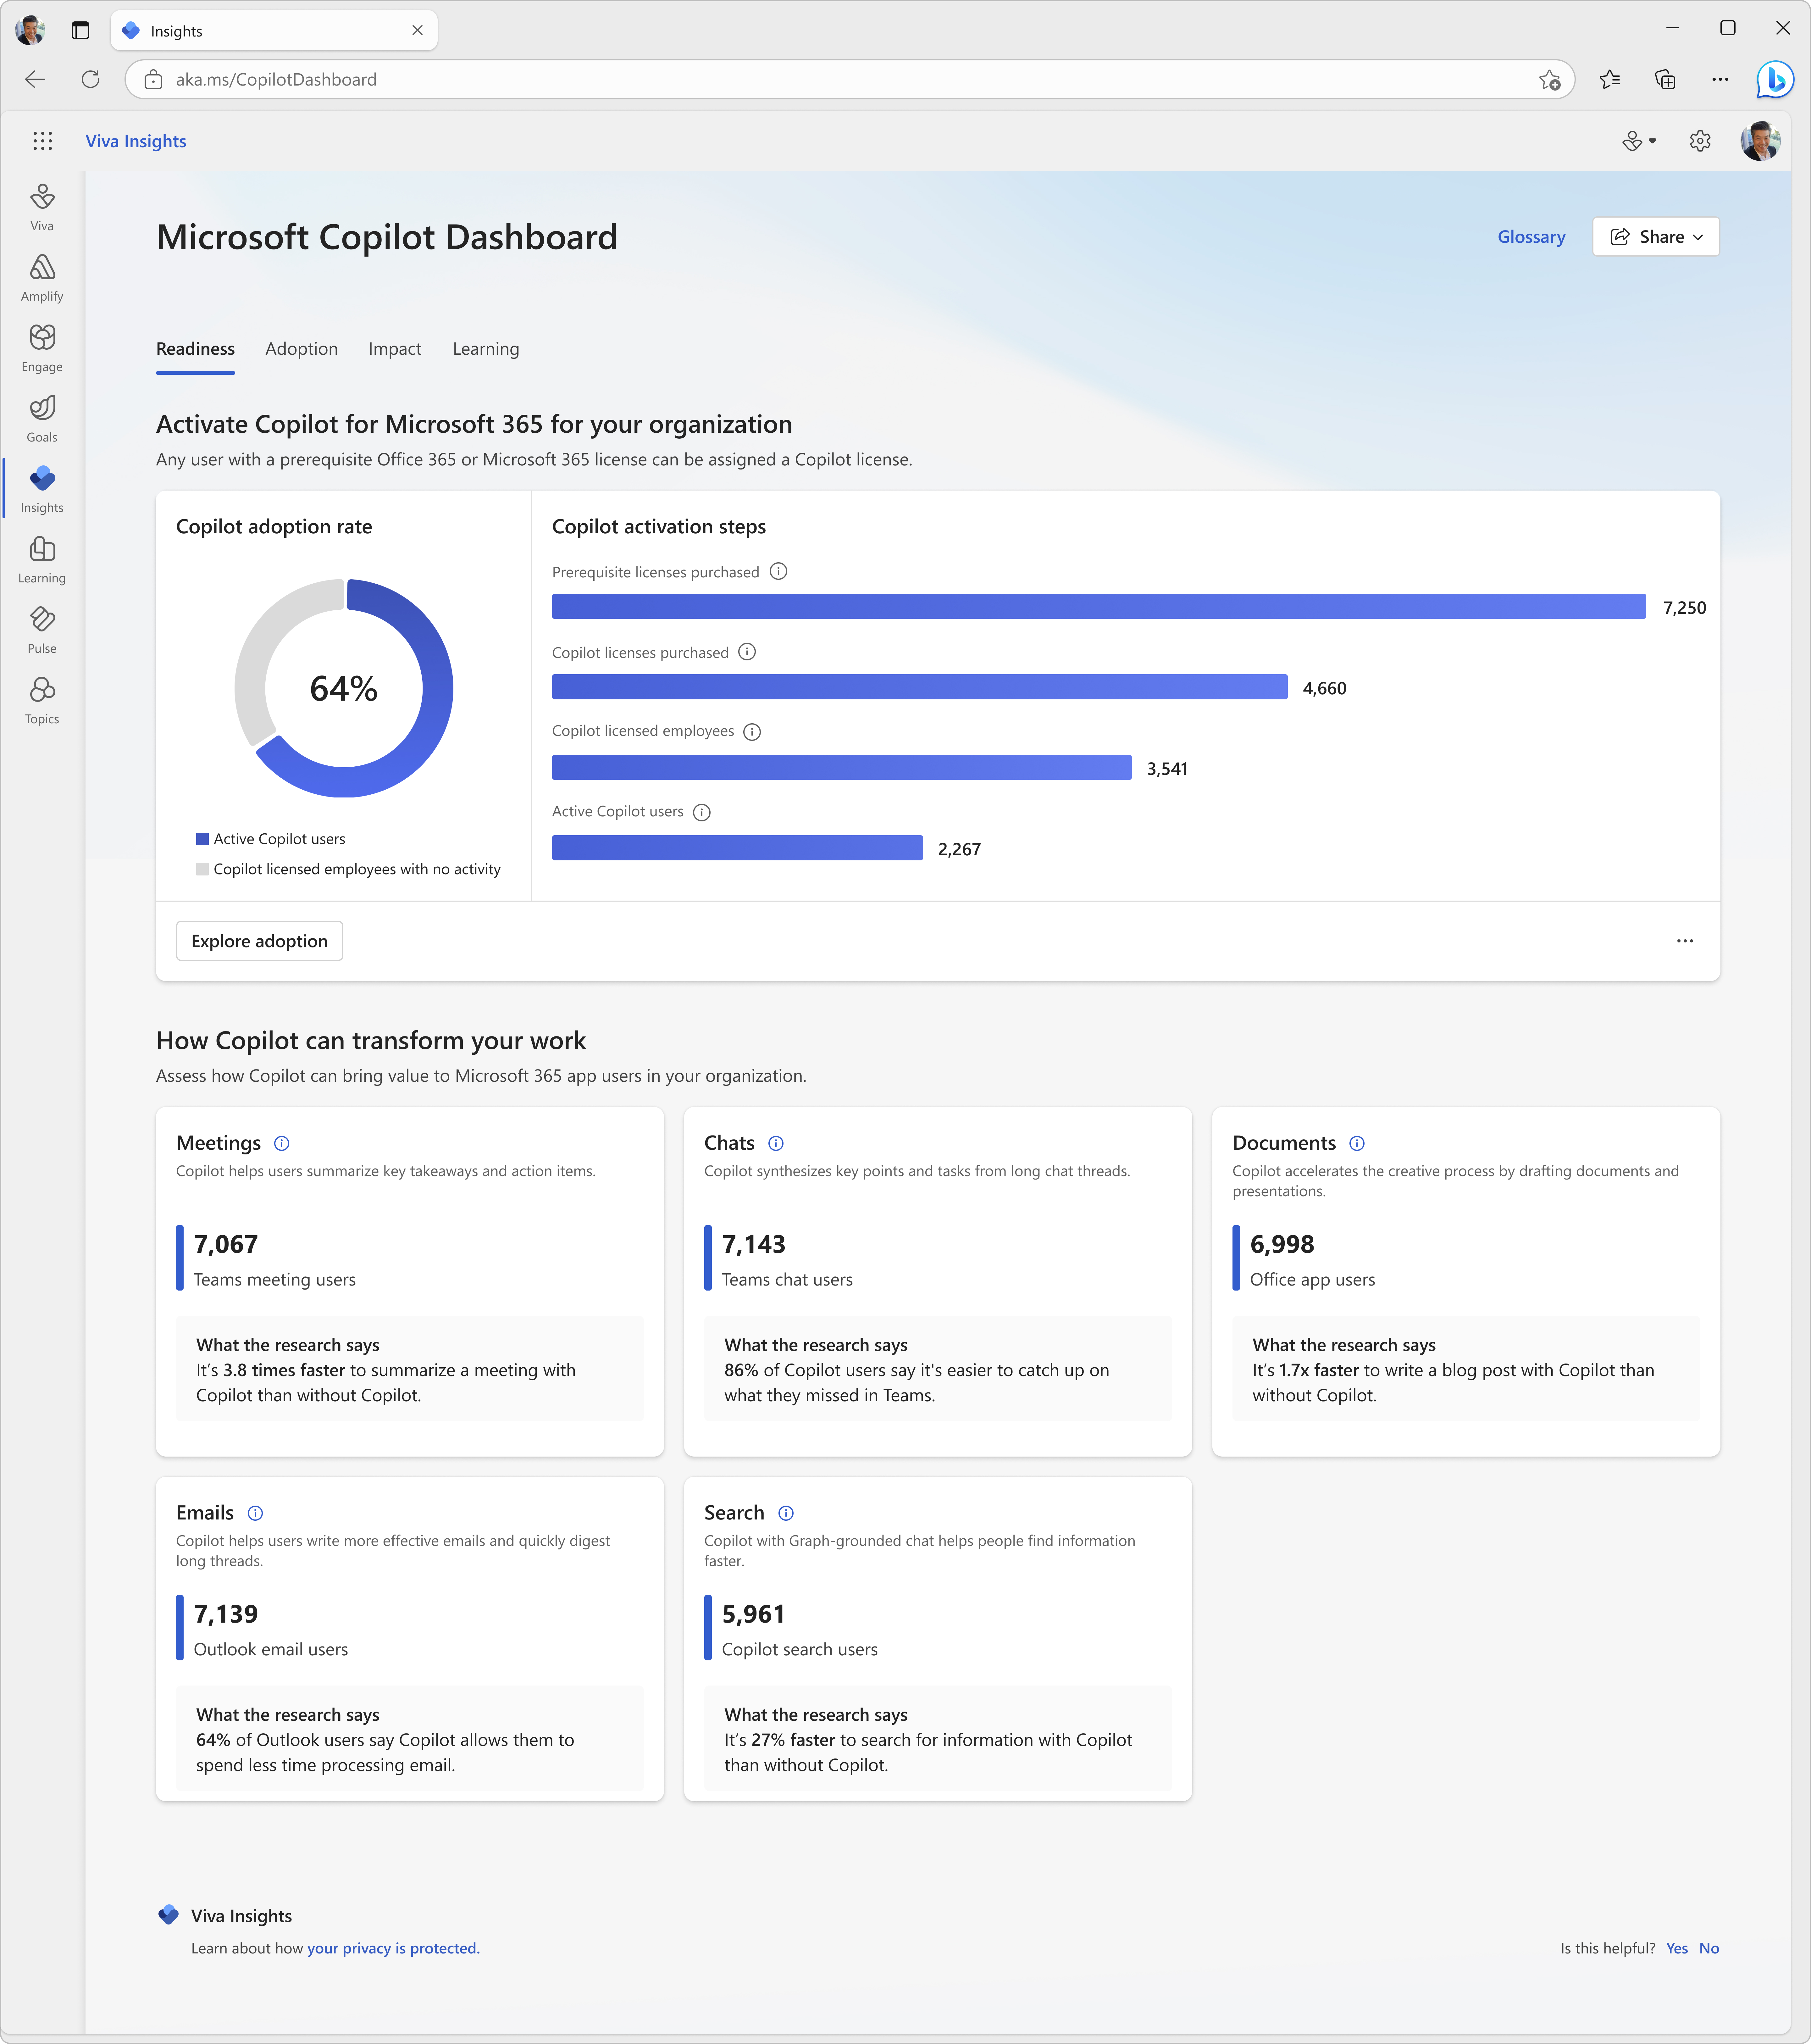

Copilot Dashboard
Measurement
Measure Copilot adoption and impact
Pre-built dashboard for business leaders to prepare for their Copilot rollout, understand and drive usage and adoption, and measure the impact of their investments.
Access directly at aka.ms/CopilotDashboard
Readiness tab to see licensing and copilot activation status across the tenant
Adoption tab to see Copilot trends and usage down to the app feature level, with filters to drill down by group, organization, and job function.
Impact tab to view Copilot actions by productivity categories, Copilot assisted hours and related value calculator and how Copilot usage is correlated with behavioral patterns in your business. Sentiment data from uploaded survey results is also available.
Learning tab for research and best practices to inform your AI journey
Use the Copilot Dashboard metrics eBook to help understand and interpret the data

Slide 9
Available with a Microsoft Viva license (All users that would access, experience or be included in these features require an applicable Viva license)

Slide 10
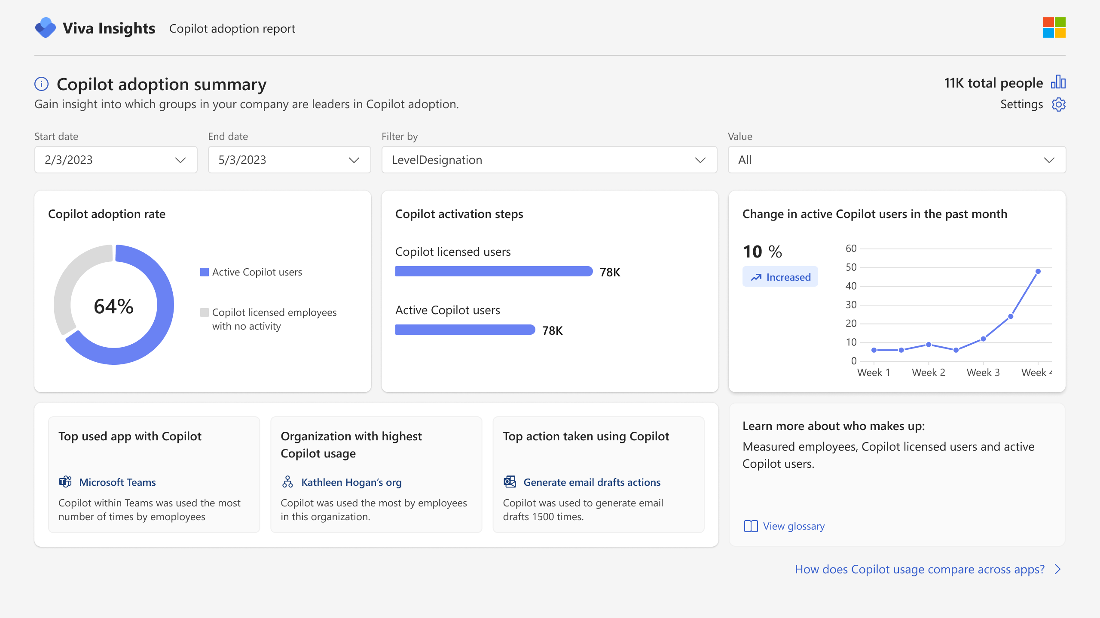
Advanced Copilot reports from Viva Insights
Measurement
Dynamic date slicers
Trendlines
Dive deeper into Copilot adoption and impact reporting with custom analytics
Start with a pre-built report template that can be tailored to include additional collaboration metrics and organizational attributes.
Create a report from scratch for a fully custom view; include additional organizational data, such as CRM or other outcome data.
View usage data older than 28 days with dynamic time ranges and customize metric definitions.
Group and filter by any org. attribute
Learn more at Microsoft Viva Insights | Employee Engagement
Notes:
Finally, Microsoft Viva delivers powerful, data-driven insights to help you maximize the value of your Microsoft 365 and Copilot investment.
We believe that by delivering the right insights and recommended actions, we can help you drive meaningful changes and we want to deliver these insights in a way that is conveniently accessible to the right people in your organization. So, we’ve recently introduced the new Microsoft Copilot Dashboard, powered by Viva.
The Copilot Dashboard helps you measure the impact of Copilot on employee productivity and sentiment, and get a better understanding of Copilot readiness, usage and adoption.
Here’s how it works: - upon launching the dashboard, you’ll see three sections:
Starting with Readiness, an overview of the technical eligibility requirements for Microsoft 365 Copilot usage, the number of users who are in a position to get the most benefit from Copilot licenses, and the volume of work activities that can be transformed using Copilot.​
Once your organization is onboarded, the Adoption section offers senior leaders visibility into the number of users in your organization that using Copilot, and a breakout by Microsoft 365 app, over a rolling 30-day period. This section also shows the number of active users by key Copilot features, like summarization of enterprise content, or AI-assisted creation of new files or content.​
Next, the dashboard conveys Microsoft 365 Copilot impact by showing the volume of AI-assisted actions per user per week, and the rate at which Copilot-generated content is kept by users.
The Copilot Dashboard is available in preview for select customers and will be generally available worldwide in late Q1 of 2024.

Slide 11
Microsoft investments to accelerate your time to value
Customers that buy more than 150 Copilot seats are eligible for Microsoft co-investment in partner deployment and adoption services through eligible Microsoft Partners.
Eligible customers can request technical and deployment assistance from Microsoft FastTrack.
Get started on your Copilot journey with expert-led services through Microsoft Unified.

Slide 12
Links to learn more (1 of 2)
How Copilot works
How Microsoft 365 Copilot works: Microsoft Mechanics video
Semantic Index for Copilot
Microsoft Graph
Microsoft Graph connectors
Additional copilot experiences across the Microsoft Cloud
Microsoft Dynamics 365 Copilot
Copilot in Power Platform
Microsoft Security Copilot
GitHub Copilot
Copilot in Microsoft Stream
Privacy
Microsoft’s privacy policy
Microsoft Privacy Statement
Trust Center data protection and privacy
Data, privacy, and security for Microsoft 365 Copilot
Data, privacy, and security for Azure OpenAI Service
Role-based access control
User permissions and permission levels in SharePoint Server
Customer Lockbox requests
Microsoft 365 isolation controls
Data Protection Addendum
Copilot Readiness Hub
What is Copilot?
Introducing Microsoft 365 Copilot
The Copilot System
ChatGPT vs. Microsoft 365 Copilot: What's the difference?
What is Microsoft Viva?
Microsoft Viva overview
Get started with Viva: plans and pricing
Learn more about Microsoft Copilot Dashboard
Learn more about Microsoft Copilot Academy
Learn more about Copilot Deployment Kit
Learn more about Copilot communities
Viva customer success stories

Slide 13
Links to learn more (2 of 2)
Data residency and storage
EU Data Boundary
Website
Blog
Documentation
Compliance
Microsoft Compliance
Service Trust Portal
Compliance offering definitions
General Dat Protection Regulation (GDPR)
Full summary
Short summary
Security
Configure usage rights for Azure Information Protection (AIP)
Universal Licensing Terms for Online Services
Data Protection Addendum
Isolation and Access Control in Microsoft 365
How to prepare for Microsoft 365 Copilot
Learn about Microsoft feedback for your organization
Manage Microsoft feedback for your organization
How to manage Microsoft Search
Microsoft 365 Product Terms
Content management and security in SharePoint, OneDrive, and Teams
Transcription Management in Microsoft 365 Copilot
Responsible AI
Responsible AI core principles
Videos
Documentation
Microsoft Responsible AI Standard
Governing AI: A Blueprint for the Future

