Slide 1
Microsoft 365
Managing employee attention

Slide 2
“Should I be multi-tasking?”
“I have too many meetings”
“Analysis-paralysis”
“I don’t have enough time”
“I need time to do my job”
The Dark Side of collaboration
“Too many notifications everywhere”
“I am getting too tied during my day”
“I get too many emails”
“I can complete all my work”

Slide 3
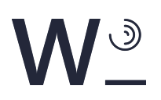
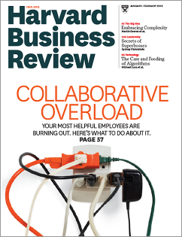
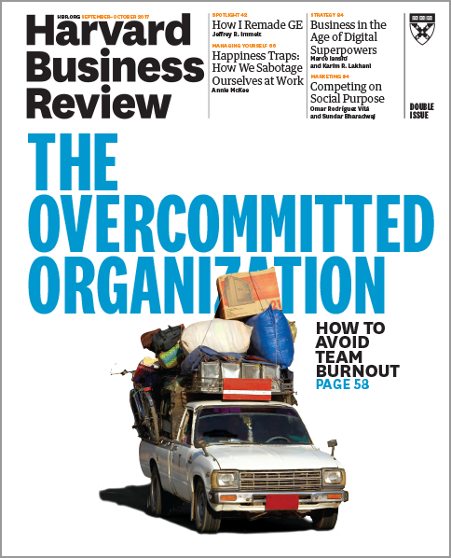
Collaboration Overload
Leaders ask:
How much time do we spend talking about work vs doing work?
How many hours do we spend in meetings and email?
How often are people doing redundant work?
How much work do we need to make up after hours?
What we’ve learned:
Burnout is reaching epidemic proportions
80% of time spent in meetings
or answering colleagues’ requests.
It’s a systems problem, not a personal problem
81-95% work concurrently work
in more than one team
Sources:
Collaborative Overload, Harvard Business Review 2016
The Overcommitted Organization, Harvard Business Review 2017

Slide 4
Collaboration (noun)
The action of working with other people or organizations to create or achieve something
‘The new airport is the result of a collaboration between two of the best architects in the country’
Traitorous cooperation with an enemy
‘he faces charges of collaboration’
Origin: Mid 19th century from Latin (colaboratio(n-), from collaborare ‘working together’.
Cambridge Business English Dictionary © Cambridge University Press

Slide 5
Collaboration = Common Goal + Effort + Commitment
1
2
3

Slide 6

Collaboration Pyramid
Business
outcomes
Collaboration = Common Goal + Effort + Commitment
C
B
Modern
Collaboration Architecture
(MOCA)
Communications Flow
Information
Flow
Focused employee attention
A

Slide 7

01 Getting things done
Managing employee attention

Slide 8



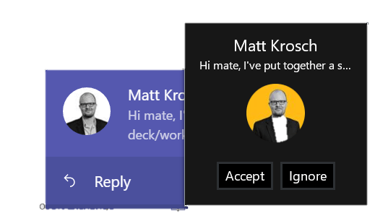

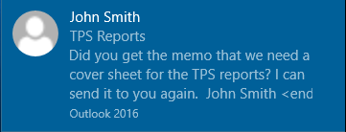
How our attention works
Weekly Report
Distraction #3
Distraction #2
Distraction #1

Slide 9
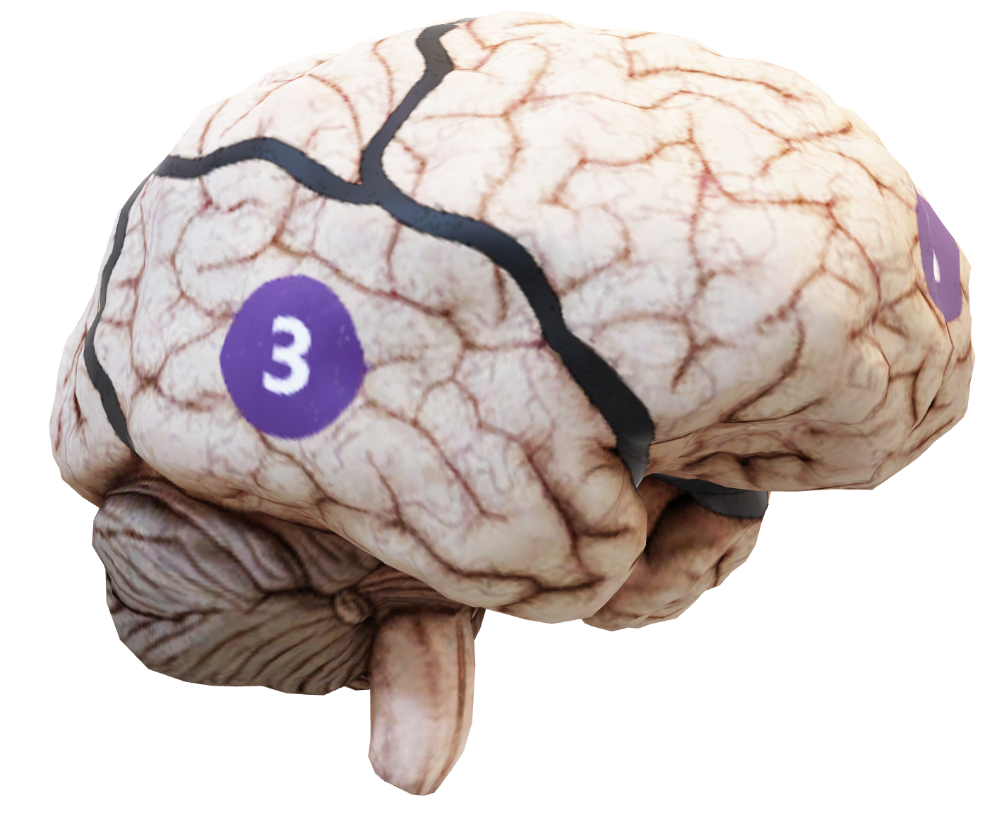
Strengthening your attention
Mental Stillness | Thoughtless Awareness
  Attention is awareness of the here and now in a focal and perceptive way.
Notes:
For free online classes to strengthen your attention, visit
http://www.sahajaonline.com
https://wemeditate.co/

Slide 10


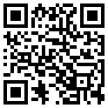

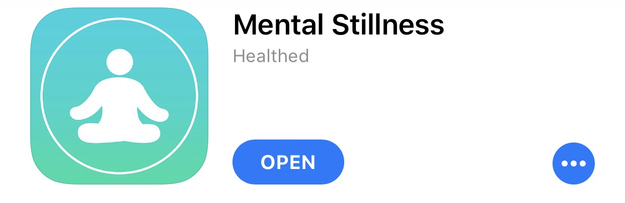


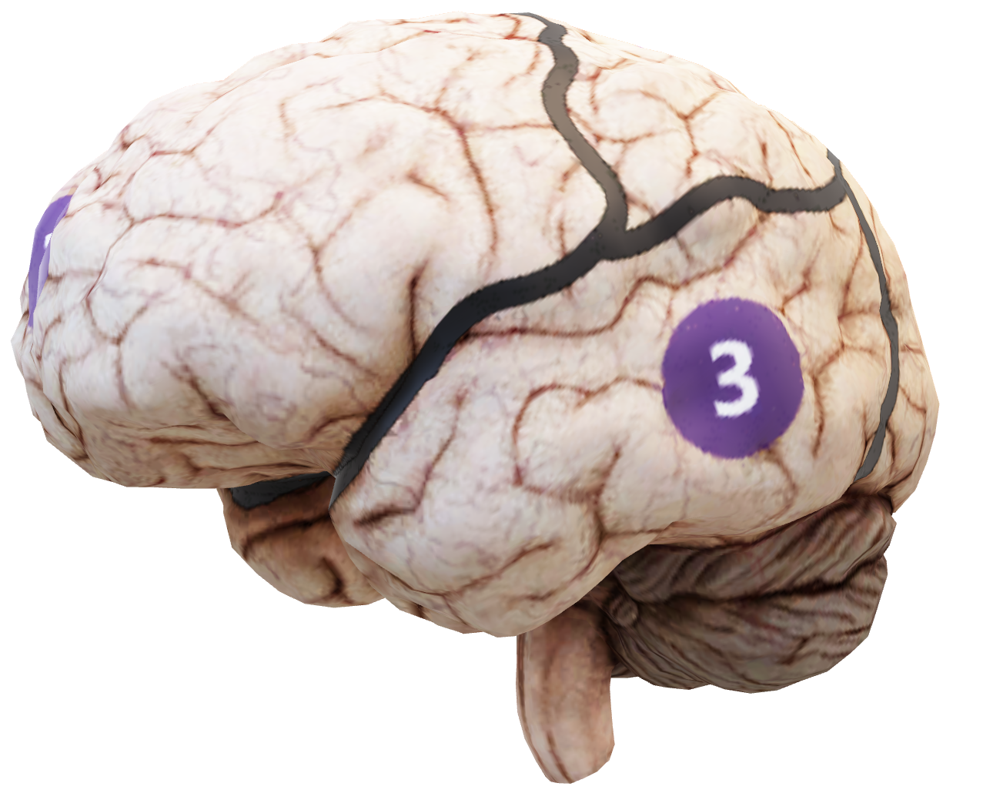
Strengthening your attention
Mental Stillness | Thoughtless Awareness
  Attention is awareness of the here and now in a focal and perceptive way.
Allocate Focus time in your
calendar
Do not build communities in
team areas
Resist multitasking when in
meetings
Turn on ‘focus assist’ in
to reduce notifications
Manage employee workload
Use the Modern Collaboration Architecture – right tool for the right job
Download the free phone app
Notes:
Silence Your Mind (by Dr. Ramesh Manocha) book - https://www.amazon.com/Silence-Your-Mind-Ramesh-Manocha/dp/0733637361/ref=tmm_pap_swatch_0?_encoding=UTF8&qid=1590370904&sr=1-1

Slide 11
Usage ≠ Adoption
Individual Choice
End User
Change
The act of a user consuming a service that’s made available to them
(ad-hoc consumption; people see new features but don’t know what to do with them)
Deep, habitual usage that delivers tangible value to the employee, Line of Business, and/or the organization
Usage ≠ Adoption
No Change Management
With Change Management

Slide 12
Thank you. http://aka.ms/MOCA

