Slide 1
WEST Member Meeting
Why WEST Now? Protecting our foundations in times of turmoil and uncertainty
July 24, 2025
10am-11:30am PDT/MST
11am-12:30pm MDT
12-1:30pm CDT
1-2:30pm EDT
Notes:
Good morning and afternoon, everyone - thank you so much for joining us today. My name is Alison Wohlers, and I am the WEST Program Manager.

Slide 2
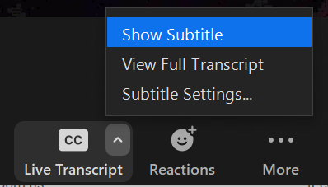
Sound and Visual Check
Can you hear the presenter?
(please note any audio issues in the chat)
Zoom Live Transcript is enabled →
This meeting is being recorded.
Notes:
Nika will screenshare
To post in chat:
Please let us know if you aren’t able to hear the speaker!
Also post in chat:
Live captioning is available for this meeting--at the bottom of the Zoom window in your meeting controls you should see an option for Live Transcript, where you can turn this feature on. Please note that the captioning is automatically generated by Zoom, so some words may transcribe strangely due to regional accents or because we are using library-specific terminology.
Alison 1 min
Before we get started with the meeting, we have a few housekeeping matters to cover. I want to do a quick check that everyone can see the screen (a slide that says “Sound and Visual Check”) and that the speaker’s audio is coming through well. If you can’t see the screen please let us know either by unmuting, or in the chat. Nika is also putting a note in the chat now to confirm everyone can hear the speaker.
Live captioning is available for this meeting--at the bottom of the Zoom window in your meeting controls you should see an option for Live Transcript, where you can turn this feature on.
Finally, everyone was muted upon entry. We ask that you remain muted during presentation portions to avoid audio interference, but please feel free to unmute yourselves during breaks for questions.
As a reminder, this meeting is being recorded, starting now.

Slide 3
WEST Member Meeting
Why WEST Now? Protecting our foundations in times of turmoil and uncertainty
July 24, 2025
10am-11:30am PDT/MST
11am-12:30pm MDT
12-1:30pm CDT
1-2:30pm EDT
Notes:
[Cycle through briefly just to have the title slide show up in the meeting recording] Just to repeat for the recording, hello everyone, I’m Alison Wohlers, WEST Program Manager and this is our annual WEST member meeting. I’ll turn things over now to our WEST Executive Committee chair, Jo Anne Newyear-Ramirez to get us started.

Slide 4
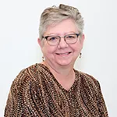
Welcome & opening remarks
Jo Anne Newyear-Ramirez
WEST Executive Committee Chair
Associate University Librarian for Scholarly Resources at UC Berkeley
Notes:
Jo Anne Newyear-Ramirez - Welcome

Slide 5
Welcome to continuing and new WEST members!
Notes:
Jo Anne Newyear-Ramirez

Slide 6
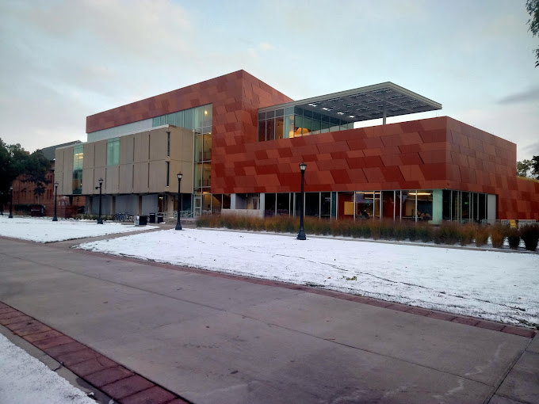
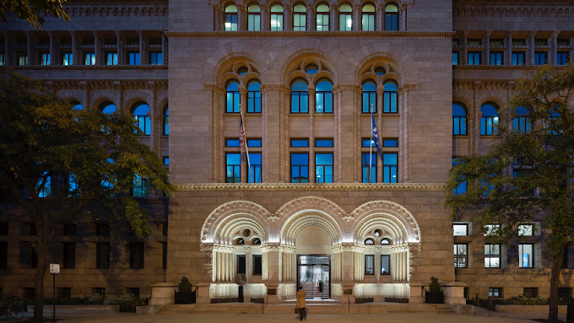
Welcome to WEST!
Newberry Library
  Consortium of Academic and Research Libraries in Illinois (CARLI) consortial agreement
Colorado College
  Colorado Alliance of Research Libraries consortial agreement
Notes:
Jo Anne Newyear-Ramirez

Slide 7
Today’s Agenda
Why WEST Now? Protecting our foundations in times of turmoil and uncertainty
Welcome and opening remarks
Collaboration in times of uncertainty - panel discussion
How we’re taking action as a community in WEST - lightning talks
  WEST Internet Archive Pilot
  WEST ASU Gap-filling Pilot
  WEST Communication Resources
Thank You & wrap-up
Notes:
Jo Anne Newyear-Ramirez
For the chat:
You can also follow along with the agenda here:
https://docs.google.com/document/d/1CaPm1DoauzdBp6TmIkoUMMJ8IK0PTK-8flmadEgajHk/edit?usp=sharing

Slide 8
Collaboration in times of uncertainty
Panel Discussion
Notes:
Alison - Thank you, Jo Anne!

Slide 9
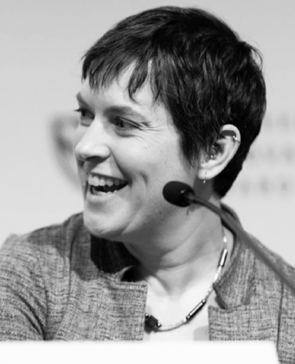
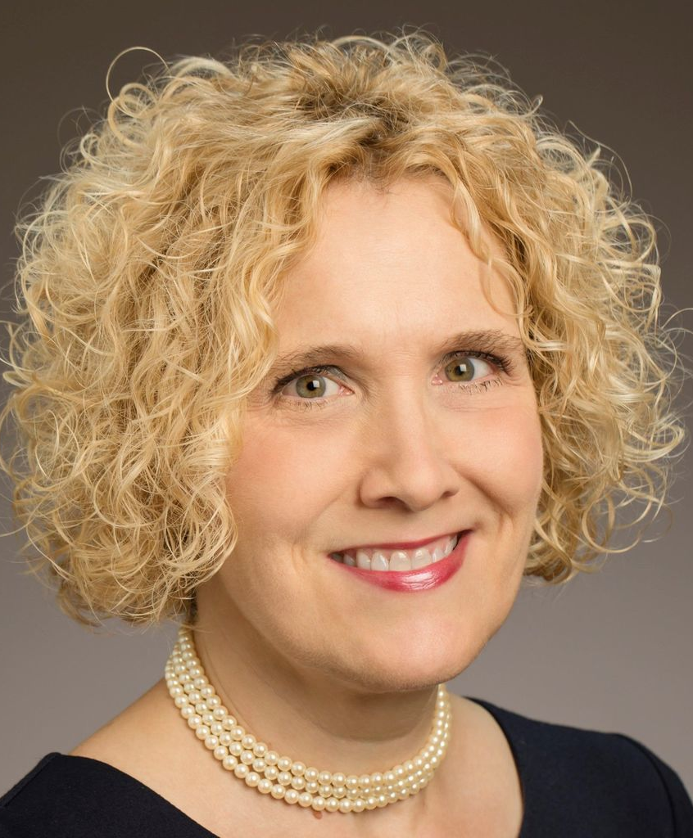
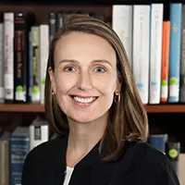
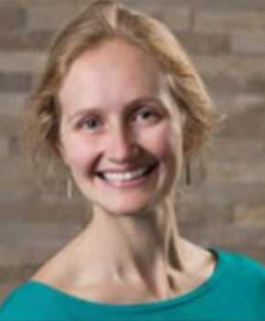
Panelists:
Karen Estlund, Dean of Libraries, Colorado State University Libraries
Anne Craig, Senior Director, Consortium of Academic and Research Libraries in Illinois (CARLI)
Danielle Salomon, Director of Libraries, Mount Saint Mary’s University
Moderator: Alison Wohlers, WEST Program Manager
Notes:
Karen Estlund, Dean of Libraries, Colorado State University Libraries
Anne Craig, Senior Director, Consortium of Academic and Research Libraries in Illinois (CARLI)
Danielle Salomon, Director of Libraries, Mount Saint Mary’s University
Stop screensharing for the panel discussion
For the chat
Membership review template: https://docs.google.com/spreadsheets/d/1aRjAkxwKLZ6gypQPmiLl1otCaqDTPISE/edit?usp=sharing&ouid=102132535710939408185&rtpof=true&sd=true
CARLI membership resources:
https://www.carli.illinois.edu/sites/files/files/FY2024ValueGraphics.pdf
https://www.carli.illinois.edu/membervalue.html

Slide 10
Audience Questions & Discussion
Notes:
Not necessary to rescreenshare

Slide 11
How we’re taking action as a community in WEST
Lightning talks - what, so what, now what
Notes:
Alison Screenshare

Slide 12
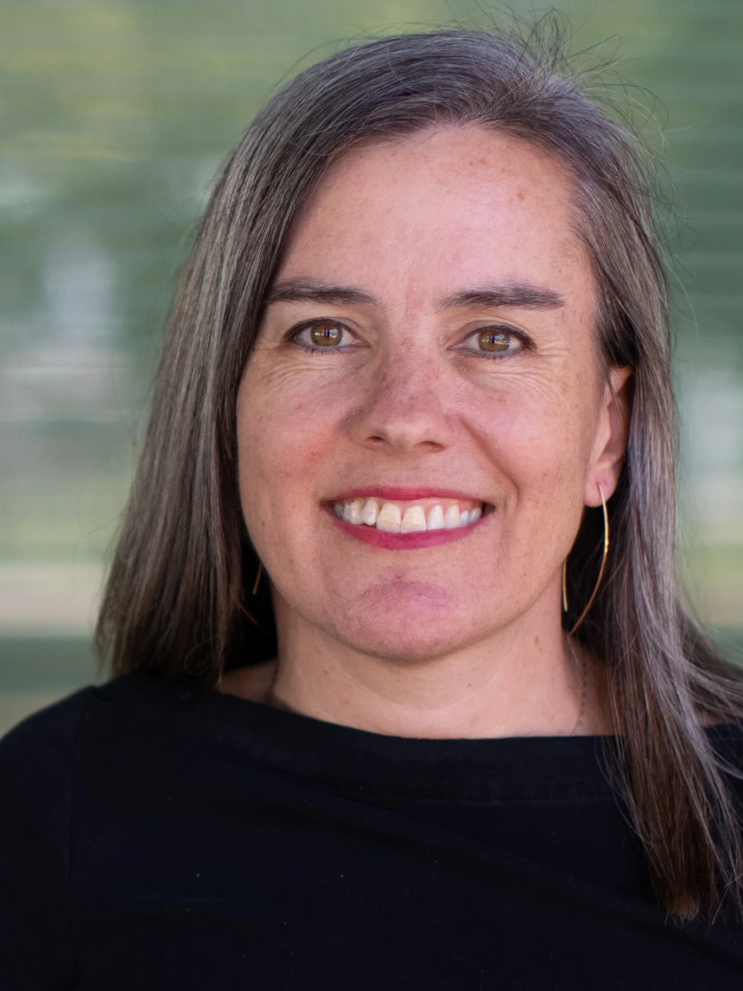
WEST Internet Archive Pilot
Niamh Wallace
WEST Operations and Collections Council Member
Associate Librarian / Print & Collaborative Collection Initiatives Unit Lead
University of Arizona

Slide 13
What
WEST goal: extend core service (ensuring access to scholarly print record) by expanding and expediting digital access to WEST serial titles
UA’s goal: participate in shared print to relieve overcrowding while maintaining broad access to content
Pilot project: donate extra copies of WEST archived serials to the Internet Archive for digitization and access via interlibrary loan

Slide 14
So What
Allows us to free up much needed shelf space while retaining access to WEST serial titles
Expands Internet Archive’s digital corpus of serial content available to users worldwide through ILL
Worked well: cohort approach allowed us to share experiences and expertise throughout process
Challenge: gathering and analyzing data for decision making

Slide 15
Now What
For UA: plan for strategic collection shifts into freed-up space
For WEST:
  Turn the pilot scope into a regular workflow and service
  Build in gap-filling step
  Explore possibility of deposit of WEST titles digitized by IA with the HathiTrust Digital Library
  Increase discoverability of WEST titles digitized by IA
  Gather statistics on ILL usage of digitized collection from IA
  Incorporate IA serials data into AGUA to support future workflow
Notes:
For the chat (Alison): https://cdlib.org/wp-content/uploads/2025/06/WEST-Internet-Archive-Pilot-Final-Report-and-Recommendations-2025.pdf

Slide 16
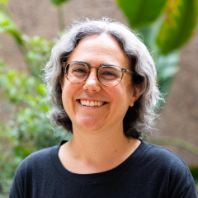
WEST ASU Gap-filling Pilot
Shari Laster
WEST Executive Committee vice chair
Head, Open Collections Curation and Access / Interim Associate University Librarian, Collections
Arizona State University

Slide 17
What
Over 20% of medium and high risk WEST archived titles are estimated to be under 50% complete
ASU revisited a selection of medium and high risk titles and explored the cost-benefit of different approaches to filling gaps
  Extend the commitment to additional local holdings
  Revisit ‘calls for holdings’
  Passive approach - receiving incidental offers

Slide 18
So What
To ensure future access and our ability to digitize content we need the medium and high risk titles to be as complete as possible…
  But what’s the best way to do that outside of the workflows we already have?
Future revisited gap-filling activities should focus on:
  Building on additional local holdings to extend archived titles
  Generally encouraging WEST members to make offers leveraging tools in AGUA and JRNL

Slide 19
Now What
ASU was particularly well-positioned for the pilot because:
  Long-time Builder with deep institutional memory and experience of WEST workflows
  Available capacity as we wrapped up the pool of eligible new titles
  Interest in exploring new avenues for collective collections
Selected recommendations for WEST include:
  Consider updating disclosure guidelines to include the entire run of the journal family
  Consider investigating the effectiveness of calls for holdings
  Continue to invest in infrastructure (e.g., JRNL and AGUA)
Notes:
For the chat (Alison): [gap filling report link]

Slide 20
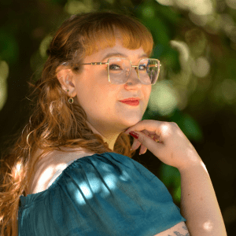
WEST Communication Resources
Nika Burns Teshin
Shared Print Analyst
WEST

Slide 21
What
We are working to connect WEST and member priorities and highlight those connections by enhancing existing communication resources and creating new ones
  Member strategic priority analysis
Goal: Help member libraries connect their work in WEST with work happening across their libraries
Notes:
[Working to connect WEST and member priorities]
Put in the chat: https://cdlib.org/cdlinfo/2025/06/18/mapping-member-strategic-priorities/

Slide 22
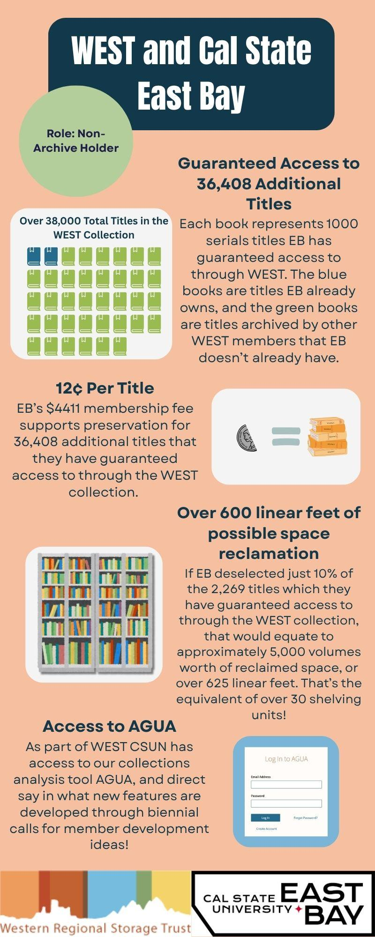
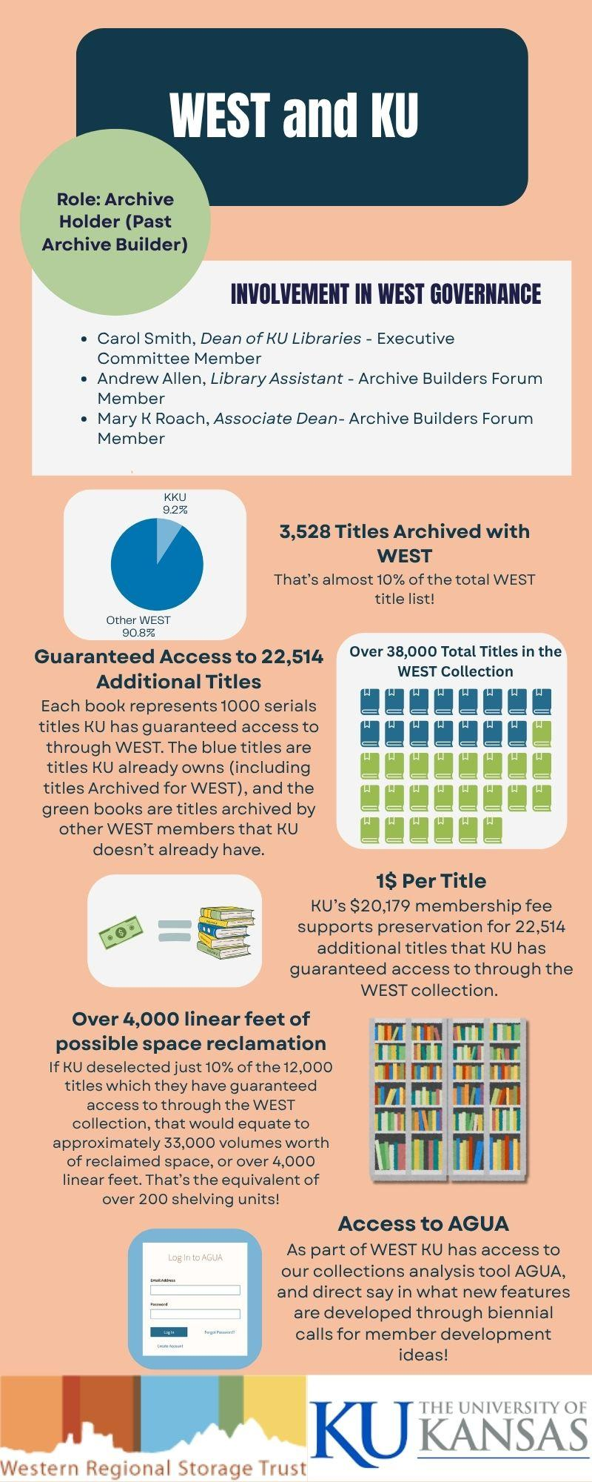
So What
Recent blog posts with examples and more information:
  Moments of Community Action:
    Celebrating WEST Member Contributions to Community Documentation
    The Iowa State Cyclones Answer the Call (for Holdings)
  Deselection Deep Dives:
    San Diego State University
    Graduate Theological Union
New customized infographics in development
Notes:
[It’s allowed us to enhance these resources]
And on the right of this slide we have previews of an additional communication resource we have in the works: customized infographics for WEST Member’s highlighting key facets of member participation in WEST and what participation in WEST might mean for a given member.
We will be sharing the slide deck after so that people can follow the links after the meeting

Slide 23
Now What
We will be continuing our Deselection Deep Dives and Moments of Community Action
We are also working to determine how/when customized infographics will be distributed to members
Looking for new ways to enhance WEST communication resources based on member needs and priorities
Send any questions / comments / feedback to Nika Burns Teshin (nika.worth@ucop.edu)
Notes:
[We’ll be continuing these resources and welcome feedback]

Slide 24
Audience Questions & Discussion

Slide 25
Thank you & closing
Jo Anne Newyear-Ramirez (University of California Berkeley, WEST Executive Committee chair)
Alison Wohlers, WEST Program Manager
alison.wohlers@ucop.edu
Nika Worth, WEST Shared Print Analyst
nika.worth@ucop.edu
https://cdlib.org/west/
Notes:
Jo Anne Newyear-Ramirez

