Slide 1
Signed Integers, Extension, Truncation, and Addition
CS 0447
Jarrett Billingsley

Slide 2
Class announcements
add/drop ends on Tuesday 1/21
but you can drop as late as 1/28
also Tue/Thu section, I will not see you on Tuesday
but if you’re in my 449, I will see you on Tuesday
I say comparison, you say subtraction.

Slide 3
Signed Integers

Slide 4
The basic idea
if we want to have negatives, we need to come up with rules which…
treat some bit patterns as negative values
allow us to do arithmetic correctly
like “a number and its negative should add up to 0”
where's the sign written in math?
how could we represent a sign in binary?
+45
-19
+
-
0101
1000
how many signs are there?
the sign bit is always the MSB – NOT "the first 1 bit"
for these slides I'm using 4-bit numbers to save space, but you always have to know how many bits the number is to know which is the MSB
Notes:
- we write the sign in front…there are only two signs…
- so we could represent the sign with one bit, and use the MSB as that sign bit
- you have to know how many bits the number is before knowing where the sign bit is.
- this is why I've been writing leading 0s.

Slide 5
Sign-magnitude? (this is not used for integers omg)
this leads us to an intuitive but suboptimal representation:
the bits after the sign bit are the distance from 0 (aka magnitude)
1110
1100
1010
0000
0010
0100
0110
1111
1101
1011
1001
0001
0011
0101
0111
-7
-6
-5
-4
-3
-2
-1
0
+1
+2
+3
+4
+5
+6
+7
negating is easy in S-M: just flip the sign bit.
1000
but what about 1000?
what is its distance from 0?
big problem: we have TWO ZEROES! +0 and -0
arithmetic on S-M is also kinda difficult.
sign-magnitude is still used for floats. but not for integers.
Notes:
- having two zeroes is… a huge pain in the ass (and that's an understatement)
zero is a super common number and having to special-case for it everywhere is not great.
the arithmetic is more difficult because you have to have special cases depending on the signs of the inputs (add in some cases, subtract in others, adjust the sign of the output appropriately). a computer has to be built to apply those rules in the right cases, and it’s just a lot of extra work.

Slide 6
Two's complement
for signed integers, we use two's complement. here's the idea:
MSB (sign)
1001 0110
-128s
64s 32s 16s 8s 4s 2s 1s
you can think of the MSB as having a negative value.
so what number does this represent?
when we say "signed integer", we mean 2's complement.
it is the only signed integer representation in widespread use today.
Notes:
- thanks to previous student Stevie Priller for sharing this insight
- it's -128 + 16 + 4 + 2 = -106
- in the Long Long Ago, both s-m and 1's complement were used for ints… but 2's compl won. cause it's best.

Slide 7
A weird number line
let's see the bit patterns for negatives in 2's complement.
1000
1010
1100
1110
0000
0010
0100
0110
1001
1011
1101
1111
0001
0011
0101
0111
-8
-7
-6
-5
-4
-3
-2
-1
0
+1
+2
+3
+4
+5
+6
+7
but wait, what about 1000?
now we only have one zero, and it's all 0 bits (whew)
but the tradeoff is that the number line is lopsided. we have one more negative than positives.
also how are we even getting the negative numbers from the positive numbers??

Slide 8
A negative number with no positive counterpart
in 2's complement, to negate, you flip all the bits (0s become 1s and 1s become 0s), then add one.
(the number you get from this is also called “the two’s complement” of the original number.)
let's negate +1 (0001) to see, then negate that to get back.
but what do we get if we negate -8 (1000)?
1
1
1
1000
0111
FLIP
+0001
you just add the sign bit like a normal place.
1
0
0
0
we negated -8 and got -8. that’s… weird.
Notes:
- flip(0001) = 1110; then add 1 to get 1111. that's -1.
- to get back, flip(1111) is 0000; then add 1 to get 0001. that's +1 again.
- Honestly, I wish we settled on using this "most-negative-integer" as an "invalid value", like a "null for ints"
- but we didn’t. and now we always have this weirdo value. wahhhh

Slide 9
The signed number tradeoff
if you have signed numbers, why would you want unsigned ones?
well, let’s look at the number lines for 4-bit unsigned and signed ints.
0
...
7
8
...
15
-8
0
+7
there is the same number of numbers on both (2⁴ = 16).
signed numbers present a tradeoff. you get to represent negative numbers… at the expense of losing half the range on the positive side of the number line!
Notes:
it’s like we cut the unsigned number line between 7 and 8, then moved that upper part to the left of 0 and reassigned the meanings of those bit patterns. what was 8 (1000) becomes -8, what was 9 (1001) becomes -7, etc.
but we didn’t get any new bit patterns. we’re still stuck with 4 bits.
as a side note, the overlapping portion of the two number lines (here, 0 to 7) is the “safe” range of numbers that can be represented as both signed and unsigned integers. so in languages with both, only numbers in that range will preserve value when converted between signed and unsigned “flavors” of ints.

Slide 10
Range of unsigned vs. signed numbers
how many different values can you represent with n bits?
2^{n}
and what are the smallest and the biggest?
0 to 2^{n}-1… for unsigned integers.
well, for signed numbers, the range is -2^{n-1} to 2^{n-1}-1 (see IntRanges.java)
that feels kinda awkward, so let's get some intuition…
in 2’s complement, half of the bit patterns are assigned negative values.
0
...
7
8
...
15
-8
0
+7
so if you know the unsigned range, chop it in half.
8 bits unsigned = 0 to 255, so…
8 bits signed is -128 to +127.
Notes:
and remember, there's always one more negative number than positive.

Slide 11
Extension and Truncation

Slide 12
Changing the number of bits
integers on computers have a fixed number of bits.
but what happens in this situation?
byte b = 10; // 8 bits
int i = b; // 32 bits
you would (reasonably) expect that i == 10, and sure enough it does.
but how does that happen? how did we go from 8 bits to 32?
also what happens in the other direction?
int i = 20;
byte b = i; // error: “possible lossy conversion”
the compiler complains about this, so we have to write…
byte b = (byte)i; // ok!
why?

Slide 13
Zero extension
let’s start with unsigned numbers. you can always put 0s before a number – so-called “leading 0s” – without changing its value.
1001₂
= 9₁₀
01001₂
= 9₁₀
that doesn’t change the value. all I said is “there are 0 16s.”
if I now put a 0 in front…
in fact, I can add as many 0s to the front as I want!
1001₂
= 01001₂
= 001001₂
= 0001001₂
= 00001001₂
etc…
this is called zero-extension. it allows you to expand unsigned numbers to larger numbers of bits without changing their value.
= 9₁₀

Slide 14
But that doesn’t work for signed numbers.
signed numbers are a bit trickier, because the MSB is special.
0111₂
= +7₁₀
00111₂
= +7₁₀
that seemed to work, but notice how the sign bit moved?
if I now put a 0 in front…
what happens if I try to do it to a negative number?
1001₂
= -7₁₀
01001₂
= +9₁₀
if I now put a 0 in front…
uhhhhh what
zero extension does not work for signed integers.
Notes:
or if you want to be pedantic, zero extension works only on positive signed integers and fails on negative ones.
but an operation that only works “some of the time” isn’t very useful, is it?

Slide 15
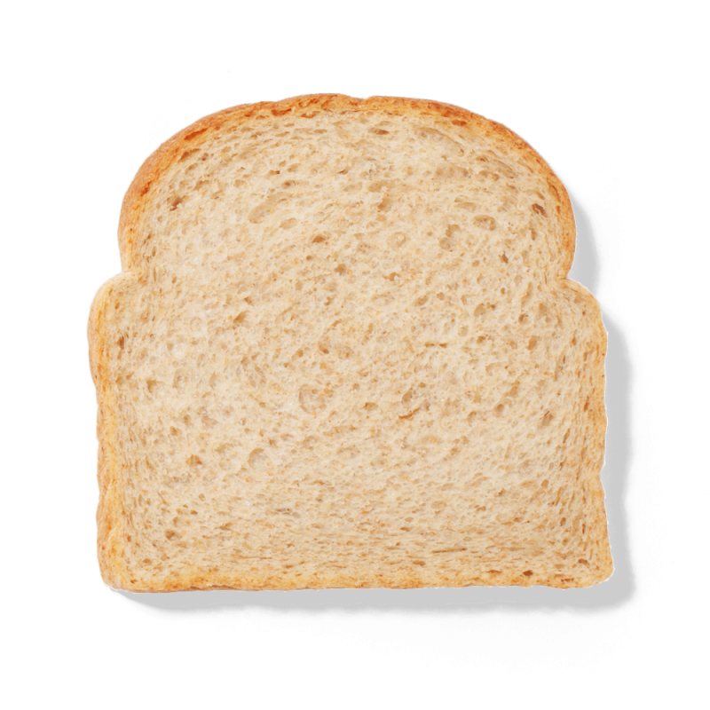
Sign extension (animated)
because the MSB of signed integers has a special meaning, we have to do different things depending on whether it’s a 1 or a 0.
sign extension puts copies of the sign bit before the number.
1001₂ (-7₁₀) ➔ to 5 bits ➔ 11001₂ (-7₁₀)
0111₂ (+7₁₀) ➔ to 5 bits ➔ 00111₂ (+7₁₀)
I like to think of it like spreading peanut butter…
why does this work? consider 1001₂. the MSB is -8. if I put a 1 before it, the MSB is now -16, and the next lower place is 8. -16+8 = -8, the same as what we started with, so the value remains unchanged.
111111111111
1011
Notes:
sign extension is important because it preserves the sign and value of signed numbers!
if you think of the original MSB as having a value of “-m”, then because each place is 2 times the next lower place, adding a 1 in front of a negative number is like adding “-2m + m”, which is “-m”, which is what you started with. this generalizes to any number of 1s you put in front (e.g. adding 11 in front is like adding “-4m + 2m + m” which is “-m”).

Slide 16
Truncation
”truncate” means to cut short, and for our purposes it means “cutting off bits on the left side of a number.”
00001001₂
= 9₁₀
if I truncate this unsigned integer to 4 bits, I get…
1001₂
= 9₁₀
the value was preserved, cause I just cut off leading 0s.
but if I keep going, strange things happen.
001₂
= 1₁₀
I cut off a 1, and now I ended up with a different value!
this is what the Java compiler means about “possible lossy conversion”: sometimes, losing bits can change the value!
for signed integers, you can get even weirder results.
1001₂
= -7₁₀
001₂
= +1₁₀
Notes:
truncation doesn’t always give you a different value. the first example worked fine.
the rule is, “if the value fits into the range of representable values for the target number of bits, it will work, otherwise you will get strange results.”
in the first example, 9 is in the range of representable values for 4 bits (0 to 15), so it works.
but in the second example, 9 is not in the range of representable values for 3 bits (0 to 7), so it fails.

Slide 17
Truncation and modular arithmetic
let’s see what happens if we truncate 4-bit unsigned ints to 2 bits.
Original | Truncated
0000₂ = 0₁₀ | 00₂ = 0₁₀
the value you get after truncation to n bits is not arbitrary. it is the original number modulo 2^{n}!
0001₂ = 1₁₀ | 01₂ = 1₁₀
0010₂ = 2₁₀ | 10₂ = 2₁₀
0011₂ = 3₁₀ | 11₂ = 3₁₀
here, n = 2, so the truncated values are the original numbers modulo 2² = 4.
0100₂ = 4₁₀ | 00₂ = 0₁₀
0101₂ = 5₁₀ | 01₂ = 1₁₀
remember when we tried to do unsigned 1111₂ + 0001₂? what happens if we truncate the result to 4 bits?
0110₂ = 6₁₀ | 10₂ = 2₁₀
0111₂ = 7₁₀ | 11₂ = 3₁₀
1000₂ = 8₁₀ | 00₂ = 0₁₀
1001₂ = 9₁₀ | 01₂ = 1₁₀
Notes:
remember modulo gives you the remainder after dividing. so when I say “modulo 2^{n}”, that means “the remainder after you divide by 2^{n}.”
1111₂ + 0001₂ = 10000₂, but truncated to 4 bits, it’s 0000₂, because it’s modulo 2⁴ = 16!

Slide 18
Integers aren’t on a line, they’re on a circle!
because of this behavior, integers wrap around, like on a clock.
unsigned integers:
signed integers:
the same positions are represented by the same bit patterns…
15
0
1
-1
0
1
14
2
-2
2
13
3
-3
3
12
4
-4
4
but the meanings are different.
11
5
-5
5
10
6
-6
6
9
7
-7
7
8
-8
adding goes clockwise; subtracting goes counterclockwise.
what is 14 + 5?
what is -2 + 5?
Notes:
- there’s an interactive version of this on my page! Materials, Reference, The Number Circle.
- -2 + 5 takes us to 3, which is correct… interesting
- 14 + 5 takes us to 3, which is weird, but makes sense in this number circle
- this is modular arithmetic: we say 14 + 5 = 3 mod 16.
- negation mirrors across the vertical axis
- so 0 is its own mirror, and so is the most-negative-integer!

Slide 19
Addition and subtraction

Slide 20
Two's complement addition
the whole reason two’s complement is so useful is that addition is dead simple. you can add any pair of two’s complement numbers using the same procedure as we learned for unsigned numbers.
Unsigned
Signed
to binary?
1
1
3
+10
13
0011
3
+-6
-3
bit pattern for -6 is… -8+2
0011
+1010
+1010
1101
1101
8 + 4 + 1 is…
-8 + 4 + 1 is…
it Just Works™.
the actual patterns of bits are the same. so how does a computer "know" whether it's
doing signed or unsigned addition?

Slide 21
IT DOESN'T

Slide 22
It's up to you!
the computer only knows one way to add numbers together.
the meaning or interpretation of the inputs and output of the addition are decided by you, the programmer.
in languages where you have signed and unsigned integers (e.g. C), you make this decision by choosing the type of the variable:
int x = -5;
unsigned int y = 20;
when these variables are printed, added, subtracted etc. they will be interpreted as signed or unsigned accordingly.

Slide 23
Subtraction
is subtraction really that different from addition?
x - y == x + -y
and in two's complement, -y == flip(y) + 1, so…
x - y == x + (flip(y) + 1)
assuming 4-bit numbers…
1
1
7
-4
3
7
+12
3
0111
+1100
=
1
0
0
1
this is typically how computers do it, since we can reuse the same circuit for both addition and subtraction.
there’s a carry out from the MSB, but because the result is truncated back to 4 bits, it’s thrown out.
Notes:
4₁₀ = 0100₂, and when we flip that we get 1011₂ = 11₁₀, then + 1 = 12₁₀.
well... the carry out from the MSB isn’t ALWAYS thrown out. later in the course we’ll learn more about what it indicates.

Slide 24
What is two’s complement doing, anyway?
on the previous slide, we saw that in 4-bit arithmetic:
the two’s complement of 4 is 12, and
adding 12 behaves the same way as subtracting 4.
why? it all comes back to the number circle.
0
if we start at 7, we can subtract 4 by going counterclockwise…
15
1
14
2
13
3
…but because it’s a circle, there are two ways around it. we can also go clockwise by 12, which is the two’s complement of 4!
12
4
11
5
10
6
9
a number’s two’s complement behaves like its negative under modular arithmetic.
8
7

Slide 25
Comparison with subtraction
subtraction is also how we compare numbers.
if we do a - b, for any a and b…
If…
then a - b will be…
a > b
positive (>0)
a < b
negative (<0)
a == b
zero
how can you quickly see if an integer is negative?
also, does this remind you of a certain Java method for comparing things…?
Notes:
you look at the sign bit (MSB)!
the Comparable.compareTo() method uses this convention for the return value. a.compareTo(b) is positive if a > b, negative if a < b, and 0 if a == b. (in C, strcmp() also uses this convention.)

