Slide 1
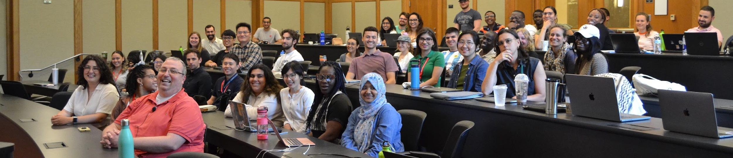
Your Guide to the ICPSR Summer Program Unlocking the World of Data Science and Quantitative Methods
Notes:
Thank you for joining me today to learn about the ICPSR Summer Program and what makes it a unique, life-changing learning experience.

Slide 2
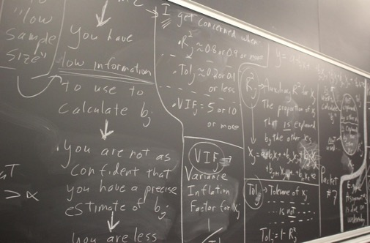
Topics covered today
What is ICPSR
About the ICPSR Summer Program
What’s unique about the program
Curriculum
Registration, fees, & discounts
Scholarships
Teaching assistant positions
Notes:
Today we’ll introduce you to the Summer Program and its history.
We’ll talk about the curriculum, which broadly breaks down into two categories: Topical Workshops, and General Sessions.
We’ll discuss fees, discounts, and scholarships.
And we’ll save some time at the end for your questions.

Slide 3
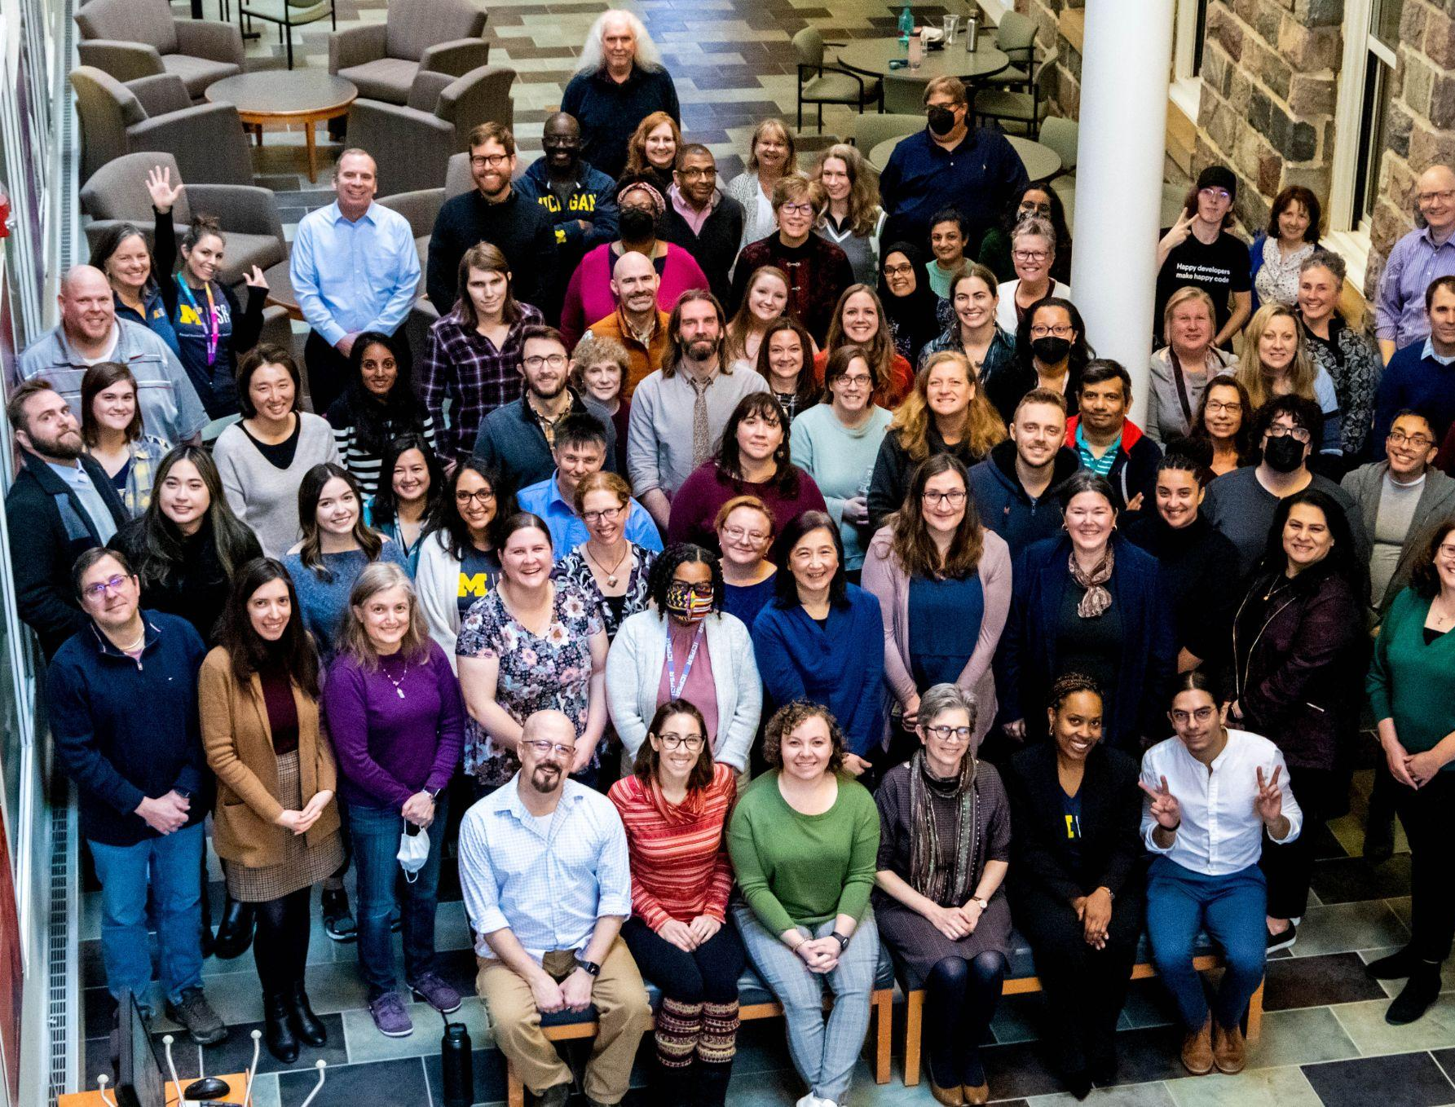
What is ICPSR?
The world’s largest social science data archive
20,000+ studies available
Data linked to over 100k publications
Data on topics including criminal justice, arts and culture, children and families, health, social media and more.

Slide 4
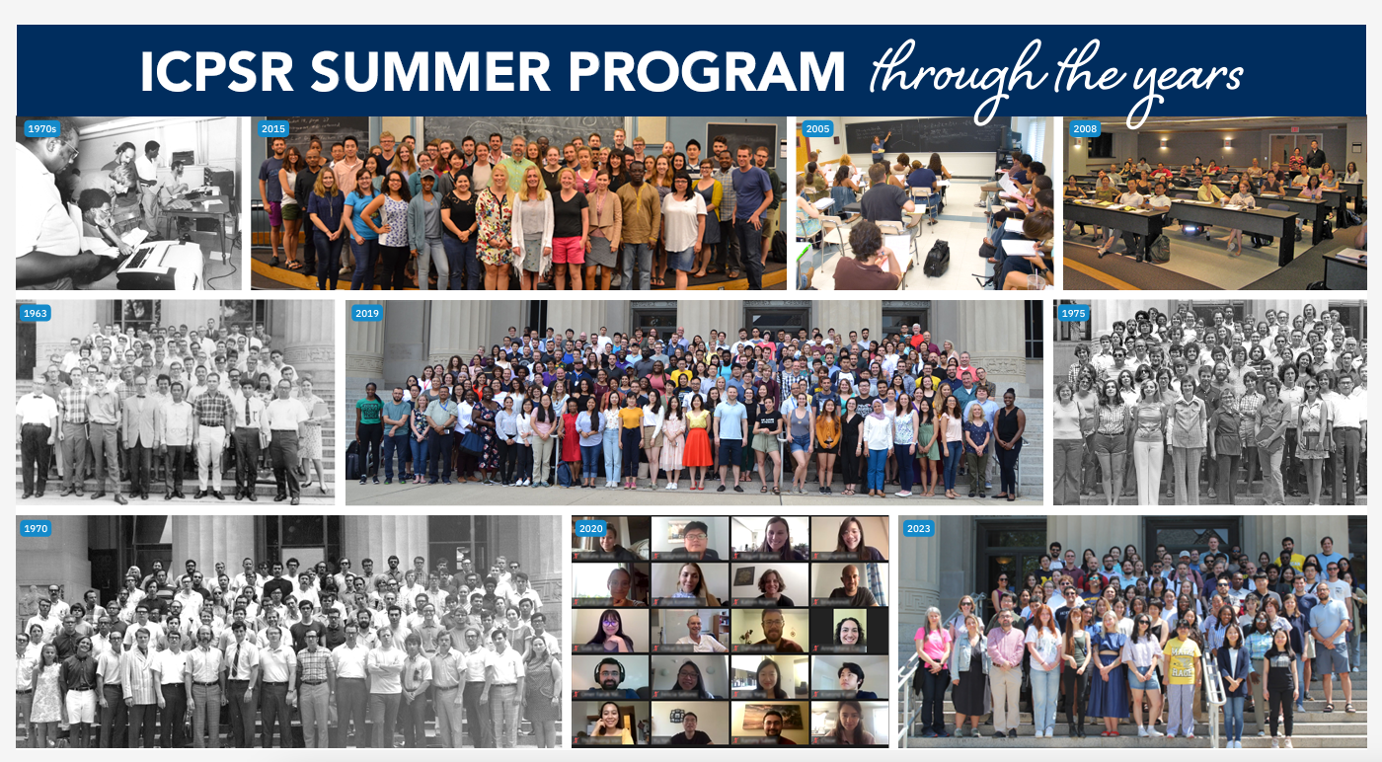
The ICPSR Summer Program
Notes:
The ICPSR Summer Program is over 60 years old. The first Program took place in 1963. Back then, there was an increasing interest and need for quantitative analysis among social scientists. There was a lack of faculty teaching social methodology at academic institutions in the US, as well as a lot of self-taught practitioners of research who wanted to gain more formal training.
In 1962, a political scientist named Warren Miller worked to create ICPSR in order to share data from the American National Election Study. A year later, the Summer Program was launched with the aim of training social scientists in elementary research methods and survey research, as well as more advanced analytic techniques.

Slide 5
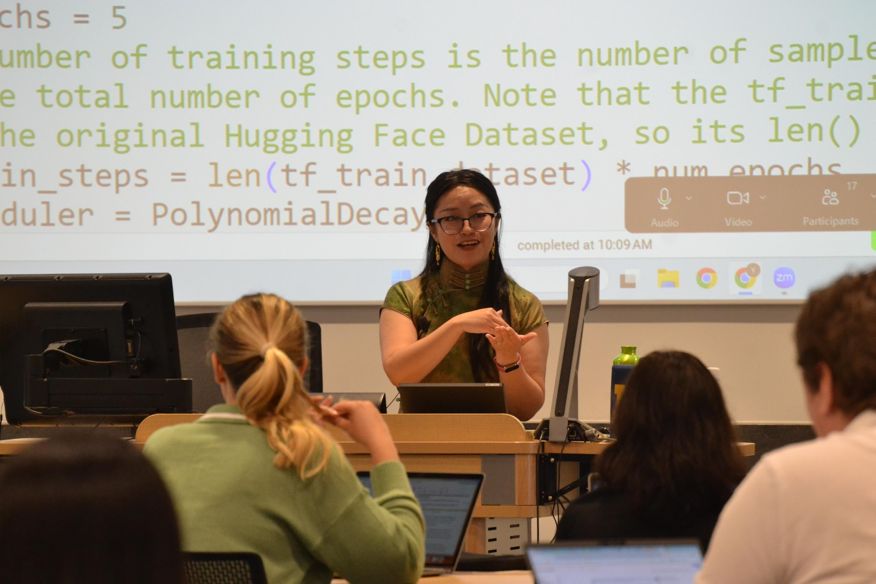
Comprehensive curriculum
What participants say:
“In the General Sessions, I liked that I could pick and choose between courses and try out ones that matched my skill level.”
“The course content is extremely helpful for advancing my career goals and for learning new concepts that are not available in my home university.”
Notes:
I’d like to talk to you about what distinguishes the ICPSR Summer Program. It starts with the breadth of courses that we offer.
The comprehensive curriculum includes more than 100 classes every summer. The curriculum is designed to meet the needs of students, faculty, scholars, and practitioners of all different skill levels and education backgrounds.
Our curriculum starts at the beginning, with a course in introductory statistics. From there, our participants can move on to regression analysis, MLE, and categorical analysis. We offer introductory to advanced courses in a variety of statistical and quantitative methods, including Bayes, multilevel models, and network analysis, as well as formal models. We also offer courses in the latest techniques, including machine learning, text analysis, as well as data science. We even offer workshops in qualitative and mixed methods.
We offer advanced and specialized courses that many participants say their home institutions do not offer on a regular basis or at all. Some universities may only offer comparable statistics courses through their computer science or statistics department, and so many participants come to ICPSR in order to get training from the perspective of the social sciences.

Slide 6
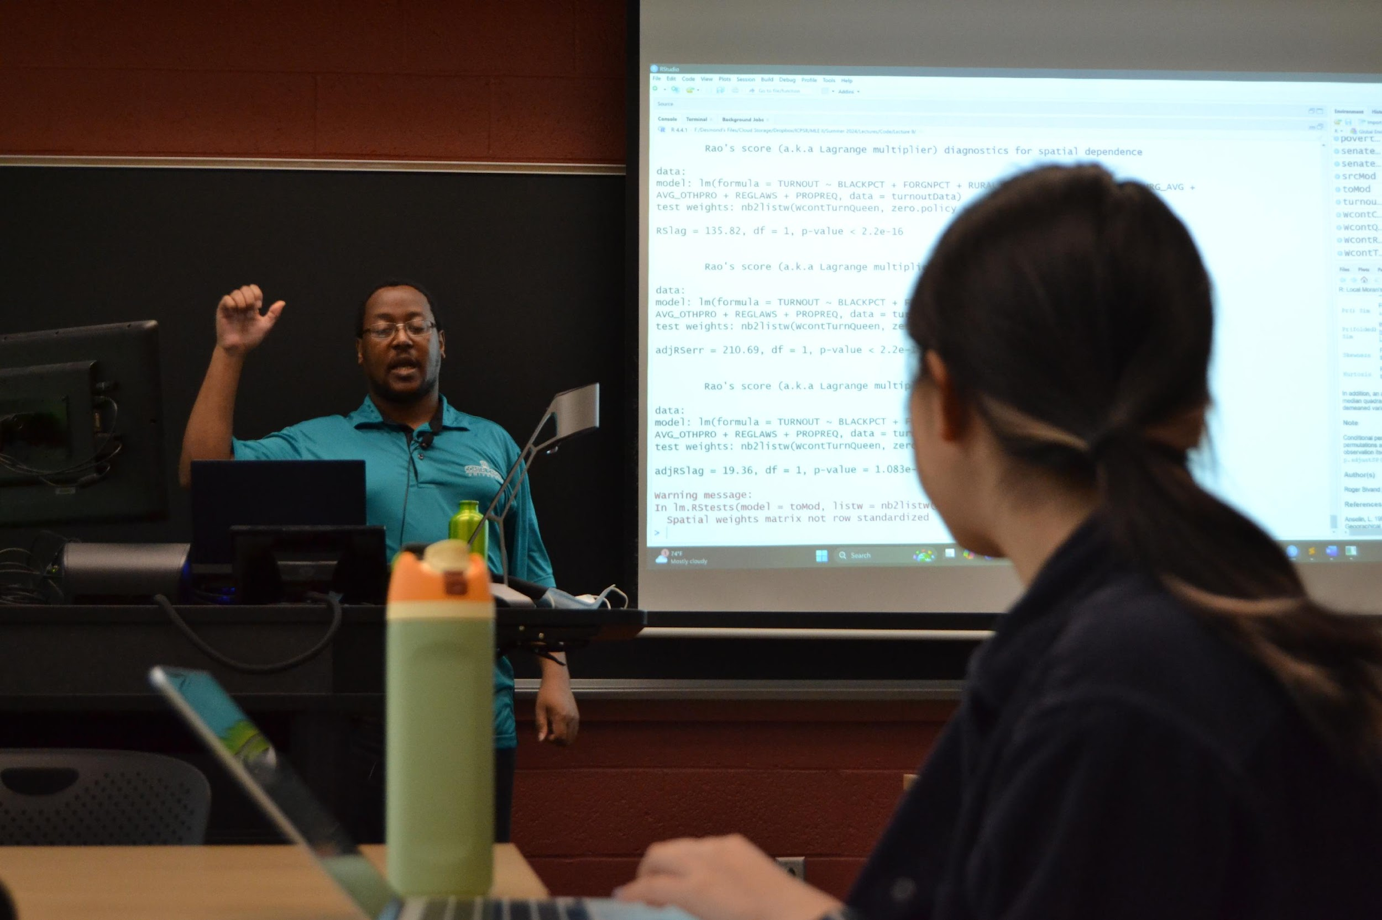
Dynamic training from leading experts
What our participants say:
“I absolutely loved the program and was very happy that I became a part of it. The best thing for me was that my instructors were genuinely interested in helping me with my current research projects and bringing them to the next level.”
Notes:
The next thing that distinguishes the Summer Program from other training programs is the quality and responsiveness of instruction.
Courses feature dynamic training from leading experts. The instruction is in-depth, applied, and responsive to your specific research needs and goals. In many of courses you are welcome to bring and use your own data.
As for instructors, the faculty include more than 100 practitioners and educators from universities and institutions across the US and around the world. These folks are at the top of their game both substantively and pedagogically. They are conducting and publishing research in respected academic journals. Not only are they experts in their fields, but they are top-notch instructors who are skillful at teaching participants of all backgrounds how to understand and employ methods in their own research. Our instructors take the time to explain the mathematical theories behind methods and then demonstrate real-world applications.
They also invite questions in-class and afterwards. The result is a very supportive and encouraging learning environment that features lots of one-on-one guidance and feedback. Many participants report that the Program has a “academically rigorous but laid-back environment” and that they appreciate the “lack of hierarchy between instructors, TAs, and participants.”

Slide 7
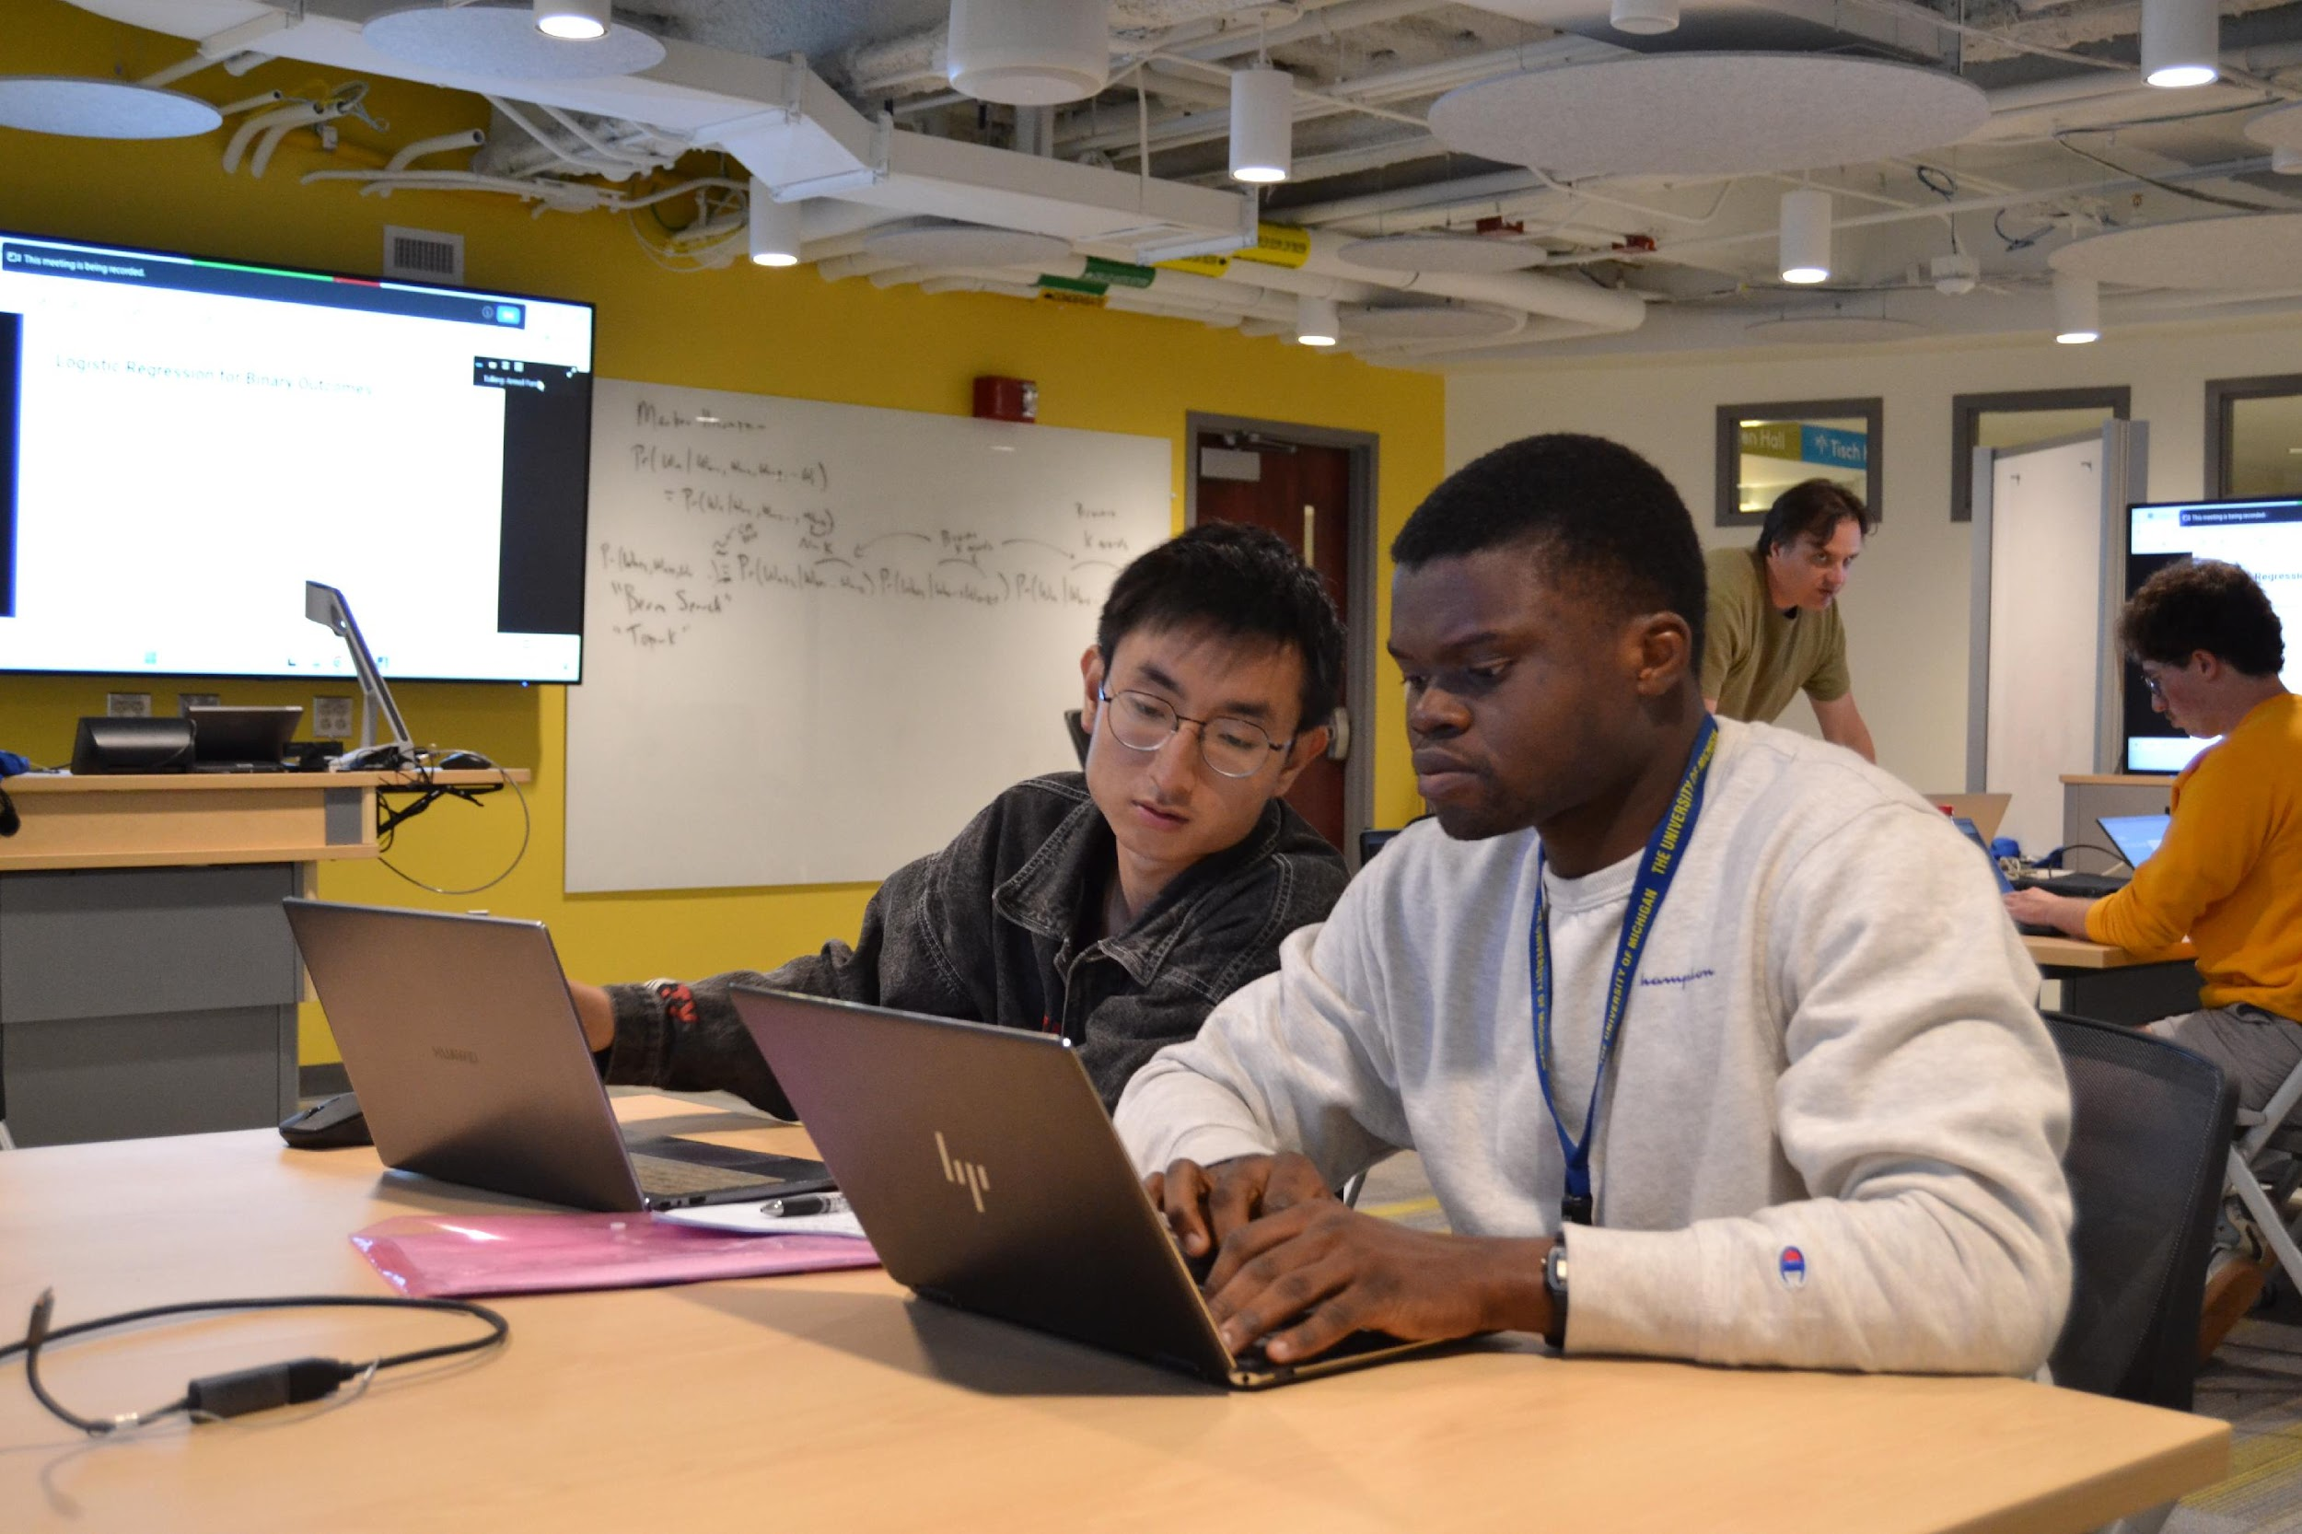
Collaborative learning and networking
What participants say:
“Group assignments and peer reviews facilitated deeper understanding and collaboration. We were able to share ideas, discuss challenging topics, and find solutions together. This approach not only reinforced the material but also developed critical thinking and analytical skills.”
Notes:
Finally, the Summer Program believes that learning is a collaborative process between you and the instructor but also between you and the other participants. Courses often feature opportunities for group learning and connections.
The Summer program trains about 1,000 individuals every summer, and they represent a wide range of institutions, disciplines, and backgrounds. There are opportunities to meet and connect with people from your field who are at other universities around the world.
There are also plenty of chances for interdisciplinary connections and insights as you learn alongside individuals from diverse methodological perspectives.
Many former participants have followed up to tell us that at the Summer Program they found a research collaborator or co-author. As one participant put it: “One of the best things of the ICPSR Summer Program was the networking opportunities. I had the chance to meet people from around the world and form friendships with them.”

Slide 8
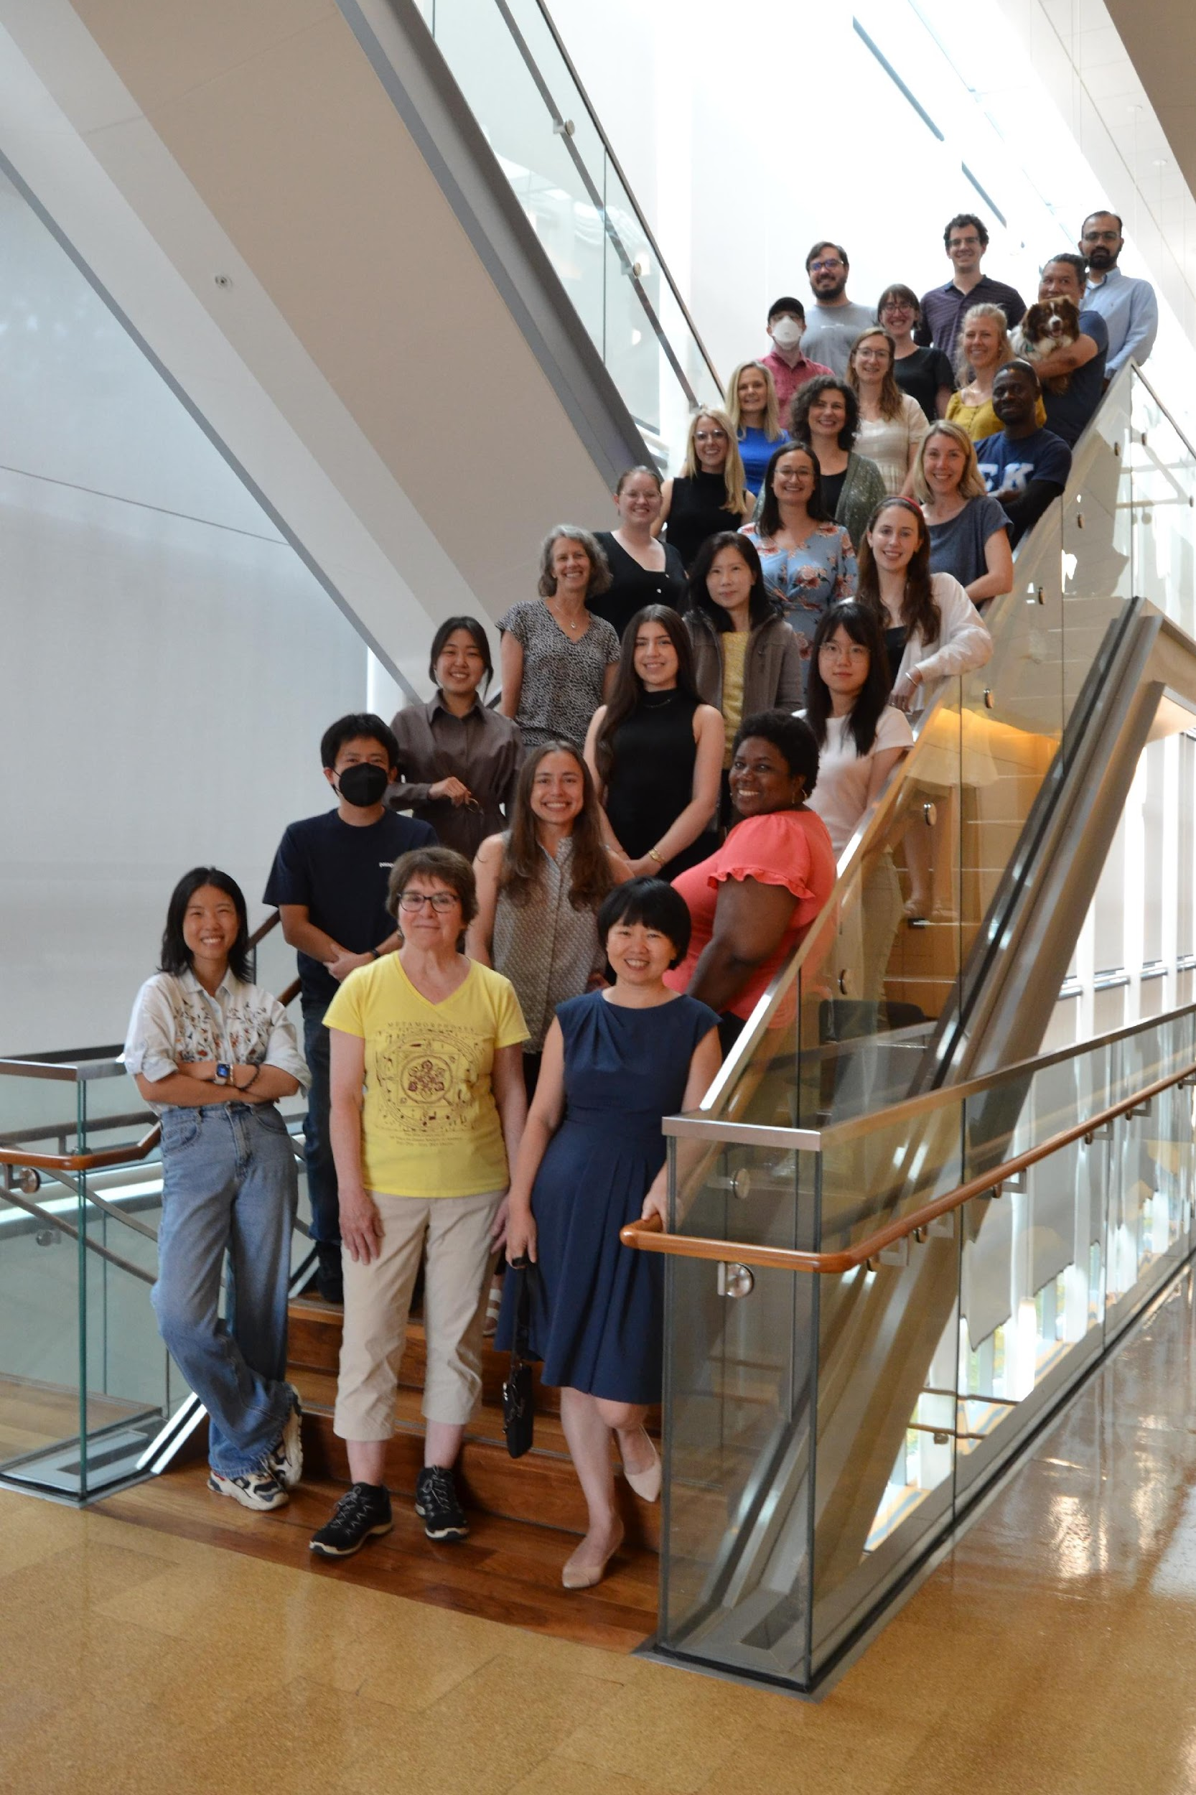
Topical Workshops
50+ workshops, typically from May through August
Most are online-only; some will be dual-mode (online with in-person components)
Participants include grad students, post-docs, faculty, & practitioners
Sponsored workshops
Notes:
Let’s return to the curriculum and take a deeper dive into the courses offered, beginning with Topical Workshops.
Our curriculum is broad
The Summer Program typically offers more than 50 topical workshops. Topical workshops provide rigorous, focused training in a specific methodological technique in a few days. Typical workshops include:
Interactive Visualization, Dashboards, and Apps with R and Shiny
Introduction to Network Analysis
Item Response Theory
Machine Learning
Causal Inference
Multilevel Modeling
Topical workshops feature instructional contact hours in a quantity of either 20 hours or 40 hours.
Topical workshops are often offered in an online-only format. When participating online, you can choose to live-stream the daily workshop lectures via Zoom, or you can watch the lecture recordings asynchronously at a time that better suits you (or you can do both). Topical workshops can range in length from several days to 2 weeks. Most workshops meet for 4-5 hours daily, Monday through Friday, with breaks included.
There will also be some dual-mode workshops in which you can choose to attend either online or in-person. Dual-mode workshops with an in-person option will be held in Ann Arbor on the University of Michigan campus.
Topical workshops typically feature extended access to lecture recordings and workshop materials through the end of the calendar year.
Who attends a topical workshop?
Participants in these workshops are mostly advanced graduate students, post-docs, faculty, and other researchers. Topical workshops are suited for anyone who needs in-depth and intensive instruction in a specific method in a short interval of time. Enrollment is typically capped at 25 people per workshop.
Sponsored topical workshops
A sponsored short workshop focuses on and explores a substantive topic or specific dataset. Workshops such as these are typically offered by an archive or project within ICPSR and are free to attend for admitted applicants. Sponsored workshops include a competitive application and review process. Sponsored workshops that we tend to offer every summer include ones on the:
The Panel Study of Income Dynamics, or the PSID study, which is a longitudinal study measuring economic, social, and health factors over the life course of families over multiple generations
The Monitoring the Future Project, a long-term study of substance use among the nation’s youth
The Population Assessment of Tobacco and Health (PATH) Study

Slide 9
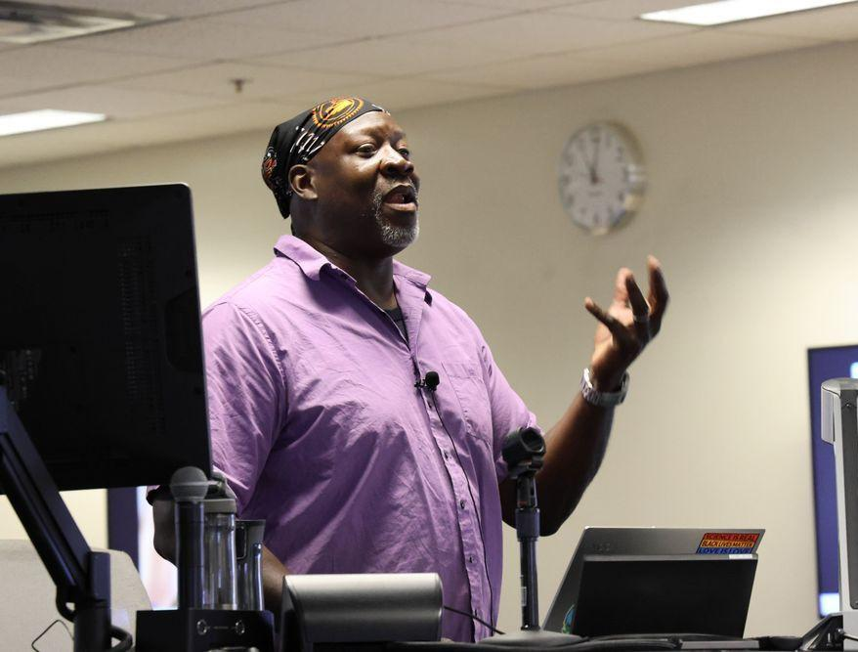
Sample Topical Workshops
Providing Data Services and Support: From Surviving to Succeeding
Generative AI and LLMs for Social and Political Analysis
Interactive Visualization, Dashboards, and Apps with R and Shiny
Methods for Better Measurement of Social Scientific Variables
Notes:
These are some sample topical workshops from previous summers.

Slide 10
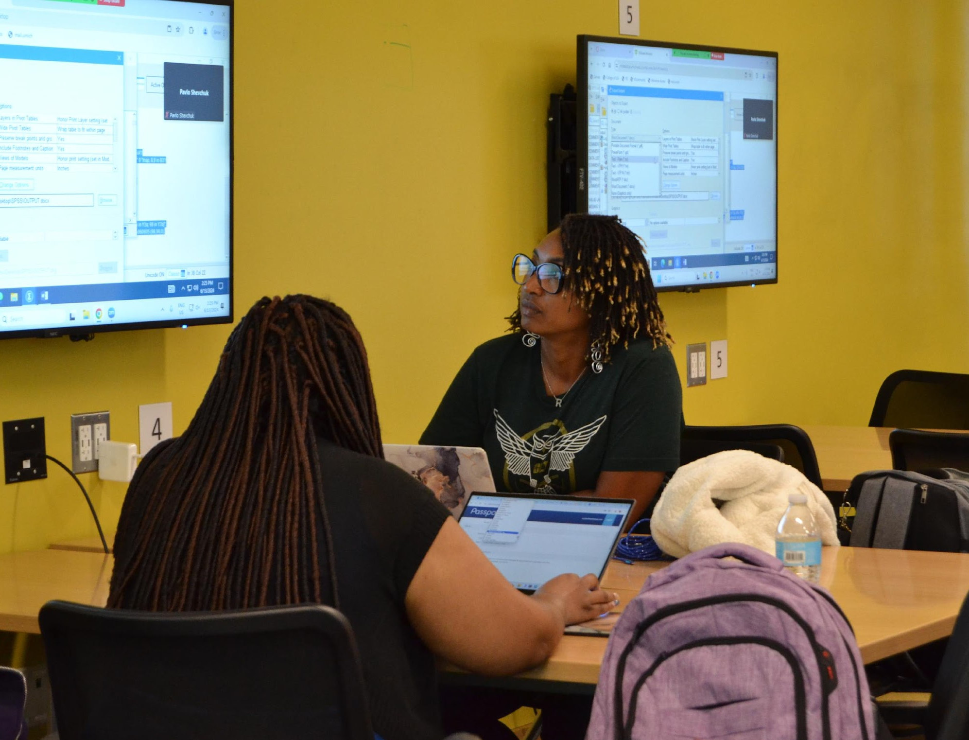
General Sessions
Typical dates:
First Session: early June – early July
Second Session: early July – early August
Each session includes about 14 methods Courses + 5-7 math & computing Lectures
Introductory to advanced courses taught at the graduate level
Dual-mode format: In-person and/or online
Notes:
So now let’s talk about General Sessions
General Sessions are a comprehensive methods training program typically comprising more than forty courses and lectures. General Sessions offer foundational training in research methods, including computation, formal theory, basic statistics, and regression analysis, as well as specialized training in a diverse array of the most advanced, cutting-edge methodological techniques, including machine learning, text analysis, network analysis, and more.
So let’s talk about the General Session Courses & Lectures
General Session classes are categorized as either a methods Course or a math and computing Lecture. Courses feature a full semester's worth (or 40 hours) of intensive instruction in specific quantitative methods and statistical techniques, while Lectures provide a half-semester's worth (or 20 hours) of supplementary instruction in math and calculus, as well as computing such as R and Python. When you register for a session, you can select up to 4 methods courses, plus unlimited math and computing lectures, in that session.
Each General Session offers a mix of introductory and advanced Courses. We also sequence introductory to advanced training across the sessions, so that you can take an introductory Course in Bayes or Network Analysis in the First Session, and then follow that course up in the Second Session with an advanced Course on Bayes or network analysis.
During the first week of each General Session, the math and computing Lectures typically will meet daily, Monday through Friday. During weeks 2-4 of each General Session, the methods Courses typically will meet daily, Monday through Friday. This way you’ll get a chance to learn the computing skills and math knowledge before beginning your methodological training.
When you register for a General Session, you get to pick the courses you want and need and customize your own schedule based on your previous training and current research needs or future goals.
As for the format, all General Session classes will be offered both in-person and online. All General Session Lectures and Courses will be held on the University of Michigan campus in Ann Arbor. For online participants, you can choose to stream the lectures live via Zoom or watch the lecture recordings asynchronously.
And, all General Session participants typically have extended access to all Zoom recording and class materials for the courses and lectures they took through the end of the calendar year.

Slide 11
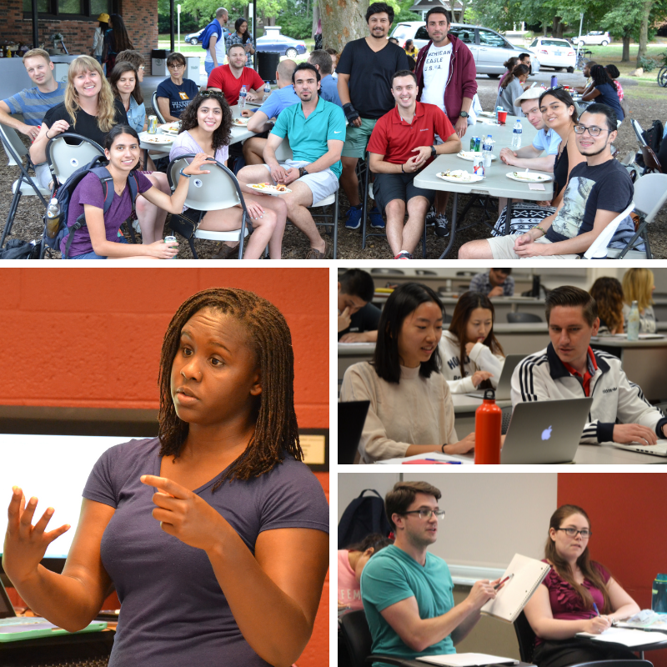
General Sessions (cont’d)
Daily office hours
Participants: Mostly grad students (MA & PhD), with some advanced undergrads, post-docs, faculty, and practitioners
Participants from 40 countries and 30+ disciplines
On-campus housing often available
Notes:
As for instructional staff
Outside of daily class meetings, instructors and TAs hold daily office hours. Participants are strongly encourage to go to office hours, and ask questions about what you’re learning, or even just talk about your own research or get advice about your dissertation. Our instructors are always willing to help and eager to share their knowledge and expertise.
So who attends our General Sessions, and why?
Most General Session participants are graduate students, including Masters and PhDs. They attend for a variety of reasons, including:
To “beef up” on their statistics skills before starting a graduate program
To take a course that will help them with their dissertation
To learn a semester’s worth of material in 4-8 weeks
General Session participants also include advanced undergraduate students and post-docs, as well as faculty and researchers who have been out of school for years but are seeking to relearn or expand their methodological skillset.
Participants come from more than 40 countries. It isn’t unusual to hear fellow participants chatting together in different languages and with different accents from around the world.
Participants represent more than 30 disciplines, including Political Science, Sociology, Education, Law, Engineering, Social Work, Journalism, Environmental Science, Public Health, Nursing, and more.
On-campus housing is often available for First and Second General Sessions. We recommend living on campus because it’s convenient, reliable, and a great way to connect with your fellow participants.

Slide 12
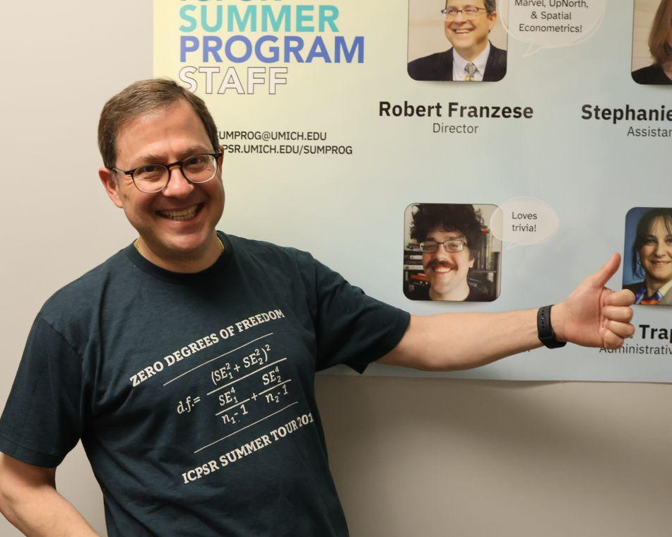
Sample General Session Classes
Mathematics for Social Scientists, Introductory Review
Evaluating Model Robustness
Machine Learning
Categorical Data Analysis
Multilevel Models
Data Science and Text Analysis
Notes:
These are some sample general sessions from previous summers.

Slide 13
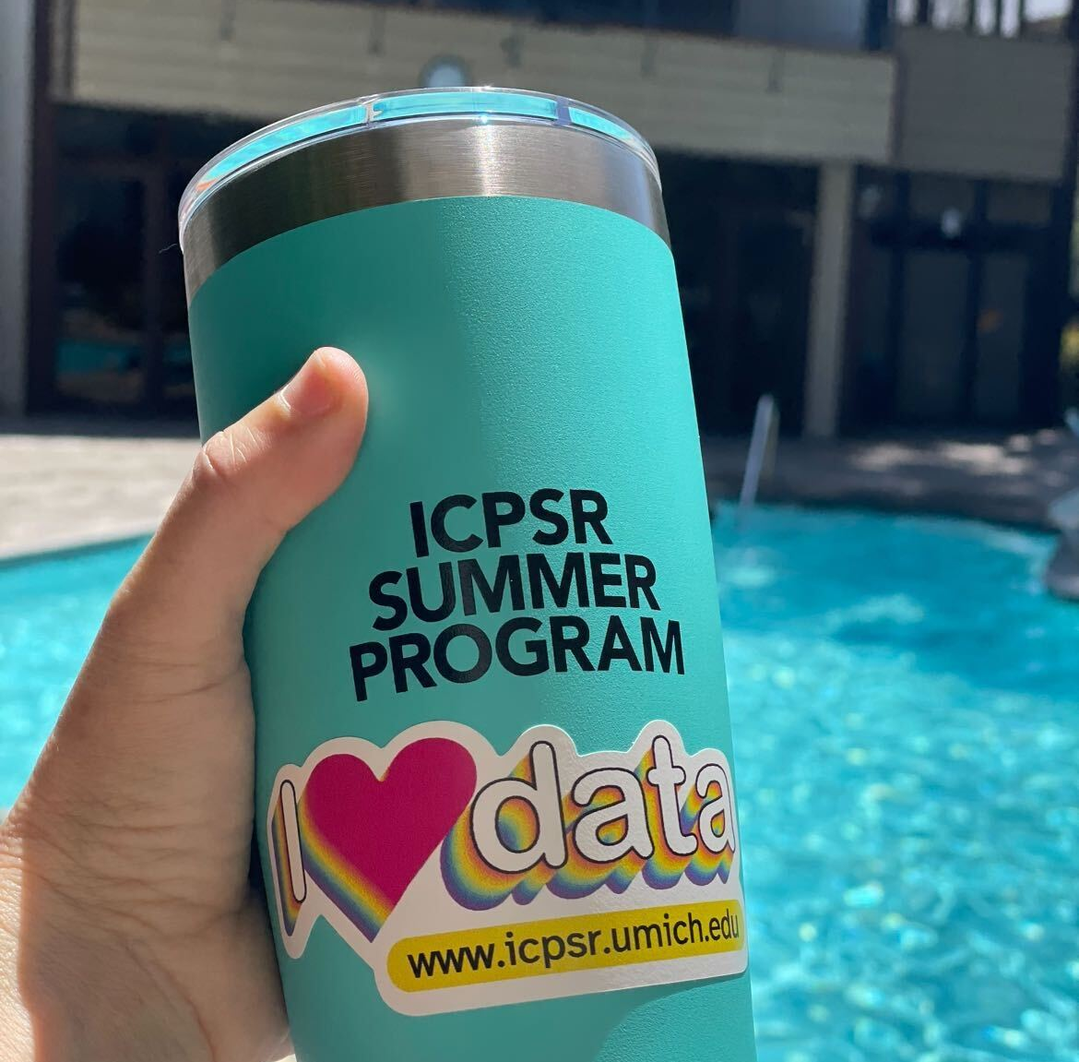
Registration and Fees
Tiered registration rates:
Topical Workshops: 20 contact hours
Topical Workshops: 40 contact hours
One General Session
Both General Sessions
Notes:
Let’s talk about registration and fees for the Program.
Registration for all classes, both Topical Workshops and the General Sessions, typically opens in February. You can sign up on the ICPSR Summer Program website to receive updates.
ICPSR offers an early registration discount. Please visit their website for the next deadline.
As for Topical Workshops, registration fees are determined by the approximate number of instructional contact hours that the workshop delivers. Some workshops deliver 20 instructional contact hours, and some deliver 40 hours. The number of contact hours each workshop offers will be listed in its workshop description in our registration portal.
A reminder when you register for a General Session, you can take up to 4 methods Courses and unlimited Lectures within that Session.
As for registration deadlines:
The deadline to register for a General Session is typically at least one week before the start date of the session.
The deadline to register for a Topical Workshop is typically a week before the listed start date of the workshop. However, many of our Topical Workshops have enrollment caps, so if you wait too long to register, there’s a chance a workshop might fill and there may not be a seat available for you.

Slide 14
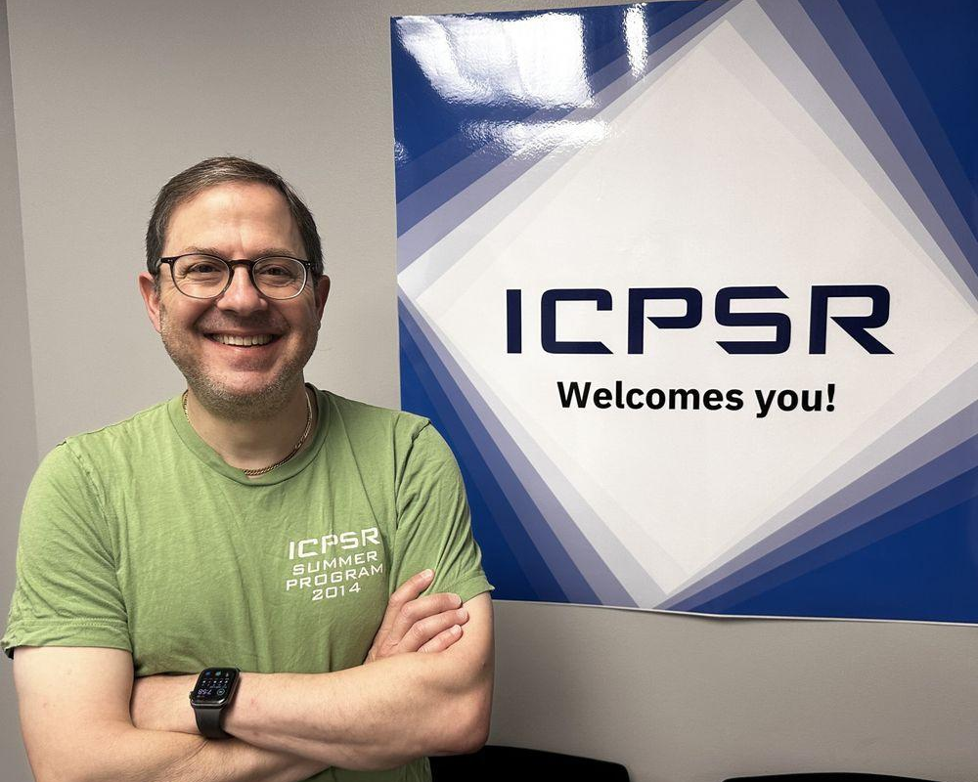
Registration and Fees
Discounted tuition for students, staff, faculty and others at ICPSR member institutions.
Early registration discounts
Additional discounts for groups, multiple workshops, and more
Visit the Summer Program website for current rates
Notes:
As mentioned in the beginning of the presentation, ICPSR is a consortium with more than 800 members. These members include universities, foundations, government institutions, nonprofits, and more.
If you are a current student, faculty, staff, or researcher at an ICPSR member institution, you qualify for the discounted registration fee for participants from ICPSR member institutions. If you are not affiliated with an ICPSR member institution, you would pay the fee for participants not from ICPSR member institutions.
Finally, ICPSR offers discounts on the registration fees, including a discount for returning participants, a discount if you enroll in two or more Topical Workshops, a group discount for academic departments, and the on-campus housing discount. For more information about current discount offers please visit the Registration page on the Summer Program website.

Slide 15
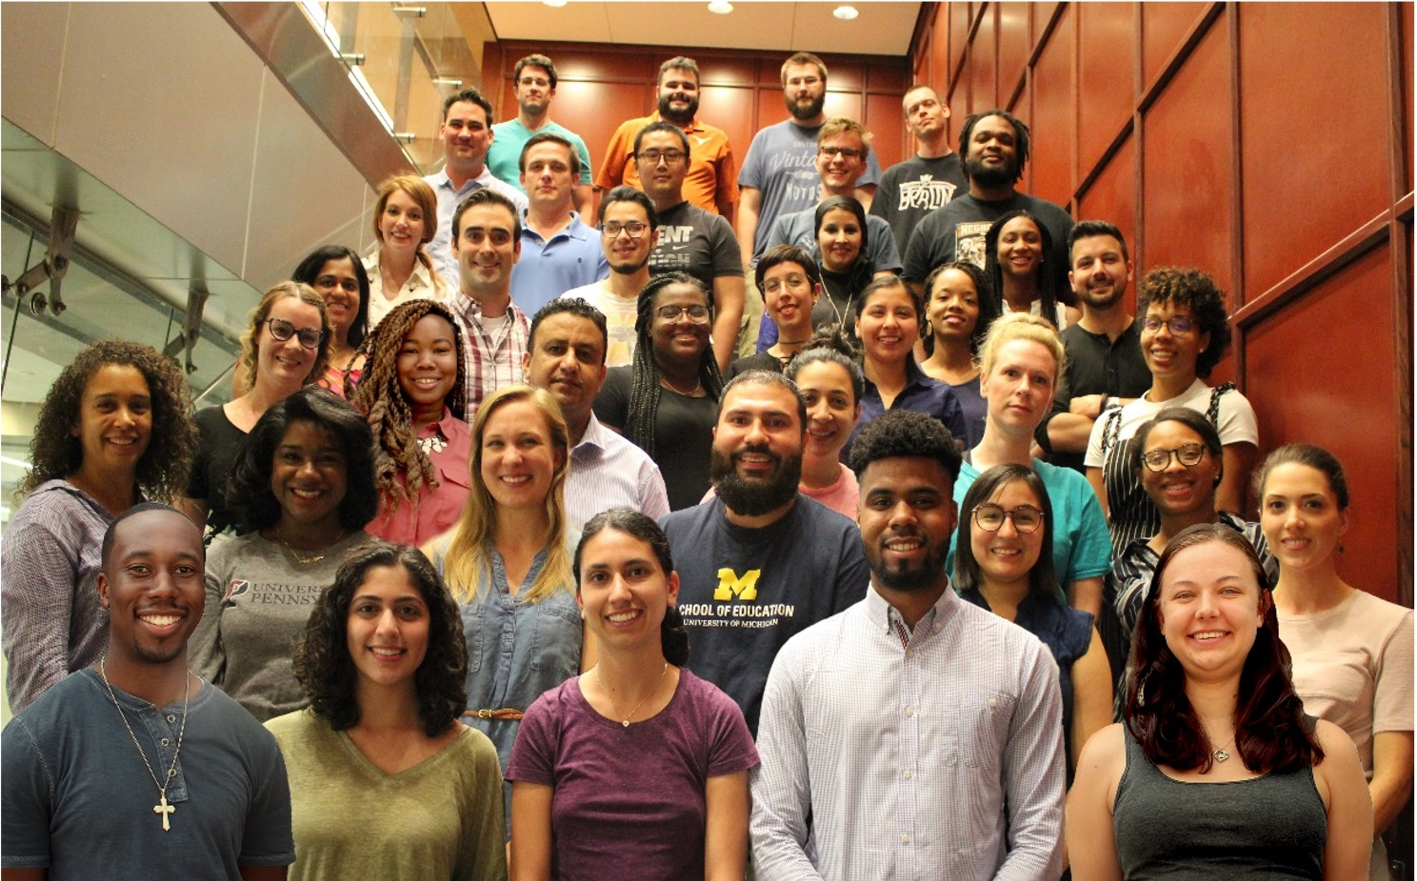
Scholarships
Registration fee waivers for our General Sessions
Open to students in Political Science, Sociology, Education, Public Policy, & other disciplines
Opportunity Scholarship
Will begin accepting applications for 2026 Program in January 2026
Notes:
ICPSR offers more than $150,000 in student scholarships every year. Their goal is to remove financial barriers to participation and increase access to statistical methods training for students of all different backgrounds.
So what do the scholarships cover?
ICPSR scholarships provide registration fee waivers to our General Sessions. One of our scholarships, the Owen, provides a registration fee waiver to a Topical Workshop of your choice.
In regards to eligibility criteria:
ICPSR scholarships are targeted to students (undergrad, MA, and PhD) in specific disciplines, including Sociology, Political Science, Public Policy, Education, Quantitative History, and several other disciplines. A few of our scholarships are also open to pre-tenure scholars and early career academics.
Additionally, we offer opportunity scholarships for graduate students from under-represented groups who are about to enter or are currently enrolled at a university within the United States. Our opportunity scholarships include free on-campus housing, meals, and a stipend.
Our scholarships are open to international students.
Applicants may apply for more than one ICPSR scholarship.
In order to apply for a scholarship, fill out the application form through the online scholarship application manager and submit all the required application materials. In most instances, these materials include a CV, a letter of recommendation, and a cover letter.
Scholarships are typically announced in January each year.
Please encourage your students and members of your community to apply!

Slide 16
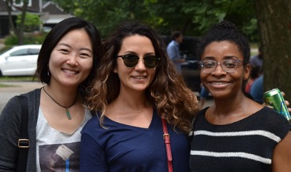
Teaching assistant positions
30+ TA positions
Assist with General Session classes in Ann Arbor
Up to 40 hours/week
Compensation: $39/hour
Positions posted in January
Notes:
Finally, ICPSR offers paid teaching assistant positions for graduate students. TA positions provide invaluable pedagogical experience for graduate students to take into future teaching positions at colleges and universities. This is a terrific opportunity to work alongside a Summer Program instructor and to meet and connect with a diverse, international, interdisciplinary constituency of participants. Some TAs eventually go on to become Summer Program instructors.
ICPSR has more than 30 TA openings each summer. Teaching assistants will be assigned to assist with methods Courses or Lectures in our General Sessions. TAs will be expected to work in-person in Ann Arbor; there are currently no virtual/remote TA positions. TAs will be expected to work up to 40 hours/week during the session their class is scheduled.
The typical responsibilities include:
Assist instructors with preparation and presentation of class materials and lectures
Meet with workshop instructors
Attend daily lectures and answer participant questions
Hold office hours
Hold lab sessions and supplemental learning sessions
Evaluate work and grade assignments
The qualifications include:
Being currently enrolled in a Ph.D. program
Having a Master’s Degree or equivalent combination of education and experience
Having experience with quantitative research skills in the social sciences or closely related field
Having experience with statistical computing software
Possessing excellent communications skills, both oral and written, in the English language
Good interpersonal skills
Past experience as a teaching assistant in a statistics course at the university level
Knowledge and command of the skills and material relevant to the course(s) that you want to assist with
The required application materials typically include a cover letter, CV, letters of recommendation, past course evaluations, and a transcript.
Positions are typically announced and posted in January.

Slide 17
Thank you
Website
www.icpsr.umich.edu/sumprog
Email
icpsr-sumprog@umich.edu
Notes:
On the homepage of the ICPSR Summer Program website you’ll find a link to subscribe to our email list. They are a very friendly team, please reach out if you have any questions.

